Slide 1
Java Log
2018-12-25

Slide 2
发展历史
结构
Bridge
Binding
实例演示

Slide 3
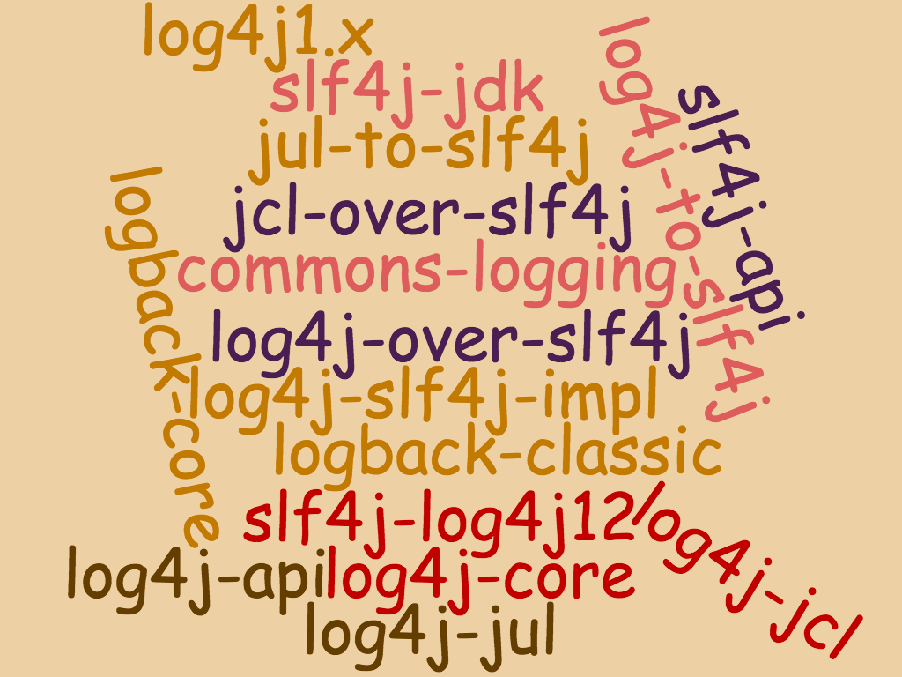

Slide 4
发展历史

Slide 5
发展历史
System.err
System.out
e.printStackTrace()
JUL
Log4j
SLF4J
Logback
Log4J2.x
JCL
最早
2001
2002
2010
2006
2012
JUL:java util logging
JCL:Apache common logging

Slide 6
结构

Slide 7
结构
Logger
Appender
Destination
Logger
Handler
Destination
Filter
Layout
Filter
Filter
Formatter
Log4j 1.x
JUL

Slide 8
Bridge

Slide 9
Bridge
业务系统
JUL
JCL
组件4
Log4j1.x
组件3
组件1
Log4j2.x
SLF4J
组件2
组件5

Slide 10
Bridge
非JUL的桥接
业务系统
业务系统
spring
spring
JCL
jcl-over-slf4j.jar
commons-logging.jar
org.apache.commons.logging.Log
org.apache.commons.logging.Log
slf4j-api.jar
org.slf4j.Logger

Slide 11
Bridge
JUL的Bridge
LogManager
LogManager
LogManager
Logger
Logger
Logger
Handler
Handler
Handler
Destination
Destination
Destination
SLF4J
Log4j2.x

Slide 12
Binding

Slide 13
Binding
SLF4J的Binding
sl4fj-api.jar
org.slf4j.Logger
业务系统
org.slf4j.LoggerFactory
SLF4J
实现
org.slf4j.impl.StaticLoggerBinder

Slide 14
实例演示

Slide 15
实例演示
https://github.com/yanglikun/log-demo.git
http://source.jd.com/app/log-jd-demo.git

Slide 16
Thanks for your time!

