Slide 1

pOWERcalc
A senior design project by:
Liron Shimrony
Jonathan Shimrony

Slide 2
What is powercalc?
PowerCalc is a system that allows a user with a mobile device to perform various tasks independent of the mobile device computing capibilities.
It is built from the following components:
A Computer which will serve as the powerful computer that actually performs the desired tasks
A linux server
A web application to manage users and evironments
A mobile device with a dedicated chat app to communicate with the server

Slide 3
What is it good for?
It is good for giving a mobile device computation power that it doesn’t really have.
It is independent of mobile devices constraints
It is a dynamic system that can be extended to support many features like:
Home automation
Data aggragation
“Internet of Things”

Slide 4
The Computer
The computer can be any computer (Mac or Windows) and there can be more than one computer connected with the system
The computer is the machine that will perform all the desired actions whether it’s a Matlab calculation or Taking a snapshop from the computer webcam

Slide 5
The server
The server we are using is actually a Linux machine that runs a python server to communicate with a mobile device, the same mobile device that run the dedicated app.
The server also hosts the web application
Server hosts SiriProxy (for voice commands)

Slide 6
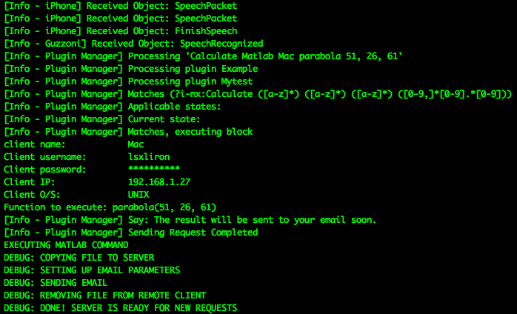
Server debug window

Slide 7
The web application
The system web application exists to make addition and management of new computers fast and easy.

Slide 8
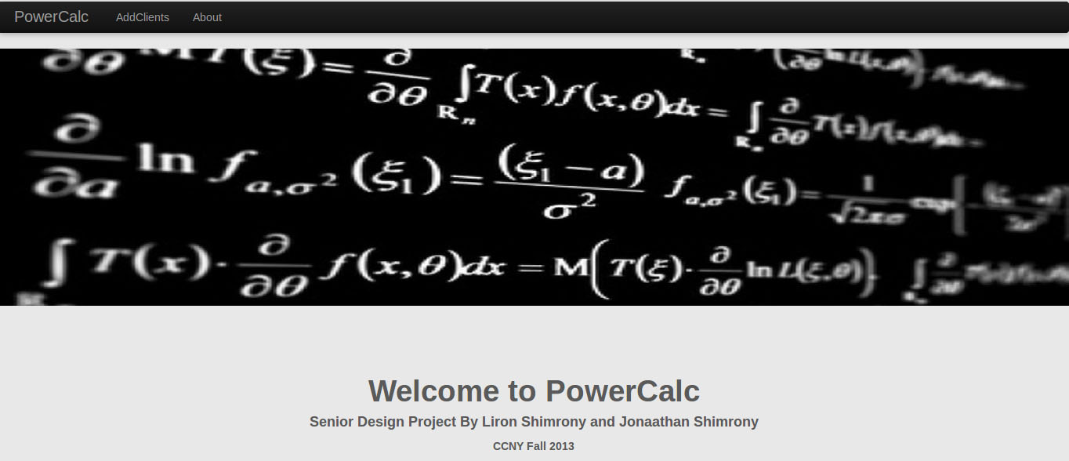

Slide 9
Mobile Device
The mobile devices currently supported by our system are Apple’s iPhone and iPad.
The mobile device sends simple commands using the dedicated chat app.
Commands are being sent to server and from there to the correct computer for computation.

Slide 10
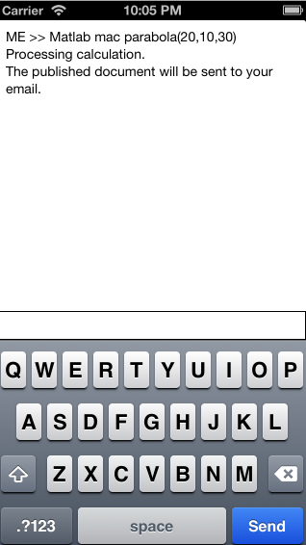
Mobile chat app image

Slide 11
So how do all theses components work?
Our chat server built to parse commands sent from a mobile device to system commands.
The server then communicate with the desired computer via SSH and execute the command. In addition, it waits for the result
The result will be sent to the client’s email using the email sender implemented in the system.

Slide 12
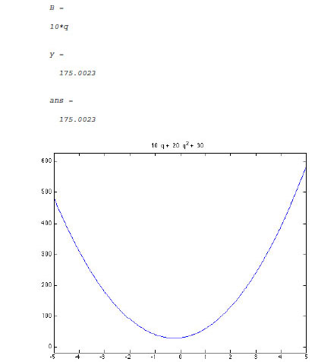
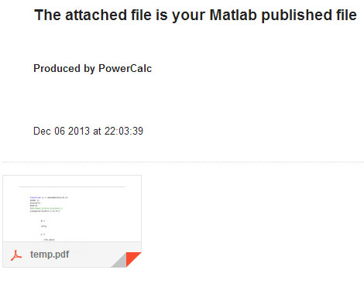
Sample output

Slide 13
Voice command
PowerCalc currently supports voice commands with Apple devices.
We wanted to allow this feature to increase the ease of computations. So instead of writing the commands in the dedicated chat app, the user can just say things like:
Calculate Matlab Jonathan Error 12,13
Capture Image from Mac
The output will be the same and will be sent to the client’s email

Slide 14
Demo time

