Slide 1
GPU与人工智能2 硬件和软件基础
Ying Yu
Mar 4，2022
yingyu@nju.edu.cn

Slide 2
Index
Some background
Modifications to the von Neumann model
Memory Hierarchy
Parallel program design
Writing and running parallel programs

Slide 3
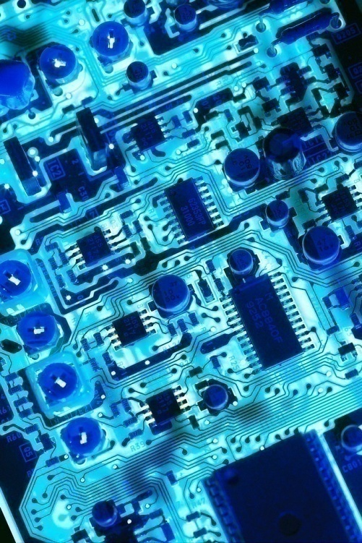
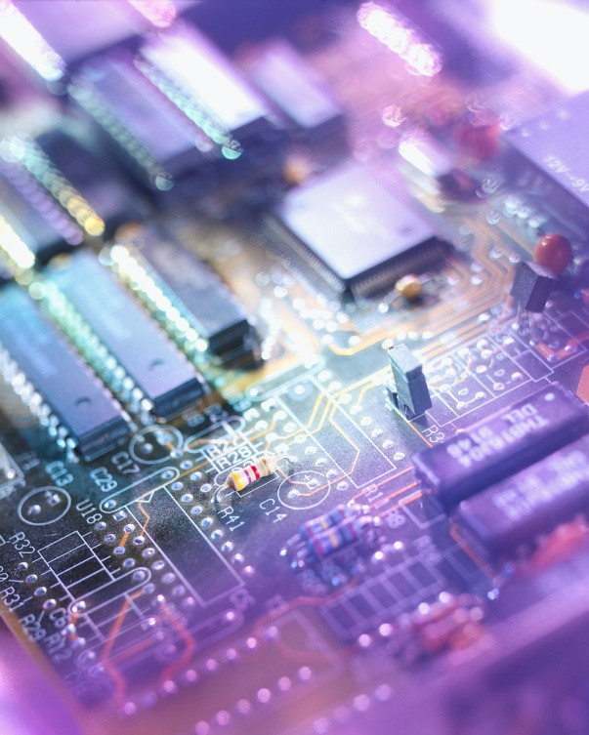
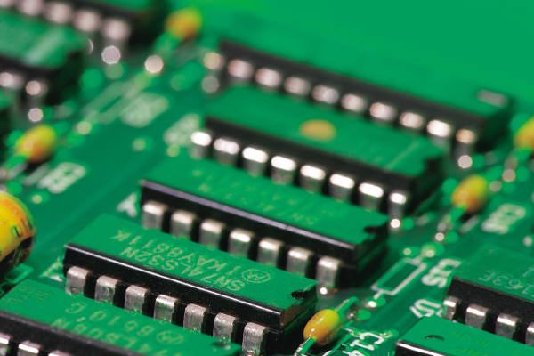
Background

Slide 4
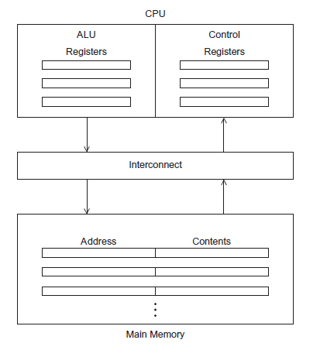
The von Neumann Architecture

Slide 5

Central processing unit (CPU)
Divided into two parts.
Control unit - responsible for deciding which instruction in a program should be executed. (the boss)
Arithmetic and logic unit (ALU) - responsible for executing the actual instructions. (the worker)
add 2+2

Slide 6
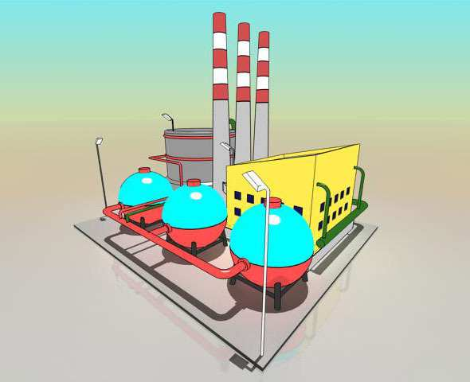
计算机的核心是CPU，它承担了所有的计算任务。它就像一座工厂，时刻在运行。

Slide 7



Serial hardware and software
programs
input
Computer runs one
program at a time.
output

Slide 8
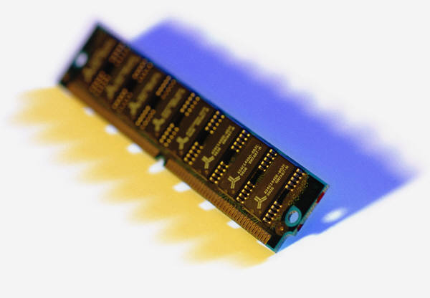
Main memory
This is a collection of locations, each of which is capable of storing both instructions and data.
Every location consists of an address, which is used to access the location, and the contents of the location

Slide 9
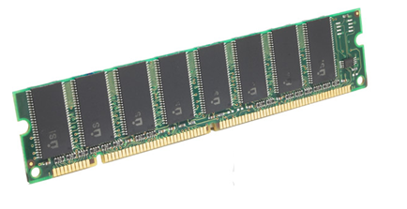

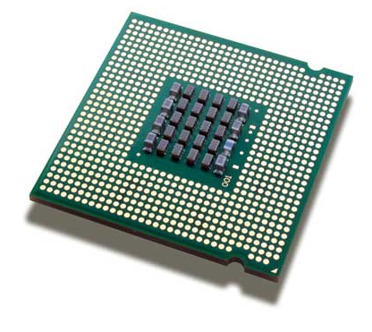
memory
CPU
fetch/read
Notes:
Back in 1993, NVIDIA was founded as a three-man start-up to make chips for PC games.
This was before there really were PC games… but the founders believed that the PC would become a consumer entertainment device.
And that gaming on the PC would take off, largely because it was convenient, the PC was already there in people’s homes.
That intuition proved to be true. The risk paid off.
With the invention of the GPU in 1999, we awakened the world to the power of computer graphics.
Games evolved… they became more realistic, beautiful, heroes became more lifelike, monsters became scarier… the GPU evolved… Games evolved more… eventually this tension pushed our technology into the professional graphics market, where today NVIDIA is the standard.
From our roots in visual computing, we’ve expanded into super computing… mobile computing… and, most recently, cloud computing.
Today NVIDIA processors power super phones… supercomputers… even super cars...
We have 7,500 employees around the world…and more than 5,000 patents granted or pending.

Slide 10

memory
CPU
write/store
Notes:
Back in 1993, NVIDIA was founded as a three-man start-up to make chips for PC games.
This was before there really were PC games… but the founders believed that the PC would become a consumer entertainment device.
And that gaming on the PC would take off, largely because it was convenient, the PC was already there in people’s homes.
That intuition proved to be true. The risk paid off.
With the invention of the GPU in 1999, we awakened the world to the power of computer graphics.
Games evolved… they became more realistic, beautiful, heroes became more lifelike, monsters became scarier… the GPU evolved… Games evolved more… eventually this tension pushed our technology into the professional graphics market, where today NVIDIA is the standard.
From our roots in visual computing, we’ve expanded into super computing… mobile computing… and, most recently, cloud computing.
Today NVIDIA processors power super phones… supercomputers… even super cars...
We have 7,500 employees around the world…and more than 5,000 patents granted or pending.

Slide 11





von Neumann bottleneck

Slide 12
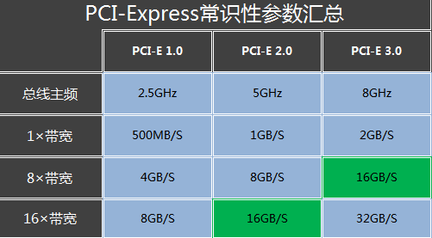
PCI-e bandwidth

Slide 13
An operating system “process”
An instance of a computer program that is being executed.
Components of a process:
The executable machine language program.
A block of memory.
Descriptors of resources the OS has allocated to the process.
Security information.
Information about the state of the process

Slide 14
Threading
Threads are contained within processes.
They allow programmers to divide their programs into (more or less) independent tasks.
The hope is that when one thread blocks because it is waiting on a resource, another will have work to do and can run

Slide 15
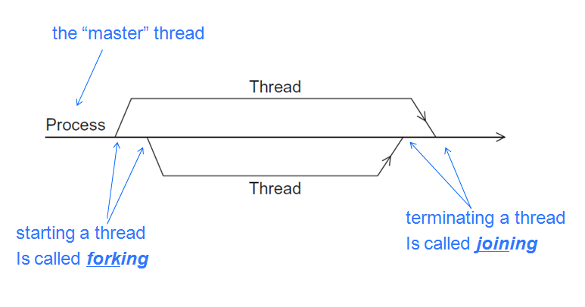
A process and two threads

Slide 16
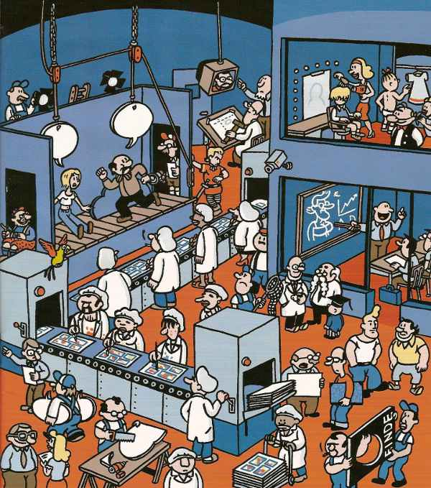

一个车间里，可以有很多工人。他们协同完成一个任务，
线程就好比车间里的工人。一个进程可以包括多个线程。

Slide 17
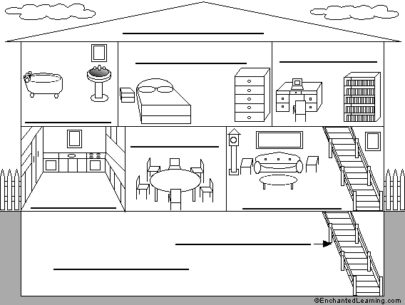
车间的空间是工人们共享的，比如许多房间是每个工人都可以进出的。这象征一个进程的内存空间是共享的，每个线程都可以使用这些共享内存。

Slide 18

可是，每间房间的大小不同，有些房间最多只能容纳一个人，比如厕所。里面有人的时候，其他人就不能进去了。这代表一个线程使用某些共享内存时，其他线程必须等它结束，才能使用这一块内存。

Slide 19
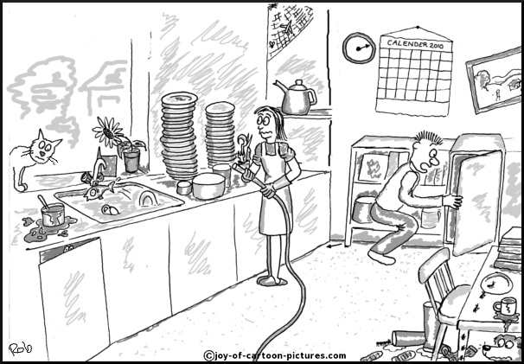
还有些房间，可以同时容纳n个人，比如厨房。也就是说，如果人数大于n，多出来的人只能在外面等着。这好比某些内存区域，只能供给固定数目的线程使用。

Slide 20

Modifications to the von neumann model

Slide 21
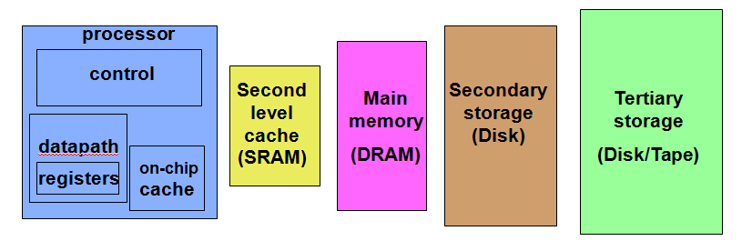
Memory Hierarchy

Slide 22
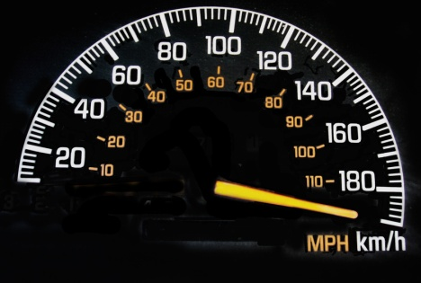
Basics of caching
A collection of memory locations that can be accessed in less time than some other memory locations.
A CPU cache is typically located on the same chip, or one that can be accessed much faster than ordinary memory.

Slide 23
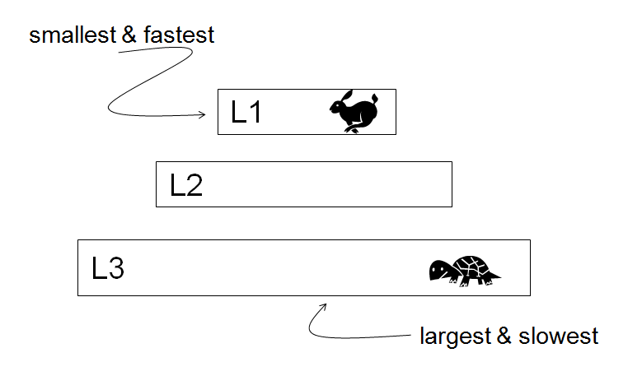
Levels of Cache

Slide 24
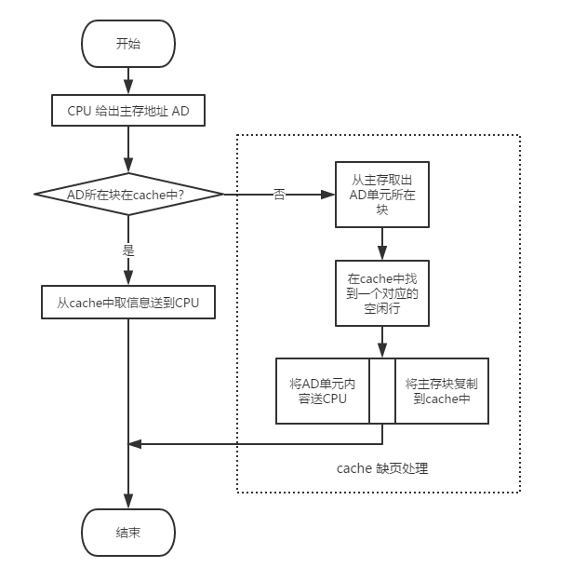

Slide 25
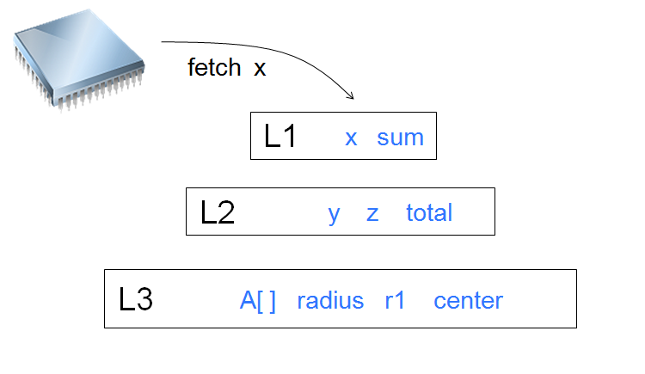
Cache hit

Slide 26
Issues with cache
When a CPU writes data to cache, the value in cache may be inconsistent with the value in main memory.
Write-through caches handle this by updating the data in main memory at the time it is written to cache.
Write-back caches mark data in the cache as dirty. When the cache line is replaced by a new cache line from memory, the dirty line is written to memory.

Slide 27
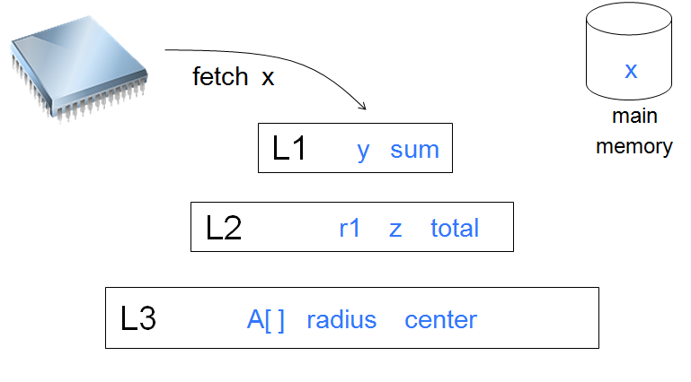
Cache miss

Slide 28
Cache mappings
Fully associative – a new line can be placed at any location in the cache.
Direct mapped – each cache line has a unique location in the cache to which it will be assigned.
n-way set associative – each cache line can be place in one of n different locations in the cache.

Slide 29
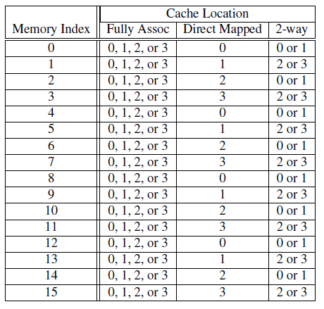
Example
Assignments of a 16-line main memory to a 4-line cache

Slide 30
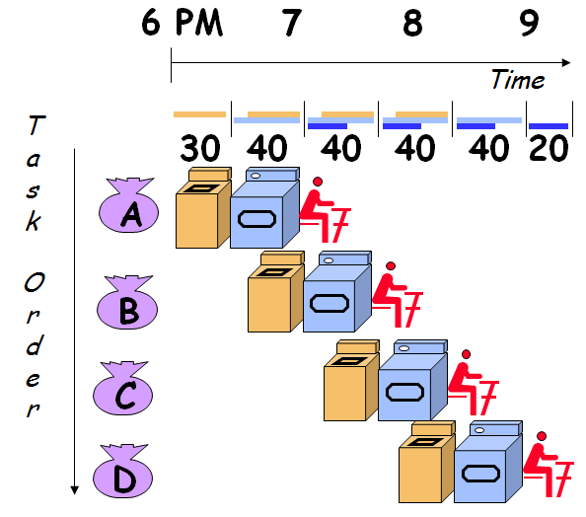
Instruction Level Parallelism - Pipelining
Dave Patterson’s Laundry example: 4 people doing laundry
wash (30 min) + dry (40 min) + fold (20 min) = 90 min Latency
In this example:
Sequential execution takes 4 * 90min = 6 hours
Pipelined execution takes 30+4*40+20 = 3.5 hours
Bandwidth = loads/hour
BW = 4/6 l/h w/o pipelining
BW = 4/3.5 l/h w pipelining
Pipelining helps bandwidth but not latency (90 min)
Bandwidth limited by slowest pipeline stage

Slide 31
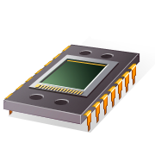
Parallel hardware---Flynn’s Taxonomy

Slide 32
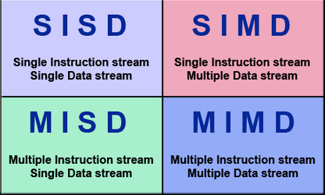
Parallel hardware

Slide 33
Speedup
Number of cores = p
Serial run-time = T(serial）
Parallel run-time = T（parallel）
T（Parallel）= T（serial）/ p

Slide 34
Speedup of a parallel program
S = T(serial) / T(parallel)

Slide 35
Efficiency of a parallel program
E = S/p = T(serial) / T(parallel)/p

Slide 36
Two important Laws
Amdahl’s Law
- Gene Amdahl observation in 1967
- Speedup is limited by serial portions
- Assumes fixed workloads and fixed problem size
Gustafson’s Law
- John Gustafson observation in 1988
- Rescues parallel processing from Amdahl’s law
- Proposes fixed time and increasing work
- Sequential portions have diminishing effect

Slide 37
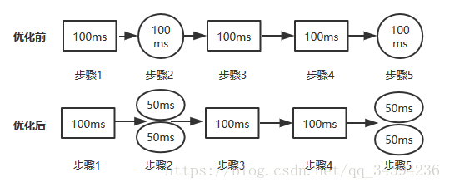

Slide 38
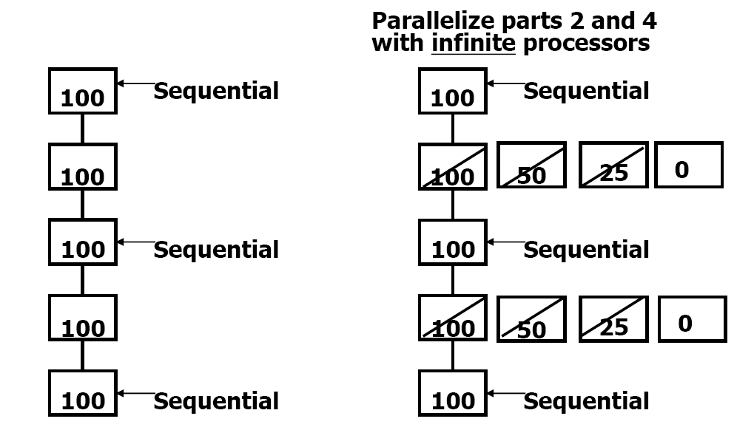
Amdahl’s Law

Slide 39
Amdahl’s Law
S=1/(1-a+a/n)
其中，a为并行计算部分所占比例，n为并行处理结点个数。这样，当1-a=0时，(即没有串行，只有并行)最大加速比s=n；当a=0时（即只有串行，没有并行），最小加速比s=1；当n→∞时，极限加速比s→ 1/（1-a），这也就是加速比的上限。例如，若串行代码占整个代码的25%，则并行处理的总体性能不可能超过4。
我们可以从“加速比”的公式中看出，单纯地增加cup处理器的数量并不一定可以有效地提高系统的性能，只有在提高系统内并行化模块比重的前提下，同时合理增加处理器的数量，才能以最小的投入得到最大的加速比，这就是阿姆达尔定律要告诉我们的核心思想，它很直观地反应了加速比与处理器个数、系统串行比例之间的关系

Slide 40
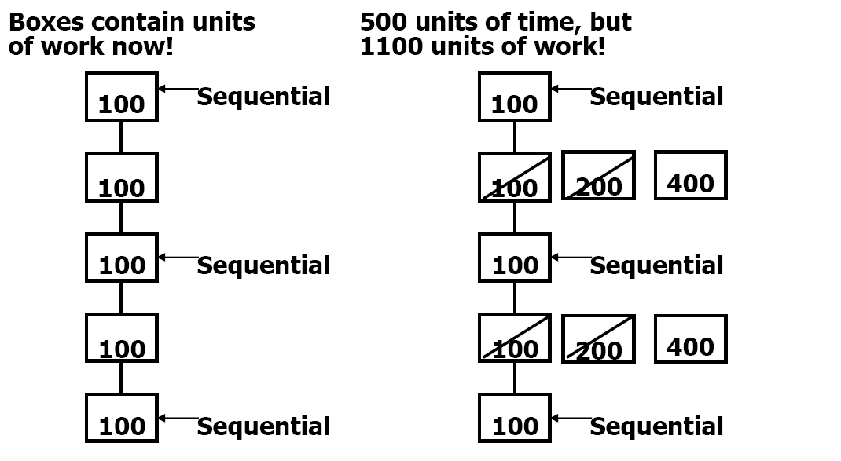
Gustafson’s Law

Slide 41
S=n-f(n-1)
执行时间： 串行时间a + 并行时间b
优化后时间： a + nb、
加速比： (a + nb) / (a + b)
f串行比例 ： a / (a + b)
如果串行比例很小，那个加速比就是处理器的个数。

Slide 42
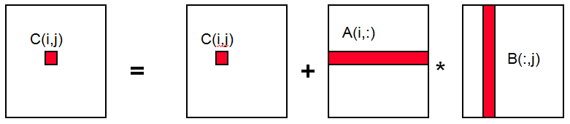
Case Study in Matrix Multiplication
Naïve Matrix Multiply
{implements C = C + A*B}
for i = 1 to n
for j = 1 to n
for k = 1 to n
C(i,j) = C(i,j) + A(i,k) * B(k,j)
Algorithm has O(n³) Flops

Slide 43
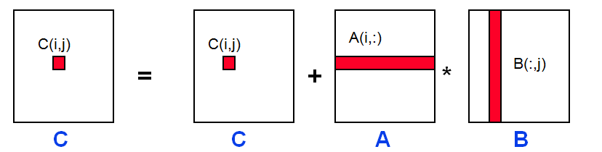
Naïve Matrix Multiply
{implements C = C + A*B}
for i = 1 to n
{read row i of A into fast memory}
for j = 1 to n
{read C(i,j) into fast memory}
{read column j of B into fast memory}
for k = 1 to n
C(i,j) = C(i,j) + A(i,k) * B(k,j)
{write C(i,j) back to slow memory}

Slide 44
Paper
BLAS：http://www.netlib.org/blas/
FFT: https://en.wikipedia.org/wiki/Fast_Fourier_transform
(1984) Gauss and the history of the fast fourier transform http://wenku.baidu.com/link?url=x_cWS5rfsAyEBSZ-Rqg2UuW4iW5SfTdzmxbelNs3AuUbCgIo95oVpIdPmsn-gSeMAGRYHY4DjU6NEhQDyyP53XmXLqZrAGXTB0bd787OdWu

Slide 45

Thanks !

