Slide 1
GPU与人工智能3 Distributed Memory Programming with MPI
Ying Yu
March 11， 2022
yingyu@nju.edu.cn

Slide 2
Index
Writing your first MPI program.
Using the common MPI functions.
The Trapezoidal Rule in MPI.
Collective communication.

Slide 3
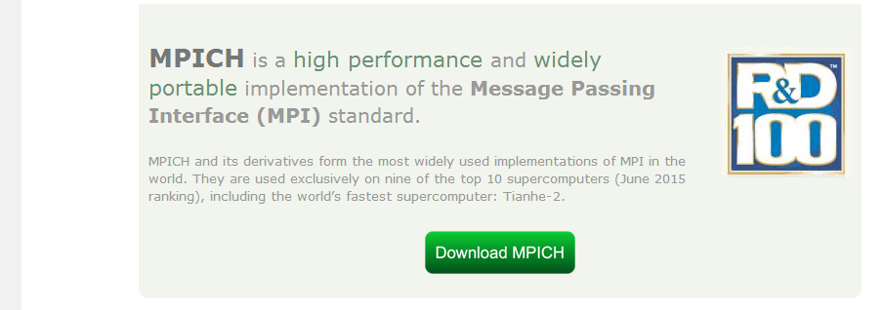
Windows 10上搭建MPI 开发环境
1. 下载mpi for windows
Windows为了兼容MPI，自己做了一套基于一般个人电脑的MPI实现。如果要安装真正意义上的MPI的话，请直接去www.mpich.org下载，里面根据对应的系统下载相应的版本

Slide 4
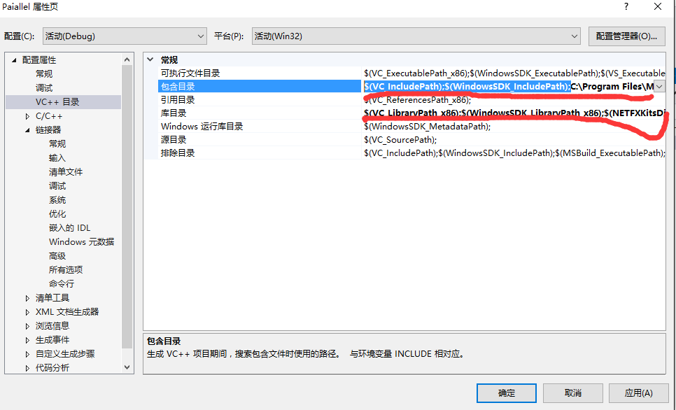
Windows 10上搭建MPI 开发环境
2. 安装mpi，配置目录，即加载Include和Lib库

Slide 5
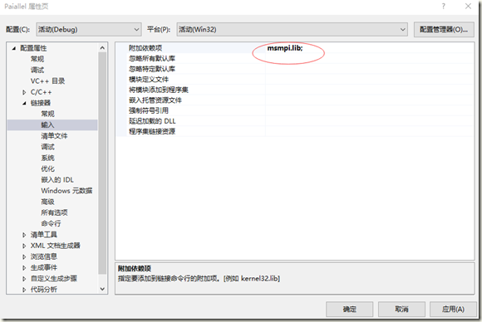
Windows 10上搭建MPI 开发环境
3. 加载依赖项
4. 编译

Slide 6
什么是MPI
对MPI的定义是多种多样的，但不外乎下面三个方面，它们限定了MPI的内涵和外延：
MPI 是一个库，不是一门语言。MPI 提供库函数/过程供C/C++/FORTRAN 调用。
MPI 是一种标准或规范的代表，而不特指某一个对它的具体实现。
MPI 是一种消息传递编程模型。最终目的是服务于进程间通信这一目标

Slide 7
名词和概念
进程(Process)
一个 MPI 并行程序由一组运行在相同或不同计算机 /计算节点上的进程或线程构成。为统一起见，我们将 MPI 程序中一个独立参与通信的个体称为一个进程。
进程组：
一个 MPI程序的全部进程集合的一个有序子集。进程组中每个进程都被赋予一个在改组中唯一的序号（rank），用于在该组中标识该进程。序号范围从 0 到进程数－1。

Slide 8
通信器（communicator）:
有时也译成通信子，是完成进程间通信的基本环境，它描述了一组可以互相通信的进程以及它们之间的联接关系等信息。MPI所有通信必须在某个通信器中进行。通信器分域内通信器（intracommunicator）和域间通信器（intercommunicator）两类，前者用于同一进程中进程间的通信，后者则用于分属不同进程的进程间的通信。
MPI 系统在一个 MPI 程序运行时会自动创建两个通信器：一个称为 MPI_COMM_WORLD，它包含 MPI 程序中所有进程，另一个称为MPI_COMM_SELF，它指单个进程自己所构成的通信器。

Slide 9
序号（rank）：
即进程的标识，是用来在一个进程组或一个通信器中标识一个进程。MPI 的进程由进程组/序号或通信器/序号唯一确定。
消息（message）：
MPI 程序中在进程间传递的数据。它由通信器、源地址、目的地址、消息标签和数据构成。
通信（communication）：
通信是指在进程之间进行消息的收发、同步等操作。

Slide 10
MPI六大核心接口
开始和结束MPI的接口：MPI_Init、 MPI_Finalize
获取进程状态的接口：MPI_Comm_rank、MPI_Comm_size
传输数据的接口：MPI_Send、MPI_Recv

Slide 11

MPI Programs
Written in C.
Has main.
Uses stdio.h, string.h, etc.
Need to add mpi.h header file.
Identifiers defined by MPI start with “MPI_”.
First letter following underscore is uppercase.
For function names and MPI-defined types.
Helps to avoid confusion.

Slide 12
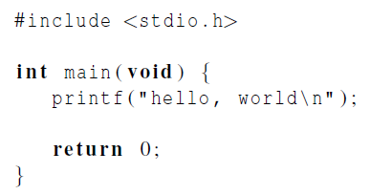

Hello World!
(a classic)

Slide 13
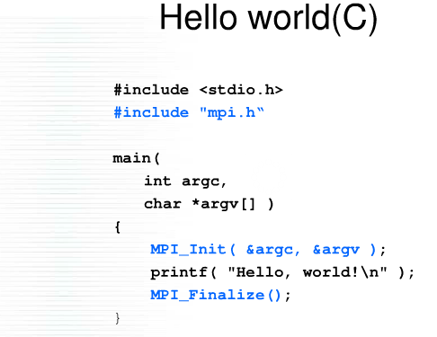
MPI-Hello World (C)

Slide 14
#include "mpi.h"
#include <stdio.h>
int main(int argc, char* argv[])
{
int rank, numproces;
int namelen;
char processor_name[MPI_MAX_PROCESSOR_NAME];
MPI_Init(&argc, &argv);
MPI_Comm_rank(MPI_COMM_WORLD, &rank);//获得进程号
MPI_Comm_size(MPI_COMM_WORLD, &numproces);//返回通信子的进程数
MPI_Get_processor_name(processor_name, &namelen);
fprintf(stderr, "hello world! process %d of %d on %s\n", rank, numproces, processor_name);
MPI_Finalize();
return 0;
}

Slide 15
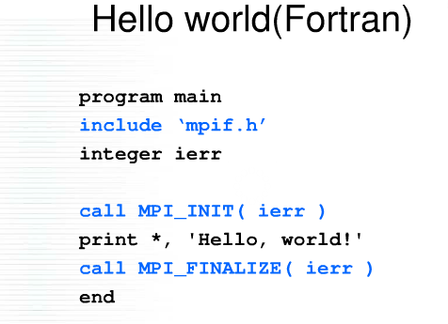
MPI-Hello World (Fortran)

Slide 16
Compilation
wrapper script to compile
source file
mpicc -g -Wall -o mpi_hello mpi_hello.c
produce debugging
information
create this executable file name
(as opposed to default a.out)
turns on all warnings

Slide 17
Execution
mpiexec -n <number of processes> <executable>
mpiexec -n 1 ./mpi_hello
run with 1 process
mpiexec -n 4 ./mpi_hello
run with 4 processes

Slide 18
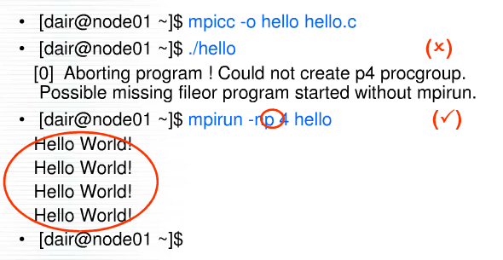
Run

Slide 19
A process and two threads
mpiexec -n 1 ./mpi_hello
Greetings from process 0 of 1 !
mpiexec -n 4 ./mpi_hello
Greetings from process 0 of 4 !
Greetings from process 1 of 4 !
Greetings from process 2 of 4 !
Greetings from process 3 of 4 !

Slide 20
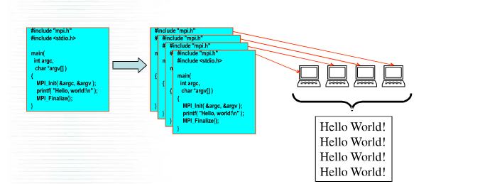

Slide 21
MPI Components
MPI_Initialized (int *flag)
Test whether MPI initialized, return flag: 1(true), 0(false)
MPI_Get_processor_name(char *name, int *resultlen)
Return the processor name and size ( buffer size > MPI_MAX_PROCESSOR_NAME)

Slide 22


MPI Components
MPI_Init
Tells MPI to do all the necessary setup.
MPI_Finalize
Tells MPI we’re done, so clean up anything allocated for this program.

Slide 23
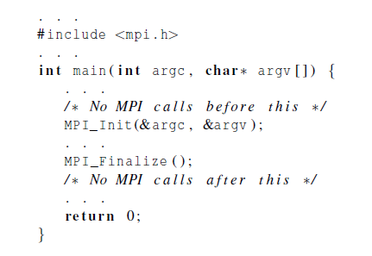
Basic Outline

Slide 24
Communicators
A collection of processes that can send messages to each other.
MPI_Init defines a communicator that consists of all the processes created when the program is started.
Called MPI_COMM_WORLD.
MPI_COMM_SELF

Slide 25


Communicators 语法结构
number of processes in the communicator
my rank (the process making this call)

Slide 26
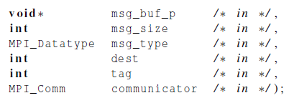
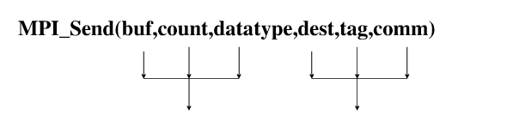
Communication
指向包含消息内容的内存块指针
消息字符串加上C语言中字符串结束符′\0′
所占的字符数量
要接收消息的进程的进程号
用以和本进程向同一目的进程发送
的其它消息区别开来
MPI进程组所在的通信域
消息的内容
消息的目的地

Slide 27
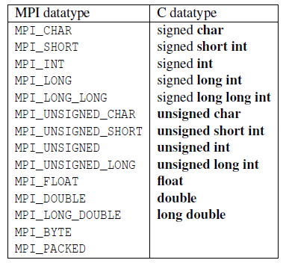
Data types

Slide 28
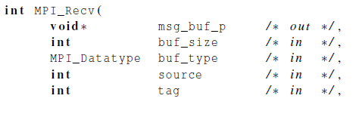

Communication

Slide 29

Message matching
MPI_Send
src = q
r
MPI_Recv
dest = r
q

Slide 30
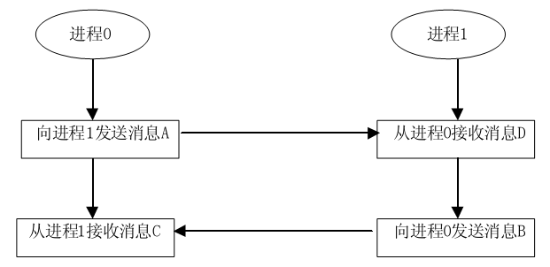
safe communication

Slide 31

Receiving messages
A receiver can get a message without knowing:
the amount of data in the message,
the sender of the message,
or the tag of the message.

Slide 32
status_p argument
MPI_Status*
MPI_Status* status;
status.MPI_SOURCE
status.MPI_TAG
MPI_SOURCE
MPI_TAG
MPI_ERROR

Slide 33
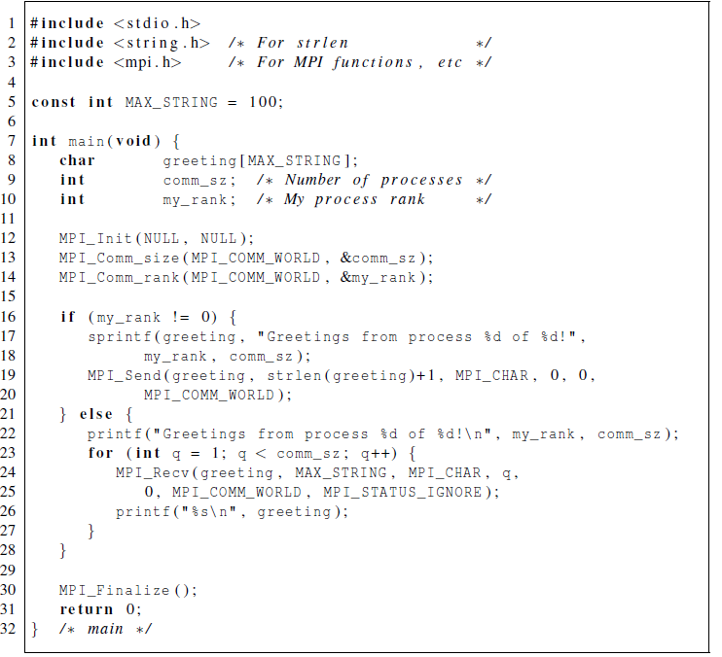
Our first MPI program

Slide 34
#include <stdio.h>
#include <string.h> /* For strlen */
//MPI相关的库
#include <mpi.h> /* For MPI functions, etc */
const int MAX_STRING = 100;
int main(void) {
char greeting[MAX_STRING]; /* String storing message*/
int comm_sz; //进程数
int my_rank; //当前进程的进程号
//初始化MPI
MPI_Init(NULL, NULL);
//获取进程的数量，并存入comm_sz变量中
MPI_Comm_size(MPI_COMM_WORLD, &comm_sz);
//获取当前进程的进程号
MPI_Comm_rank(MPI_COMM_WORLD, &my_rank);

Slide 35
// 进程号不为0的处理逻辑。
// 在该程序中，进程号不为0的进程，只负责发数据给进程0。
if (my_rank != 0) {
//创建要发送的数据
sprintf(greeting, "Greetings from process %d of %d!",
my_rank, comm_sz);
//发送数据给进程0
MPI_Send(greeting, strlen(greeting)+1, MPI_CHAR, 0, 0,
MPI_COMM_WORLD);
}
// 进程号为0的处理逻辑
else {
// 打印进程0的数据
printf("Hello! Greetings from process %d of %d!\n", my_rank, comm_sz);
// 循环接收其它进程发送的数据，并打印。
for (int q = 1; q < comm_sz; q++) {
// 接收其它进程的数据
MPI_Recv(greeting, MAX_STRING, MPI_CHAR, q,
0, MPI_COMM_WORLD, MPI_STATUS_IGNORE);
// 打印

Slide 36
printf("%s\n", greeting);
}
}
// 关闭MPI
MPI_Finalize();
return 0;
} /* main */

Slide 37

Trapezoidal rule in mpi

Slide 38
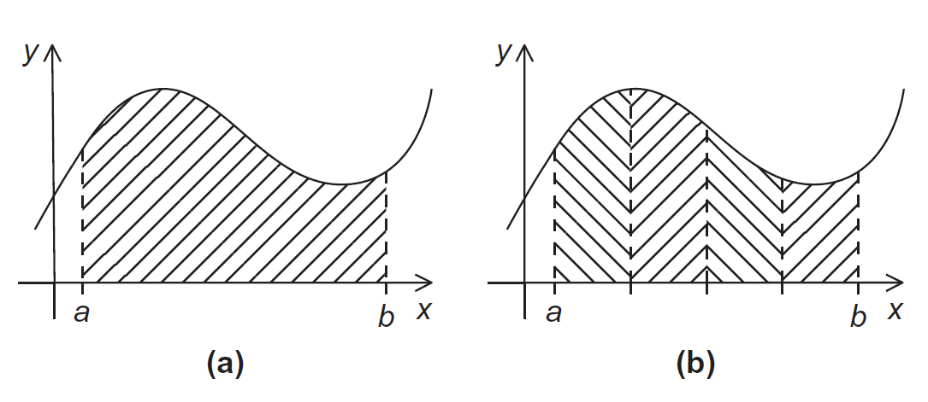
The Trapezoidal Rule

Slide 39
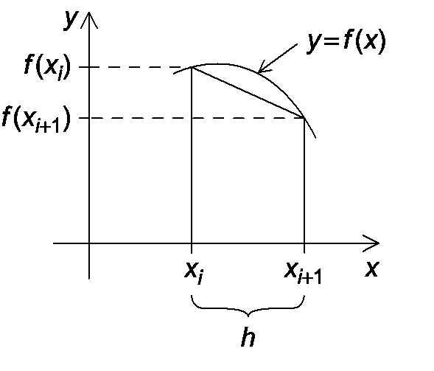
One trapezoid

Slide 40


The Trapezoidal Rule

Slide 41
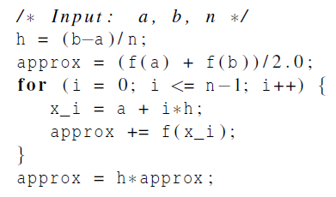
Pseudo-code for a serial program

Slide 42
Parallelizing the Trapezoidal Rule
Partition problem solution into tasks.
Identify communication channels between tasks.
Aggregate tasks into composite tasks.
Map composite tasks to cores.

Slide 43
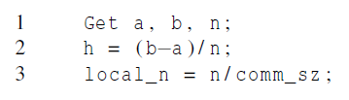
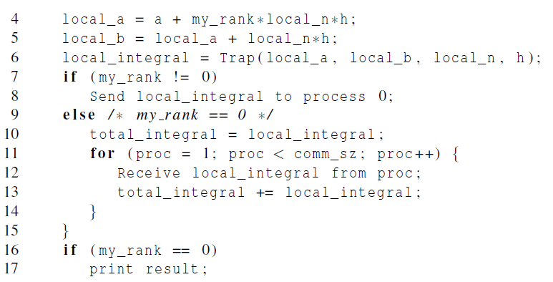
Parallel pseudo-code

Slide 44
Tasks and communications for Trapezoidal Rule

Slide 45
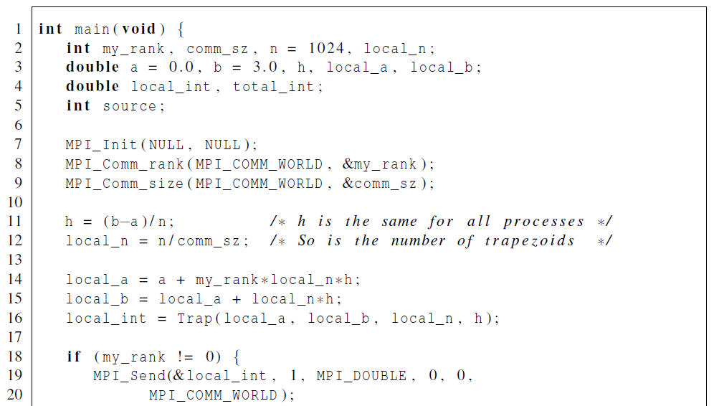
First version (1)

Slide 46
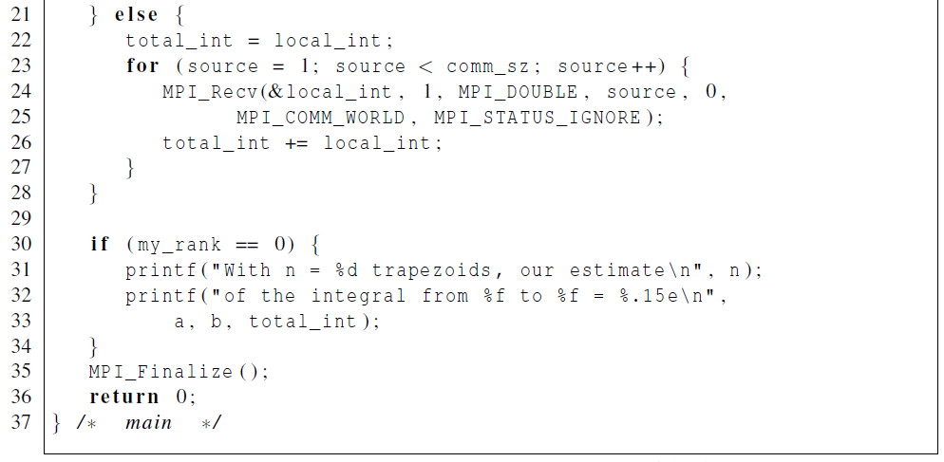
First version (2)

Slide 47
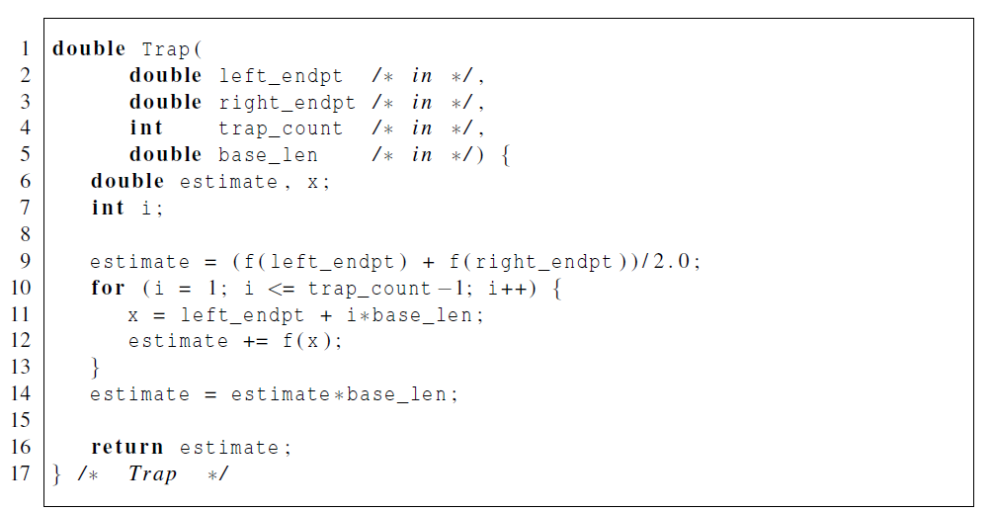
First version (3)

Slide 48
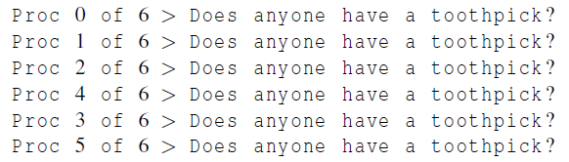

Running with 6 processes
unpredictable output

Slide 49

Collective communication

Slide 50
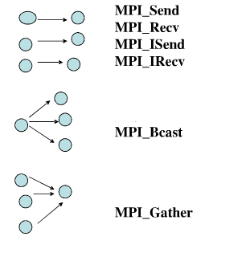
Communication

Slide 51
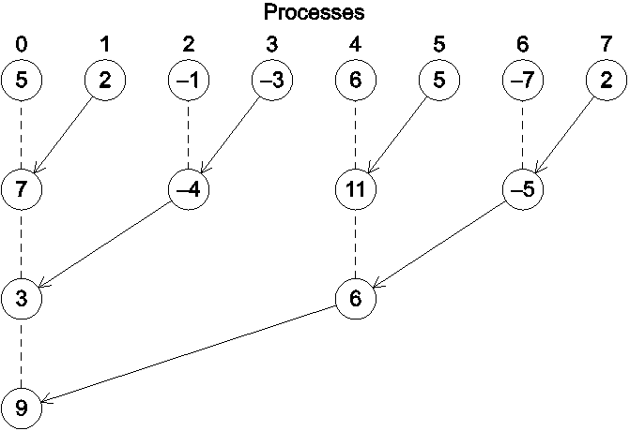
A tree-structured global sum

Slide 52
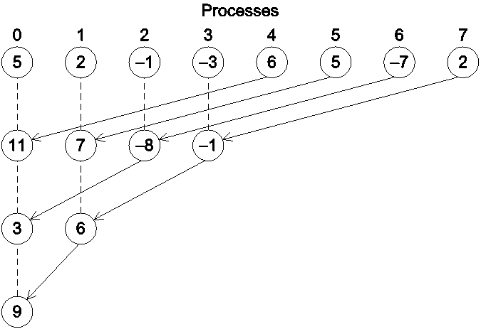
An alternative tree-structured global sum
1024 processors?

Slide 53
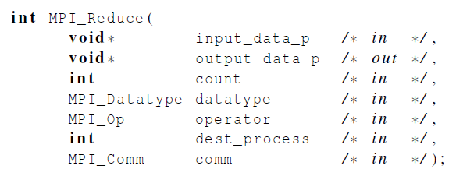
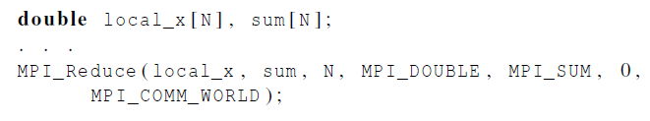
MPI_Reduce

Slide 54
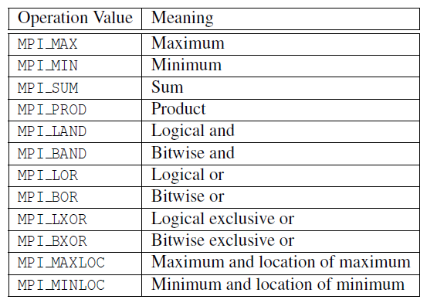
Predefined reduction operators in MPI

Slide 55
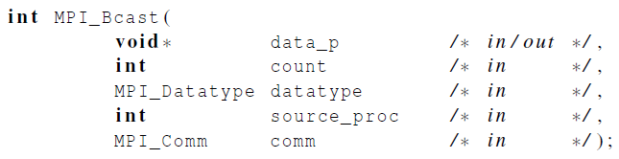
Broadcast
Data belonging to a single process is sent to all of the processes in the communicator.

Slide 56
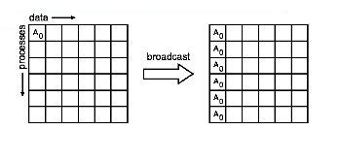
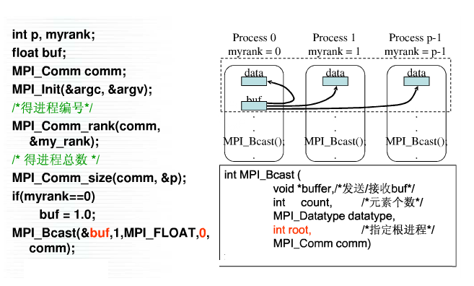
Broadcast

Slide 57
Partitioning options
Block partitioning
Assign blocks of consecutive components to each process.
Cyclic partitioning
Assign components in a round robin fashion.
Block-cyclic partitioning
Use a cyclic distribution of blocks of components.

Slide 58
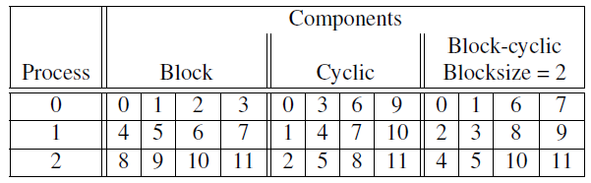
Different partitions of a 12-component vector among 3 processes

Slide 59

Matrix-vector multiplication
i-th component of y
Dot product of the ith row of A with x.

Slide 60
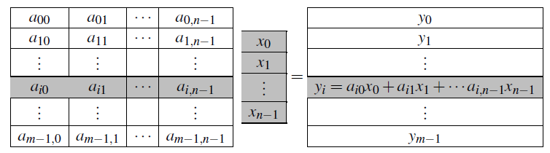
Matrix-vector multiplication

Slide 61
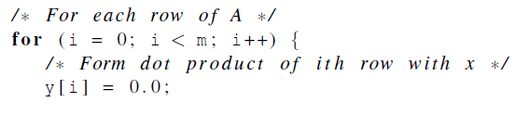

Multiply a matrix by a vector
Serial pseudo-code

Slide 62
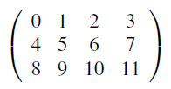

C style arrays
stored as

Slide 63
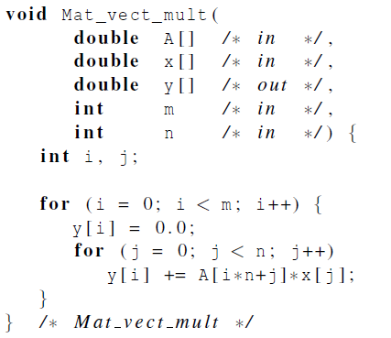
Serial matrix-vector multiplication

Slide 64
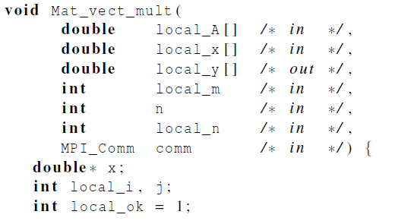
After class --- An MPI matrix-vector multiplication function (1)

Slide 65
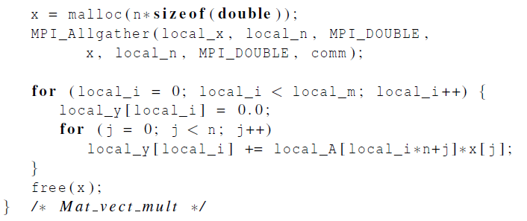
After class --- An MPI matrix-vector multiplication function (2)

Slide 66
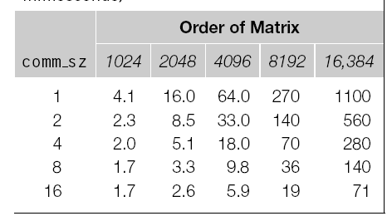
Performance

