Slide 1
GPU与人工智能 Shared Memory Programming with OpenMP
Ying Yu
March 28, 2022
yingyu@nju.edu.cn

Slide 2
Roadmap
# Chapter Subtitle
Writing programs that use OpenMP.
Using OpenMP to parallelize many serial for loops with only small changes to the source code.
Task parallelism.
Explicit thread synchronization.
Standard problems in shared-memory programming.

Slide 3
OpenMP
Open Specfication for Multi-processing
Standard API for defining multi-threaded shared-memory programs.
An API for shared-memory parallel programming.
MP = multiprocessing
Designed for systems in which each thread or process can potentially have access to all available memory.
System is viewed as a collection of cores or CPU’s, all of which have access to main memory.
www.openmp.org for examples, talks, forums etc.

Slide 4
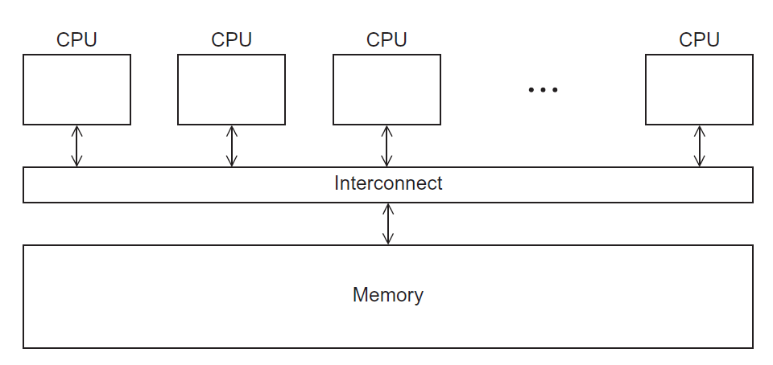
A shared memory system

Slide 5

Shared Memory Parallel Programming in the Multi-Core Era
Desktop and Laptop
- 2, 4, 8 cores and … ?
A single node in distributed memory clusters
- Steele cluster node: 2 → 8 → (16) cores
- /proc/cpuinfo
Shared memory hardware Accelerators
- Cell processors: 1 PPE and 8 SPEs
- Nvidia GPUs: at least 128 processing units

Slide 6
In case the compiler doesn’t support OpenMP
# include <omp.h>
#ifdef _OPENMP
# include <omp.h>
#endif

Slide 7
Pragmas
Most of the constructs in OpenMP are compiler directives or pragmas.
For C and C++, the pragmas take the form:
#pragma omp construct [clause [clause]…]
For Fortran, the directives take one of the forms:
C$OMP construct [clause [clause]…]
!$OMP construct [clause [clause]…]
*$OMP construct [clause [clause]…]
Include files
#include “omp.h”
#pragma

Slide 8
OpenMp pragmas
# pragma omp parallel
Most basic parallel directive.
The number of threads that run the following structured block of code is determined by the run-time system.

Slide 9
OpenMP Constructs
OpenMP’s constructs:
Parallel Regions
Worksharing (for/DO, sections, …)
Data Environment (shared, private, …)
Synchronization (barrier, flush, …)
Runtime functions/environment variables (omp_get_num_threads(), …)

Slide 10
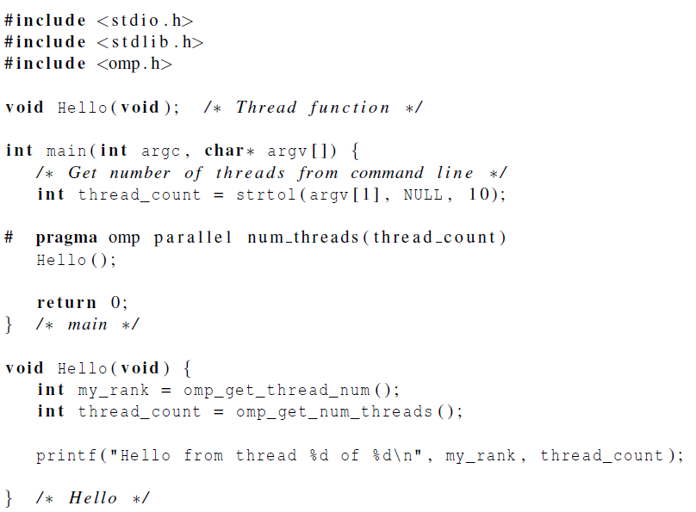

Slide 11
gcc −g −Wall −fopenmp −o omp_hello omp_hello . c
. / omp_hello 4
compiling
running with 4 threads
Hello from thread 0 of 4
Hello from thread 1 of 4
Hello from thread 2 of 4
Hello from thread 3 of 4
possible outcomes
Hello from thread 3 of 4
Hello from thread 1 of 4
Hello from thread 2 of 4
Hello from thread 0 of 4
Hello from thread 1 of 4
Hello from thread 2 of 4
Hello from thread 0 of 4
Hello from thread 3 of 4

Slide 12
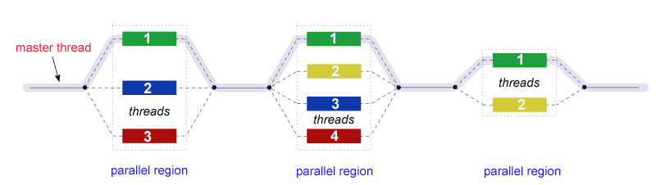
A process forking and joining two threads

Slide 13
How is OpenMP typically used?
OpenMP is usually used to parallelize loops:
Find your most time consuming loops.
Split them up between threads.
Sequential Program
Parallel Program
#include “omp.h” void main() { int i, k, N=1000;
double A[N], B[N], C[N]; #pragma omp parallel for for (i=0; i<N; i++) {
A[i] = B[i] + k*C[i]; } }
void main() { int i, k, N=1000;
double A[N], B[N], C[N]; for (i=0; i<N; i++) { A[i] = B[i] + k*C[i] } }

Slide 14
How is OpenMP typically used?
Single Program Multiple Data (SPMD)
Thread 1
void main() { int i, k, N=1000;
double A[N], B[N], C[N]; lb = 250;
ub = 500;
for (i=lb;i<ub;i++) {
A[i] = B[i] + k*C[i]; } }
Parallel Program
Thread 0
Thread 2
Thread 3
void main() { int i, k, N=1000;
double A[N], B[N], C[N]; lb = 0;
ub = 250;
for (i=lb;i<ub;i++) {
A[i] = B[i] + k*C[i]; } }
#include “omp.h” void main() { int i, k, N=1000;
double A[N], B[N], C[N]; #pragma omp parallel for for (i=0; i<N; i++) {
A[i] = B[i] + k*C[i]; } }
void main() { int i, k, N=1000;
double A[N], B[N], C[N]; lb = 500;
ub = 750;
for (i=lb;i<ub;i++) {
A[i] = B[i] + k*C[i]; } }
void main() { int i, k, N=1000;
double A[N], B[N], C[N]; lb = 750;
ub = 1000;
for (i=lb;i<ub;i++) {
A[i] = B[i] + k*C[i]; } }

Slide 15
How is OpenMP typically used?
double A[1000]; omp_set_num_threads(4);
#pragma omp parallel {
int ID = omp_get_thread_num(); pooh(ID, A); }
printf(“all done\n”);
Each thread executes the same code redundantly.
double A[1000];
omp_set_num_threads(4)
pooh(0,A)
pooh(1,A)
pooh(2,A)
pooh(3,A)
A single copy of A is shared between all threads.
printf(“all done\n”);
Threads wait here for all threads to finish before proceeding (I.e. a barrier)

Slide 16
The OpenMP API Combined parallel work-share
OpenMP shortcut: Put the “parallel” and the work-share on the same line
int i;
double res[MAX];
#pragma omp parallel
{
#pragma omp for
for (i=0;i< MAX; i++) {
res[i] = huge();
}
}
int i;
double res[MAX];
#pragma omp parallel for
for (i=0;i< MAX; i++) {
res[i] = huge();
}
These are equivalent

Slide 17
OpenMP Fork-and-Join model
printf(“program begin\n”);
N = 1000;
#pragma omp parallel for
for (i=0; i<N; i++)
A[i] = B[i] + C[i];
M = 500;
#pragma omp parallel for
for (j=0; j<M; j++)
p[j] = q[j] – r[j];
printf(“program done\n”);
Serial
Parallel
Serial
Parallel
Serial

Slide 18
Shared Memory Model
private
private
thread2
Data can be shared or private
Shared data is accessible by all threads
Private data can be accessed only by the threads that owns it
Data transfer is transparent to the programmer
thread1
Shared
Memory
thread3
thread5
thread4
private
private
private

Slide 19
In case the compiler doesn’t support OpenMP
# ifdef _OPENMP
int my_rank = omp_get_thread_num ( );
int thread_count = omp_get_num_threads ( );
# e l s e
int my_rank = 0;
int thread_count = 1;
# endif

Slide 20
OpenMP中的任务调度-Schedule
在OpenMP中，对for循环并行化的任务调度使用schedule子句来实现
使用格式：schedule(type,size)
· dynamic
· static

Slide 21
静态调度(static)
#pragma omp parallel for schedule(static)
for(i = 0; i < 10; i++ )
{
printf("i=%d, thread_id=%d/n", i, omp_get_thread_num());
}
上面代码执行时打印的结果如下：
i=0, thread_id=0
i=1, thread_id=0
i=2, thread_id=0
i=3, thread_id=0
i=4, thread_id=0
i=5, thread_id=1
i=6, thread_id=1
i=7, thread_id=1
i=8, thread_id=1
i=9, thread_id=1
#pragma omp parallel for schedule(static, 2)
for(i = 0; i < 10; i++ )
{
printf("i=%d, thread_id=%d/n", i, omp_get_thread_num());
}
上面代码执行时打印的结果如下：
i=0, thread_id=0
i=1, thread_id=0
i=4, thread_id=0
i=5, thread_id=0
i=8, thread_id=0
i=9, thread_id=0
i=2, thread_id=1
i=3, thread_id=1
i=6, thread_id=1
i=7, thread_id=1

Slide 22
动态调度(dynamic)
#pragma omp parallel for schedule(dynamic)
for(i = 0; i < 10; i++ )
{
printf("i=%d, thread_id=%d/n", i, omp_get_thread_num());
}
打印结果如下：
i=0, thread_id=0
i=1, thread_id=1
i=2, thread_id=0
i=3, thread_id=1
i=5, thread_id=1
i=6, thread_id=1
i=7, thread_id=1
i=8, thread_id=1
i=4, thread_id=0
i=9, thread_id=1
#pragma omp parallel for schedule(dynamic, 2)
for(i = 0; i < 10; i++ )
{
printf("i=%d, thread_id=%d/n", i, omp_get_thread_num());
}
打印结果如下：
i=0, thread_id=0
i=1, thread_id=0
i=4, thread_id=0
i=2, thread_id=1
i=5, thread_id=0
i=3, thread_id=1
i=6, thread_id=0
i=8, thread_id=1
i=7, thread_id=0
i=9, thread_id=1

Slide 23

The Trapezoidal Rule

Slide 24
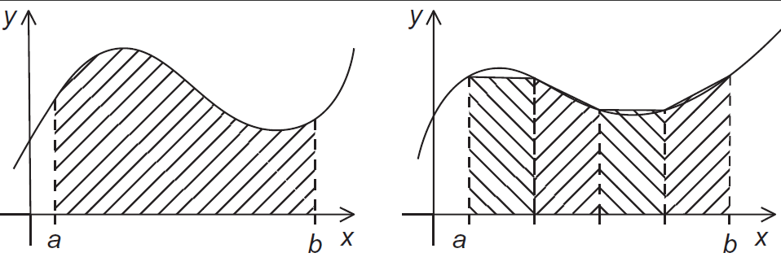
The trapezoidal rule

Slide 25
Serial algorithm
//积分函数
double blog4::Trap(double a, double b, int n)
{
double h, x, my_result;
double local_a, local_b;
int i, local_n;
int my_rank = omp_get_thread_num();
int thread_count = omp_get_num_threads();
h = (b - a) / n;
local_n = n / thread_count;
local_a = a + my_rank*local_n*h;
local_b = local_a + local_n*h;
my_result = (f(local_a) + f(local_b)) / 2.0;
for (i = 1; i <= local_n - 1; i++)
{
x = local_a + i*h;
my_result += f(x);
}
my_result = my_result*h;
return my_result;
}

Slide 26
A First OpenMP Version
1) We identified two types of tasks:
a) computation of the areas of individual trapezoids, and
b) adding the areas of trapezoids.
2) There is no communication among the tasks in the first collection, but each task in the first collection communicates with task 1b.
3) We assumed that there would be many more trapezoids than cores.
So we aggregated tasks by assigning a contiguous block of trapezoids to each thread (and a single thread to each core).

Slide 27
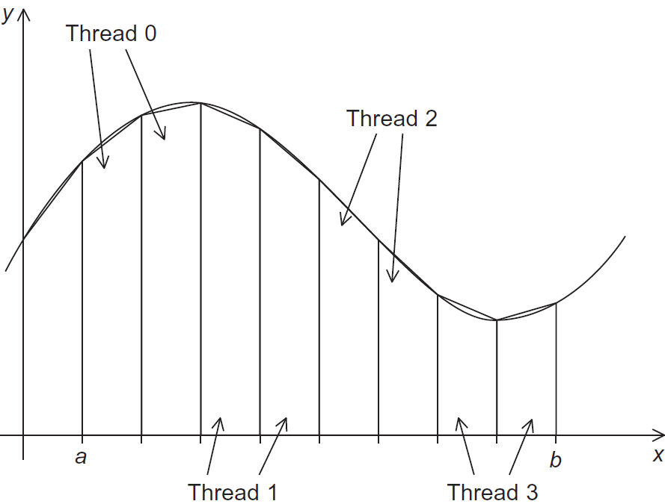
Assignment of trapezoids to threads

Slide 28
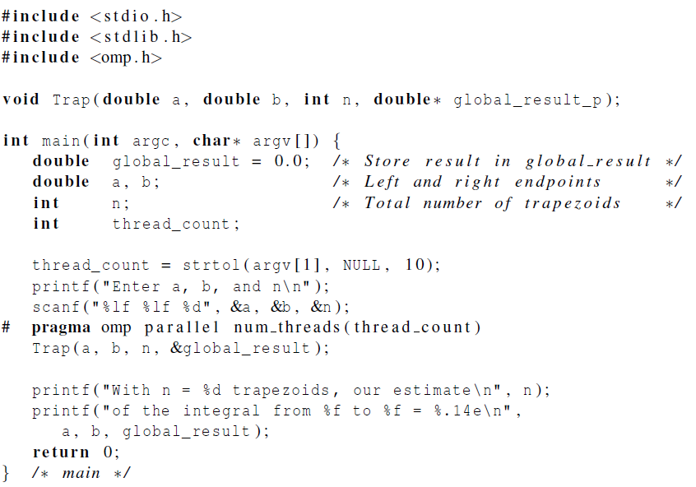

Slide 29
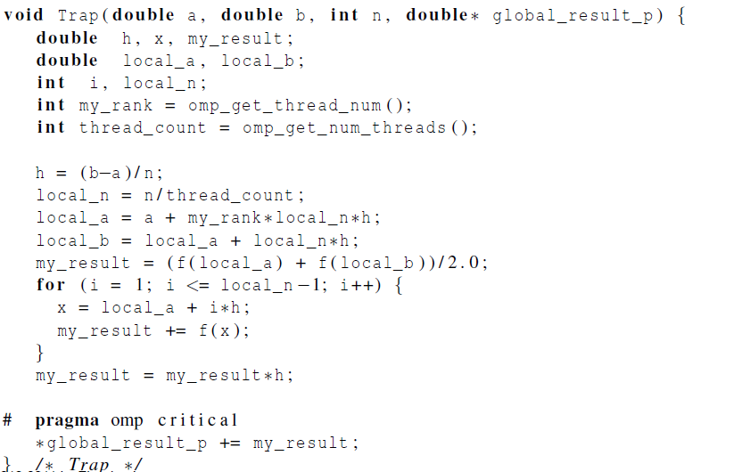

Slide 30

Scope of Variables

Slide 31
Scope
In serial programming, the scope of a variable consists of those parts of a program in which the variable can be used.
In OpenMP, the scope of a variable refers to the set of threads that can access the variable in a parallel block.

Slide 32

Scope in OpenMP
A variable that can be accessed by all the threads in the team has shared scope.
A variable that can only be accessed by a single thread has private scope.
The default scope for variables declared before a parallel block is shared.

Slide 33
Reduction operators
A reduction operator is a binary operation (such as addition or multiplication).
A reduction is a computation that repeatedly applies the same reduction operator to a sequence of operands in order to get a single result.
All of the intermediate results of the operation should be stored in the same variable: the reduction variable.

Slide 34
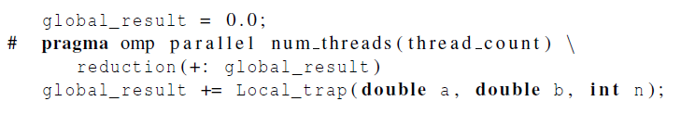
A reduction clause can be added to a parallel directive.
+, *, -, &, |, ˆ, &&, ||

Slide 35

The “Parallel For” Directive

Slide 36
Parallel for
Forks a team of threads to execute the following structured block.
However, the structured block following the parallel for directive must be a for loop.
Furthermore, with the parallel for directive the system parallelizes the for loop by dividing the iterations of the loop among the threads.

Slide 37
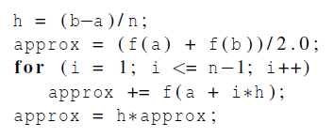
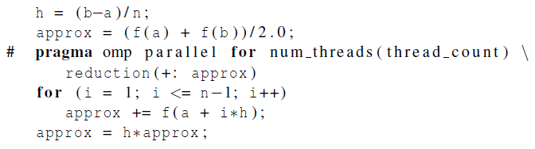

Slide 38
Limitation for parallelizable for statements
Could not parallel While or do – while loop.
Infinite loop
ex: for( ; ;){
…..
}
3. Only one exit
ex: for(i=0; i<n; i++){
if(…) break;
…..
}

Slide 39
Data dependencies
fibo[ 0 ] = fibo[ 1 ] = 1;
for (i = 2; i < n; i++)
fibo[ i ] = fibo[ i – 1 ] + fibo[ i – 2 ];
note 2 threads
fibo[ 0 ] = fibo[ 1 ] = 1;
# pragma omp parallel for num_threads(2)
for (i = 2; i < n; i++)
fibo[ i ] = fibo[ i – 1 ] + fibo[ i – 2 ];
but sometimes we get this
1 1 2 3 5 8 13 21 34 55
this is correct
1 1 2 3 5 8 0 0 0 0

Slide 40

What happened?
OpenMP compilers don’t check for dependences among iterations in a loop that’s being parallelized with a parallel for directive.
A loop in which the results of one or more iterations depend on other iterations cannot, in general, be correctly parallelized by OpenMP.

Slide 41
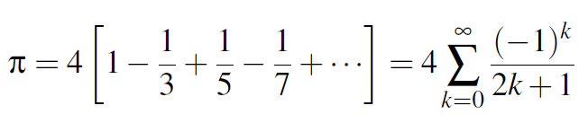
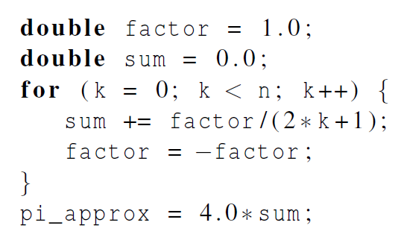
Estimating π

Slide 42
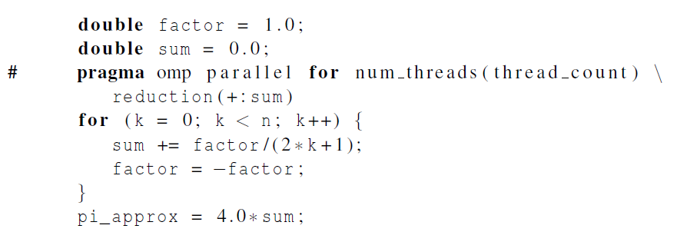
OpenMP solution #1
loop dependency

Slide 43
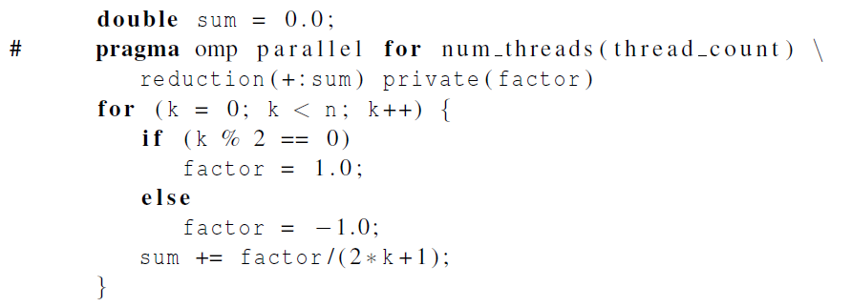
OpenMP solution #2
Insures factor has private scope.

Slide 44
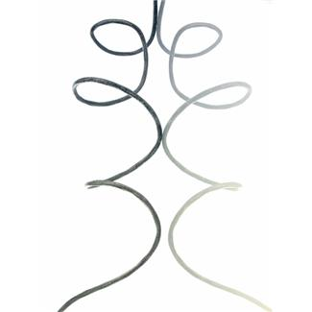
More About Loops in OpenMP: Sorting

Slide 45
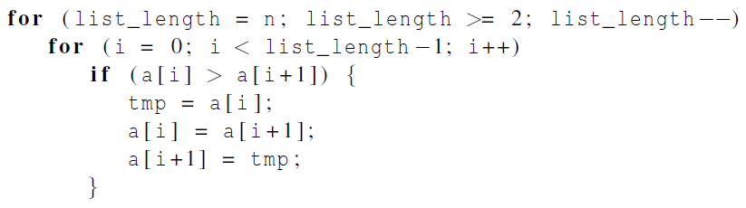

Bubble Sort

Slide 46
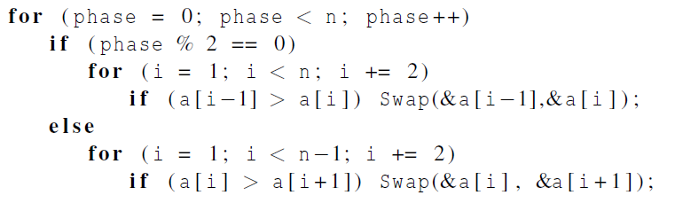
Serial Odd-Even Transposition Sort

Slide 47
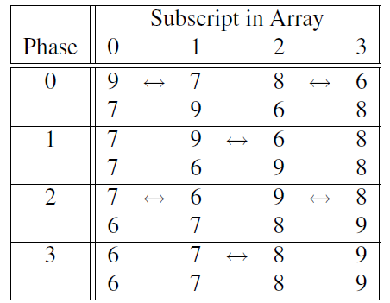
Serial Odd-Even Transposition Sort

Slide 48
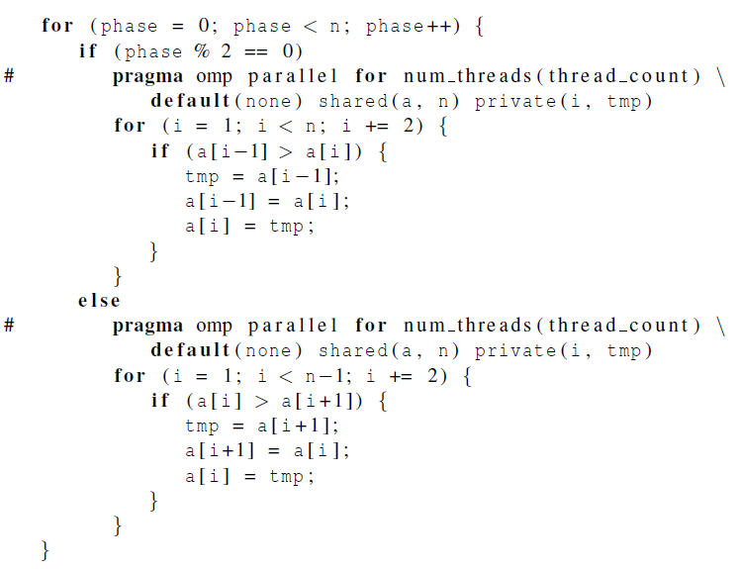
First OpenMP Odd-Even Sort

Slide 49
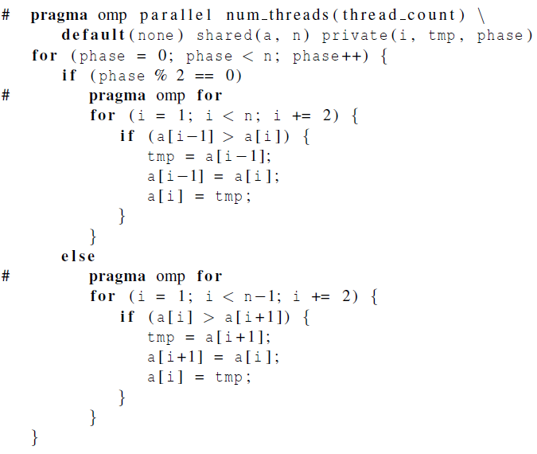
Second OpenMP Odd-Even Sort

Slide 50
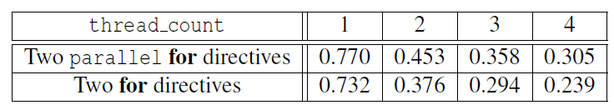

Odd-even sort with two parallel for directives and two for directives.
(Times are in seconds.)

Slide 51

Thanks !

