Slide 1
Computer Vision Final Project — 3D Reconstruction

Slide 2

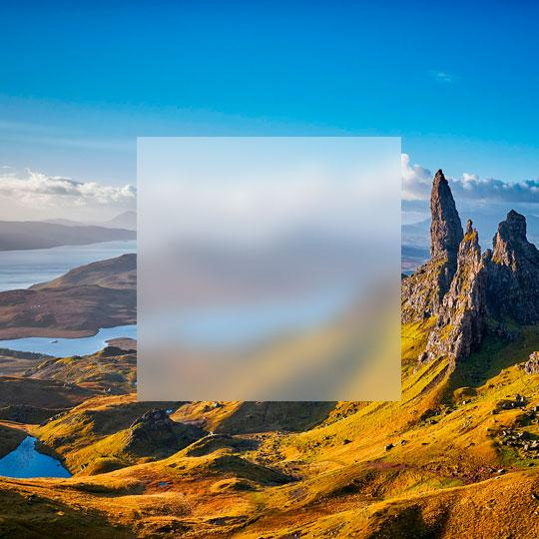
Outline
Task Description
Dataset
Evaluation
Objective

Slide 3
Task Description

Slide 4
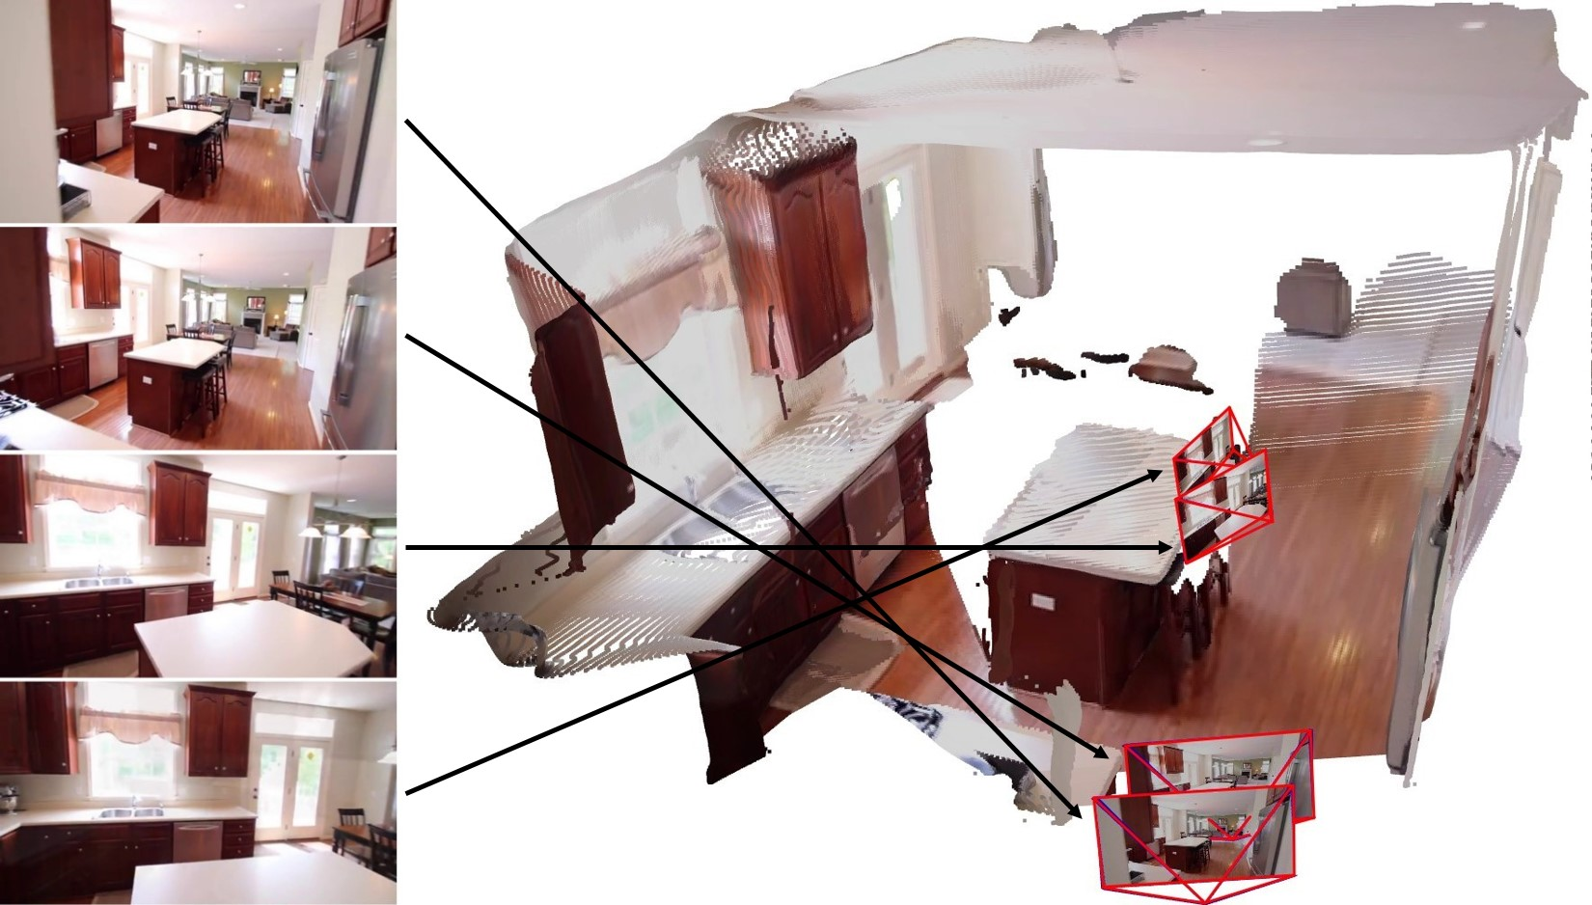
3D Reconstruction
Input: 2D Multi-view Images
Output: 3D Scene Reconstruction

Slide 5
Dataset

Slide 6
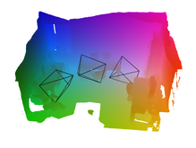
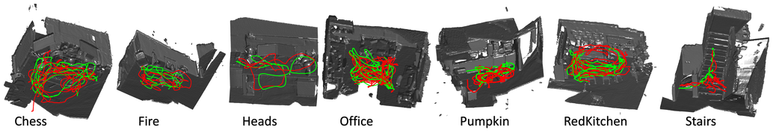
Dataset
The 7-Scenes dataset is a collection of tracked RGB-D camera frames. All scenes were recorded from a handheld Kinect RGB-D camera at 640×480 resolution.

Slide 7
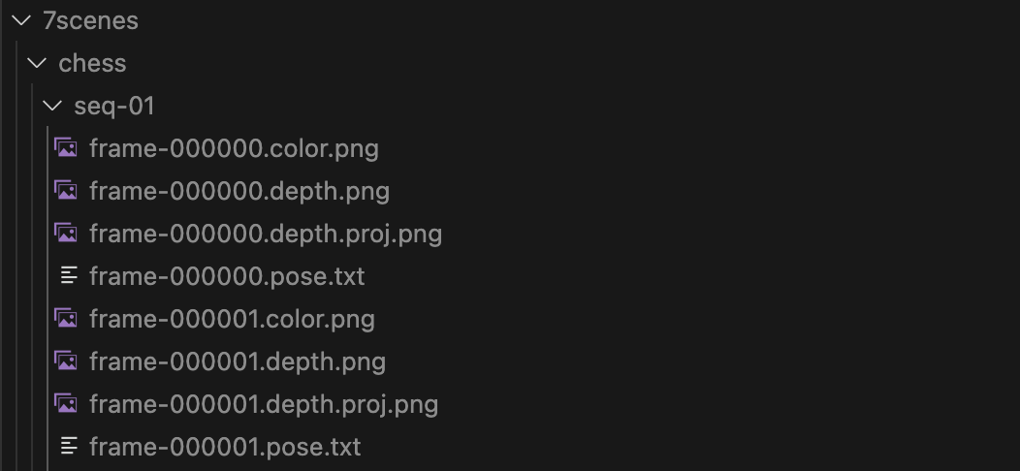
Dataset
Each sequence (seq-XX.zip) consists of 500-1000 frames. Each frame consists of three files:
Color: frame-XXXXXX.color.png (RGB, 24-bit, PNG)
Depth: frame-XXXXXX.depth.png (depth in millimeters, 16-bit, PNG, invalid depth is set to 65535).
Pose: frame-XXXXXX.pose.txt (camera-to-world, 4×4 matrix in homogeneous coordinates).
Depth Projection: frame-XXXXXX.depth.proj.png
RGB-D Dataset 7-Scenes

Slide 8
Evaluation

Slide 9
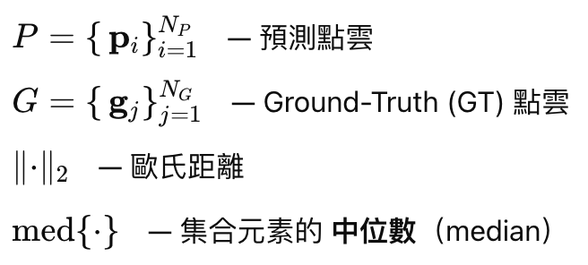
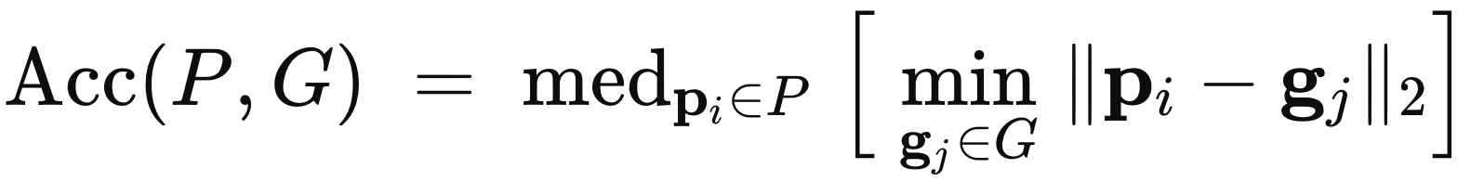
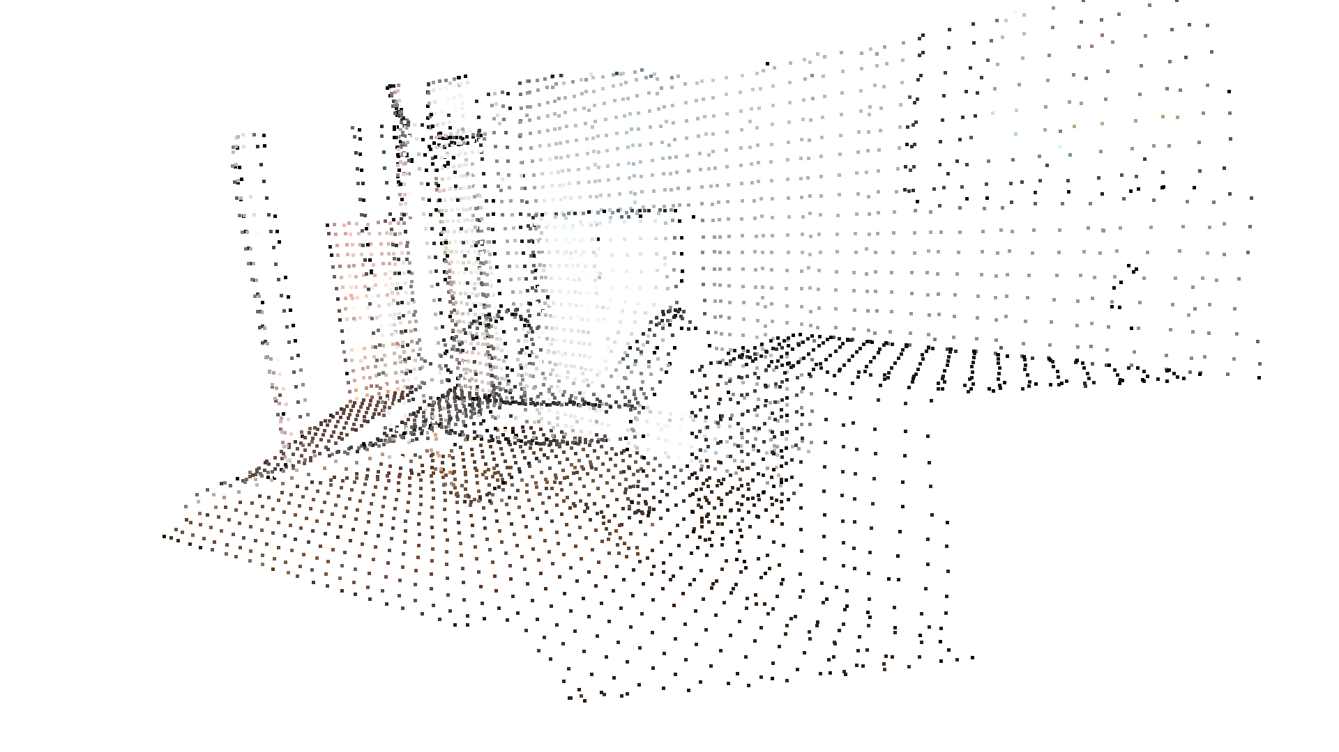
Evaluation Metrics - Acc
Acc: For each predicted point, find its nearest neighbor in the ground-truth point cloud, compute the Euclidean distance between the two points, and take the median of these distances as the Acc score.
: Predicted Point Cloud
: Ground-Truth Point Cloud
: Euclidean Distance
: Median number of a set
Predicted Point Cloud
Ground Truth Point Cloud

Slide 10
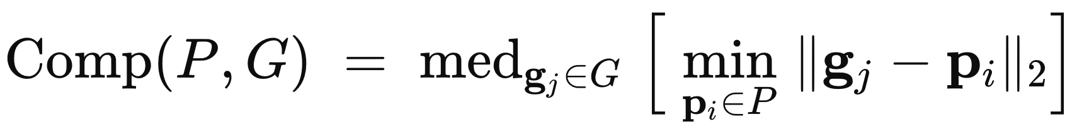
Evaluation Metrics - Comp
Comp: For each ground-truth point, find its nearest neighbor in the predicted point cloud, compute the Euclidean distance between the two points, and take the median of these distances as the Acc score.
: Predicted Point Cloud
: Ground-Truth Point Cloud
: Euclidean Distance
: Median number of a set
Ground-truth Point Cloud
Predicted Point Cloud

Slide 11
Objective

Slide 12
Objective
The goal of this project is to reconstruct accurate 3D scenes using the 7-Scenes Dataset and to be ranked on a Leaderboard based on two metrics:
Accuracy (Acc): Median distance between reconstructed points and ground-truth points.
Completeness (Comp): How well the reconstructed scene covers the ground-truth geometry.
Students are encouraged to:
✅ Use any 3D reconstruction method or pretrained model
✅ Train from scratch or fine-tune on external datasets
✅ Experiment freely, as long as testing data from 7-Scenes remains unseen during training
However, the following are strictly prohibited:
🚫 Directly using pretrained models already trained on the 7-Scenes dataset
🚫 Fine-tuning any models on the 7-Scenes testing set

Slide 13
Grading

Slide 14
Grading
Performance (60%)
Average Acc (30%)
Average Comp (30%)
Report (40%) (For Top 10 Teams)
Novelty and technical contribution (15%)
Experiment completeness (15%)
Oral Presentation (10%)
Report (40%) (For Others)
Novelty and technical contribution (20%)
Experiment completeness (20%)
Bonus (10%)
Reconstruction with sparse sequence
Points (For each Metric) | # of Teams
30% | 1
29% | 2
28% | 2
26% | The rest teams / 4
24% | The rest teams / 4
22% | The rest teams / 4
20% | The rest teams / 4

Slide 15
Thanks

