Slide 1
PART6 – Ajax와 JSON

Slide 2
REST 방식의 서비스
과거의 웹은 경로 자체가 특정한 행위를 의미하고 추가적인 데이터는 파라미터를 이용해서 처리하는 방식으로 설계
URI/URL의 고유한 의미에 대한 재인식
URL자체가 하나의 고유한 목적지이면서 자원에 대한 의미
행위에 대한 부분은 GET/POST등을 활용해서 처리
URI(자원)
GET/POST/PUT/DELETE(행위)

Slide 3
Ajax와 JSON
Asynchronous JavaScript And XML – 비동기로 서버와의 통신 처리
JavaScript에서 많은 역할을 수행하고 서버에서는 XML이나 JSON과 같이 순수한 데이터만 처리하는 방식
개발의 무게 중심 변화
JSON(JavaScript Object Notation)

Slide 4
REST방식의 구현
Ajax를 이용해서 클라이언트와 서버 사이의 통신이 가능하다.
Ajax는 처음에는 브라우저에서 서버를 호출하는데 사용되었지만 모바일에서도 유용하다.
Ajax로 데이터를 주고 받을 때는 문자열이 가장 적합하다.
문자열로 구조화된 데이터를 표현하기 위해서 JSON이라는 포맷이 사용된다.
JSON은 ‘키:값’과 ‘{ }’를 이용해서 객체의 구조를 표현할 수 있다.

Slide 5

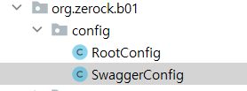
Swagger UI
REST api document tool
약간의 설정으로 api 테스트 환경과 문서 작업을 처리할 수 있음
dependencies { ... implementation 'io.springfox:springfox-boot-starter:3.0.0' implementation 'io.springfox:springfox-swagger-ui:3.0.0' }
package org.zerock.b01.config; import org.springframework.context.annotation.Bean; import org.springframework.context.annotation.Configuration; import org.springframework.web.servlet.config.annotation.EnableWebMvc; import springfox.documentation.builders.ApiInfoBuilder; import springfox.documentation.builders.PathSelectors; import springfox.documentation.builders.RequestHandlerSelectors; import springfox.documentation.service.ApiInfo; import springfox.documentation.spi.DocumentationType; import springfox.documentation.spring.web.plugins.Docket; @Configuration public class SwaggerConfig { @Bean public Docket api() { return new Docket(DocumentationType.OAS_30) .useDefaultResponseMessages(false) .select() .apis(RequestHandlerSelectors.basePackage("org.zerock.b01.controller")) .paths(PathSelectors.any()) .build() .apiInfo(apiInfo()); } private ApiInfo apiInfo() { return new ApiInfoBuilder() .title("Boot 01 Project Swagger") .build(); } }

Slide 6
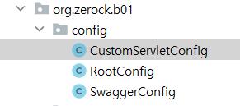
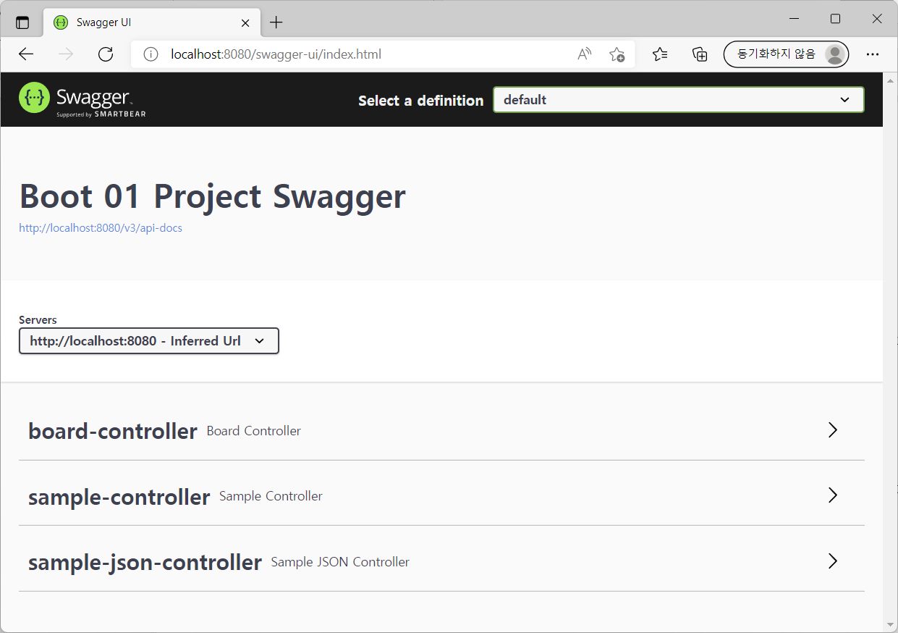
package org.zerock.b01.config; import org.springframework.context.annotation.Configuration; import org.springframework.web.servlet.config.annotation.EnableWebMvc; @Configuration @EnableWebMvc public class CustomServletConfig { }

Slide 7
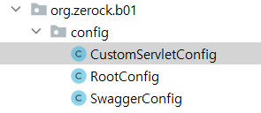
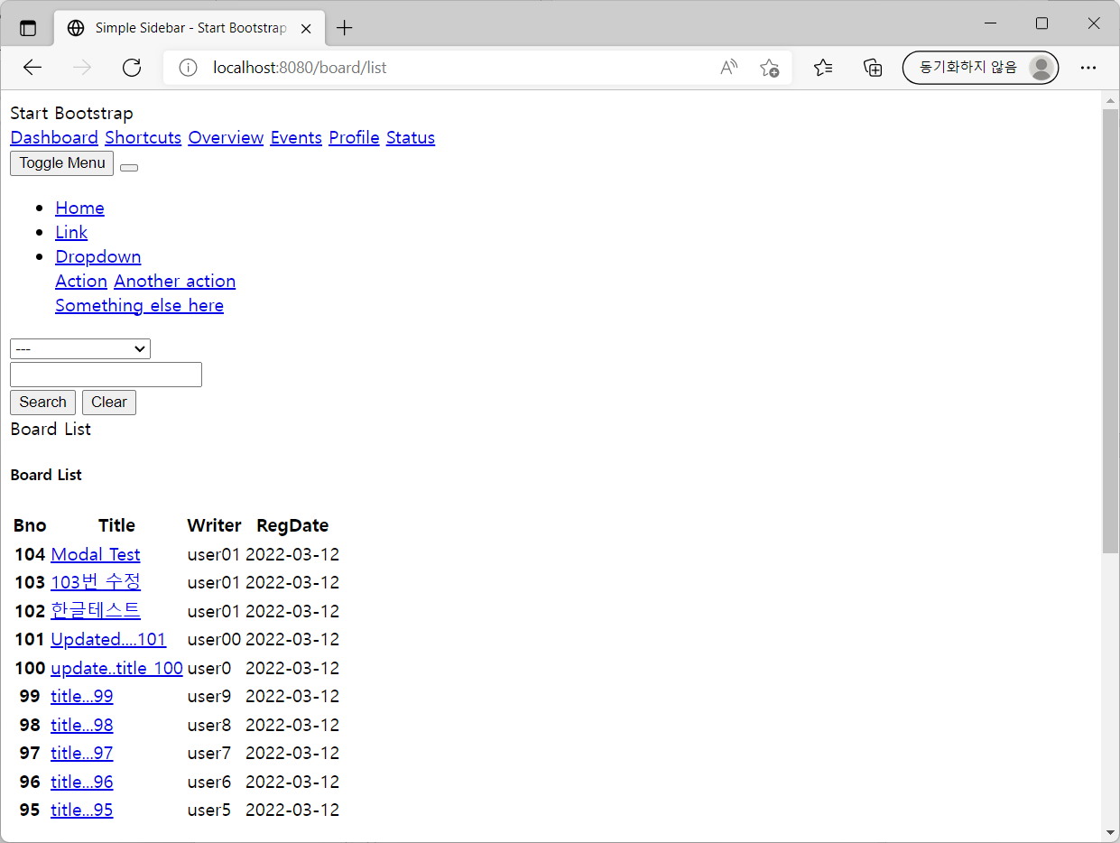
정적 파일을 위한 Swagger UI 설정
package org.zerock.b01.config; import org.springframework.context.annotation.Configuration; import org.springframework.web.servlet.config.annotation.EnableWebMvc; import org.springframework.web.servlet.config.annotation.ResourceHandlerRegistry; import org.springframework.web.servlet.config.annotation.WebMvcConfigurer; @Configuration @EnableWebMvc public class CustomServletConfig implements WebMvcConfigurer { @Override public void addResourceHandlers(ResourceHandlerRegistry registry) { registry.addResourceHandler("/js/**") .addResourceLocations("classpath:/static/js/"); registry.addResourceHandler("/fonts/**") .addResourceLocations("classpath:/static/fonts/"); registry.addResourceHandler("/css/**") .addResourceLocations("classpath:/static/css/"); registry.addResourceHandler("/assets/**"). addResourceLocations("classpath:/static/assets/"); } }

Slide 8
REST방식의 댓글 처리 준비
구현 단계
URL의 설계와 데이터 포맷 결정
컨트롤러의 JSON/XML 처리
동작 확인
JavaScript를 통한 화면 처리

Slide 9
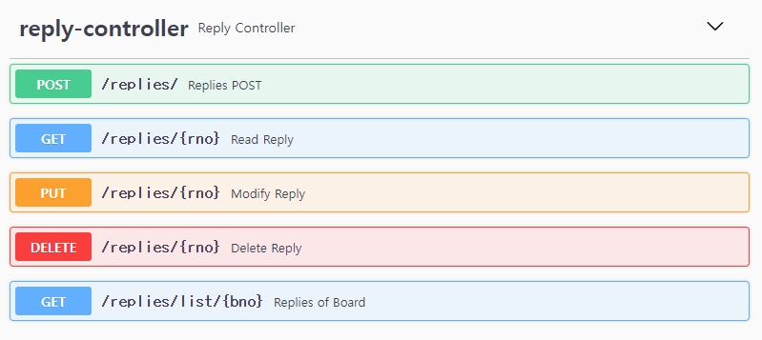
URL설계와 DTO 설계
URL(Method) | 설명 | 반환 데이터
/replies (POST) | 특정한 게시물의 댓글 추가 | {‘rno’:11 } – 생성된 댓글의 번호
/replies/list/:bno (GET) | 특정 게시물(bno)의 댓글의 목록 ‘?’ 뒤에 페이지 번호 등을 추가해서 댓글 페이징 처리 | PageResponseDTO를 JSON으로 처리
/replies/:rno (PUT) | 특정한 번호의 댓글 수정 | {‘rno’:11} -수정된 댓글의 번호
/replies/:rno (DELETE) | 특정한 번호의 댓글 삭제 | {‘rno’:11} – 삭제된 댓글의 번호
/replies/:rno (GET) | 특정한 번호의 댓글 조회 | 댓글 객체를 JSON으로 변환한 문자열

Slide 10
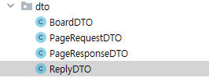
package org.zerock.b01.dto; import lombok.AllArgsConstructor; import lombok.Builder; import lombok.Data; import lombok.NoArgsConstructor; import java.time.LocalDateTime; @Data @Builder @AllArgsConstructor @NoArgsConstructor public class ReplyDTO { private Long rno; private Long bno; private String replyText; private String replyer; private LocalDateTime regDate, modDate; }

Slide 11

ReplyController의 준비
package org.zerock.b01.controller; import io.swagger.annotations.ApiOperation; import lombok.extern.log4j.Log4j2; import org.springframework.http.MediaType; import org.springframework.http.ResponseEntity; import org.springframework.web.bind.annotation.PostMapping; import org.springframework.web.bind.annotation.RequestBody; import org.springframework.web.bind.annotation.RequestMapping; import org.springframework.web.bind.annotation.RestController; import org.zerock.b01.dto.ReplyDTO; import java.util.HashMap; import java.util.Map; @RestController @RequestMapping("/replies") @Log4j2 public class ReplyController { @ApiOperation(value = "Replies POST", notes = "POST 방식으로 댓글 등록") @PostMapping(value = "/", consumes = MediaType.APPLICATION_JSON_VALUE) public ResponseEntity<Map<String,Long>> register(@RequestBody ReplyDTO replyDTO){ log.info(replyDTO); Map<String, Long> resultMap = Map.of("rno", 111L); return ResponseEntity.ok(resultMap); } }

Slide 12

@Valid와 @RestControllerAdvice
package org.zerock.b01.controller.advice; import lombok.extern.log4j.Log4j2; import org.springframework.http.HttpStatus; import org.springframework.http.ResponseEntity; import org.springframework.validation.BindException; import org.springframework.validation.BindingResult; import org.springframework.web.bind.annotation.ExceptionHandler; import org.springframework.web.bind.annotation.ResponseStatus; import org.springframework.web.bind.annotation.RestControllerAdvice; import java.util.HashMap; import java.util.Map; @RestControllerAdvice @Log4j2 public class CustomRestAdvice { @ExceptionHandler(BindException.class) @ResponseStatus(HttpStatus.EXPECTATION_FAILED) public ResponseEntity<Map<String, String>> handleBindException(BindException e) { log.error(e); Map<String, String> errorMap = new HashMap<>(); if(e.hasErrors()){ BindingResult bindingResult = e.getBindingResult(); bindingResult.getFieldErrors().forEach(fieldError -> { errorMap.put(fieldError.getField(), fieldError.getCode()); }); } return ResponseEntity.badRequest().body(errorMap); } }

Slide 13
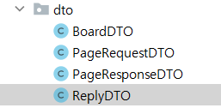
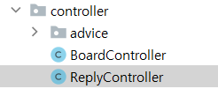
댓글 등록의 @Valid
package org.zerock.b01.controller; import io.swagger.annotations.ApiOperation; import lombok.extern.log4j.Log4j2; import org.springframework.http.MediaType; import org.springframework.validation.BindException; import org.springframework.validation.BindingResult; import org.springframework.web.bind.annotation.PostMapping; import org.springframework.web.bind.annotation.RequestBody; import org.springframework.web.bind.annotation.RequestMapping; import org.springframework.web.bind.annotation.RestController; import org.zerock.b01.dto.ReplyDTO; import javax.validation.Valid; import java.util.HashMap; import java.util.Map; @RestController @RequestMapping("/replies") @Log4j2 public class ReplyController { @ApiOperation(value = "Replies POST", notes = "POST 방식으로 댓글 등록") @PostMapping(value = "/", consumes = MediaType.APPLICATION_JSON_VALUE) public Map<String,Long> register( @Valid @RequestBody ReplyDTO replyDTO, BindingResult bindingResult)throws BindException{ log.info(replyDTO); if(bindingResult.hasErrors()){ throw new BindException(bindingResult); } Map<String, Long> resultMap = new HashMap<>(); resultMap.put("rno",111L); return resultMap; } }
package org.zerock.b01.dto; import lombok.AllArgsConstructor; import lombok.Builder; import lombok.Data; import lombok.NoArgsConstructor; import javax.validation.constraints.NotEmpty; import javax.validation.constraints.NotNull; import java.time.LocalDateTime; @Data @Builder @AllArgsConstructor @NoArgsConstructor public class ReplyDTO { private Long rno; @NotNull private Long bno; @NotEmpty private String replyText; @NotEmpty private String replyer; private LocalDateTime regDate, modDate; }

Slide 14
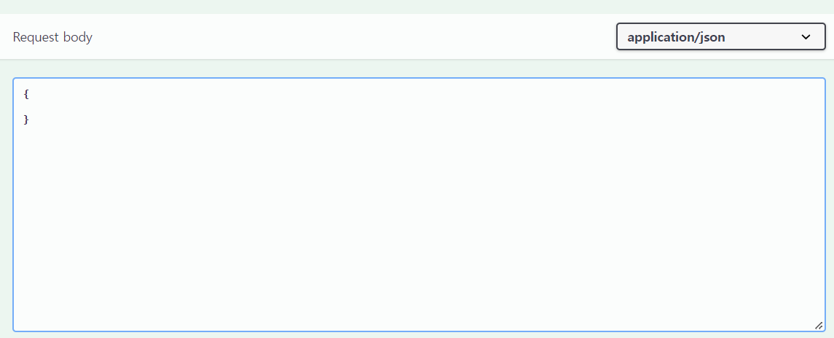
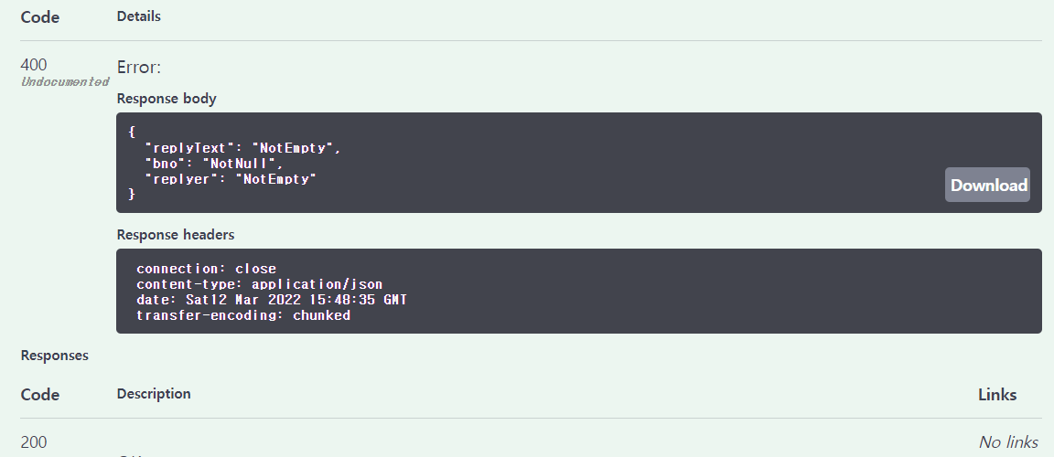

Slide 15
다대일(ManyToOne) 연관관계
연관관계의 기준 결정
연관관계의 기준은 항상 변화가 많은 쪽을 기준으로 결정
ERD의 FK를 기준으로 결정
단방향과 양방향
데이터베이스의 연관관계는 PK/FK만으로 구성되지만 객체지향에서는 양방향 참조/단방향 참조의 형태가 가능
양방향의 경우 복잡성이 증가하므로 주의

Slide 16
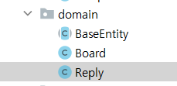
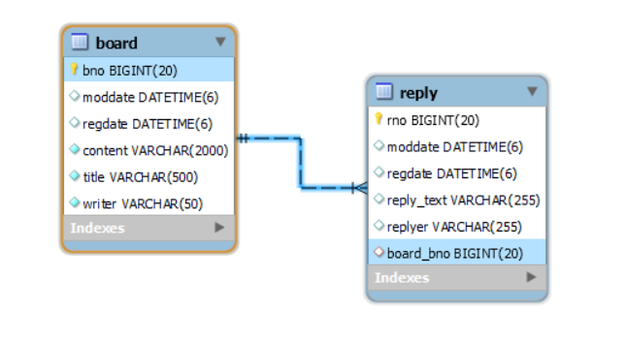
다대일 연관 관계의 구현
package org.zerock.b01.domain; import lombok.*; import javax.persistence.*; @Entity @Getter @Builder @AllArgsConstructor @NoArgsConstructor @ToString(exclude = "board") public class Reply extends BaseEntity{ @Id @GeneratedValue(strategy = GenerationType.IDENTITY) private Long rno; @ManyToOne(fetch = FetchType.LAZY) private Board board; private String replyText; private String replyer; }

Slide 17
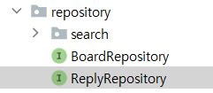
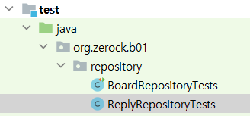
ReplyRepository의 생성과 테스트
package org.zerock.b01.repository; import org.springframework.data.jpa.repository.JpaRepository; import org.zerock.b01.domain.Reply; public interface ReplyRepository extends JpaRepository<Reply, Long> { }
package org.zerock.b01.repository; import lombok.extern.log4j.Log4j2; import org.junit.jupiter.api.Test; import org.springframework.beans.factory.annotation.Autowired; import org.springframework.boot.test.context.SpringBootTest; import org.zerock.b01.domain.Board; import org.zerock.b01.domain.Reply; @SpringBootTest @Log4j2 public class ReplyRepositoryTests { @Autowired private ReplyRepository replyRepository; @Test public void testInsert() { //실제 DB에 있는 bno Long bno = 100L; Board board = Board.builder().bno(bno).build(); Reply reply = Reply.builder() .board(board) .replyText("댓글.....") .replyer("replyer1") .build(); replyRepository.save(reply); } }

Slide 18
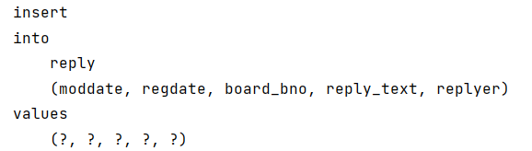
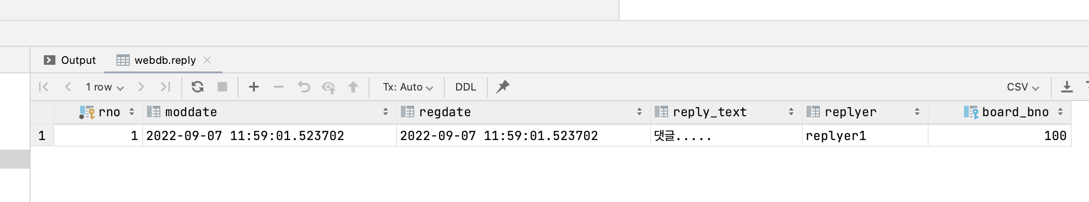

Slide 19
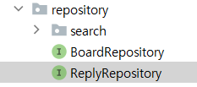
특정 게시물의 댓글을 위한 인덱스 생성
@Entity @Table(name = "Reply", indexes = { @Index(name = "idx_reply_board_bno", columnList = "board_bno") }) @Getter @Builder @AllArgsConstructor @NoArgsConstructor @ToString(exclude = "board") public class Reply extends BaseEntity{ ... }
package org.zerock.b01.repository; import org.springframework.data.domain.Page; import org.springframework.data.domain.Pageable; import org.springframework.data.jpa.repository.JpaRepository; import org.springframework.data.jpa.repository.Query; import org.zerock.b01.domain.Reply; public interface ReplyRepository extends JpaRepository<Reply, Long> { @Query("select r from Reply r where r.board.bno = :bno") Page<Reply> listOfBoard(Long bno, Pageable pageable); }

Slide 20
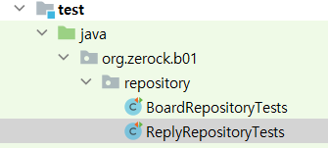
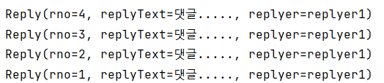
@Test public void testBoardReplies() { Long bno = 100L; Pageable pageable = PageRequest.of(0,10, Sort.by("rno").descending()); Page<Reply> result = replyRepository.listOfBoard(bno, pageable); result.getContent().forEach(reply -> { log.info(reply); }); }
Hibernate:
select
reply0_.rno as rno1_1_,
reply0_.moddate as moddate2_1_,
reply0_.regdate as regdate3_1_,
reply0_.board_bno as board_bn6_1_,
reply0_.reply_text as reply_te4_1_,
reply0_.replyer as replyer5_1_
from
reply reply0_
where
reply0_.board_bno=?
order by
reply0_.rno desc limit ?

Slide 21
Fetch 모드
FetchType.LAZY
자신이 참조하고 있는 다른 엔티티에 대한 로딩은 최대한 지연한다. 필요한 순간까지 로딩하지 않는다.
FetchType.EAGER
엔티티의 로딩 시에 적극적으로 참조관계가 있는 엔티티를 같이 로딩

Slide 22
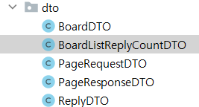
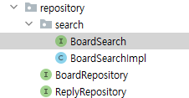
게시물의 목록과 Projections
package org.zerock.b01.dto; import lombok.Data; import java.time.LocalDateTime; @Data public class BoardListReplyCountDTO { private Long bno; private String title; private String writer; private LocalDateTime regDate; private Long replyCount; }
public interface BoardSearch { Page<Board> search1(Pageable pageable); Page<Board> searchAll(String[] types, String keyword, Pageable pageable); Page<BoardListReplyCountDTO> searchWithReplyCount(String[] types, String keyword, Pageable pageable); }

Slide 23

@Override public Page<BoardListReplyCountDTO> searchWithReplyCount(String[] types, String keyword, Pageable pageable) { QBoard board = QBoard.board; QReply reply = QReply.reply; JPQLQuery<Board> query = from(board); query.leftJoin(reply).on(reply.board.eq(board)); query.groupBy(board); if( (types != null && types.length > 0) && keyword != null ){ BooleanBuilder booleanBuilder = new BooleanBuilder(); // ( for(String type: types){ switch (type){ case "t": booleanBuilder.or(board.title.contains(keyword)); break; case "c": booleanBuilder.or(board.content.contains(keyword)); break; case "w": booleanBuilder.or(board.writer.contains(keyword)); break; } }//end for query.where(booleanBuilder); } //bno > 0 query.where(board.bno.gt(0L)); JPQLQuery<BoardListReplyCountDTO> dtoQuery = query.select(Projections.bean(BoardListReplyCountDTO.class, board.bno, board.title, board.writer, board.regDate, reply.count().as("replyCount") )); this.getQuerydsl().applyPagination(pageable,dtoQuery); List<BoardListReplyCountDTO> dtoList = dtoQuery.fetch(); long count = dtoQuery.fetchCount(); return new PageImpl<>(dtoList, pageable, count); }

Slide 24
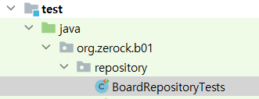
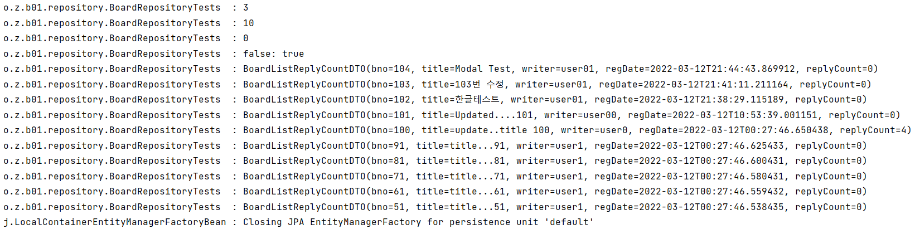
Hibernate:
select
board0_.bno as col_0_0_,
board0_.title as col_1_0_,
board0_.writer as col_2_0_,
board0_.regdate as col_3_0_,
count(reply1_.rno) as col_4_0_
from
board board0_
left outer join
reply reply1_
on (
reply1_.board_bno=board0_.bno
)
where
(
board0_.title like ? escape '!'
or board0_.content like ? escape '!'
or board0_.writer like ? escape '!'
)
and board0_.bno>?
group by
board0_.bno
order by
board0_.bno desc limit ?
@Test public void testSearchReplyCount() { String[] types = {"t","c","w"}; String keyword = "1"; Pageable pageable = PageRequest.of(0,10, Sort.by("bno").descending()); Page<BoardListReplyCountDTO> result = boardRepository.searchWithReplyCount(types, keyword, pageable ); //total pages log.info(result.getTotalPages()); //pag size log.info(result.getSize()); //pageNumber log.info(result.getNumber()); //prev next log.info(result.hasPrevious() +": " + result.hasNext()); result.getContent().forEach(board -> log.info(board)); }
select
count(distinct board0_.bno) as col_0_0_
from
board board0_
left outer join
reply reply1_
on (
reply1_.board_bno=board0_.bno
)
where
(
board0_.title like ? escape '!'
or board0_.content like ? escape '!'
or board0_.writer like ? escape '!'
)
and board0_.bno>?

Slide 25
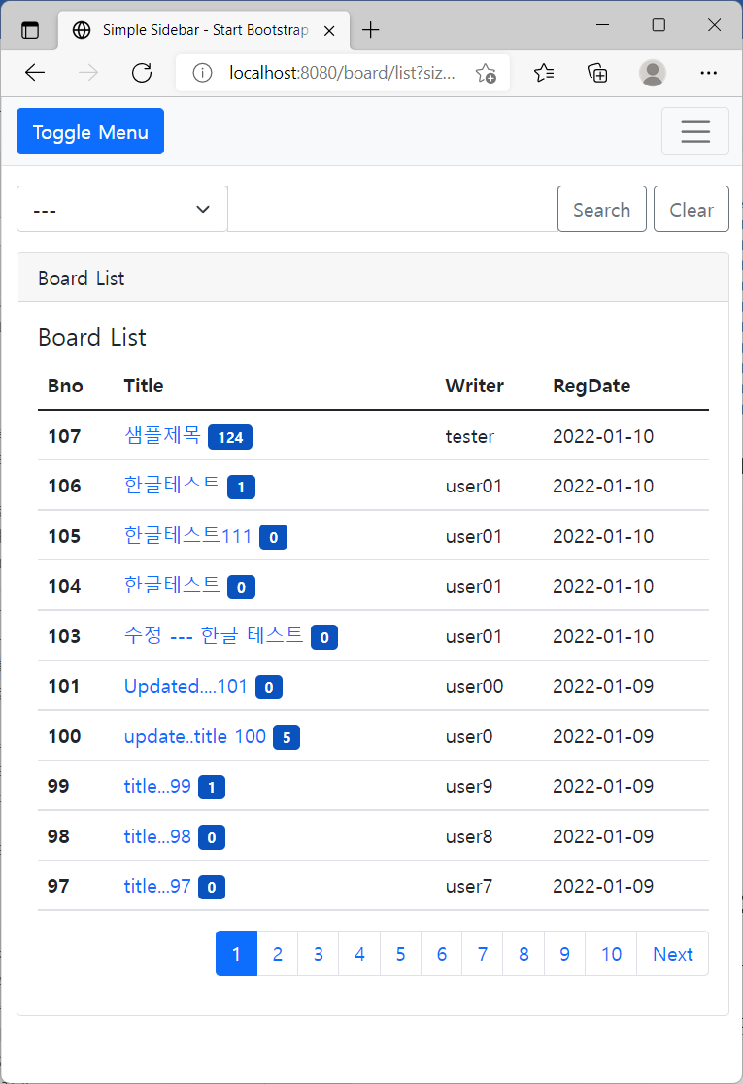

게시물의 목록 화면 처리
public interface BoardService { Long register(BoardDTO boardDTO); BoardDTO readOne(Long bno); void modify(BoardDTO boardDTO); void remove(Long bno); PageResponseDTO<BoardDTO> list(PageRequestDTO pageRequestDTO); //댓글의 숫자까지 처리 PageResponseDTO<BoardListReplyCountDTO> listWithReplyCount(PageRequestDTO pageRequestDTO); }
@Override public PageResponseDTO<BoardListReplyCountDTO> listWithReplyCount(PageRequestDTO pageRequestDTO) { String[] types = pageRequestDTO.getTypes(); String keyword = pageRequestDTO.getKeyword(); Pageable pageable = pageRequestDTO.getPageable("bno"); Page<BoardListReplyCountDTO> result = boardRepository.searchWithReplyCount(types, keyword, pageable); return PageResponseDTO.<BoardListReplyCountDTO>withAll() .pageRequestDTO(pageRequestDTO) .dtoList(result.getContent()) .total((int)result.getTotalElements()) .build(); }

Slide 26


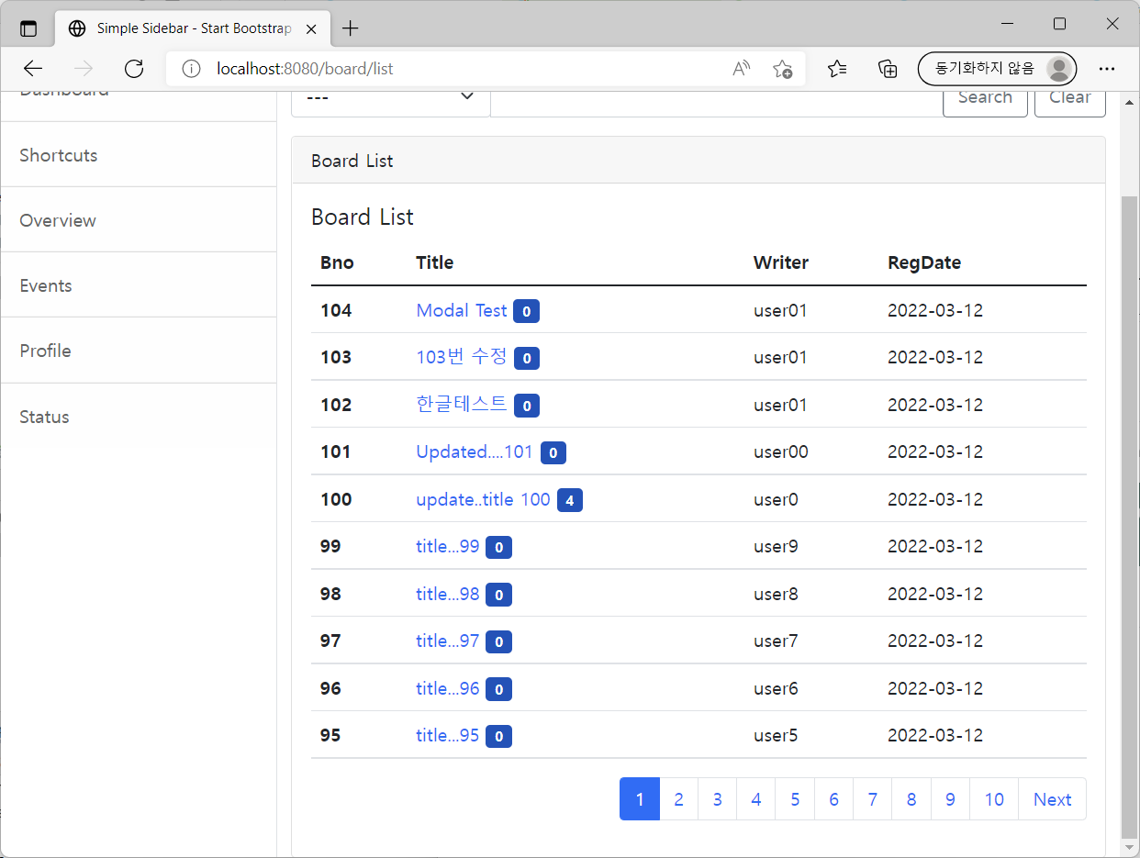
@GetMapping("/list") public void list(PageRequestDTO pageRequestDTO, Model model){ //PageResponseDTO<BoardDTO> responseDTO = boardService.list(pageRequestDTO); PageResponseDTO<BoardListReplyCountDTO> responseDTO = boardService.listWithReplyCount(pageRequestDTO); log.info(responseDTO); model.addAttribute("responseDTO", responseDTO); }
<tbody th:with="link = ${pageRequestDTO.getLink()}"> <tr th:each="dto:${responseDTO.dtoList}" > <th scope="row">[[${dto.bno}]]</th> <td> <a th:href="|@{/board/read(bno =${dto.bno})}&${link}|" class="text-decoration-none"> [[${dto.title}]] </a> <span class="badge progress-bar-success" style="background-color: #0a53be">[[${dto.replyCount}]]</span> </td> <td>[[${dto.writer}]]</td> <td>[[${#temporals.format(dto.regDate, 'yyyy-MM-dd')}]]</td> </tr> </tbody>

Slide 27
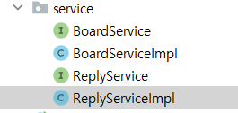
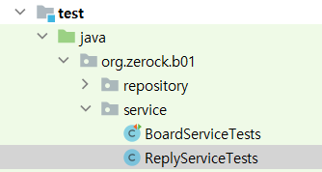
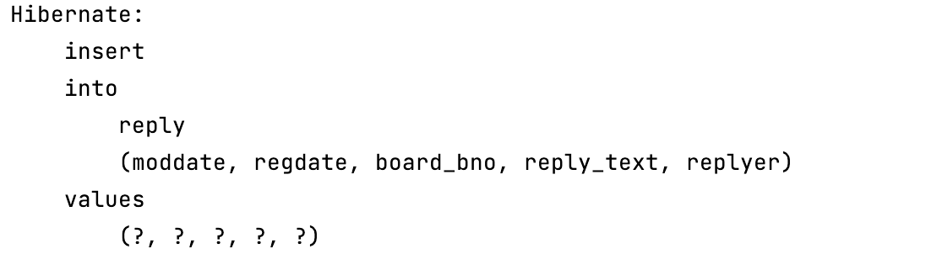
댓글 서비스 계층의 구현
package org.zerock.b01.service; import org.zerock.b01.dto.ReplyDTO; public interface ReplyService { Long register(ReplyDTO replyDTO); }
package org.zerock.b01.service; import lombok.extern.log4j.Log4j2; import org.junit.jupiter.api.Test; import org.springframework.beans.factory.annotation.Autowired; import org.springframework.boot.test.context.SpringBootTest; import org.zerock.b01.dto.ReplyDTO; @SpringBootTest @Log4j2 public class ReplyServiceTests { @Autowired private ReplyService replyService; @Test public void testRegister() { ReplyDTO replyDTO = ReplyDTO.builder() .replyText("ReplyDTO Text") .replyer("replyer") .bno(100L) .build(); log.info(replyService.register(replyDTO)); } }
package org.zerock.b01.service; import lombok.RequiredArgsConstructor; import lombok.extern.log4j.Log4j2; import org.modelmapper.ModelMapper; import org.springframework.stereotype.Service; import org.zerock.b01.domain.Reply; import org.zerock.b01.dto.ReplyDTO; import org.zerock.b01.repository.ReplyRepository; @Service @RequiredArgsConstructor @Log4j2 public class ReplyServiceImpl implements ReplyService{ private final ReplyRepository replyRepository; private final ModelMapper modelMapper; @Override public Long register(ReplyDTO replyDTO) { Reply reply = modelMapper.map(replyDTO, Reply.class); Long rno = replyRepository.save(reply).getRno(); return rno; } }

Slide 28
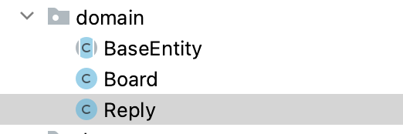
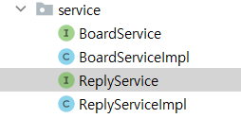
댓글 조회/수정/삭제/목록
public interface ReplyService { Long register(ReplyDTO replyDTO); ReplyDTO read(Long rno); void modify(ReplyDTO replyDTO); void remove(Long rno); }
public class Reply extends BaseEntity{ @Id @GeneratedValue(strategy = GenerationType.IDENTITY) private Long rno; @ManyToOne(fetch = FetchType.LAZY) private Board board; private String replyText; private String replyer; public void changeText(String text){ this.replyText = text; } }
@Override public ReplyDTO read(Long rno) { Optional<Reply> replyOptional = replyRepository.findById(rno); Reply reply = replyOptional.orElseThrow(); return modelMapper.map(reply, ReplyDTO.class); } @Override public void modify(ReplyDTO replyDTO) { Optional<Reply> replyOptional = replyRepository.findById(replyDTO.getRno()); Reply reply = replyOptional.orElseThrow(); reply.changeText(replyDTO.getReplyText()); replyRepository.save(reply); } @Override public void remove(Long rno) { replyRepository.deleteById(rno); }

Slide 29
특정 게시물의 목록 처리
public interface ReplyService { ... PageResponseDTO<ReplyDTO> getListOfBoard(Long bno, PageRequestDTO pageRequestDTO); }
@Override public PageResponseDTO<ReplyDTO> getListOfBoard(Long bno, PageRequestDTO pageRequestDTO) { Pageable pageable = PageRequest.of(pageRequestDTO.getPage() <=0? 0: pageRequestDTO.getPage() -1, pageRequestDTO.getSize(), Sort.by("rno").ascending()); Page<Reply> result = replyRepository.listOfBoard(bno, pageable); List<ReplyDTO> dtoList = result.getContent().stream().map(reply -> modelMapper.map(reply, ReplyDTO.class)) .collect(Collectors.toList()); return PageResponseDTO.<ReplyDTO>withAll() .pageRequestDTO(pageRequestDTO) .dtoList(dtoList) .total((int)result.getTotalElements()) .build(); }

Slide 30
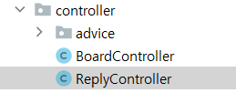
컨트롤러 계층의 처리
@RestController @RequestMapping("/replies") @Log4j2 @RequiredArgsConstructor //의존성 주입을 위한 public class ReplyController { private final ReplyService replyService; ... }

Slide 31
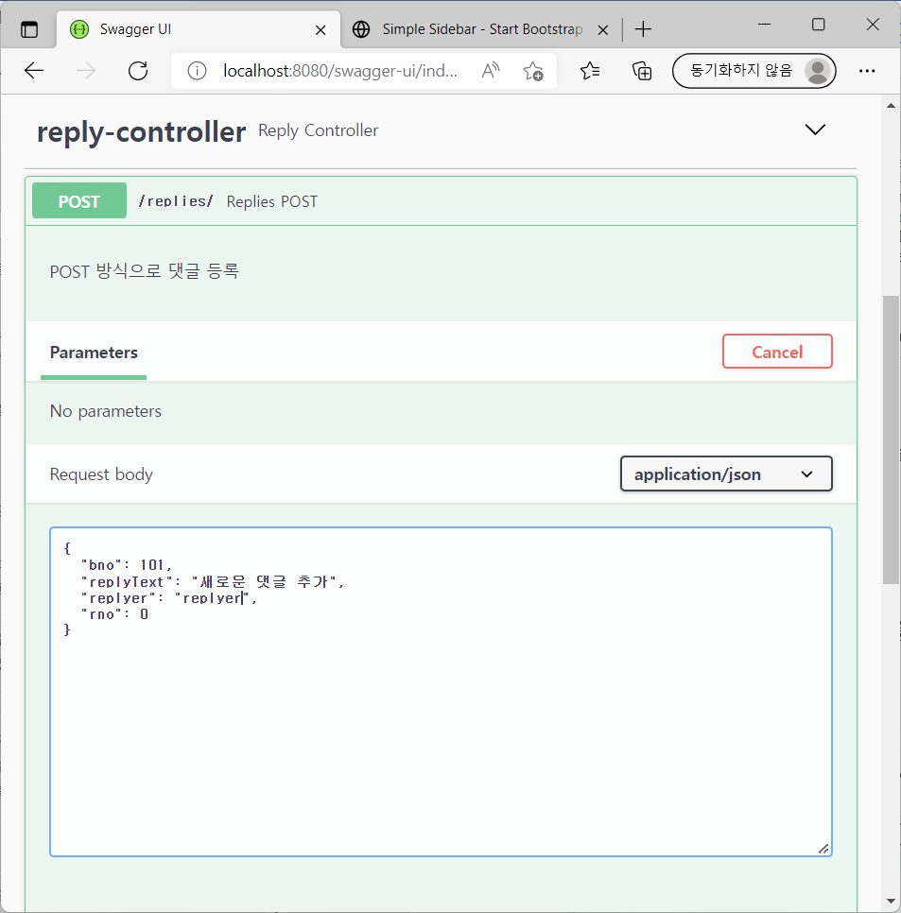
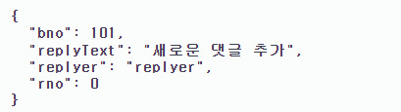
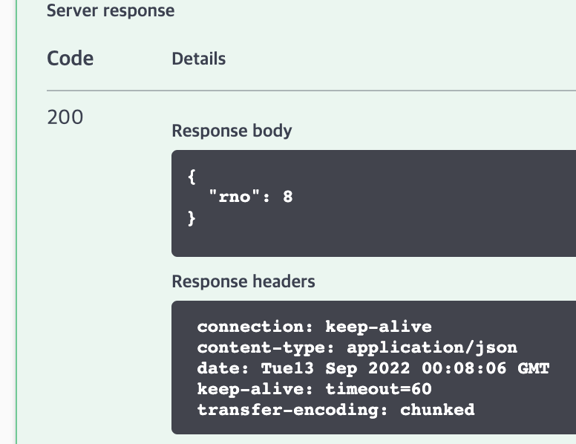
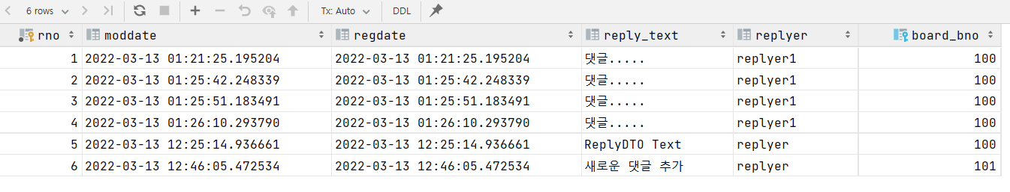
등록 기능의 확인
@ApiOperation(value = "Replies POST", notes = "POST 방식으로 댓글 등록") @PostMapping(value = "/", consumes = MediaType.APPLICATION_JSON_VALUE) public Map<String,Long> register( @Valid @RequestBody ReplyDTO replyDTO, BindingResult bindingResult)throws BindException{ log.info(replyDTO); if(bindingResult.hasErrors()){ throw new BindException(bindingResult); } Map<String, Long> resultMap = new HashMap<>(); Long rno = replyService.register(replyDTO); resultMap.put("rno",rno); return resultMap; }

Slide 32

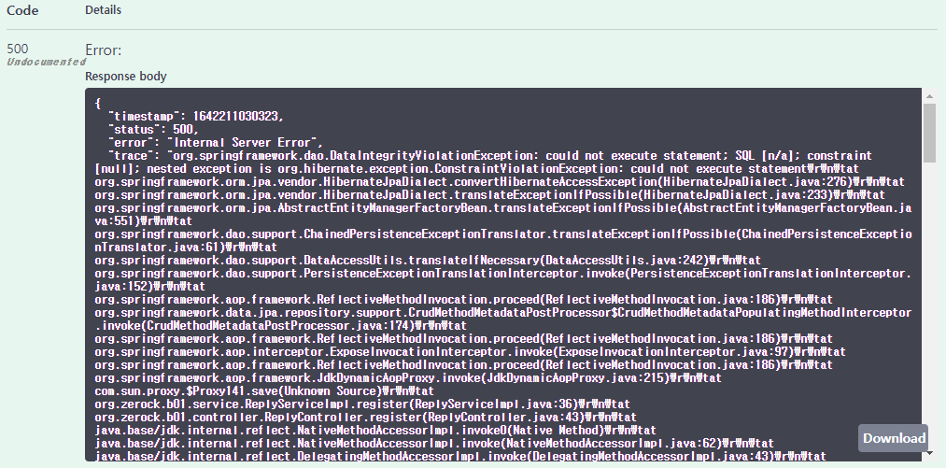
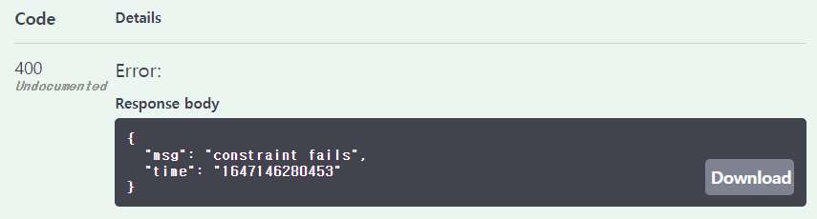
잘못된 상황에 대한 처리
package org.zerock.b01.controller.advice; ... @RestControllerAdvice @Log4j2 public class CustomRestAdvice { @ExceptionHandler(BindException.class) @ResponseStatus(HttpStatus.EXPECTATION_FAILED) public ResponseEntity<Map<String, String>> handleBindException(BindException e) { log.error(e); Map<String, String> errorMap = new HashMap<>(); if(e.hasErrors()){ BindingResult bindingResult = e.getBindingResult(); bindingResult.getFieldErrors().forEach(fieldError -> { errorMap.put(fieldError.getField(), fieldError.getCode()); }); } return ResponseEntity.badRequest().body(errorMap); } @ExceptionHandler(DataIntegrityViolationException.class) @ResponseStatus(HttpStatus.EXPECTATION_FAILED) public ResponseEntity<Map<String, String>> handleFKException(Exception e) { log.error(e); Map<String, String> errorMap = new HashMap<>(); errorMap.put("time", ""+System.currentTimeMillis()); errorMap.put("msg", "constraint fails"); return ResponseEntity.badRequest().body(errorMap); } }
@Valid의 검증 결과 예외 처리

Slide 33
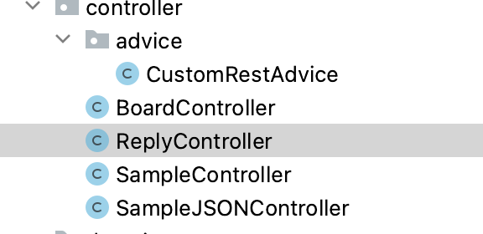
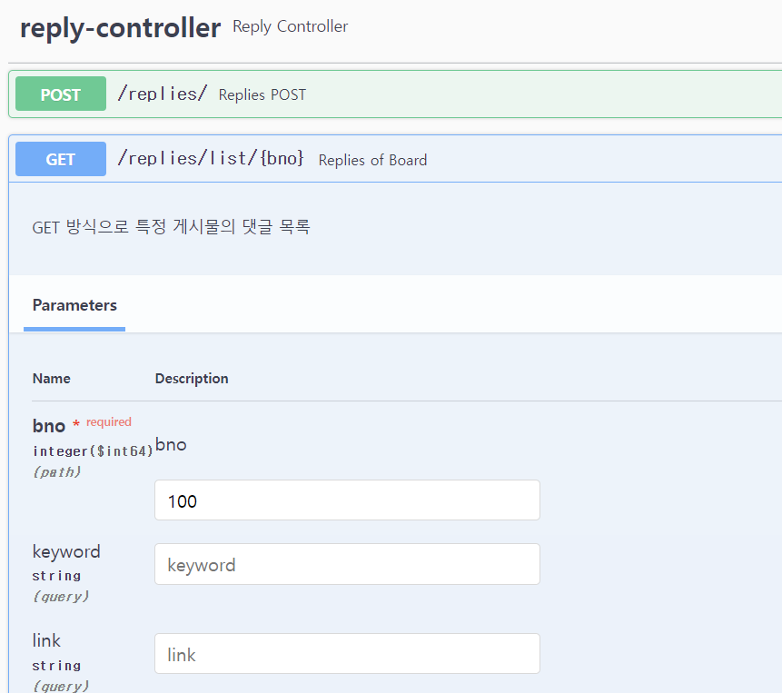
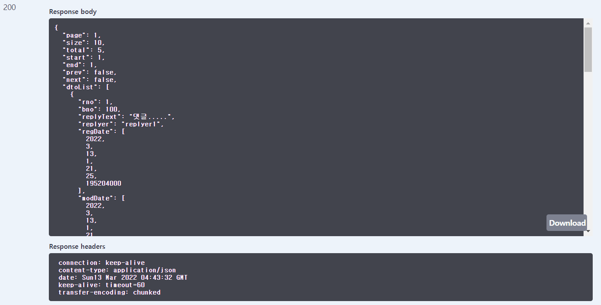
특정 게시물의 댓글 목록
@ApiOperation(value = "Replies of Board", notes = "GET 방식으로 특정 게시물의 댓글 목록") @GetMapping(value = "/list/{bno}") public PageResponseDTO<ReplyDTO> getList(@PathVariable("bno") Long bno, PageRequestDTO pageRequestDTO){ PageResponseDTO<ReplyDTO> responseDTO = replyService.getListOfBoard(bno, pageRequestDTO); return responseDTO; }

Slide 34
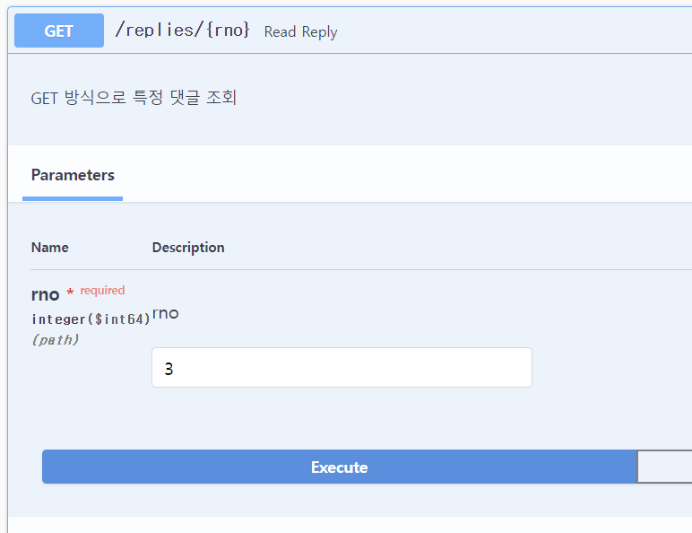
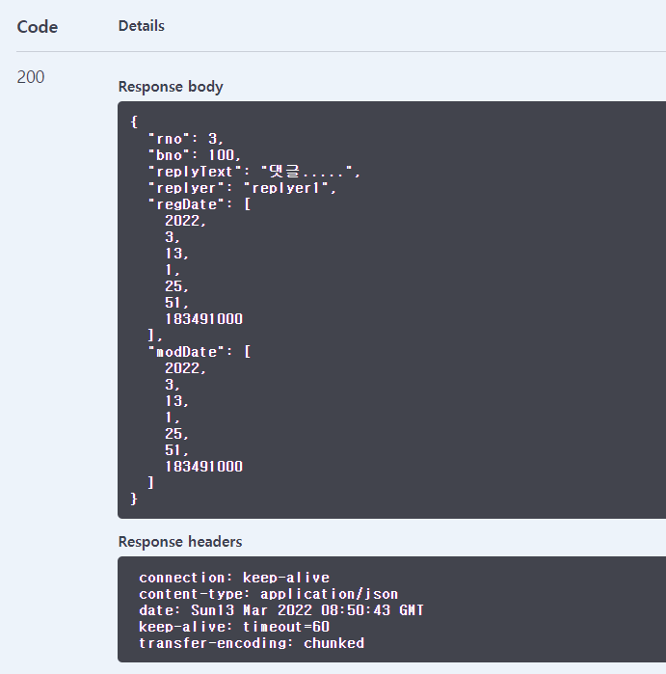
특정 댓글의 조회
@ApiOperation(value = "Read Reply", notes = "GET 방식으로 특정 댓글 조회") @GetMapping("/{rno}") public ReplyDTO getReplyDTO( @PathVariable("rno") Long rno ){ ReplyDTO replyDTO = replyService.read(rno); return replyDTO; }

Slide 35
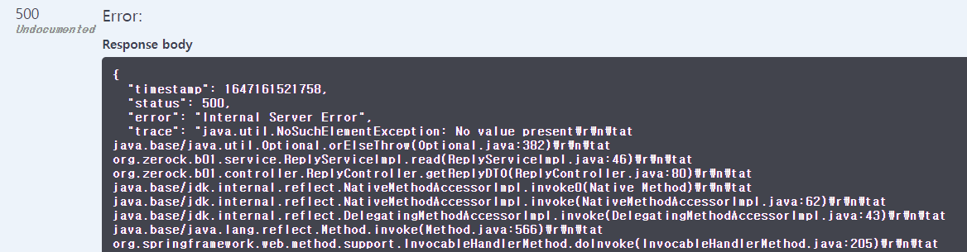
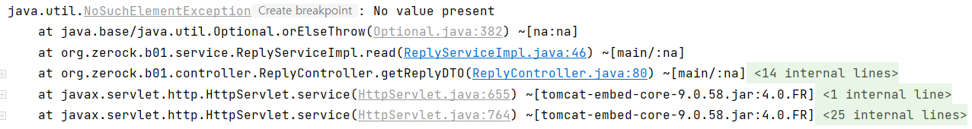

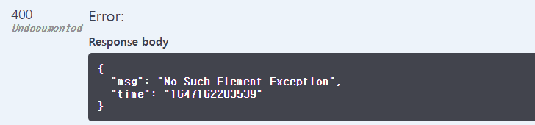
데이터가 존재하지 않는 경우의 처리
@ExceptionHandler(NoSuchElementException.class) @ResponseStatus(HttpStatus.EXPECTATION_FAILED) public ResponseEntity<Map<String, String>> handleNoSuchElement(Exception e) { log.error(e); Map<String, String> errorMap = new HashMap<>(); errorMap.put("time", ""+System.currentTimeMillis()); errorMap.put("msg", "No Such Element Exception"); return ResponseEntity.badRequest().body(errorMap); }

Slide 36
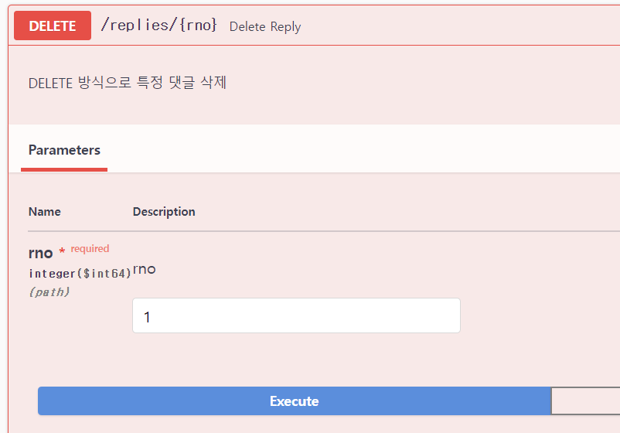
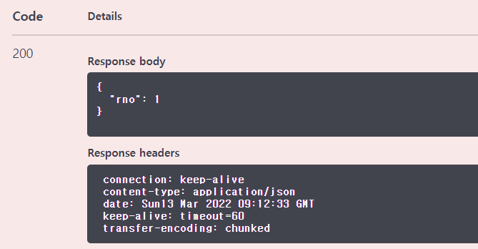
특정 댓글의 삭제
@ApiOperation(value = "Delete Reply", notes = "DELETE 방식으로 특정 댓글 삭제") @DeleteMapping("/{rno}") public Map<String,Long> remove( @PathVariable("rno") Long rno ){ replyService.remove(rno); Map<String, Long> resultMap = new HashMap<>(); resultMap.put("rno", rno); return resultMap; }

Slide 37
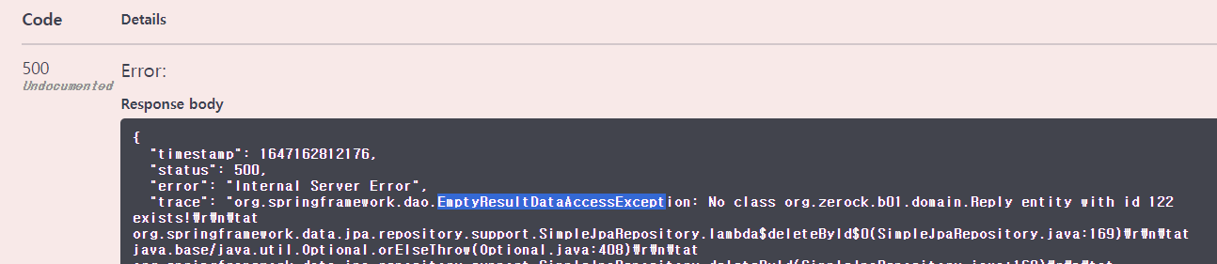

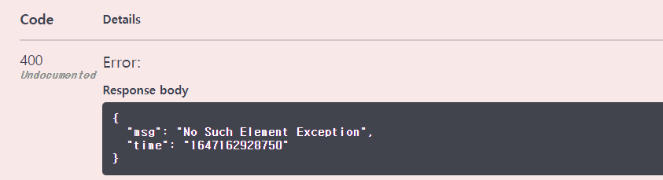
존재하지 않는 댓글의 삭제 문제
@ExceptionHandler({ NoSuchElementException.class, EmptyResultDataAccessException.class }) //추가 @ResponseStatus(HttpStatus.EXPECTATION_FAILED) public ResponseEntity<Map<String, String>> handleNoSuchElement(Exception e) { log.error(e); Map<String, String> errorMap = new HashMap<>(); errorMap.put("time", ""+System.currentTimeMillis()); errorMap.put("msg", "No Such Element Exception"); return ResponseEntity.badRequest().body(errorMap); }

Slide 38




특정 댓글의 수정
@ApiOperation(value = "Modify Reply", notes = "PUT 방식으로 특정 댓글 수정") @PutMapping(value = "/{rno}", consumes = MediaType.APPLICATION_JSON_VALUE ) public Map<String,Long> remove( @PathVariable("rno") Long rno, @RequestBody ReplyDTO replyDTO ){ replyDTO.setRno(rno); //번호를 일치시킴 replyService.modify(replyDTO); Map<String, Long> resultMap = new HashMap<>(); resultMap.put("rno", rno); return resultMap; }

Slide 40
댓글의 JavaScript처리
Ajax를 이용해서 GET/POST/PUT/DELETE방식등을 호출
Axios라이브러리를 이용
JavaScript를 이용한 동적 처리

Slide 41

비동기 처리와 Ajax
동기화 vs 비동기 처리
콜백 패턴(callback)

Slide 42




Axios
비동기 처리를 위한 라이브러리
Promise기반
댓글 추가 버튼
클릭하면 댓글을 추가할 수 있는 모달창을 보여주도록
댓글들이 출력되는
<ul class="list-group replyList">
댓글의 페이징 처리를 담당하는
<ul class="pagination replyPaging">

Slide 43




Axios호출해 보기
async function get1(bno) { const result = await axios.get(`/replies/list/${bno}`) console.log(result) }
<script layout:fragment="script" th:inline="javascript"> const bno = [[${dto.bno}]] get1(bno) </script>

Slide 44

비동기 함수의 반환
Axios의 경우 비동기 함수의 반환은 항상 Promise
async function get1(bno) { const result = await axios.get(`/replies/list/${bno}`) return result.data }
<script layout:fragment="script" th:inline="javascript"> const bno = [[${dto.bno}]] console.log(get1(bno)) </script>
async function get1(bno) { const result = await axios.get(`/replies/list/${bno}`) //console.log(result) return result; }
<script layout:fragment="script" th:inline="javascript"> const bno = [[${dto.bno}]] get1(bno).then(data => { console.log(data) }).catch(e => { console.error(e) }) </script>

Slide 45


댓글 처리 JavaScript – 댓글 목록 처리
async function getList({bno, page, size, goLast}){ const result = await axios.get(`/replies/list/${bno}`, {params: {page, size}}) return result.data }
<script layout:fragment="script" th:inline="javascript"> const bno = [[${dto.bno}]] function printReplies(page,size,goLast){ getList({bno, page,size, goLast}).then( data => {console.log(data)} ).catch(e => { console.error(e) }) } printReplies(1,10) </script>

Slide 46

const bno = [[${dto.bno}]] const replyList = document.querySelector('.replyList') //댓글 목록 DOM const replyPaging = document.querySelector('.replyPaging') //페이지 목록 DOM function printList(dtoList){ //댓글 목록 출력 let str = ''; if(dtoList && dtoList.length > 0){ for (const dto of dtoList) { str += `<li class="list-group-item d-flex replyItem"> <span class="col-2">${dto.rno}</span> <span class="col-6" data-rno="${dto.rno}">${dto.replyText}</span> <span class="col-2">${dto.replyer}</span> <span class="col-2">${dto.regDate} </span> </li>` } } replyList.innerHTML = str } function printPages(data){ //페이지 목록 출력 //pagination let pageStr = ''; if(data.prev) { pageStr +=`<li class="page-item"><a class="page-link" data-page="${data.start-1}">PREV</a></li>` } for(let i = data.start; i <= data.end; i++){ pageStr +=`<li class="page-item ${i == data.page?"active":""} "><a class="page-link" data-page="${i}">${i}</a></li>` } if(data.next) { pageStr +=`<li class="page-item"><a class="page-link" data-page="${data.end +1}">NEXT</a></li>` } replyPaging.innerHTML = pageStr }
function printReplies(page,size,goLast){ getList({bno, page,size, goLast}).then( data => { printList(data.dtoList) //목록 처리 printPages(data) //페이지 처리 } ).catch(e => { console.error(e) }) } printReplies(1,10)

Slide 47


@JsonFormat, @JsonIgnore
package org.zerock.b01.dto; import com.fasterxml.jackson.annotation.JsonFormat; import com.fasterxml.jackson.annotation.JsonIgnore; import lombok.AllArgsConstructor; import lombok.Builder; import lombok.Data; import lombok.NoArgsConstructor; import javax.validation.constraints.NotEmpty; import javax.validation.constraints.NotNull; import java.time.LocalDateTime; @Data @Builder @AllArgsConstructor @NoArgsConstructor public class ReplyDTO { private Long rno; @NotNull private Long bno; @NotEmpty private String replyText; @NotEmpty private String replyer; @JsonFormat(pattern="yyyy-MM-dd HH:mm:ss") private LocalDateTime regDate; @JsonIgnore private LocalDateTime modDate; }

Slide 48


마지막 페이지로 이동
async function getList({bno, page, size, goLast}){ const result = await axios.get(`/replies/list/${bno}`, {params: {page, size}}) if(goLast){ const total = result.data.total const lastPage = parseInt(Math.ceil(total/size)) return getList({bno:bno, page:lastPage, size:size}) } return result.data }
printReplies(1,10,true)

Slide 49


댓글의 등록
async function addReply(replyObj) { const response = await axios.post(`/replies/`,replyObj) return response.data }
<div class="modal registerModal" tabindex="-1"> <div class="modal-dialog"> <div class="modal-content"> <div class="modal-header"> <h5 class="modal-title">Register Reply</h5> <button type="button" class="btn-close" data-bs-dismiss="modal" aria-label="Close"></button> </div> <div class="modal-body"> <div class="input-group mb-3"> <span class="input-group-text">Reply Text</span> <input type="text" class="form-control replyText" > </div> <div class="input-group mb-3"> <span class="input-group-text">Replyer</span> <input type="text" class="form-control replyer" > </div> </div> <div class="modal-footer"> <button type="button" class="btn btn-primary registerBtn">Register</button> <button type="button" class="btn btn-outline-dark closeRegisterBtn" >Close</button> </div> </div> </div> </div>

Slide 50



//댓글 등록 모달 const registerModal = new bootstrap.Modal(document.querySelector(".registerModal")) //registerModel const registerBtn = document.querySelector(".registerBtn") const replyText = document.querySelector(".replyText") const replyer = document.querySelector(".replyer") const closeRegisterBtn = document.querySelector(".closeRegisterBtn") document.querySelector(".addReplyBtn").addEventListener("click", function (e){ registerModal.show() },false) closeRegisterBtn.addEventListener("click", function (e){ registerModal.hide() },false)
registerBtn.addEventListener("click", function(e){ const replyObj = { bno:bno, replyText:replyText.value, replyer:replyer.value} addReply(replyObj).then(result => { alert(result.rno) registerModal.hide() replyText.value = '' replyer.value ='' printReplies(1,10, true) //댓글 목록 갱신 }).catch(e => { alert("Exception...") }) }, false)

Slide 51



댓글 페이지 번호 클릭
//댓글 페이지 클릭 let page = 1 let size = 10 replyPaging.addEventListener("click", function (e){ e.preventDefault() e.stopPropagation() const target = e.target if(!target || target.tagName != 'A'){ return } const pageNum = target.getAttribute("data-page") page = pageNum printReplies(page, size) },false)

Slide 52

댓글 조회와 수정
//modifyModal const modifyModal = new bootstrap.Modal(document.querySelector(".modifyModal")) const replyHeader = document.querySelector(".replyHeader") const modifyText = document.querySelector(".modifyText") const modifyBtn = document.querySelector(".modifyBtn") const removeBtn = document.querySelector(".removeBtn") const closeModifyBtn = document.querySelector(".closeModifyBtn")
async function getReply(rno) { const response = await axios.get(`/replies/${rno}`) return response.data } async function modifyReply(replyObj) { const response = await axios.put(`/replies/${replyObj.rno}`, replyObj) return response.data }
replyList.addEventListener("click", function (e){ e.preventDefault() e.stopPropagation() const target = e.target if(!target || target.tagName != 'SPAN'){ return } const rno = target.getAttribute("data-rno") if(!rno){ return } getReply(rno).then(reply => { //댓글의 내용을 모달창에 채워서 보여주는 console.log(reply) replyHeader.innerHTML = reply.rno modifyText.value = reply.replyText modifyModal.show() }).catch(e => alert('error')) },false)
<div class="modal modifyModal" tabindex="-1"> <div class="modal-dialog"> <div class="modal-content"> <div class="modal-header"> <h5 class="modal-title replyHeader"></h5> <button type="button" class="btn-close" data-bs-dismiss="modal" aria-label="Close"></button> </div> <div class="modal-body"> <div class="input-group mb-3"> <span class="input-group-text">Reply Text</span> <input type="text" class="form-control modifyText" > </div> </div> <div class="modal-footer"> <button type="button" class="btn btn-info modifyBtn">Modify</button> <button type="button" class="btn btn-danger removeBtn">Remove</button> <button type="button" class="btn btn-outline-dark closeModifyBtn">Close</button> </div> </div> </div> </div> <!--modifyModal -->

Slide 53



modifyBtn.addEventListener("click", function(e) { const replyObj = { bno:bno, rno:replyHeader.innerHTML, replyText:modifyText.value} modifyReply(replyObj).then(result => { alert(result.rno+' 댓글이 수정되었습니다.') replyText.value = '' modifyModal.hide() printReplies(page, size) }).catch(e => { console.log(e) }) },false) closeModifyBtn.addEventListener("click", function(e){ modifyModal.hide() }, false)

Slide 54





댓글의 삭제
removeBtn.addEventListener("click", function(e) { removeReply(replyHeader.innerHTML).then(result => { alert(result.rno +' 댓글이 삭제되었습니다.') replyText.value = '' modifyModal.hide() page = 1 // 이 부분이 없다면 원래 페이지로 printReplies(page, size) }).catch(e => { console.log(e) }) },false)
async function removeReply(rno) { const response = await axios.delete(`/replies/${rno}`) return response.data }

