Slide 1
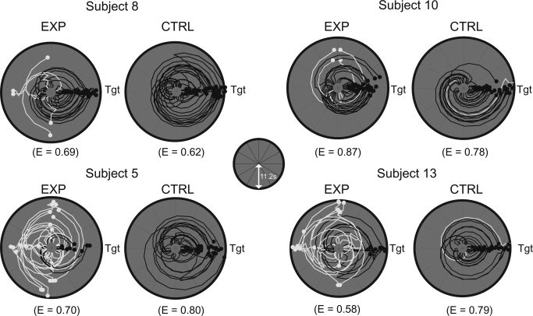
Functional cross‐hemispheric shift between object‐place paired associate memory and spatial memory in the human hippocampus
Hippocampus Volume 26, Issue 8, pages 1061-1077, 9 APR 2016 DOI: 10.1002/hipo.22587 http://onlinelibrary.wiley.com/doi/10.1002/hipo.22587/full#hipo22587-fig-0005
Notes:
Individual difference in search efficiency. Examples of angular trajectory of four subjects with efficiency indices (E) during the object‐cued place recognition period. For each subject, trajectory data were aligned so that the correct target (denoted as Tgt) was located on the east, separately shown for the experimental and control conditions. Distance from the center of the plot represents the duration of time (maximum of 11.2 s, as depicted in inset) and the azimuth of the point depicts the viewing angle of the subject at that particular time. Black and white lines denote trajectories for correct and incorrect trials, respectively.
IF THIS IMAGE HAS BEEN PROVIDED BY OR IS OWNED BY A THIRD PARTY, AS INDICATED IN THE CAPTION LINE, THEN FURTHER PERMISSION MAY BE NEEDED BEFORE ANY FURTHER USE. PLEASE CONTACT WILEY'S PERMISSIONS DEPARTMENT ON PERMISSIONS@WILEY.COM OR USE THE RIGHTSLINK SERVICE BY CLICKING ON THE 'REQUEST PERMISSIONS' LINK ACCOMPANYING THIS ARTICLE. WILEY OR AUTHOR OWNED IMAGES MAY BE USED FOR NON-COMMERCIAL PURPOSES, SUBJECT TO PROPER CITATION OF THE ARTICLE, AUTHOR, AND PUBLISHER.

