Slide 1
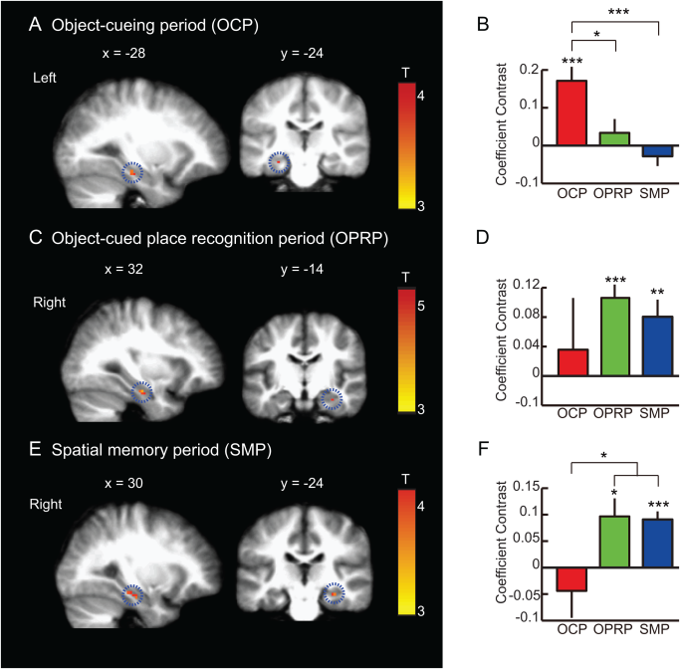
Functional cross‐hemispheric shift between object‐place paired associate memory and spatial memory in the human hippocampus
Hippocampus Volume 26, Issue 8, pages 1061-1077, 9 APR 2016 DOI: 10.1002/hipo.22587 http://onlinelibrary.wiley.com/doi/10.1002/hipo.22587/full#hipo22587-fig-0006
Notes:
BOLD activity during object‐cueing period, object‐cued place recognition period, and spatial memory period. (A, C, E) A sagittal (left) and a coronal (right) section showing the peak hippocampal activity for each event period (P < 0.05, FWE‐corrected, one‐sample t test). MNI coordinates are shown above the corresponding sections. In each row, the scale bar shows the range of the t‐statistics from GLM analysis for each event period with red color representing higher response. OCP: Object‐cueing period, OPRP: Object‐cued place recognition period, SMP: Spatial memory period. Mean ± S.E.M. *P < 0.05, **P < 0.01, ***P < 0.001. (A) Object‐cueing period (OCP): A subset of voxels in the left hippocampus showing significant activity during the object‐cueing period (highlighted with a dotted circle), compared to the control. (B) Mean coefficient contrasts of the OCP‐responsive voxels in the left hippocampus across three different periods. (C) Object‐cued place recognition period (OPRP): A subset of voxels in the right hippocampus (highlighted with dotted circles) showing significant BOLD activity during the OPRP. (D) Mean coefficient contrasts of the OPRP‐response voxels in the right hippocampus across three different event periods. (E) Spatial memory period (SMP): During the spatial memory period, the right hippocampus (highlighted with a dotted circle) showed significant BOLD activity compared to the control condition. (F) Average coefficient contrasts of the SMP‐responsive voxels in the right hippocampus across three different event periods. [Color figure can be viewed in the online issue, which is available at wileyonlinelibrary.com.]
IF THIS IMAGE HAS BEEN PROVIDED BY OR IS OWNED BY A THIRD PARTY, AS INDICATED IN THE CAPTION LINE, THEN FURTHER PERMISSION MAY BE NEEDED BEFORE ANY FURTHER USE. PLEASE CONTACT WILEY'S PERMISSIONS DEPARTMENT ON PERMISSIONS@WILEY.COM OR USE THE RIGHTSLINK SERVICE BY CLICKING ON THE 'REQUEST PERMISSIONS' LINK ACCOMPANYING THIS ARTICLE. WILEY OR AUTHOR OWNED IMAGES MAY BE USED FOR NON-COMMERCIAL PURPOSES, SUBJECT TO PROPER CITATION OF THE ARTICLE, AUTHOR, AND PUBLISHER.

