Slide 1
Left–right dissociation of hippocampal memory processes in mice
Notes:
PNAS是《美国科学院院报》9.423

Slide 2

PNAS 9.423
Shipton , 2014
Optogenetics
LTP(CA3-CA1)
Spontaneous alternation T-maze task (86)
Spatial novelty preference Y-maze task (22)
Spatial long-term memory Y-maze task (80)
Visual discrimination T-maze task (67)

Slide 3
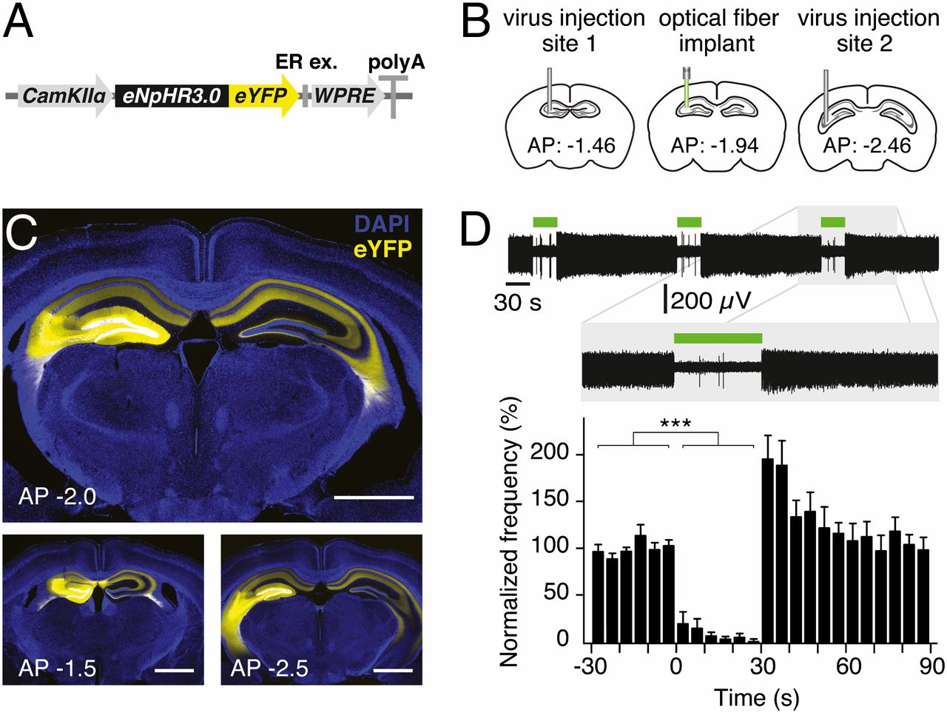

Optogenetics enables acute silencing of CA3 activity in vivo.
Olivia A. Shipton et al. PNAS 2014;111:42:15238-15243
©2014 by National Academy of Sciences
Notes:
Optogenetics enables acute silencing of CA3 activity in vivo. (A) Adeno-associated virus containing the eNpHR3.0-eYFP construct under the control of a CaMKIIα promoter was used. WPRE, woodchuck hepatitis posttranscriptional regulatory element. (B) Virus was unilaterally injected into two sites in the dorsal CA3 area of C57BL/6J mice for use in optrode recordings. For behavioral experiments, an optical fiber was also implanted between the two injection sites. (C) Two-site virus injection resulted in eNpHR3.0-eYFP or eYFP expression in CA3 and CA3 projections in the entire dorsal hippocampus. (Upper) Expression at approximate location of implant. (Lower) Approximate location of two injection sites. (Scale bars, 1 mm.) (D) Illumination of CA3 neurons in eNpHR3.0-expressing mice for 30 s resulted in a reversible reduction in spontaneous spiking frequency. A representative optrode recording trace as well as normalized mean frequency is shown. Error bars represent SEM.

Slide 4
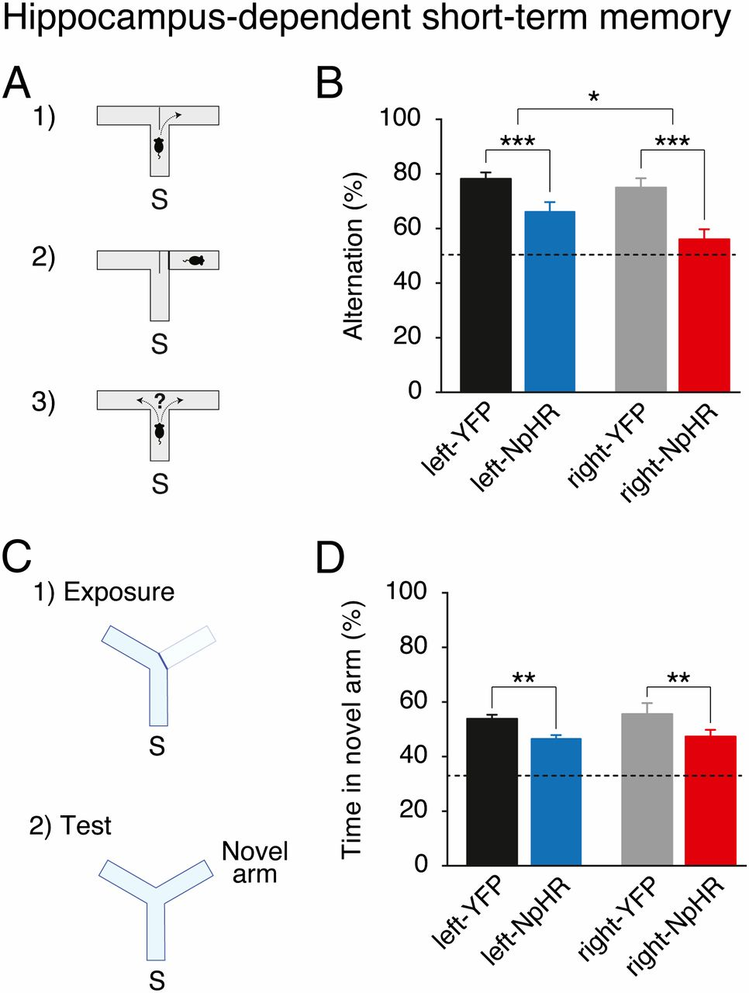
Hippocampus-dependent short-term memory requires the left and right CA3.
Olivia A. Shipton et al. PNAS 2014;111:42:15238-15243
©2014 by National Academy of Sciences
Notes:
Hippocampus-dependent short-term memory requires the left and right CA3. (A) Mice were tested on a spontaneous alternation task in a T-maze. S, start arm. (B) Light delivery during this task reduces spontaneous alternation of right-NpHR and left-NpHR mice compared with their respective YFP controls. (C) Mice were tested on a spatial novelty preference task in a Y-maze. (D) Light delivery during this task reduces preference for the novel arm in right-NpHR and left-NpHR mice compared with their respective YFP controls. Broken lines represent chance performance. Mean percentages ± SEM. *P < 0.05; **P < 0.01, ***P < 0.001.

Slide 5
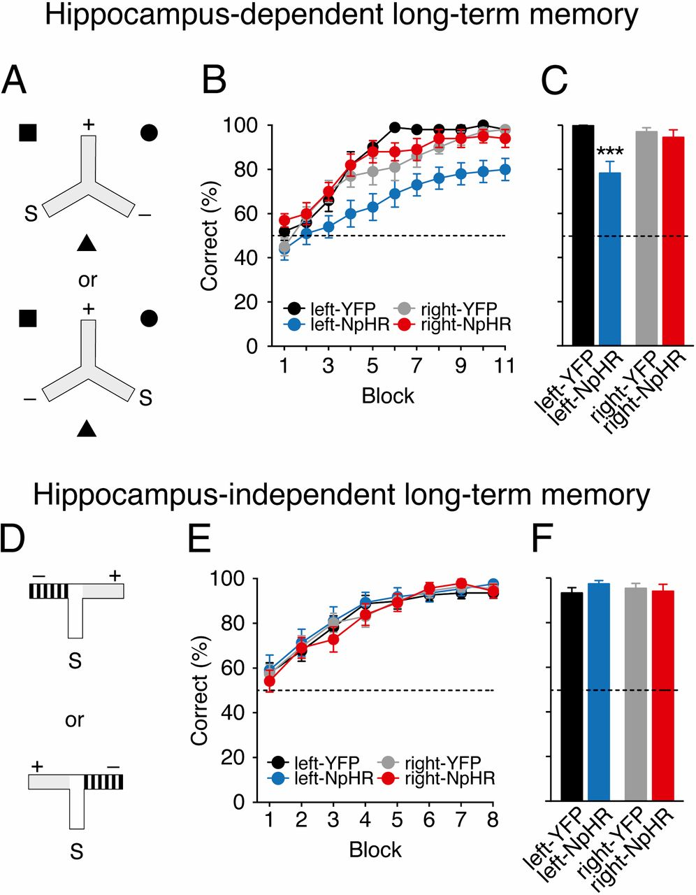
Hippocampus-dependent associative spatial long-term memory uniquely requires the left CA3.
Olivia A. Shipton et al. PNAS 2014;111:42:15238-15243
©2014 by National Academy of Sciences
Notes:
Hippocampus-dependent associative spatial long-term memory uniquely requires the left CA3. (A) Mice were trained on a hippocampus-dependent long-term memory task where they had to associate a reward location that was fixed with respect to allocentric extramaze spatial cues (black square, circle, and triangle), and remained constant for each mouse across consecutive days of testing. Mice received arm starts (S) to the left or the right of the rewarded arm (+) in a pseudorandom order. Mice entering the nonrewarded arm (−) were not allowed to self-correct. (B) Light delivery in mice expressing eNpHR3.0 in the left CA3 (left-NpHR, blue) impairs but does not affect learning in right-NpHR mice (red) and control groups (left-YFP: black, right-YFP: gray) in this hippocampus-dependent long-term memory task. (C) Average performance on penultimate day. (D) Mice were trained on a hippocampus-independent visual-discrimination long-term memory task where they had to associate arm floor and wall color (gray vs. black-and-white stripes) with a reward; this was fixed for each mouse across consecutive days of testing. Rewarded (+) and nonrewarded (−) arms were pseudorandomly interchanged so that reward location was learnt independent of the spatial position of the arms of the maze. (E) Mice in all groups successfully learned this task at an equivalent rate. (F) Average performance on penultimate day. In both tasks, on the last day of testing, reward was delivered after the animal had chosen to control for the possibility of mice smelling the milk (postchoice baiting). Broken lines represent chance performance. Mean percentage correct choices ± SEM. ***P < 0.001.

Slide 6
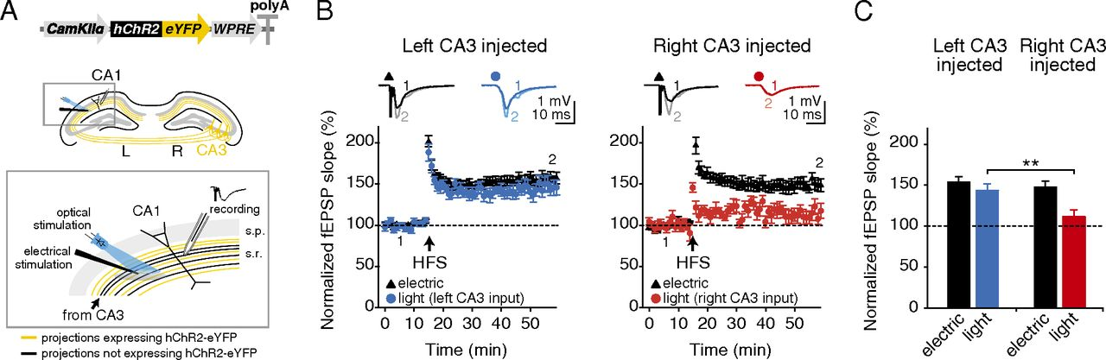
High-frequency stimulation-induced LTP is asymmetrically expressed at the CA3–CA1 pyramidal cell synapse.
Olivia A. Shipton et al. PNAS 2014;111:42:15238-15243
©2014 by National Academy of Sciences
Notes:
High-frequency stimulation-induced LTP is asymmetrically expressed at the CA3–CA1 pyramidal cell synapse. (A, Upper) Adeno-associated virus containing hChR2-eYFP construct under the control of a CaMKIIα promoter was unilaterally injected into the dorsal CA3 area of C57BL/6J mice. (Lower) An electrode to deliver nonselective electrical stimulation was placed in the stratum radiatum and a high-power 470-nm LED was arranged to recruit an overlapping population of projections. Optical stimulation only recruits projections originating in the CA3 of the injected hemisphere (yellow), whereas electrical stimulation is nonselective (black and yellow). Electrical stimulation was used to deliver the high-frequency LTP induction protocol and the effects were monitored via field recording of EPSPs evoked by electrical or optical stimulation. (B) HFS produces robust LTP in the electrical pathway (black triangles), but LTP is only expressed in the optical pathway (circles) when projections originate in the left CA3. (Insets) Representative field EPSPs at the indicated time points (1, 2). (C) Significantly more LTP is observed in left-injected mice than in right-injected mice in the optical pathway. Broken lines represent baseline. Error bars represent SEM. **P < 0.01, Student’s t test.

Slide 7
ICA Analysis
Concat-ICA :Multisession temporal ICA concatenated approach
IC maps :for each analysis group (70 independent components)
Threshold : based on fitting a Gaussian/gamma mixture model ,

Slide 8
ICA Analysis
Exclude :
overlapped with vascular structures and ventricles
regressors of no interest in the DR analysis
prone to be affected by motion-related artifacts
17 independent components remained at last

Slide 9
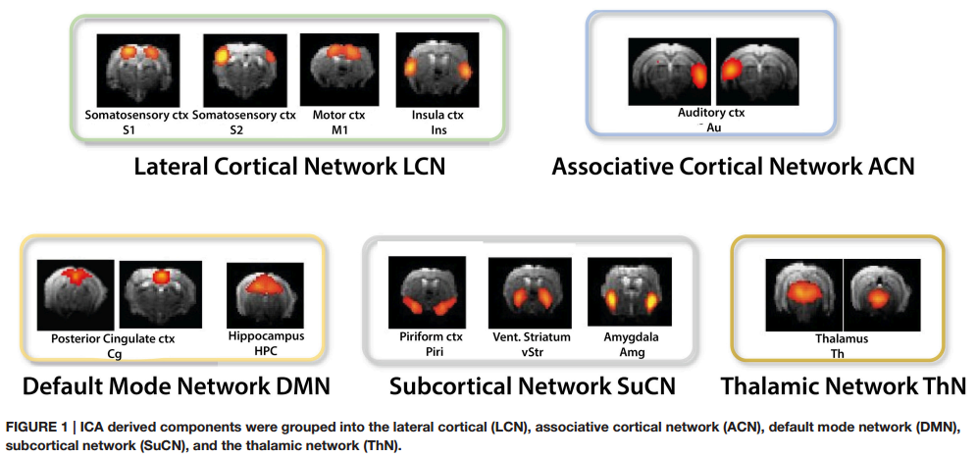

Slide 10
Dual Regression(DR)
Between-subject analysis
Unpaired t-tests among different groups
Matrix : subject to [1 -1] contrasts
Notes:
To identify brain regions and networks displaying greater FC in one anesthetic condition relative to another.

Slide 11
Dual Regression(DR)
Non-parametric permutation based inference analysis
performed with subject-specific component spatial maps concatenated across subjects
5000 randomized permutations :for each analysis
Notes:
Then submitted to voxel-wise between-subject analysis testing for effects of anesthetics on FC using FSL-randomize

Slide 12
Dual Regression(DR)
TFCE: threshold-free cluster enhancement
Correction for multiple comparisons
Bonferroni correction
Notes:
These clusters were then used as input in to the GLM analysis and run through FSLrandomize (Winkler et al., 2014) to perform 5000 permutations to test for statistical significance.

Slide 13
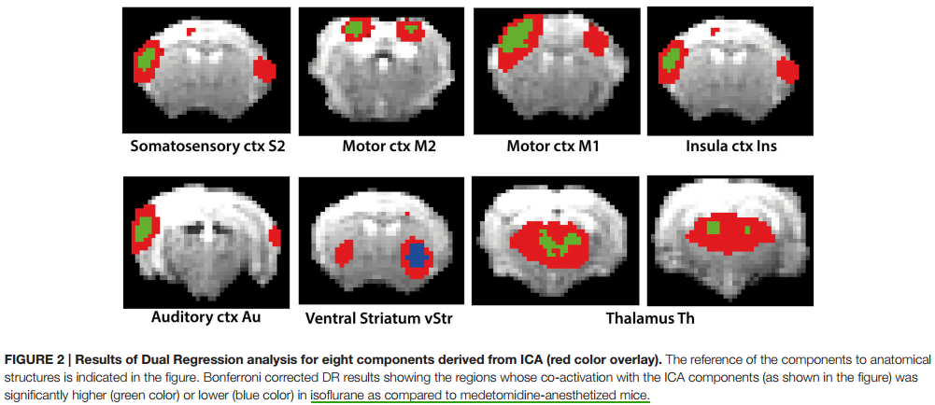

Slide 14
Network Modeling
Different network matrix calculation methods:
FC: Full correlation (direct and indirect connections )
PC : Partial Correlation (direct connections,this one )
FDR(multiple comparisons with false discovery rate) using the same unpaired t-test design matrix
Notes:
BOLD time courses
Hence, seed-based analysis is limited to the analysis of “withinnetwork” connectivity, while DR-based FSLNets allows modeling of connectivity between network components in addition.

Slide 15
Propofol :
A GABA receptor agonist
Not attenuating BOLD activation even at high dose
well-preserved neurovascular coupling
minimal vascular effects
Dosage-dependent changes in RSNs
Be used to induce hypnotic sedation through to deep anesthesia for surgery as the dosage increases
For studying the loss of consciousness

Slide 16
PNAS
Barttfeld , 2015
Propofol
Spontaneous activity
Signature of consciousness
Stationary Connectivity Analysis
Dynamical Connectivity Analysis
Unsupervised clustering
Monkeys
RsfMRI
CoCoMac database

Slide 17
Stationary Connectivity Analysis
Time-averaged stationary pattern of functional correlations
Zc,s :
Fisher-transformed covariance matrix for each vigilance condition c and session s
Zc,s(i,j): temporal covariance of the average fMRI signal of ROIs i and j throughout an entire fMRI session (20 min)

Slide 18
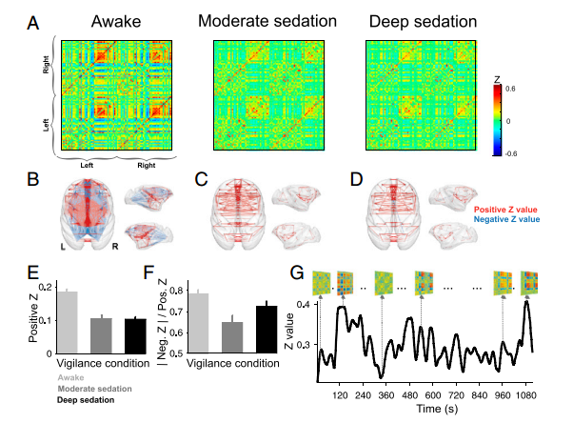

Slide 19
Dynamics Connectivity Analysis
Zc,s ,w:
Sliding window Fisher-transformed covariance matrices for each fMRI vigilance condition c, session s, and time window w
The covariance between specific ROI pairs, as well as the whole-brain average of the covariance, constantly varied over time

Slide 20
Unsupervised clustering
& brain States
k-means clustering algorithm
L1 distance function
500 times
Zexamplesc,s (Subsampled Zc,s ,w) → BSn (n=1,2,...,7) →
initialize a clustering of all data (obtaining a matrix of brain states Bc,s,w )
Notes:
500:escaping local minima
Subsampling was performed to reduce redundancy between windows.
The sampled connectivity matrices (Zexamplesc,s) were chosen as those windows with local maxima in functional connectivity variance.
probability distributions (column D) do not significantly change with k.

Slide 21
Similarity score &
probability of each state
Similarity score :
similarity between anatomical connectivity and functional connectivity, to rank all brain states along this dimension
computed by measuring the correlation coefficient between the vectorized structural matrix and each vectorized brain from the clustering analysis
Notes:
Euclidean distance instead of correlation or only positive values of the brain states to calculate the correlation

Slide 22
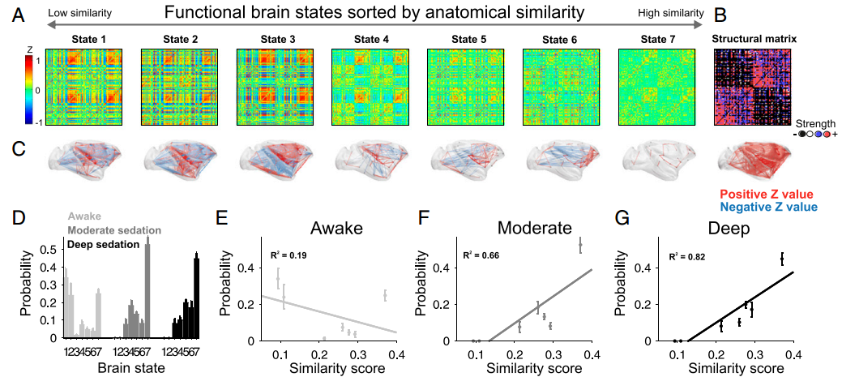

Slide 23
Propofol :
With increased dose:
cortical connectivity in the motor cortex and DMN decreases
thalamic and hypothalamic connectivity remains stable
in some subcortical areas, connectivity is reduced but rebounds at a higher dose
Similar to isoflurane and α-chloralose : ,the thalamic connectivity is weak even at very low doses
Greater anti-correlation
Notes:
some subcortical areas: hippocampus and caudate putamen

Slide 24
Urethane:
Multiple neurotransmitter systems
GABA receptors
N-methyl-D-aspartate (NMDA) receptors
Minimal impact on systemic hemodynamics and the cardiovascular system
Dosage-dependent depression of bilateral connectivity and loss of spatial specificity
Induce sleep-like states
Rapid eye movement (fast wave)
Non-rapid eye movement (slow wave)
Investigate RSN dynamics in sleep
Notes:
vascular effect with broad and slow hemodynamic oscillation

Slide 25
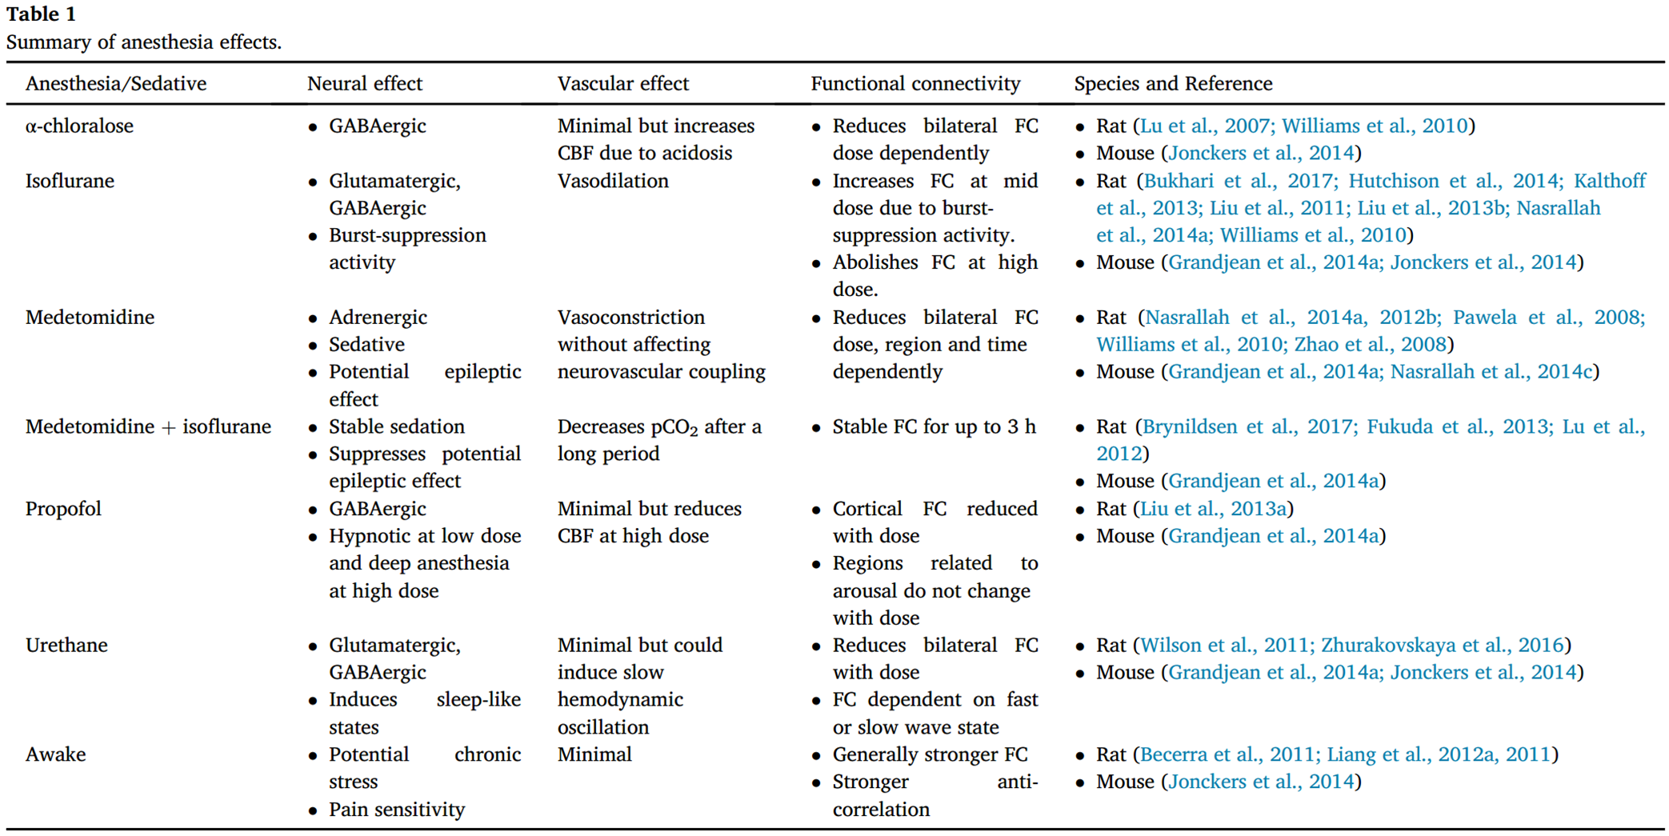

Slide 26
Thank you all for listening~

Slide 27
01
Part ONE
Anesthesias
α-chloralose
Isoflurane & Medetomidine/dexmedetomidine
Propofol
Urethane

Slide 28
02
Part TWO
Neural systems
Identify brain regions scopolamine induce intensity changes
Evaluate the effects of scopolamine on FC
Whether scopolamine-induced memory effect could be
reversed with milameline

