Slide 1
Dynamic
Time courses
Modularity

Slide 2
01
Part ONE
Medaglia, 2017
Identify brain regions scopolamine induce intensity changes
Evaluate the effects of scopolamine on FC
Whether scopolamine-induced memory effect could be
reversed with milameline

Slide 3
Brain state expression and transitions are related to complex executive cognition in normative neurodevelopment

Slide 4

NeuroImage
Medaglia , 2017
780(10 bins)
120TRs
264 rois
Time spent in two primary states
Flexibility
Rs & task evoled
Dynamic graph

Slide 5
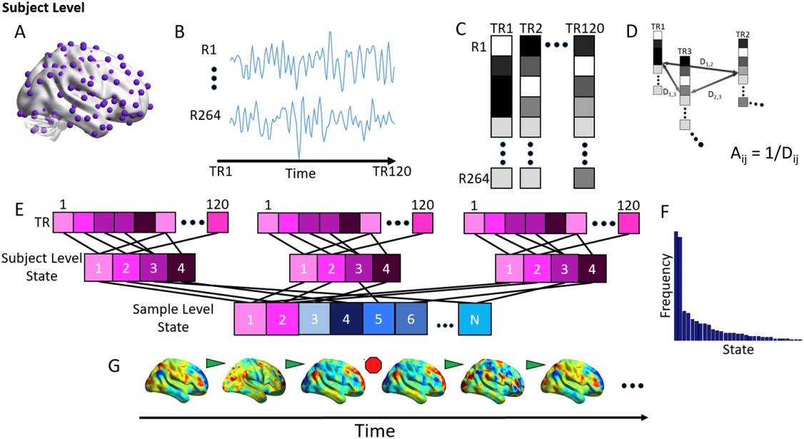
Notes:
A 264 roi → 264 node
B time courses (/TR)
C vector(each vector element:mean z for each roi)
D distance
person-level:
matrix/person,120*120
temporal adjancy matrix
modularity result:3~6or4average states per sub
group-level:
matrix/bin,N*N(N:number of mean state vector,all mean state vectors from all sub in respective bin)
state adjancency matrix
modularity 2 primary states
E clustering( louvain-like locally greedy algorithm, person-level, group-level)
F frequency
G state shift ?

Slide 6
Assessing
the significance of states
2 permutation tests:
Examine the significance of state organization
Examine the significance of activity in primary states

Slide 7
Assessing
the significance of states
Permutation 1(The significance of state):
Group-level
Person-level

Slide 8
Assessing
the significance of states
Permutation 1(The significance of state ):
Group-level:
State adjancency matrix(for each bin)
1000 times, Q ,95%(greater)
Notes:
100% primary states 92% remain states : P<0.05

Slide 9
Assessing
the significance of states
Permutation 1(The significance of state ):
Person-level:
Temporal adjancency matrix for each sub
Notes:
100% primary states 96.8% remain states : P<0.05

Slide 10
Assessing
the significance of states
Permutation 2(The significance of activity):
Person-level:
Z-scored BOLD signal intensities
In all TRs contributing to the two primary state vectors
1000, BOLD,97.5%(greater or less)

Slide 11
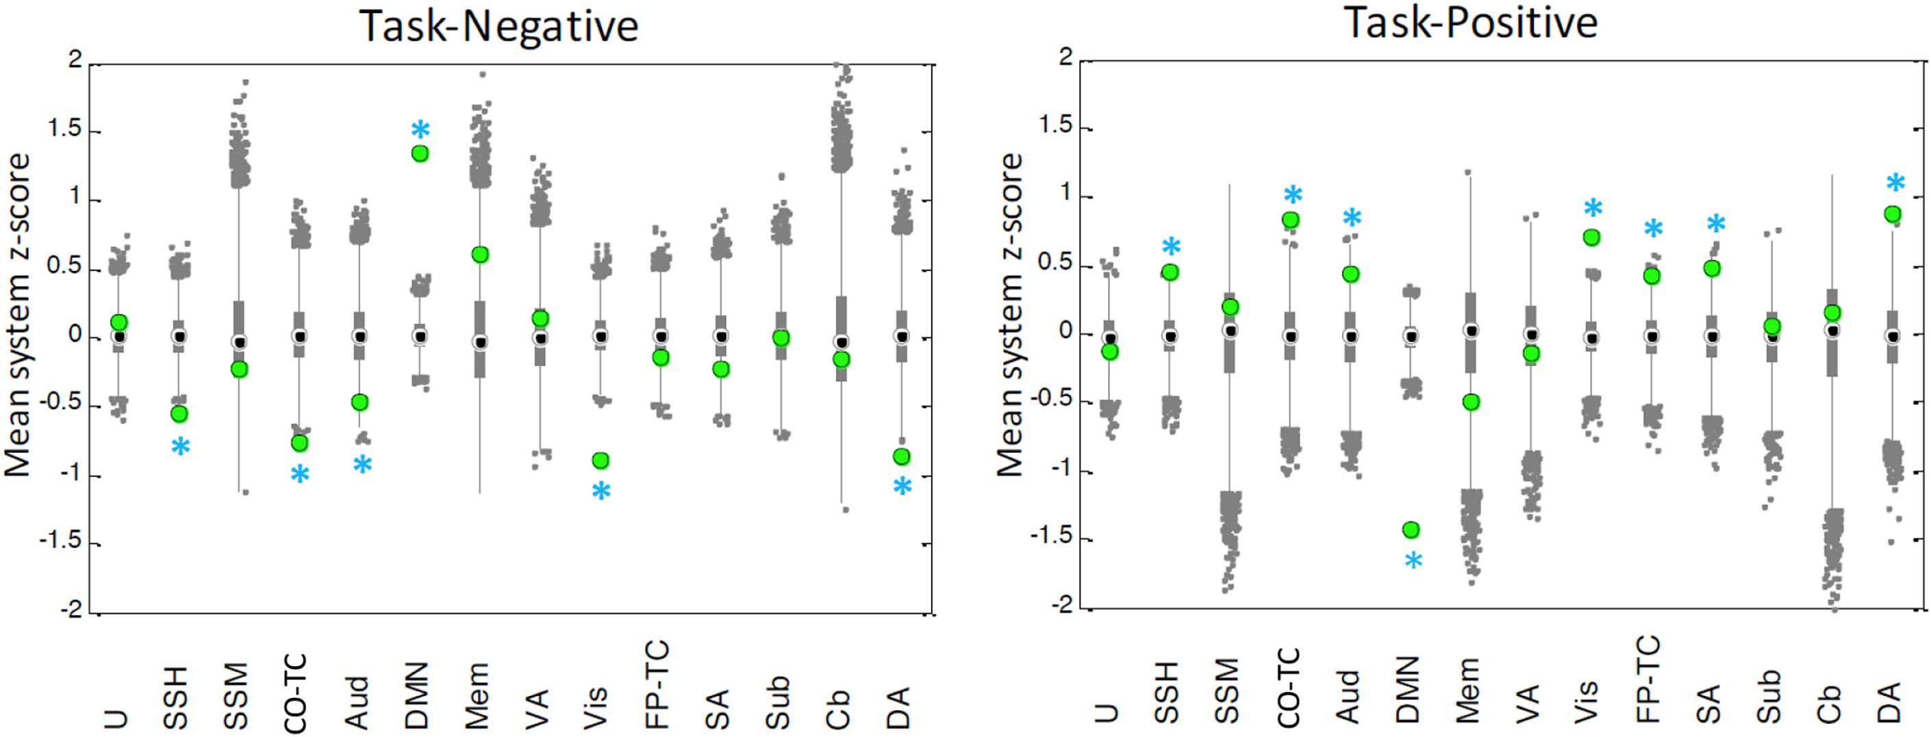
Notes:
The results from this analysis demonstrate that (both relative to the null distribution):
(1)the state activity in the task-negative systems is significantly increased
in the task-negative state relative to the null;
(2)the state activity in the task-positive systems is significantly increased
in the task-positive state relative to the null

Slide 12
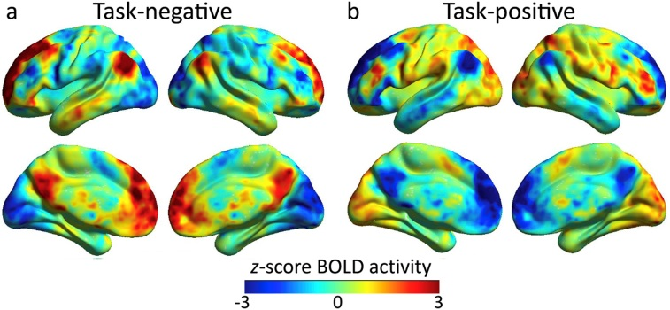
Notes:
Youngest bin :
1st primary state :
displays high activity in brain regions traditionally observed to be active at rest (“task-negative”)
2nd primary state :
displays high activity in regions traditionally observed to be active during cognitive tasks (“task-positive”)
All bins :
Compute the Pearson's correlation coefficient between the mean BOLD values for each system for each state pair.
We found that the correlation in BOLD among average task-negative states extracted from each age group was r = 0.90 among task-positive states was r = 0.92

Slide 13
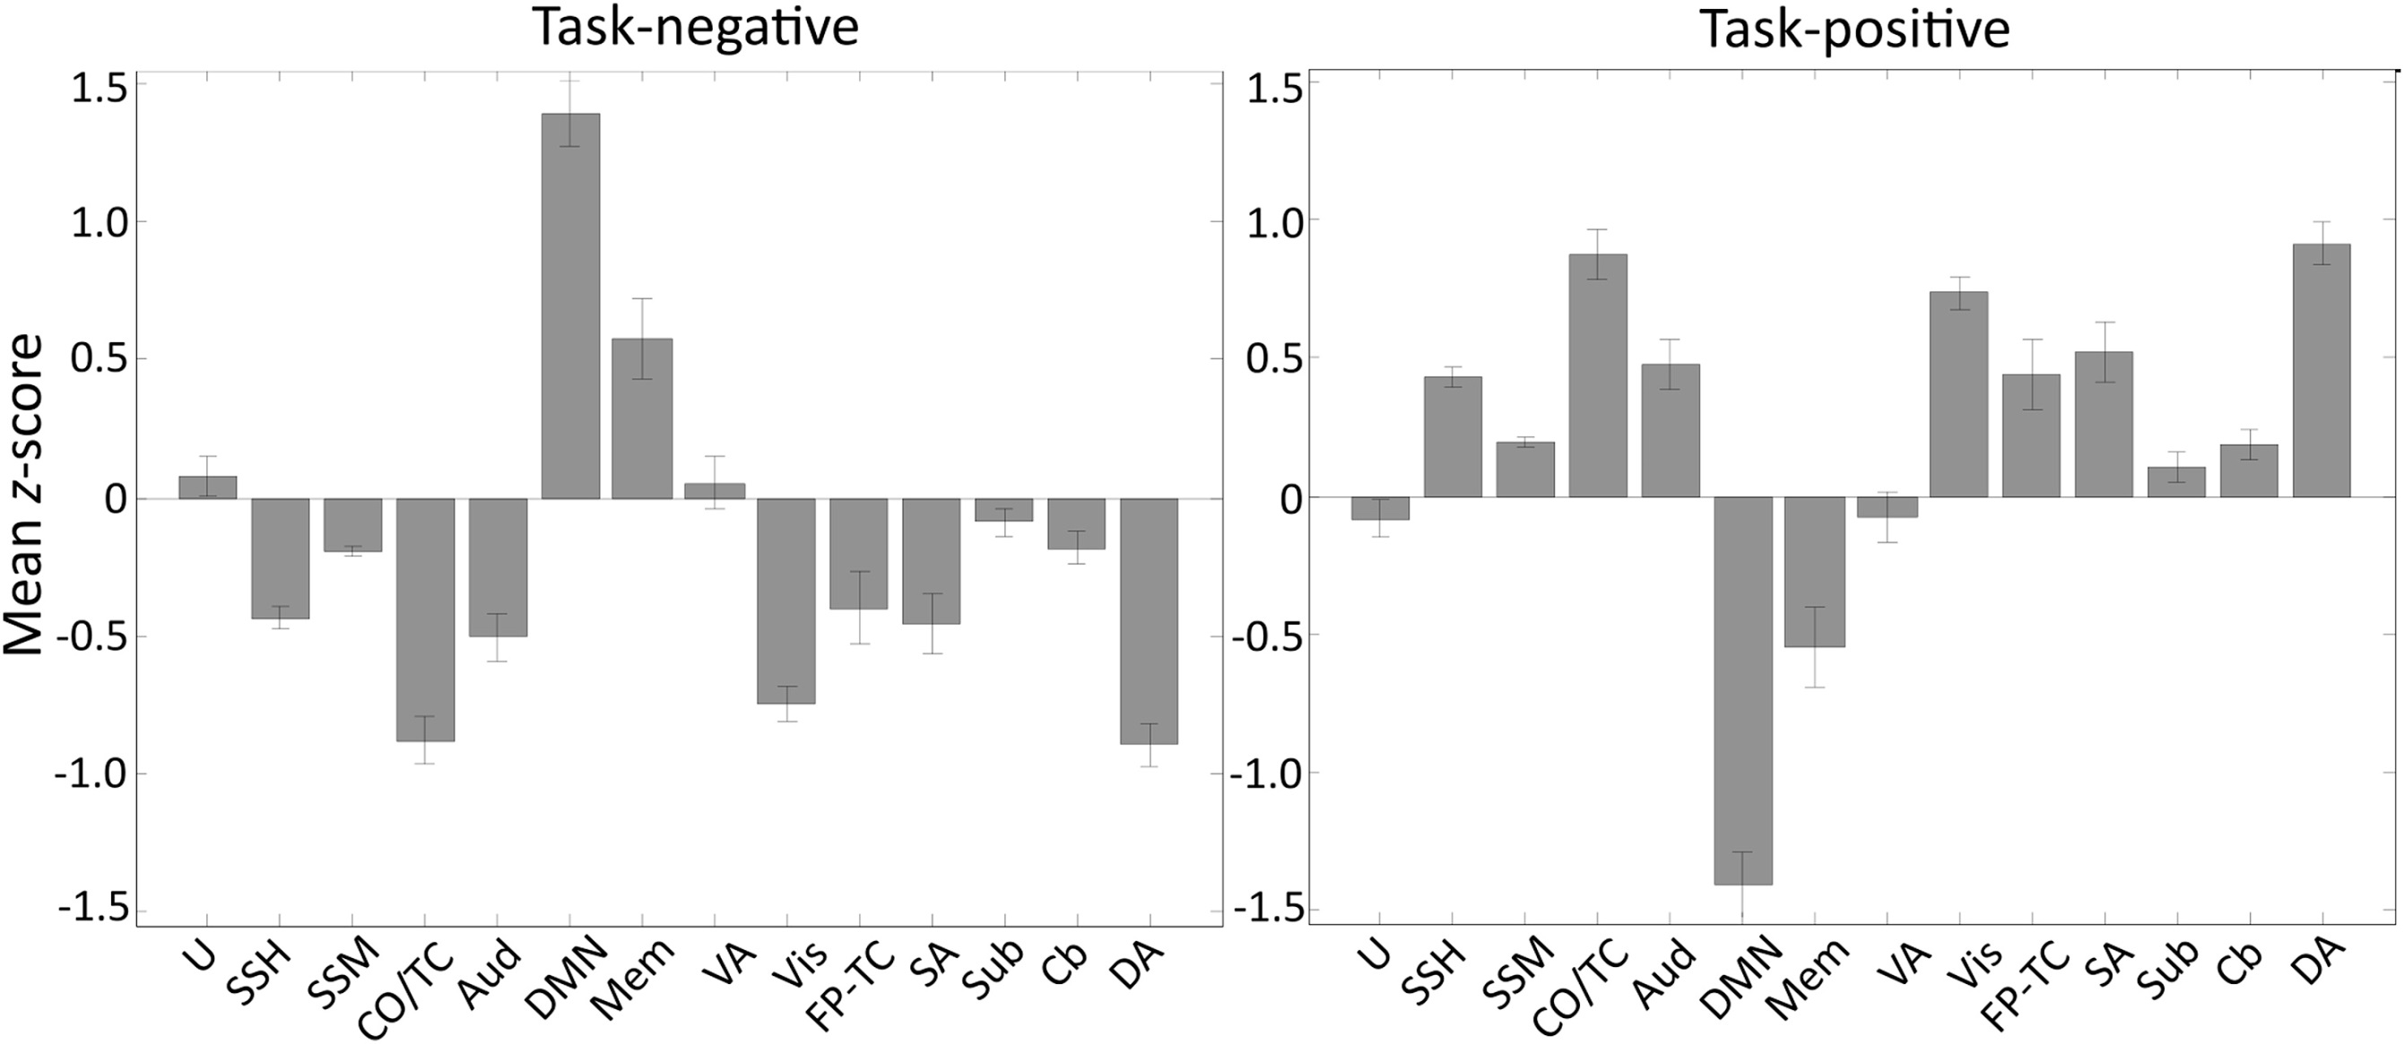
Notes:
means over age bin and its std

Slide 14
Define the Flexibility
F =T/S (for each sub):
F: the state flexibility
T: the number of state transitions
S: relative to the number of states
Inclusive of all primary and secondary states

Slide 15
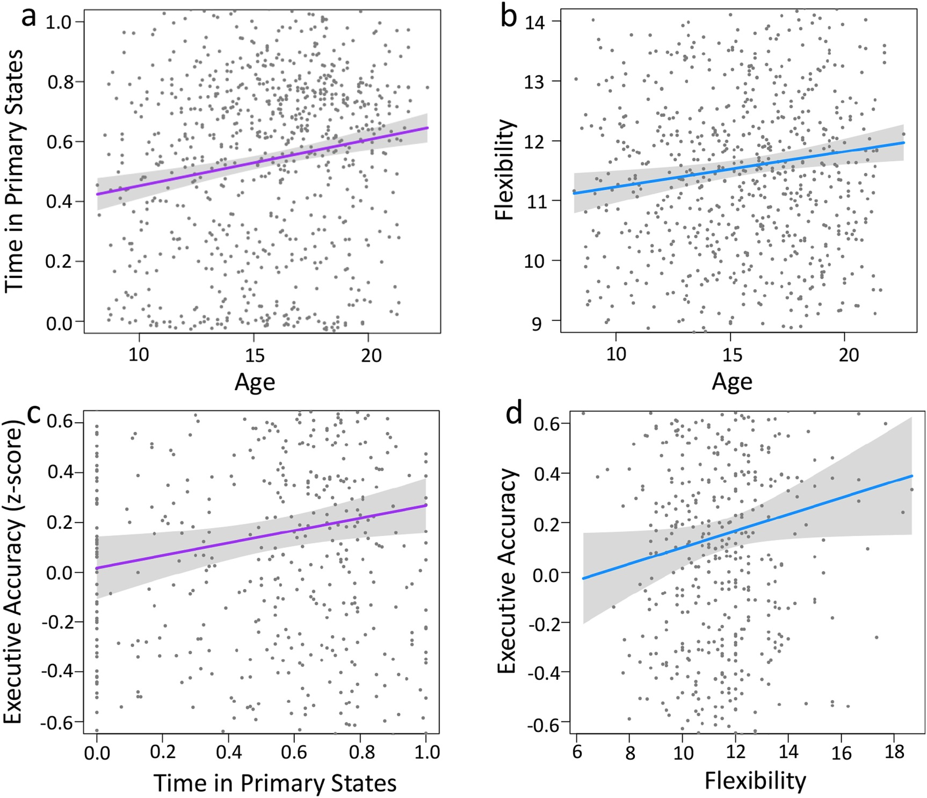
Notes:
Linear regression models
greater complex executive accuracy in adulthood is supported by :
increasing refinement of brain state dynamics, which in turn is characterized by greater time spent in primary states ,as well as greater flexibility of state transitions

Slide 16
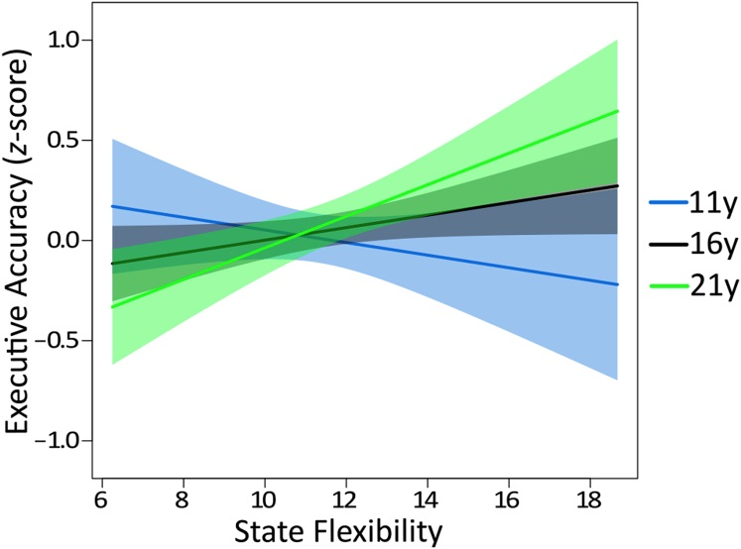
Notes:
No significant interaction with age : complex executive accuracy & time spent in primary states Significant interaction with age : executive accuracy & state flexibility :
Greater state flexibility was related to :
poorer complex executive accuracy in children
better complex executive accuracy in young adults
Cognitive states in childhood is disadvantageous for cognitive control, but advantageous for learning specifically and behavioral adaptation more generally

Slide 17
02
Part TWO
Gerraty, 2018
Identify brain regions scopolamine induce intensity changes
Evaluate the effects of scopolamine on FC
Whether scopolamine-induced memory effect could be
reversed with milameline

Slide 18
Dynamic flexibility in striatal-cortical circuits supports reinforcement 2 learning

Slide 19
BioRxiv
Gerraty , 2018
22subs
110 rois
4 blocks
Probabilistic learning task
Many models
Sub-blocks
Density
Multi-slice modularity
Flexibility

Slide 20
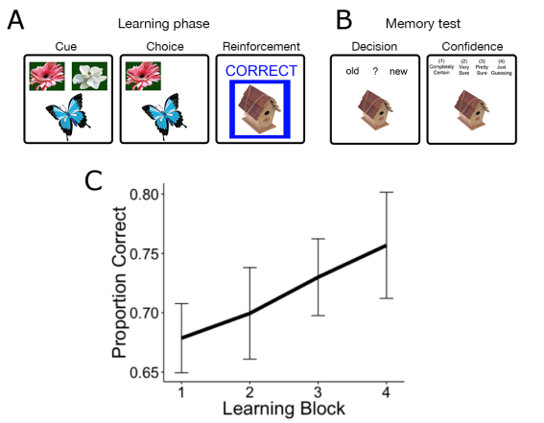
Probabilistic learning task

Slide 21
Network Construction
& Modularity
Multilayer temporal network
Identity link : a new type of edge that links one node in one time slice to itself in the next time slice
Muti-slice Community Detection:
Louvain-like locally greedy algorithm
500 times
Notes:
In this framework, each network node (or ROI) in the multi-layer network is connected to itself in the preceding and following time windows in order to link networks in time.

Slide 22

Dynamic Connectivity Analysis
Time courses totally : 200TRs
Sub-timecourse/Time window: 25TRs (8 windows)
Connectivity: roi by roi
cross-spectral density between regions x and y,
Subject-specific connectivity matrix : (110*110*8 )*4

Slide 23
Flexibility
F=T/P :
per time/block/sub/roi,500*4*22*110
T:the number of times a node displays a change
P:the number of possible changes (time points minus 1)

Slide 24
Flexibility
Measures the extent to which a region changed its community over time
Flexibility : average over 500 times(4*22*110)
Spatial flexibility : average over blocks(22*110)
Temporal flexibilty:average over rois(4*22)

Slide 25
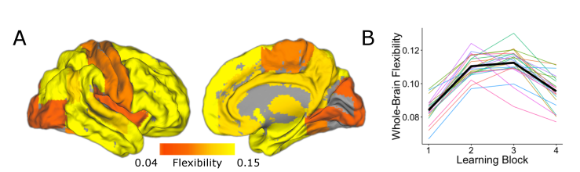
Flexibility
Notes:
Spatial and temporal characteristics of network flexibility

Slide 26
Subjects
Adult male wild-type mice
Groups: 2 experimental groups of mice: left-NpHR and right-NpHR, with their respective control groups, left-YFP and right-YFP
Control mice received equivalent injections of a virus lacking eNpHR3.0

Slide 27
Behavioral tests
Short-term memory tasks :
Spontaneous alternation short-term memory T-maze task
Spatial novelty preference short-term memory Y-maze task
Long-term memory tasks :
Spatial long-term memory Y-maze task
Visual discrimination long-term memory T-maze task
Notes:
训练时间： light：
A 30s On & Off separately
B 6 min On
C 11 days ，then 7 days blank On
D 8 days On

Slide 28
Analysis
The behavioral results were analyzed by two-way ANOVA with between-subjects factors of transgene (NpHR vs. YFP) and hemisphere (left vs. right), and also a within-subjects factor of block for the long-term memory tests.

Slide 29
Results
Silencing of either the left or right CA3 can impair short-term memory.
A striking asymmetry emerged in long-term memory :
Only left CA3 silencing impaired associative spatial long-term memory.
Notes:
Unilateral silencing of either the left or right CA3 was sufficient to impair short-term memory
A striking asymmetry emerged in long-term memory, wherein only left CA3 silencing impaired performance on an associative spatial long-term memory task.

Slide 30
Thank you all for listening~

