Slide 1
Current Results
for
Anesthetized Rats

Slide 2
Data management
fMRI data
All subjects exclude some with bad data : N=11 rats
3 Group : 20mg/ml/h as low-dose group,
40 as mid, 80 as high
Notes:
Some conclusions this slice and the next slice

Slide 3
Perspective
Inter-subject modular comparision(done,details later):
Do modularity for each subject and for each group
Do modular comparision between each pair of subject in every modules derived from group
Inter-subject modular comparision(next step):
Some dynamic things
Notes:
Also conclusion

Slide 4
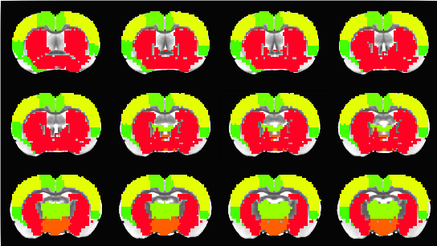
Statistical Measurement --Modularity
7 modules :
Insular, Anterior DMN, Hippocampus and thalamus, Posterior DMN, Sensory-motor, Striatum, Hypothalamus

Slide 5
Statistical Measurement –
MV across subjects
Node level – MV(modular variability):
Consider each roi as a node
Calculate for different levels:
1st level : each node between pair of subject
2nd level: each node foreach subject
3rd level: each node
Notes:
Explain what MV is from this slice

Slide 6

Statistical Measurement --MV
1st level : node k between pair of subject(i and j):
MV _{k} (i,j) = 1-$\frac{|Mk\left(i\right) ∩ M{k(j)}^{′}|}{|Mk(i)|}$ *$\frac{|Mk\left(i\right) ∩ M{k(j)}^{′}|}{|Mk(j)|}$
$Mk(i)$ : the module node(roi) k belong in subject k
$∩$: calculate the nodes both in $Mk(i)$ and $Mk\left(j\right)$
|M| : calculate the number of nodes in set M

Slide 7

Statistical Measurement --MV
2nd level: node k for subject i :
MV _{k} (i) = $\sum{j≠i}$ MV _{k} (i,j) / (N-1)
3rd level: each node :\
MV _{k} = $\sum_{i=1}^{N}{\text{MV} \text{k}\text{ (}\text{i}\text{)}}$ / (N-1)
Larger MV means there are more diffenerces across subjects in this node k
Notes:
0: no difference
Not 0, small figure near 0: there node escape or join in the module this node belong , but not this node itself
Not 0, big figure: this node k doesn’t belongs to the same module along subjects

Slide 8
Statistical Measurement --MV _{k} (i):
We do averge across nodes(rois) in each module
11 subjects, 3 doses, 7 modules
Two-way ANOVA:
Significance: dose(F=11.9336,P<4.3639e-1), module(F=13.1388,P<3.3891e-06)
Interaction : F=0.2903,P<0.9983
Notes:
How we use MV to do statistics
Do muticompare after two-way ANOVA ,there’re significance in:
Module: (1)insular, pos-DMN, hypothalamus
(2)sensory,striatum
(3)ant-DMN, other 6 modules
Dose: low ,high
mid,high

Slide 9
Statistical Measurement --MV _{k} (i):
One-way ANOVA for each dose(module as the factor):
Low dose : F=3.6321, P<5.8987e-04
Mid dose : F=6.5128, P<2.9444e-07
High dose : F=8.9626, P<8.2378e-10
One-way ANOVA for each module(dose as the factor):
Significance in : insular, ant-DMN,and hypothalamus
Notes:
Multicomparision after One-way ANOVA for each dose(module as the factor): pos-DMN is significant smaller in MV k (i) in each dose
Multicomparision after One-way ANOVA for each module(dose as the factor):
insular: low,mid
ant-DMN: (1)low,mid (2)low,high
hypothalamus: low,high

Slide 10
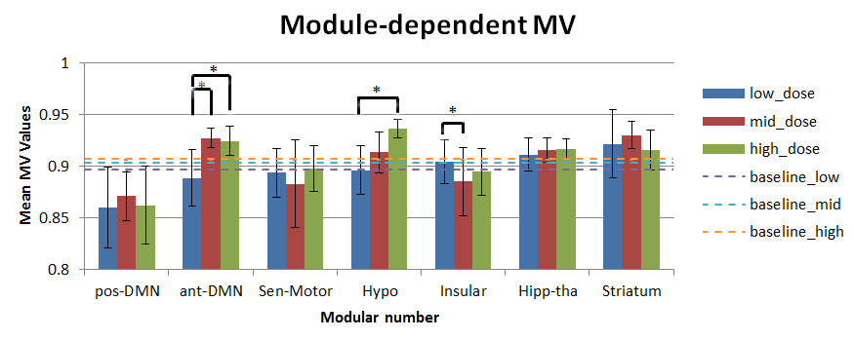
Statistical Measurement --MV _{k} :

Slide 11
Statistical Measurement –
Sub-Modularity
Do modularity in modules:
Insular, Anterior DMN, Hypothalamus
The modules above show significantly increase(ant-DMN and Hypo) or decrease(Insular) in MV along dose

Slide 12
Statistical Measurement –
Sub-Modularity
The number of sub-modules in each module above:
Insular: decrease, but not significant
Anterior DMN: increase, and P<0.05
Hypothalamus: decrease, but not significant
Bar graph below
Notes:
Explain why these modules show increase or decrease variability across subjects along dose

Slide 13
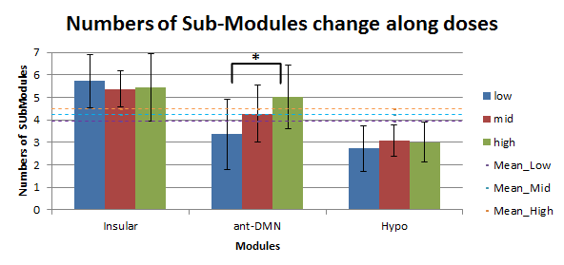
Statistical Measurement –
Sub-Modularity
Notes:
Explain why these modules show increase or decrease variability across subjects along dose

Slide 14
Statistical Measurement –
MV across doses
Only calculate in the way of 1st level mentioned before:
each node between pair of dose for each subject
1:low;2:mid;3:high
There’s smaller or bigger tendency, but all not significant ,shown in bar graph below
Notes:
May explain the increase or decrease between low&mid or mid&hgih

Slide 15
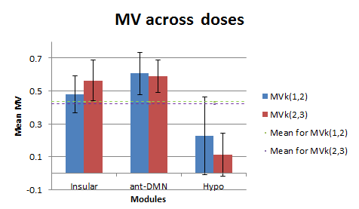
Statistical Measurement –
MV across doses
Notes:
May explain the increase or decrease between low&mid or mid&hgih

Slide 16
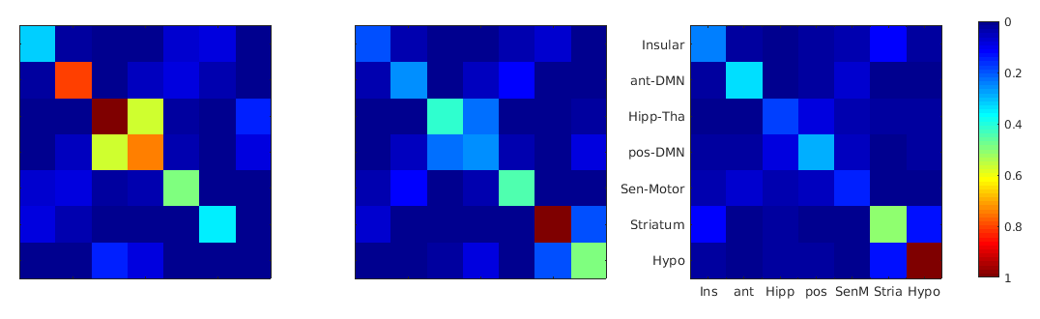
Statistical Measurement –
correlation matrix
Correlation matrix for each subject for each dose

Slide 17
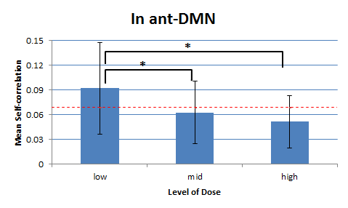
Statistical Measurement –
correlation matrix
Significance in t-test in pairs of doses

Slide 18
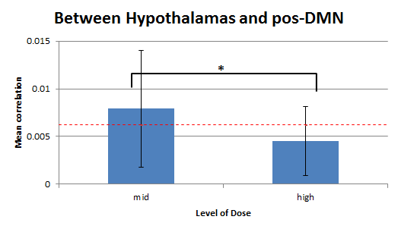
Statistical Measurement –
correlation matrix
Significance in t-test in pairs of doses

Slide 19
Infer 1
Increasing invariability across subjects along dose is beacuse:
Correaltion decrease till disappear along dose
The number of sub-modules is increase

Slide 20
Infer 2
Decreasing invariability across subjects along dose is beacuse:
Modules is silencing along dose, and at last all similar to anatomical structure

Slide 21
Thank you all for listening~

