Slide 1

Functional Analysis for
Mouse Resting
Images

Slide 2
01
Part ONE
Significant regions

Slide 3
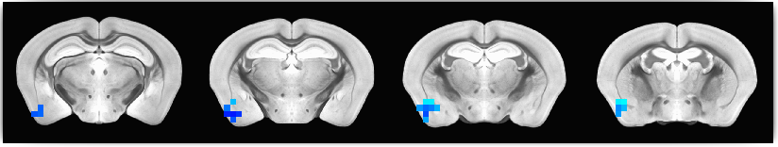
CA1 TgLNBP & WtCON
Regions showing significant differences
Amygdaloid region including：Dorsal nucleus of the endopiriform ，Piriform cortex ，Ventral nucleus of the endopiriform claustrum ，Central amygdaloid nucleus
(P < 0.01)

Slide 4
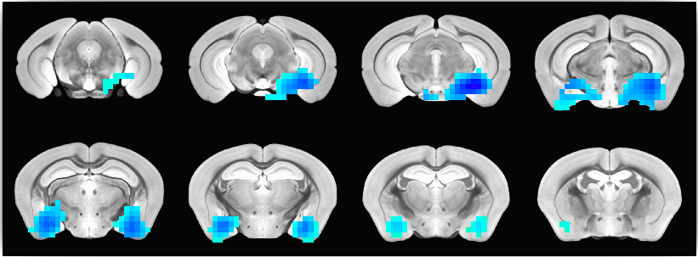
CA3 TgLNBP & WtCON
Entorhinal & Amygdaloid regions including：Corpus callosum / External capsule ，Cortex-amygdala transition zones ，Dorsal intermediate entorhinal cortex ，Ventral intermediate entorhinal cortex ，Piriform cortex ，Posterolateral cortical amygdaloid area ，Posteromedial cortical amygdaloid area ，Rostral amygdalopiriform area，Amygdalostriatal transition area ，Central amygdaloid nucleus (P < 0.01)

Slide 5
CA3 TgLNBP & WtCON
Amygdaloid region including：Cortex-amygdala transition zones . Piriform cortex , Posterolateral cortical amygdaloid area , Posteromedial cortical amygdaloid area , Rostral amygdalopiriform area , Central amygdaloid nucleus (P < 0.01)

Slide 6
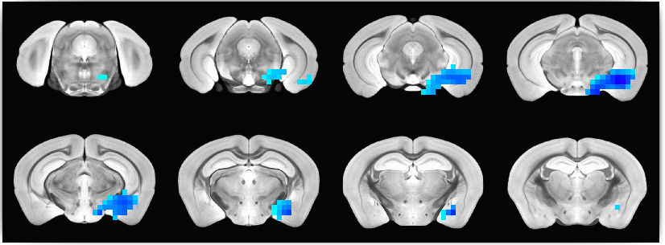
GM TgLNBP & WtCON
Entorhinal & Amygdaloid regions including：Amygdalopiriform transition area , Dorsolateral entorhinal cortex , Dorsal intermediate entorhinal cortex , Ventral intermediate entorhinal cortex , Posteromedial cortical amygdaloid area , Central amygdaloid nucleus (P < 0.01)

Slide 7
02
Part THREE
Strength in regions
Connectivity strength
Significant regions
Each group

Slide 8
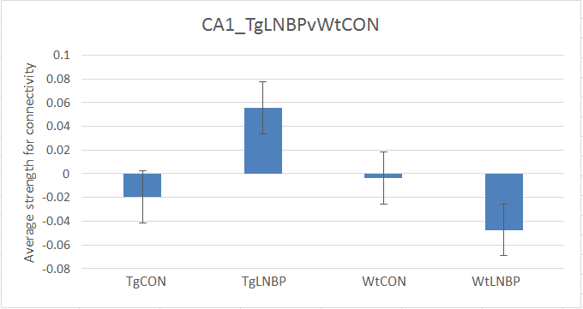
Amygdaloid region

Slide 9
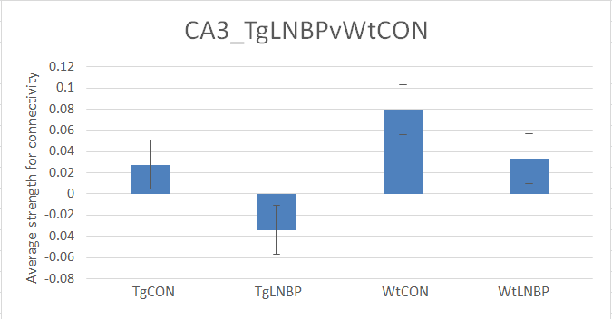
Entorhinal & Amygdaloid regions

Slide 10
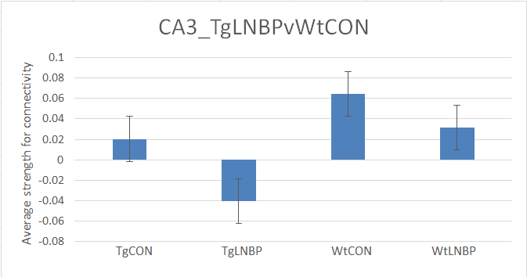
Amygdaloid region

Slide 11
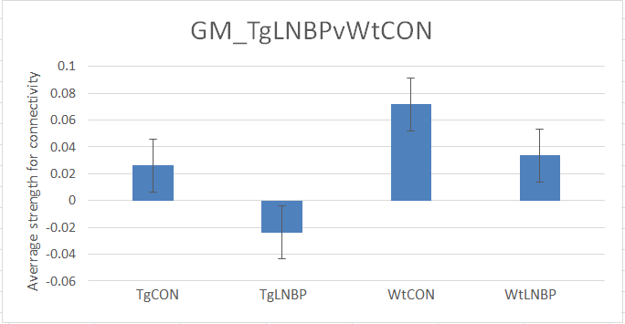
Entorhinal & Amygdaloid regions

