Slide 1
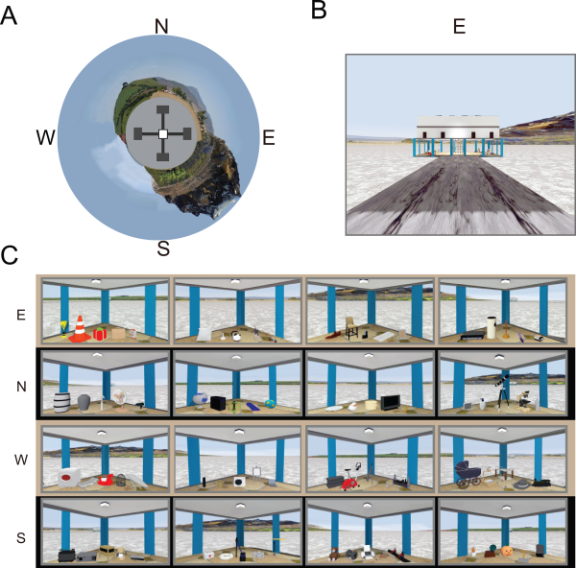
Functional cross‐hemispheric shift between object‐place paired associate memory and spatial memory in the human hippocampus
Hippocampus Volume 26, Issue 8, pages 1061-1077, 9 APR 2016 DOI: 10.1002/hipo.22587 http://onlinelibrary.wiley.com/doi/10.1002/hipo.22587/full#hipo22587-fig-0001
Notes:
VR Environment. (A) Bird's eye view of the VR environment. N: North, E: East, S: South, W: West. (B) Front view of the east building. (C) Objects in the four corners inside each building. [Color figure can be viewed in the online issue, which is available at wileyonlinelibrary.com.]
IF THIS IMAGE HAS BEEN PROVIDED BY OR IS OWNED BY A THIRD PARTY, AS INDICATED IN THE CAPTION LINE, THEN FURTHER PERMISSION MAY BE NEEDED BEFORE ANY FURTHER USE. PLEASE CONTACT WILEY'S PERMISSIONS DEPARTMENT ON PERMISSIONS@WILEY.COM OR USE THE RIGHTSLINK SERVICE BY CLICKING ON THE 'REQUEST PERMISSIONS' LINK ACCOMPANYING THIS ARTICLE. WILEY OR AUTHOR OWNED IMAGES MAY BE USED FOR NON-COMMERCIAL PURPOSES, SUBJECT TO PROPER CITATION OF THE ARTICLE, AUTHOR, AND PUBLISHER.

