Slide 1
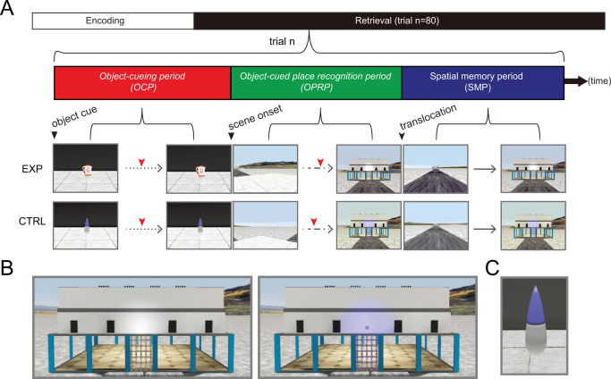
Functional cross‐hemispheric shift between object‐place paired associate memory and spatial memory in the human hippocampus
Hippocampus Volume 26, Issue 8, pages 1061-1077, 9 APR 2016 DOI: 10.1002/hipo.22587 http://onlinelibrary.wiley.com/doi/10.1002/hipo.22587/full#hipo22587-fig-0002
Notes:
Experimental design. (A) After the encoding period, fMRI scanning was conducted for testing memory retrieval. The structure of a single trial is shown (trial n). Red tick marks denote button responses for recognition. EXP and CTRL denote experimental and control conditions, respectively. Dotted, dashed, and continuous lines denote three types of movement allowed for each period: passive viewing, rotation at a fixed position, and free navigation, respectively. (B) Close‐up views of the building in experimental (left) and control (right) conditions. Note that the light above the entrance door was lit only in the control condition. (C) The control object used throughout all control trials. [Color figure can be viewed in the online issue, which is available at wileyonlinelibrary.com.]
IF THIS IMAGE HAS BEEN PROVIDED BY OR IS OWNED BY A THIRD PARTY, AS INDICATED IN THE CAPTION LINE, THEN FURTHER PERMISSION MAY BE NEEDED BEFORE ANY FURTHER USE. PLEASE CONTACT WILEY'S PERMISSIONS DEPARTMENT ON PERMISSIONS@WILEY.COM OR USE THE RIGHTSLINK SERVICE BY CLICKING ON THE 'REQUEST PERMISSIONS' LINK ACCOMPANYING THIS ARTICLE. WILEY OR AUTHOR OWNED IMAGES MAY BE USED FOR NON-COMMERCIAL PURPOSES, SUBJECT TO PROPER CITATION OF THE ARTICLE, AUTHOR, AND PUBLISHER.

