Slide 1
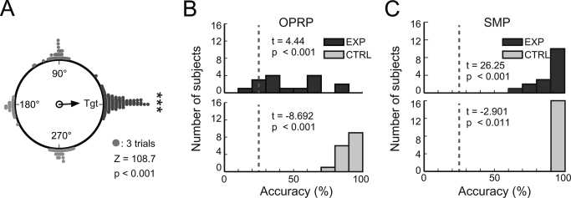
Functional cross‐hemispheric shift between object‐place paired associate memory and spatial memory in the human hippocampus
Hippocampus Volume 26, Issue 8, pages 1061-1077, 9 APR 2016 DOI: 10.1002/hipo.22587 http://onlinelibrary.wiley.com/doi/10.1002/hipo.22587/full#hipo22587-fig-0003
Notes:
Task performance. (A) Cumulative choices for target buildings (Tgt) in the object‐cued place recognition period (all targets aligned to 0°). The vector arrow indicates the strength of the target response. (B–C) Distributions of response accuracies in the object‐cued place recognition period (OPRP) (B) and the spatial memory period (SMP) (C) for individual subjects. Dashed lines denote chance level (25%). For each period, results of one‐sample t tests for comparing average retrieval accuracy during the experimental condition (top) and paired t test for comparing average retrieval accuracies between experimental and control conditions (bottom) are shown.
IF THIS IMAGE HAS BEEN PROVIDED BY OR IS OWNED BY A THIRD PARTY, AS INDICATED IN THE CAPTION LINE, THEN FURTHER PERMISSION MAY BE NEEDED BEFORE ANY FURTHER USE. PLEASE CONTACT WILEY'S PERMISSIONS DEPARTMENT ON PERMISSIONS@WILEY.COM OR USE THE RIGHTSLINK SERVICE BY CLICKING ON THE 'REQUEST PERMISSIONS' LINK ACCOMPANYING THIS ARTICLE. WILEY OR AUTHOR OWNED IMAGES MAY BE USED FOR NON-COMMERCIAL PURPOSES, SUBJECT TO PROPER CITATION OF THE ARTICLE, AUTHOR, AND PUBLISHER.

