Slide 1
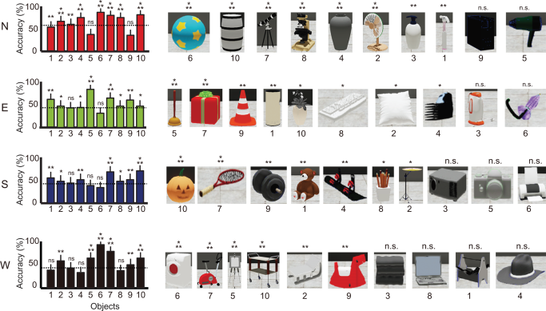
Functional cross‐hemispheric shift between object‐place paired associate memory and spatial memory in the human hippocampus
Hippocampus Volume 26, Issue 8, pages 1061-1077, 9 APR 2016 DOI: 10.1002/hipo.22587 http://onlinelibrary.wiley.com/doi/10.1002/hipo.22587/full#hipo22587-fig-0004
Notes:
Choice accuracy for individual buildings and objects. Average choice accuracy for all objects associated with the four buildings in the experimental condition in the object‐cued place recognition period. Dotted lines indicate the mean accuracy for the corresponding building. Objects are shown in a descending order based on choice accuracy. Mean ± S.E.M. *P < 0.05, **P < 0.01, ***P < 0.001, n.s. P > 0.05. [Color figure can be viewed in the online issue, which is available at wileyonlinelibrary.com.]
IF THIS IMAGE HAS BEEN PROVIDED BY OR IS OWNED BY A THIRD PARTY, AS INDICATED IN THE CAPTION LINE, THEN FURTHER PERMISSION MAY BE NEEDED BEFORE ANY FURTHER USE. PLEASE CONTACT WILEY'S PERMISSIONS DEPARTMENT ON PERMISSIONS@WILEY.COM OR USE THE RIGHTSLINK SERVICE BY CLICKING ON THE 'REQUEST PERMISSIONS' LINK ACCOMPANYING THIS ARTICLE. WILEY OR AUTHOR OWNED IMAGES MAY BE USED FOR NON-COMMERCIAL PURPOSES, SUBJECT TO PROPER CITATION OF THE ARTICLE, AUTHOR, AND PUBLISHER.

