Slide 1
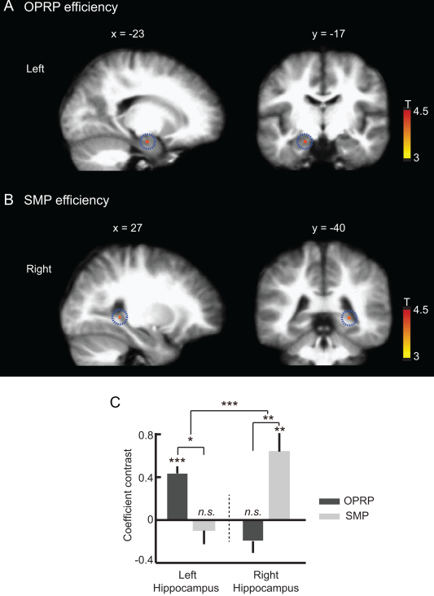
Functional cross‐hemispheric shift between object‐place paired associate memory and spatial memory in the human hippocampus
Hippocampus Volume 26, Issue 8, pages 1061-1077, 9 APR 2016 DOI: 10.1002/hipo.22587 http://onlinelibrary.wiley.com/doi/10.1002/hipo.22587/full#hipo22587-fig-0008
Notes:
Left and right hippocampal BOLD activity correlated with efficient search for target place during the object‐cued place recognition period (OPRP) and spatial memory period (SMP), respectively. (A,B) Sagittal (left) and coronal (right) hippocampal sections showing the regions significantly modulated by search efficiency during the OPRP and the SMP, two event periods in which spatial memory components were important. Scale bars show the range of the t‐statistics from t test. (A) The BOLD signal in the left hippocampus (highlighted with dotted circles) was significantly modulated by search efficiency during the OPRP, compared to the control baseline (P < 0.001, uncorrected, one‐sample t test). (B) The BOLD response of the right hippocampus (highlighted with dotted circles) was significantly modulated by search efficiency during the SMP, compared to the control baseline (P < 0.001, uncorrected, one‐sample t test). (C) Comparison of the modulatory coefficient contrasts for the left and right hippocampal voxels showed a significant interaction between hemisphere and event period. Mean ± S.E.M. *P < 0.05, **P < 0.01, ***P < 0.001 (Bonferroni corrected, paired t test). [Color figure can be viewed in the online issue, which is available at wileyonlinelibrary.com.]
IF THIS IMAGE HAS BEEN PROVIDED BY OR IS OWNED BY A THIRD PARTY, AS INDICATED IN THE CAPTION LINE, THEN FURTHER PERMISSION MAY BE NEEDED BEFORE ANY FURTHER USE. PLEASE CONTACT WILEY'S PERMISSIONS DEPARTMENT ON PERMISSIONS@WILEY.COM OR USE THE RIGHTSLINK SERVICE BY CLICKING ON THE 'REQUEST PERMISSIONS' LINK ACCOMPANYING THIS ARTICLE. WILEY OR AUTHOR OWNED IMAGES MAY BE USED FOR NON-COMMERCIAL PURPOSES, SUBJECT TO PROPER CITATION OF THE ARTICLE, AUTHOR, AND PUBLISHER.

