Slide 1
Dynamic
Time courses
Modularity

Slide 2
01
Part ONE
Medaglia, 2017
Identify brain regions scopolamine induce intensity changes
Evaluate the effects of scopolamine on FC
Whether scopolamine-induced memory effect could be
reversed with milameline

Slide 3
Brain state expression and transitions are related to complex executive cognition in normative neurodevelopment

Slide 4

NeuroImage
Medaglia , 2017
780(10 bins)
120TRs
264 rois
Time spent in two primary states
Flexibility
Rs & task evoled
Dynamic graph

Slide 5
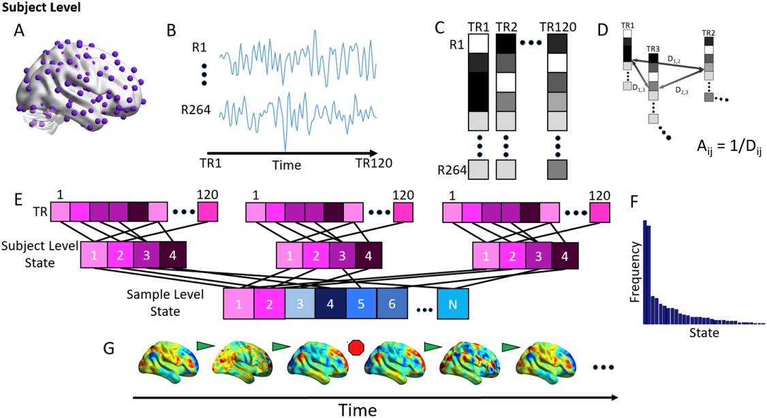
Notes:
A 264 roi → 264 node
B time courses (/TR)
C vector(each vector element:mean z for each roi)
D distance
person-level:
matrix/person,120*120
temporal adjancy matrix
modularity result:3~6or4average states per sub
group-level:
matrix/bin,N*N(N:number of mean state vector,all mean state vectors from all sub in respective bin)
state adjancency matrix
modularity 2 primary states
E clustering( louvain-like locally greedy algorithm, person-level, group-level)
F frequency
G state shift ?

Slide 6
Assessing
the significance of states
2 permutation tests:
Examine the significance of state organization
Examine the significance of activity in primary states

Slide 7
Assessing
the significance of states
Permutation 1(The significance of state):
Group-level
Person-level

Slide 8
Assessing
the significance of states
Permutation 1(The significance of state ):
Group-level:
State adjancency matrix(for each bin)
1000 times, Q ,95%(greater)
Notes:
100% primary states 92% remain states : P<0.05

Slide 9
Assessing
the significance of states
Permutation 1(The significance of state ):
Person-level:
Temporal adjancency matrix for each sub
Notes:
100% primary states 96.8% remain states : P<0.05

Slide 10
Assessing
the significance of states
Permutation 2(The significance of activity):
Person-level:
Z-scored BOLD signal intensities
In all TRs contributing to the two primary state vectors
1000, BOLD,97.5%(greater or less)

Slide 11
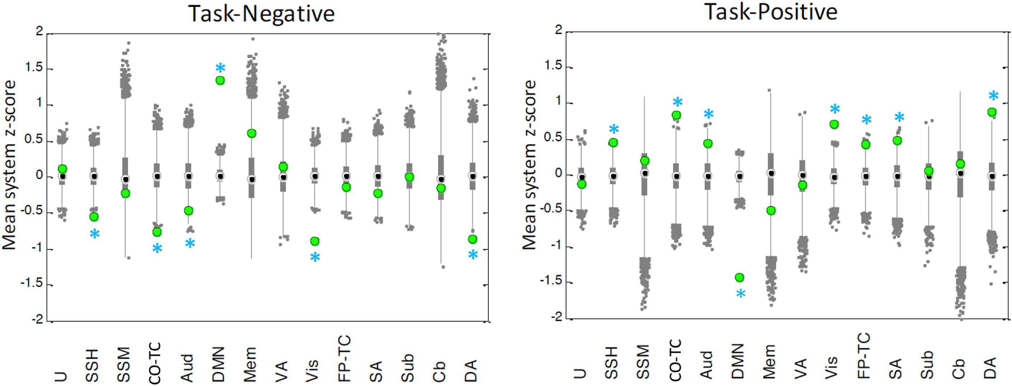
Notes:
The results from this analysis demonstrate that (both relative to the null distribution):
(1)the state activity in the task-negative systems is significantly increased
in the task-negative state relative to the null;
(2)the state activity in the task-positive systems is significantly increased
in the task-positive state relative to the null

Slide 12
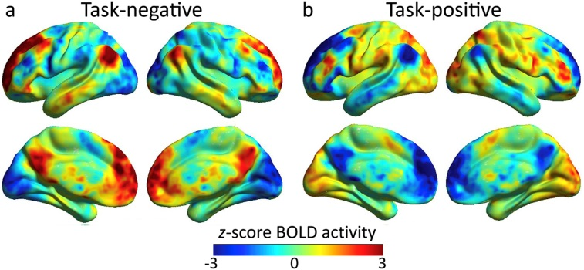
Notes:
Youngest bin :
1st primary state :
displays high activity in brain regions traditionally observed to be active at rest (“task-negative”)
2nd primary state :
displays high activity in regions traditionally observed to be active during cognitive tasks (“task-positive”)
All bins :
Compute the Pearson's correlation coefficient between the mean BOLD values for each system for each state pair.
We found that the correlation in BOLD among average task-negative states extracted from each age group was r = 0.90 among task-positive states was r = 0.92

Slide 13
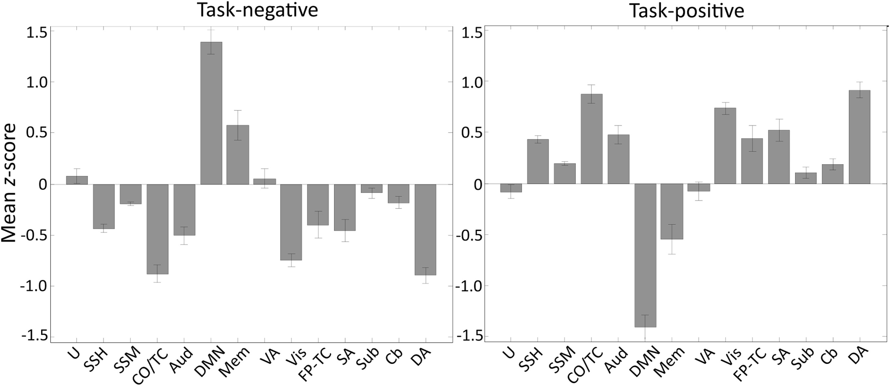
Notes:
means over age bin and its std

Slide 14
Define the Flexibility
F =T/S (for each sub):
F: the state flexibility
T: the number of state transitions
S: relative to the number of states
Inclusive of all primary and secondary states

Slide 15
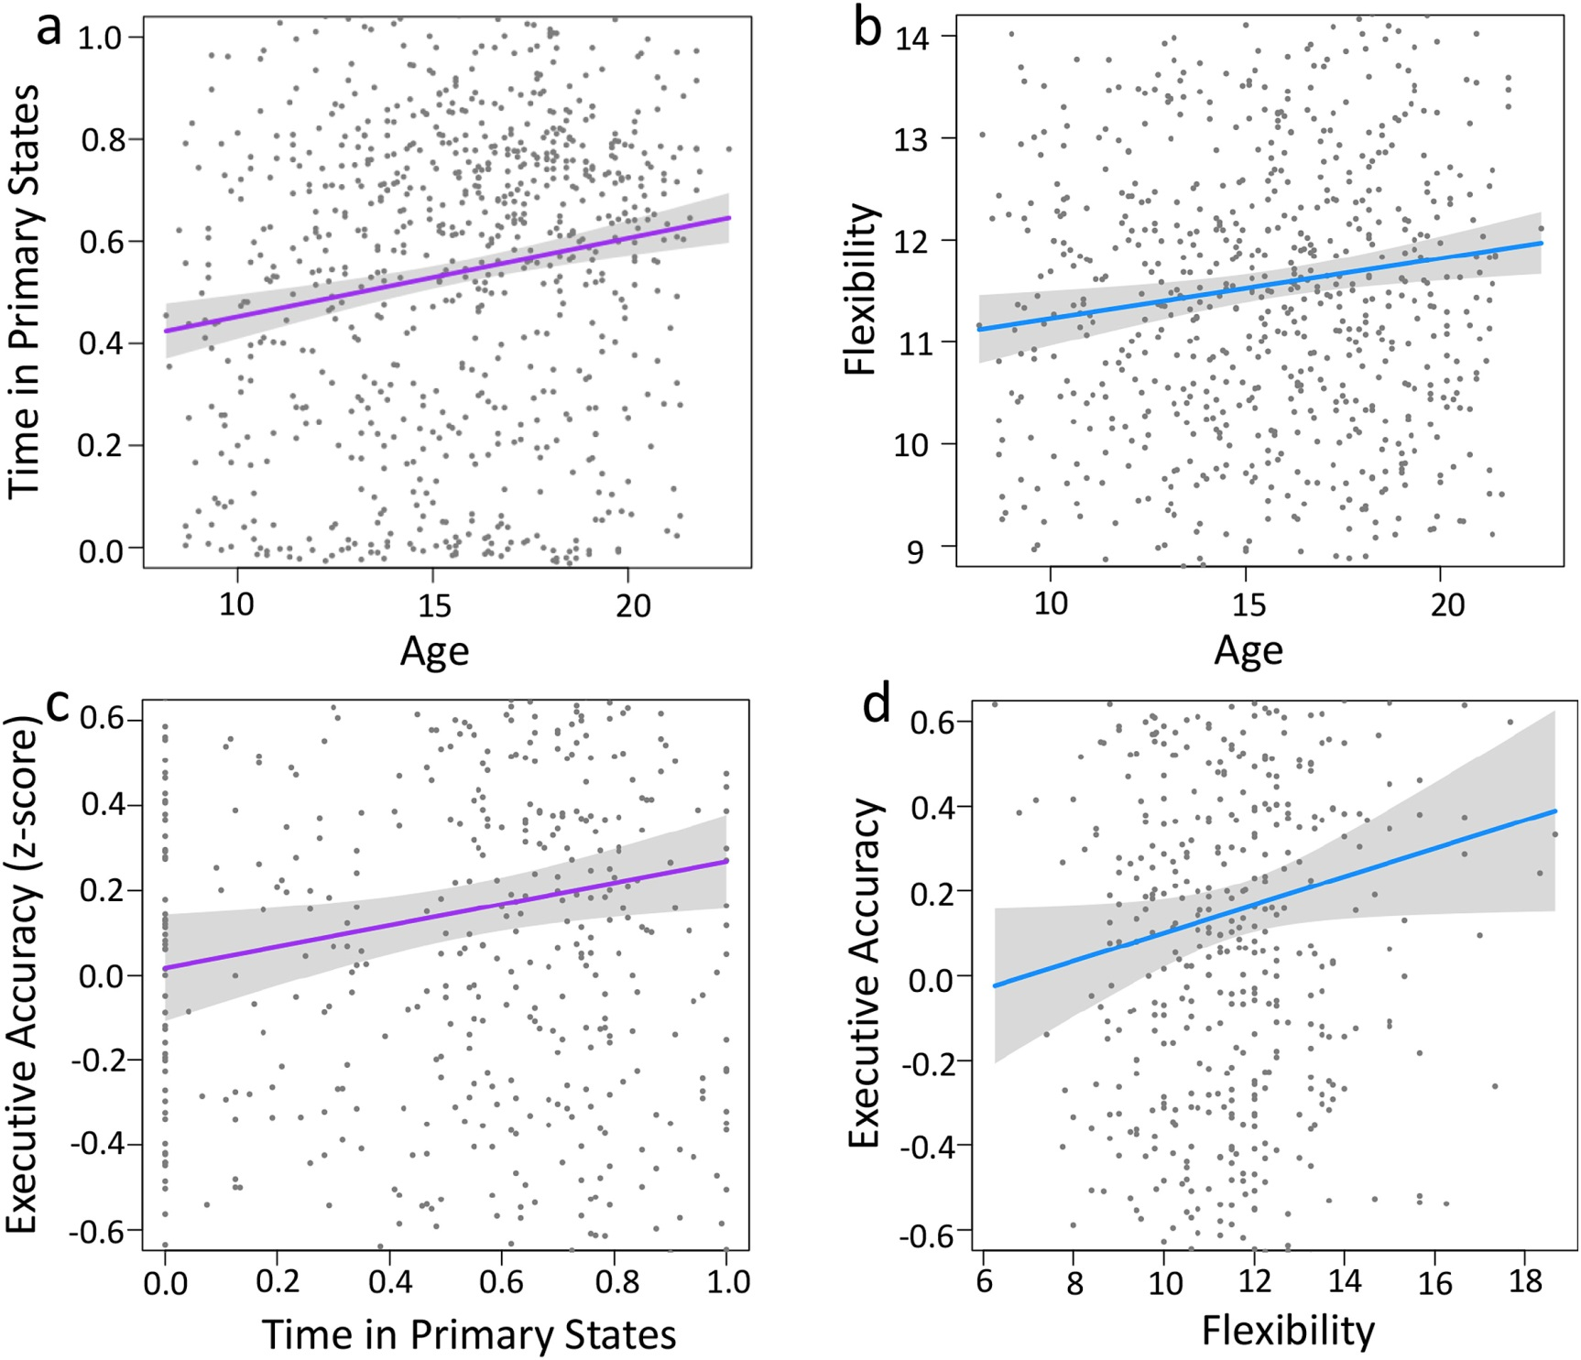
Notes:
Linear regression models
greater complex executive accuracy in adulthood is supported by :
increasing refinement of brain state dynamics, which in turn is characterized by greater time spent in primary states ,as well as greater flexibility of state transitions

Slide 16
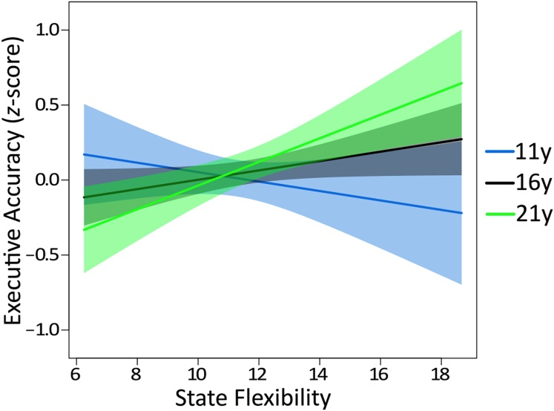
Notes:
No significant interaction with age : complex executive accuracy & time spent in primary states Significant interaction with age : executive accuracy & state flexibility :
Greater state flexibility was related to :
poorer complex executive accuracy in children
better complex executive accuracy in young adults
Cognitive states in childhood is disadvantageous for cognitive control, but advantageous for learning specifically and behavioral adaptation more generally

Slide 17
02
Part TWO
Gerraty, 2018
Identify brain regions scopolamine induce intensity changes
Evaluate the effects of scopolamine on FC
Whether scopolamine-induced memory effect could be
reversed with milameline

Slide 18
Dynamic flexibility in striatal-cortical circuits supports reinforcement 2 learning

Slide 19
BioRxiv
Gerraty , 2018
22subs
110 rois
4 blocks
Probabilistic learning task
Many models
Sub-blocks
Density
Multi-slice modularity
Flexibility

Slide 20
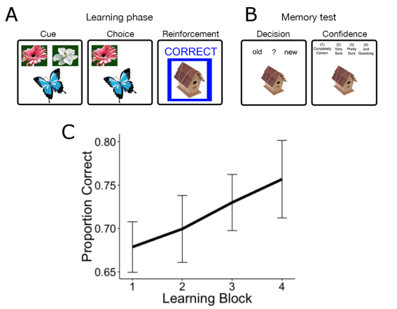
Probabilistic learning task

Slide 21
Network Construction
& Modularity
Multilayer temporal network
Identity link : a new type of edge that links one node in one time slice to itself in the next time slice
Muti-slice Community Detection:
Louvain-like locally greedy algorithm
500 times
Notes:
In this framework, each network node (or ROI) in the multi-layer network is connected to itself in the preceding and following time windows in order to link networks in time.

Slide 22

Dynamic Connectivity Analysis
Time courses totally : 200TRs
Sub-timecourse/Time window: 25TRs (8 windows)
Connectivity: roi by roi
cross-spectral density between regions x and y,
Subject-specific connectivity matrix : (110*110*8 )*4

Slide 23
Flexibility
F=T/P :
per time/block/sub/roi,500*4*22*110
T:the number of times a node displays a change
P:the number of possible changes (time points minus 1)

Slide 24
Flexibility
Measures the extent to which a region changed its community over time
Flexibility : average over 500 times(4*22*110)
Spatial flexibility : average over blocks & subs(110)
Temporal flexibilty:average over rois(4*22)

Slide 25
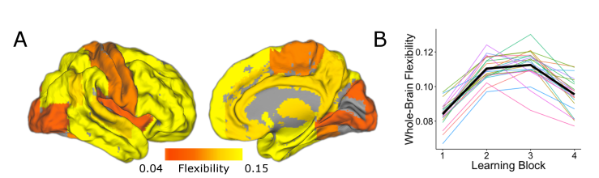
Flexibility
Notes:
Spatial and temporal characteristics of network flexibility

Slide 26
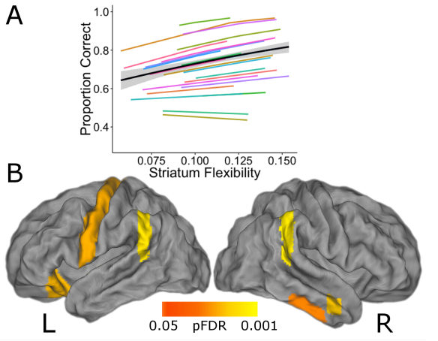
Notes:
Flexibility in the striatum relates to reinforcement learning P<0.001
Colorred P<0.0005

Slide 27
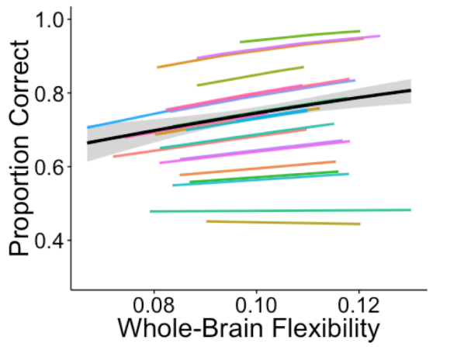
Notes:
Flexibility in the whole brain relates to reinforcement learning P<0.005

Slide 28
Notes:
Flexibility in other rois relates to reinforcement learning after FDR

Slide 29
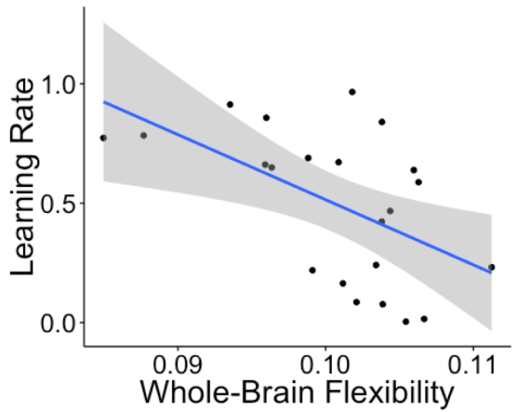
Notes:
Whole-brain flexibility is negatively correlated with single-trial learning rate P<0.005 These results indicate that whole-brain flexibility is greater when individuals are integrating information across many trials. PS : a lower learning rate → more integration of information across multiple trials
We did not detect a relationship between flexibility in the striatal ROI and learning rate

Slide 30
Thank you all for listening~

