Slide 1
Multiple Anesthesias

Slide 2
α-chloralose:
Minimal impact on neuro-metabolic coupling
Potentiate GABAergic transmission
Allows measurement of FC with strong strength and good localization
Caudate putamen
Dosage-dependent effects
Evoked activation
Interhemispheric coherence
Attenuated at high dose

Slide 3
Isoflurane :
Quick, easy ,safe and
good recovery
Multiple systems
Gutamatergic system
GABAergic systems
Strong vasodilatory effect
Neurovascular coupling
Dosage-dependent
High dose :
reduced or complete loss of bilateral FC
Mid-to-high dose :
burst-suppression activity
Low dose :
strong focal connectivity
thalamocortical connectivity

Slide 4
Medetomidine/dexmedetomidine :
Agonizes the α2- adrenergic receptor
Cause bradycardia and act as vasoconstrictors
Less impact on neural activity and neurovascular coupling
Easily reversible by an antagonist
Low dose: strong and focal RSNs
High α2 receptor density:
Connectivity reduces dosage- and duration-dependently
Low receptor density: unaffected
Unlike : α-chloralose &isoflurane
Increasing the dosage :
no neurovascularcoupling
No evoked activation
No fluctuation amplitude
Reduces the synchrony
Notes:
Dexmedetomidine is the active enantiomer of medetomidine and has twice the potency; consequently, the dosage is typically half that of medetomidine. HIGH:thalamus LOW:caudate putamen

Slide 5
Medetomidine + isoflurane :
Medetomidine : epileptic activity after long periods of sedation
Combining medetomidine with a very low dose of isoflurane
Detecting strong bilateral FC, the DMN and even anti-correlation
Suppressing the potential epileptic effects without altering the evoked potential

Slide 6

Front. Neural Circuits
Bukhari , 2017
Isoflurane
Medetomidine
Combined
ICA analysis
Dual Regression
Network modeling
C57bl/6 mice
RsfMRI
FSL

Slide 7
ICA Analysis
Concat-ICA :Multisession temporal ICA concatenated approach
IC maps :for each analysis group (70 independent components)
Threshold : based on fitting a Gaussian/gamma mixture model ,

Slide 8
ICA Analysis
Exclude :
overlapped with vascular structures and ventricles
regressors of no interest in the DR analysis
prone to be affected by motion-related artifacts
17 independent components remained at last

Slide 9
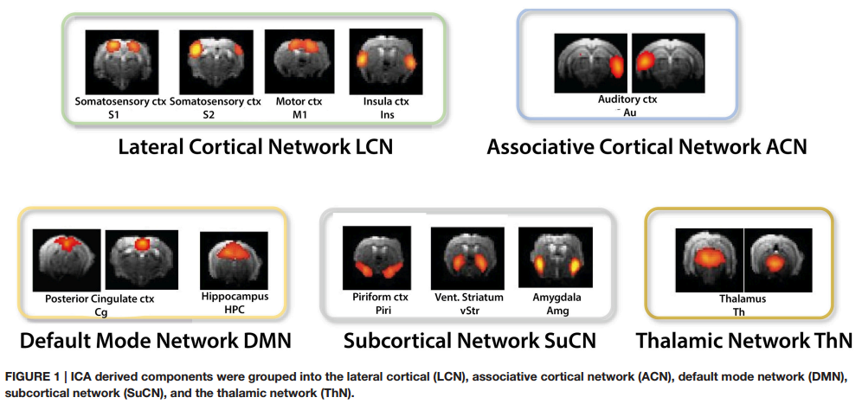

Slide 10
Dual Regression(DR)
Between-subject analysis
Unpaired t-tests among different groups
Matrix : subject to [1 -1] contrasts
Notes:
To identify brain regions and networks displaying greater FC in one anesthetic condition relative to another.

Slide 11
Dual Regression(DR)
Non-parametric permutation based inference analysis
performed with subject-specific component spatial maps concatenated across subjects
5000 randomized permutations :for each analysis
Notes:
Then submitted to voxel-wise between-subject analysis testing for effects of anesthetics on FC using FSL-randomize

Slide 12
Dual Regression(DR)
TFCE: threshold-free cluster enhancement
Correction for multiple comparisons
Bonferroni correction
Notes:
These clusters were then used as input in to the GLM analysis and run through FSLrandomize (Winkler et al., 2014) to perform 5000 permutations to test for statistical significance.

Slide 13
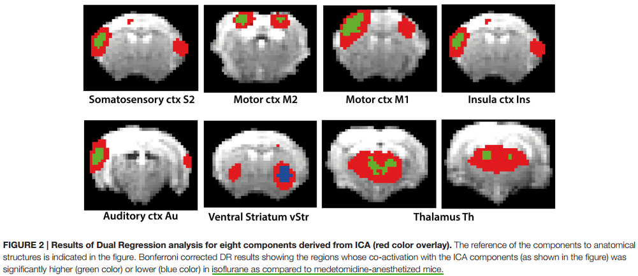

Slide 14
Network Modeling
Different network matrix calculation methods:
FC: Full correlation (direct and indirect connections )
PC : Partial Correlation (direct connections,this one )
FDR(multiple comparisons with false discovery rate) using the same unpaired t-test design matrix
Notes:
BOLD time courses
Hence, seed-based analysis is limited to the analysis of “withinnetwork” connectivity, while DR-based FSLNets allows modeling of connectivity between network components in addition.

Slide 15
Propofol :
A GABA receptor agonist
Not attenuating BOLD activation even at high dose
well-preserved neurovascular coupling
minimal vascular effects
Dosage-dependent changes in RSNs
Be used to induce hypnotic sedation through to deep anesthesia for surgery as the dosage increases
For studying the loss of consciousness

Slide 16
PNAS
Barttfeld , 2015
Propofol
Spontaneous activity
Signature of consciousness
Stationary Connectivity Analysis
Dynamical Connectivity Analysis
Unsupervised clustering
Monkeys
RsfMRI
CoCoMac database

Slide 17
Stationary Connectivity Analysis
Time-averaged stationary pattern of functional correlations
Zc,s :
Fisher-transformed covariance matrix for each vigilance condition c and session s
Zc,s(i,j): temporal covariance of the average fMRI signal of ROIs i and j throughout an entire fMRI session (20 min)

Slide 18
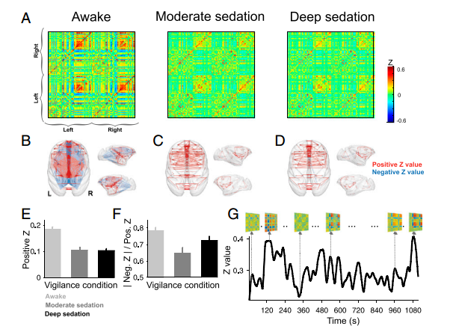

Slide 19
Dynamics Connectivity Analysis
Zc,s ,w:
Sliding window Fisher-transformed covariance matrices for each fMRI vigilance condition c, session s, and time window w
The covariance between specific ROI pairs, as well as the whole-brain average of the covariance, constantly varied over time

Slide 20
Unsupervised clustering
& brain States
k-means clustering algorithm
L1 distance function
500 times
Zexamplesc,s (Subsampled Zc,s ,w) → BSn (n=1,2,...,7) →
initialize a clustering of all data (obtaining a matrix of brain states Bc,s,w )
Notes:
500:escaping local minima
Subsampling was performed to reduce redundancy between windows.
The sampled connectivity matrices (Zexamplesc,s) were chosen as those windows with local maxima in functional connectivity variance.
probability distributions (column D) do not significantly change with k.

Slide 21
Similarity score &
probability of each state
Similarity score :
similarity between anatomical connectivity and functional connectivity, to rank all brain states along this dimension
computed by measuring the correlation coefficient between the vectorized structural matrix and each vectorized brain from the clustering analysis
Notes:
Euclidean distance instead of correlation or only positive values of the brain states to calculate the correlation

Slide 22
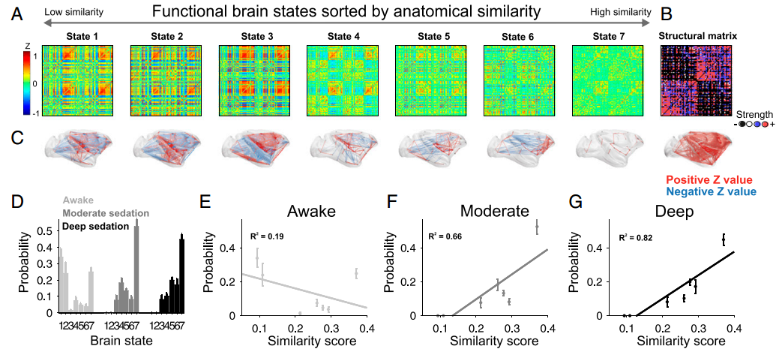

Slide 23
Propofol :
With increased dose:
cortical connectivity in the motor cortex and DMN decreases
thalamic and hypothalamic connectivity remains stable
in some subcortical areas, connectivity is reduced but rebounds at a higher dose
Similar to isoflurane and α-chloralose : ,the thalamic connectivity is weak even at very low doses
Greater anti-correlation
Notes:
some subcortical areas: hippocampus and caudate putamen

Slide 24
Urethane:
Multiple neurotransmitter systems
GABA receptors
N-methyl-D-aspartate (NMDA) receptors
Minimal impact on systemic hemodynamics and the cardiovascular system
Dosage-dependent depression of bilateral connectivity and loss of spatial specificity
Induce sleep-like states
Rapid eye movement (fast wave)
Non-rapid eye movement (slow wave)
Investigate RSN dynamics in sleep
Notes:
vascular effect with broad and slow hemodynamic oscillation

Slide 25
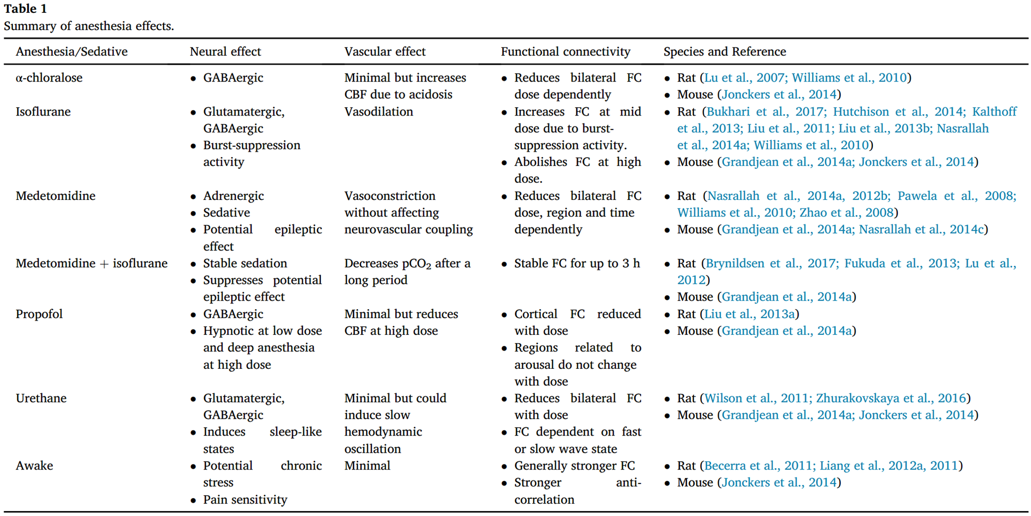

Slide 26
Thank you all for listening~

Slide 27
01
Part ONE
Anesthesias
α-chloralose
Isoflurane & Medetomidine/dexmedetomidine
Propofol
Urethane

Slide 28
02
Part TWO
Neural systems
Identify brain regions scopolamine induce intensity changes
Evaluate the effects of scopolamine on FC
Whether scopolamine-induced memory effect could be
reversed with milameline

