Slide 1
Brain state expression and transitions are related to complex executive cognition in normative neurodevelopment

Slide 2

NeuroImage
Medaglia , 2017
780(10 bins)
120TRs
264 rois
Time spent in two primary states
Flexibility
Rs & task evoled
Dynamic graph

Slide 3
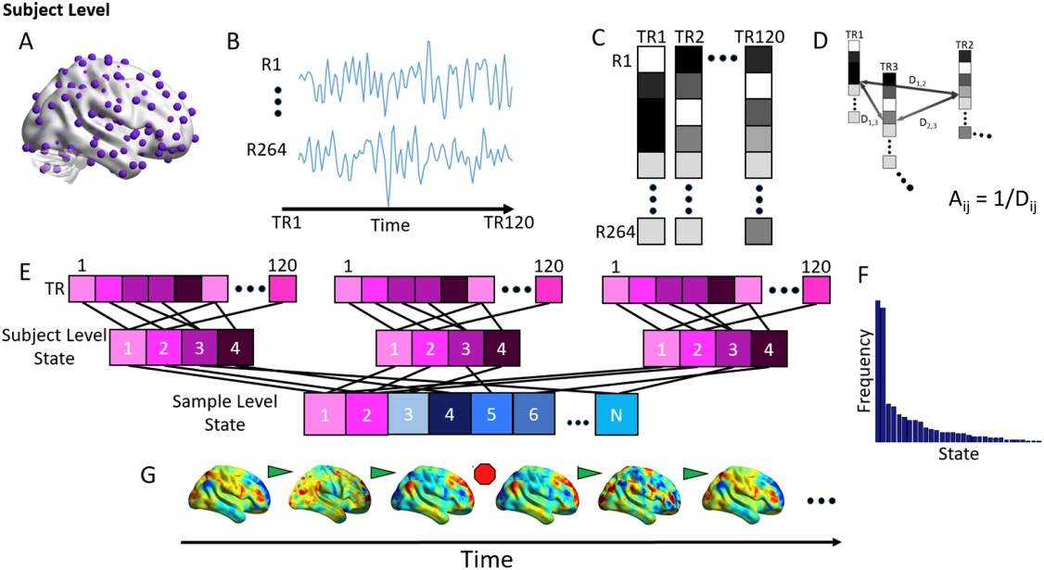
Notes:
A 264 roi → 264 node
B time courses (/TR)
C vector(each vector element:mean z for each roi)
D distance
person-level:
matrix/person,120*120
temporal adjancy matrix
modularity result:3~6or4average states per sub
group-level:
matrix/bin,N*N(N:number of mean state vector,all mean state vectors from all sub in respective bin)
state adjancency matrix
modularity 2 primary states
E clustering( louvain-like locally greedy algorithm, person-level, group-level)
F frequency
G state shift ?

Slide 4
Assessing
the significance of states
2 permutation tests:
Examine the significance of state organization
Examine the significance of activity in primary states

Slide 5
Assessing
the significance of states
Permutation 1(The significance of state):
Group-level
Person-level

Slide 6
Assessing
the significance of states
Permutation 1(The significance of state ):
Group-level:
State adjancency matrix(for each bin)
1000 times, Q ,95%(greater)
Notes:
100% primary states 92% remain states : P<0.05

Slide 7
Assessing
the significance of states
Permutation 1(The significance of state ):
Person-level:
Temporal adjancency matrix for each sub
Notes:
100% primary states 96.8% remain states : P<0.05

Slide 8
Assessing
the significance of states
Permutation 2(The significance of activity):
Person-level:
Z-scored BOLD signal intensities
In all TRs contributing to the two primary state vectors
1000, BOLD,97.5%(greater or less)

Slide 9
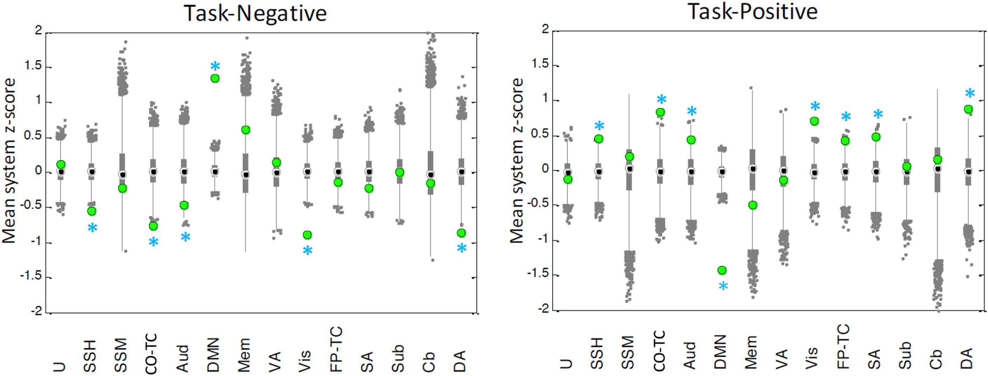
Notes:
The results from this analysis demonstrate that (both relative to the null distribution):
(1)the state activity in the task-negative systems is significantly increased
in the task-negative state relative to the null;
(2)the state activity in the task-positive systems is significantly increased
in the task-positive state relative to the null

Slide 10
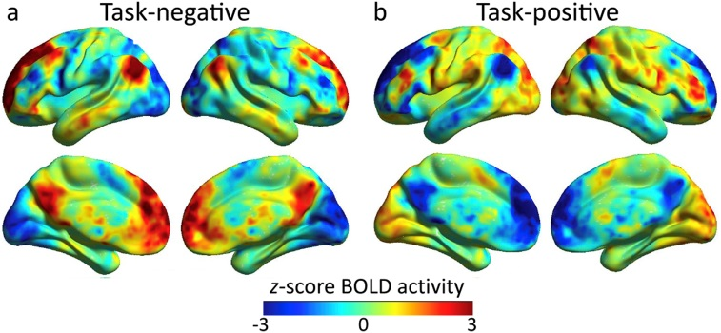
Notes:
Youngest bin :
1st primary state :
displays high activity in brain regions traditionally observed to be active at rest (“task-negative”)
2nd primary state :
displays high activity in regions traditionally observed to be active during cognitive tasks (“task-positive”)
All bins :
Compute the Pearson's correlation coefficient between the mean BOLD values for each system for each state pair.
We found that the correlation in BOLD among average task-negative states extracted from each age group was r = 0.90 among task-positive states was r = 0.92

Slide 11
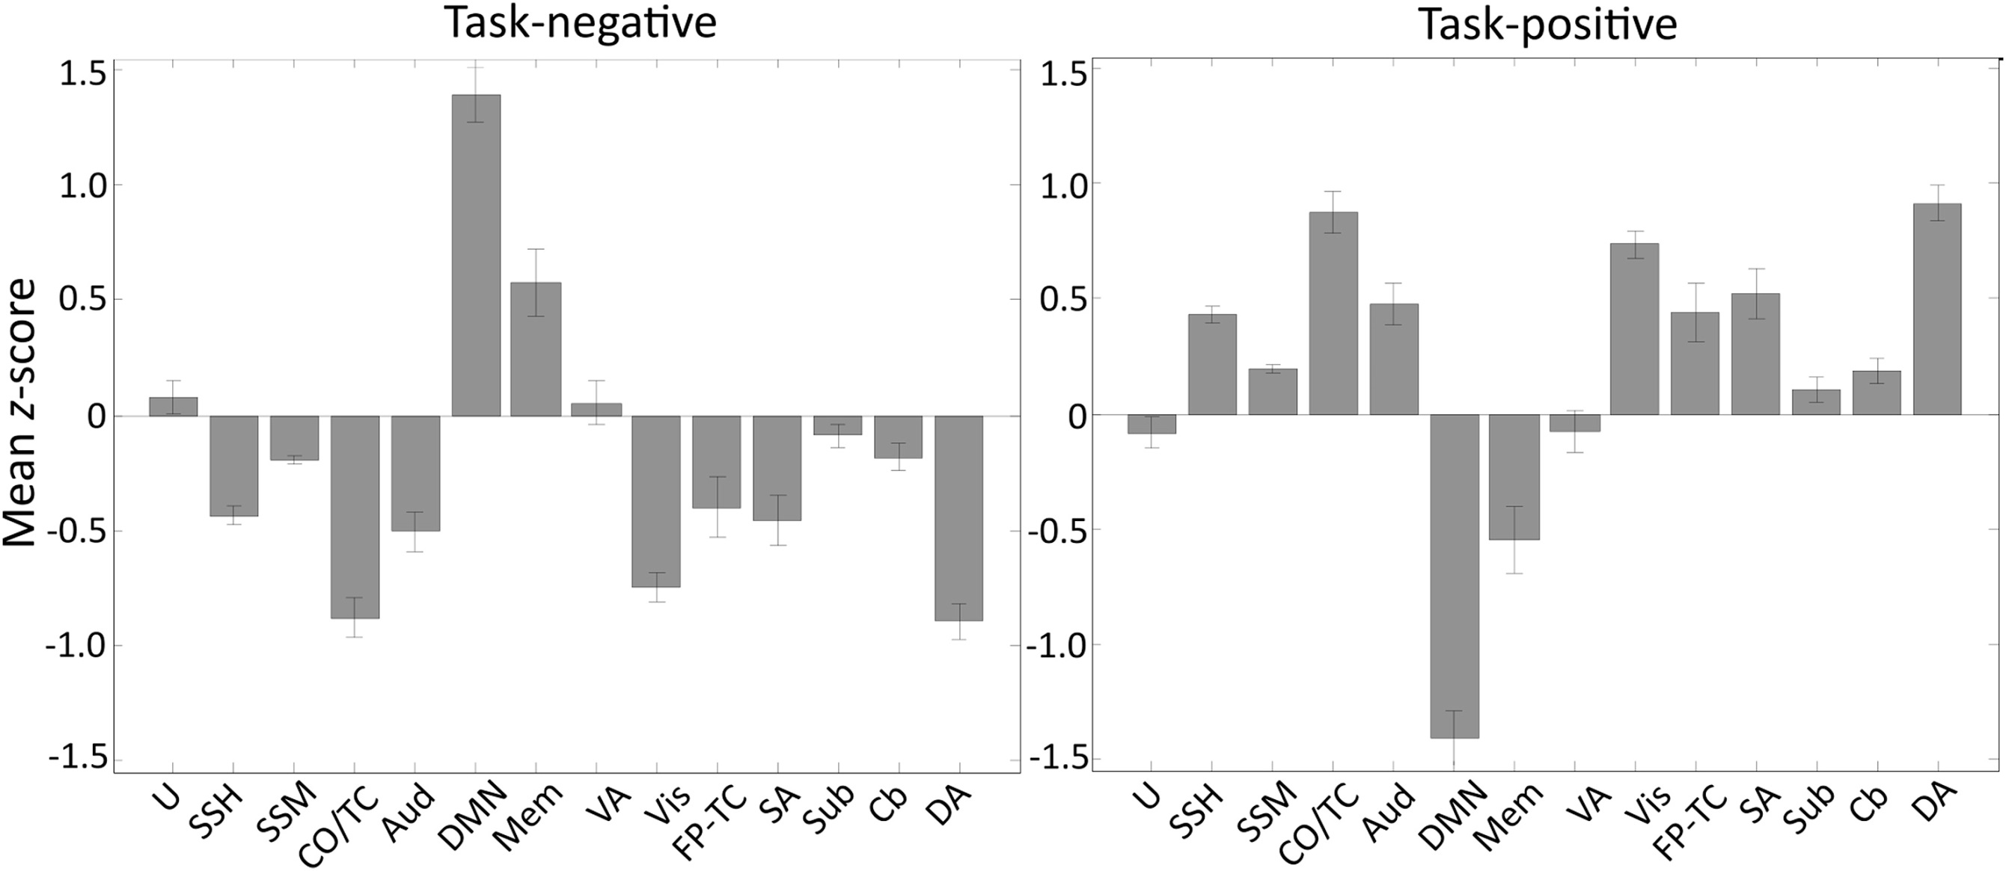
Notes:
means over age bin and its std

Slide 12
Define the Flexibility
F =T/S (for each sub):
F: the state flexibility
T: the number of state transitions
S: relative to the number of states
Inclusive of all primary and secondary states

Slide 13
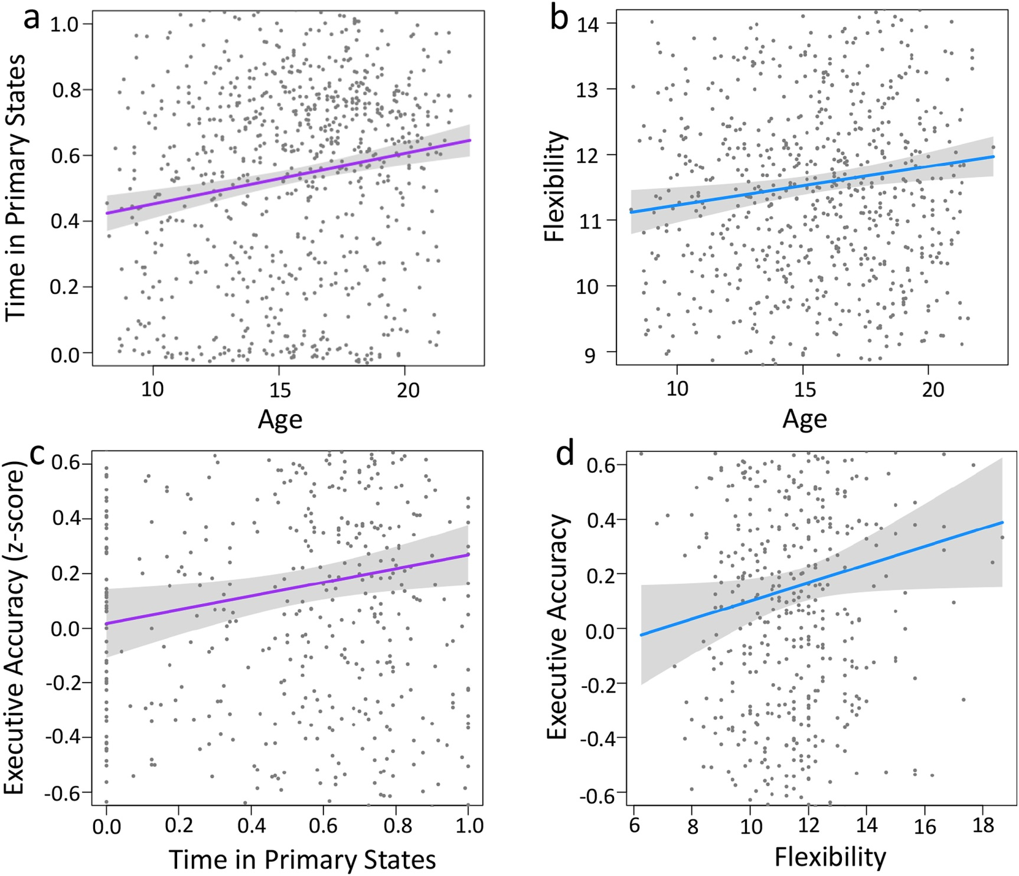
Notes:
Linear regression models
greater complex executive accuracy in adulthood is supported by :
increasing refinement of brain state dynamics, which in turn is characterized by greater time spent in primary states ,as well as greater flexibility of state transitions

Slide 14
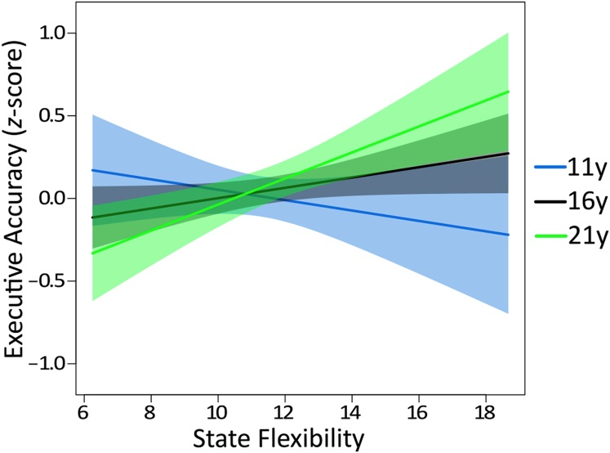
Notes:
No significant interaction with age : complex executive accuracy & time spent in primary states Significant interaction with age : executive accuracy & state flexibility :
Greater state flexibility was related to :
poorer complex executive accuracy in children
better complex executive accuracy in young adults
Cognitive states in childhood is disadvantageous for cognitive control, but advantageous for learning specifically and behavioral adaptation more generally

Slide 15
Thank you all for listening~

