Slide 1

Data Processing of Resting-State fMRI
(Part 2)
YAN Chao-Gan
严超赣
Ph. D.
ycg.yan@gmail.com
State Key Laboratory of Cognitive Neuroscience and Learning,
Beijing Normal University, China

Slide 2
Outline
Statistical Analysis
Results Viewing
Multiple Comparisons
REST Image Calculator
Other Functions

Slide 3
Statistical Analysis
One sample T test
Two Sample T test
Paired T test
ANOVA analysis

Slide 4
One sample T test
Preparation
ALFF: mALFF-1
fALFF: mfALFF-1
ReHo: smReHo-1
FC: zFC

Slide 5
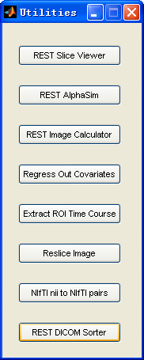
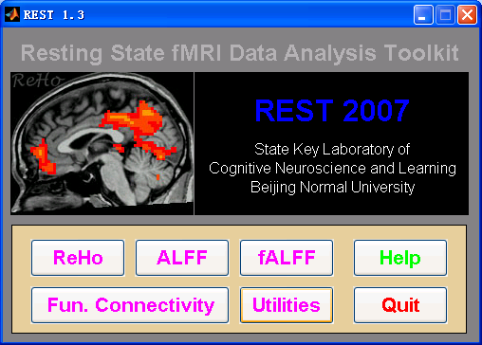
One sample T test

Slide 6
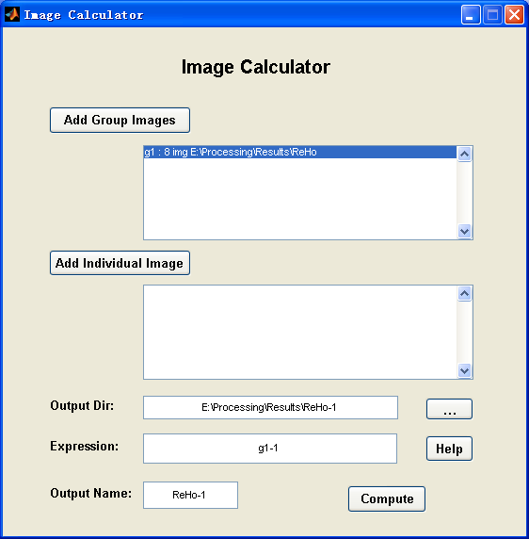
One sample T test
smReHo
mALFF
g1-1

Slide 7
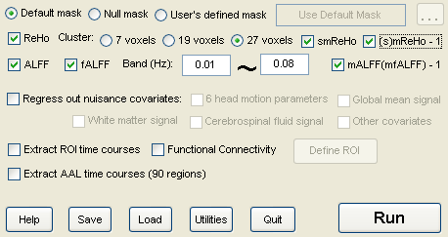
One sample T test

Slide 8
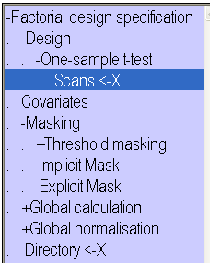
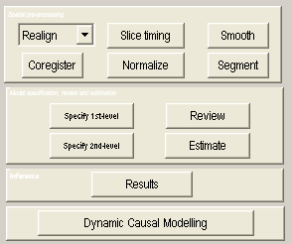
One sample T test
m*-1 images
zFC images
Brain Mask
Directory for
saving SPM.mat

Slide 9
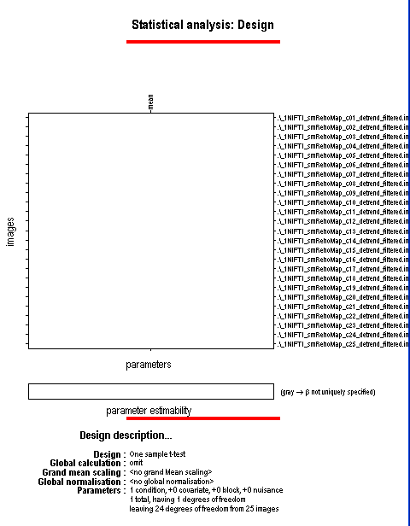
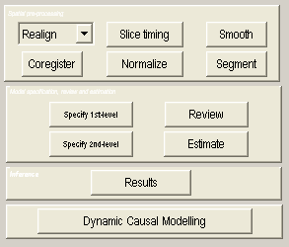

One sample T test
The generated
spm.mat

Slide 10
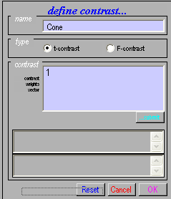
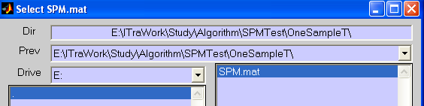
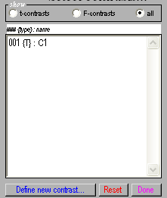
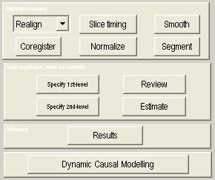
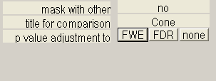

One sample T test
The generated spm.mat
1

Slide 11
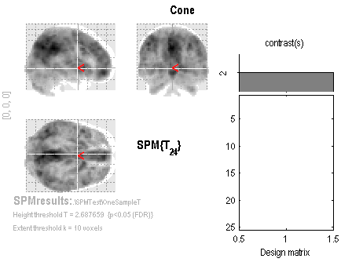
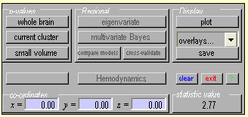
One sample T test
spmT_0001.img
HeightthresholdT = 2.687659 {p<0.05(FDR)}
Extentthresholdk = 10 voxels

Slide 12
Two sample T test
Preparation
ALFF：mALFF
fALFF: mfALFF
ReHo: smReHo
FC: zFC
Mask

Slide 13
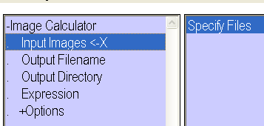
Two sample T test
Mask
Brain Mask
Mask=Patient_1T.img + CON_1T.img>0
Patient_1T.img
CON_1T.img
Mask_2T.img
i1+i2>0

Slide 14
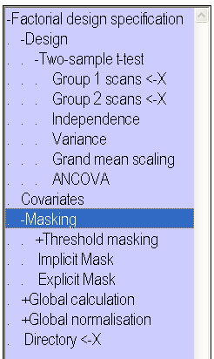
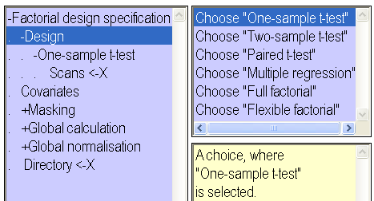
Two sample T test
Brain Mask or
Mask_2T.img
m* or zFC* images
for the two groups
Directory for
saving SPM.mat

Slide 15
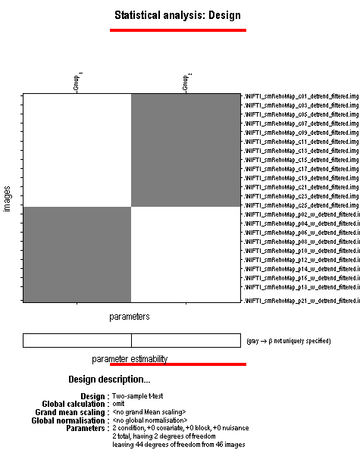
Two sample T test
The generated
spm.mat

Slide 16
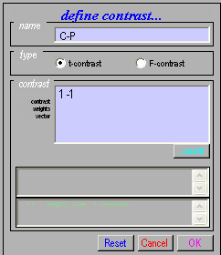


Two sample T test
The generated
spm.mat
1 -1

Slide 17
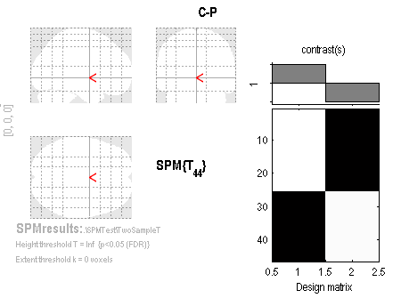
Two sample T test
spmT_0001.img
HeightthresholdT = Inf {p<0.05(FDR)}
Extentthresholdk = 0 voxels

Slide 18
Paired T test

Slide 19
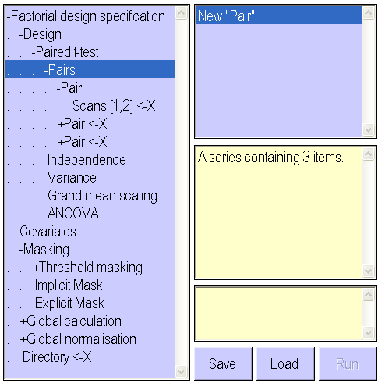
Paired T test
m* or zFC* images
for each pair
Brain Mask

Slide 20
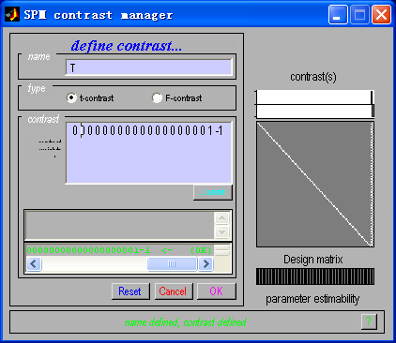
Paired T test

Slide 21
ANOVA Analysis

Slide 22
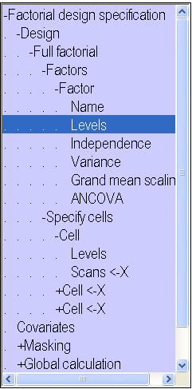
ANOVA Analysis
3
Corresponding level
Images for this group

Slide 23
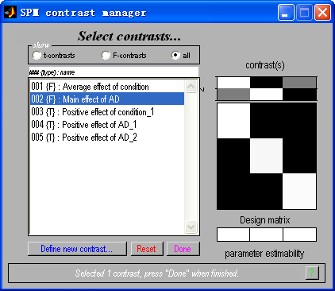
ANOVA Analysis

Slide 24
Outline
Statistical Analysis
Results Viewing
Multiple Comparisons
REST Image Calculator
Other Functions

Slide 25
Results Viewing
SPM5
xjview
MRIcroN
REST Slice Viewer

Slide 26
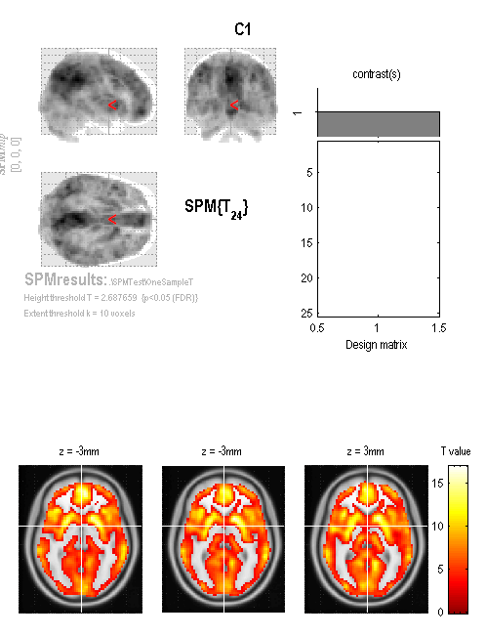
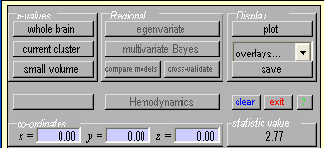

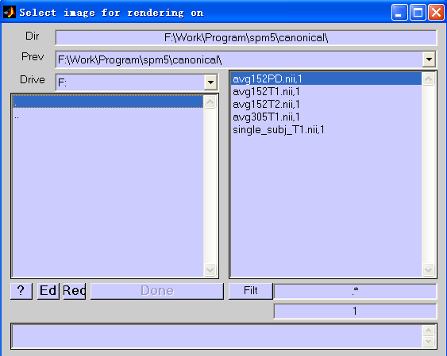
Results Viewing - SPM5

Slide 27
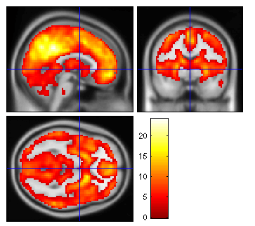
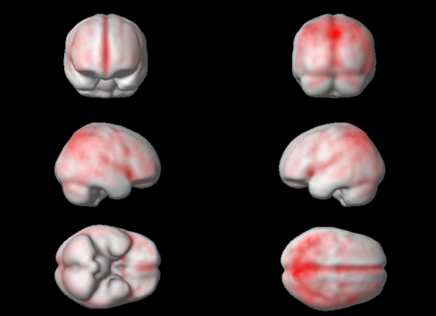
Results Viewing - SPM5

Slide 28
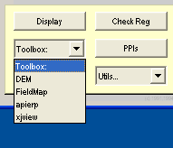
Results Viewing - xjview

Slide 29
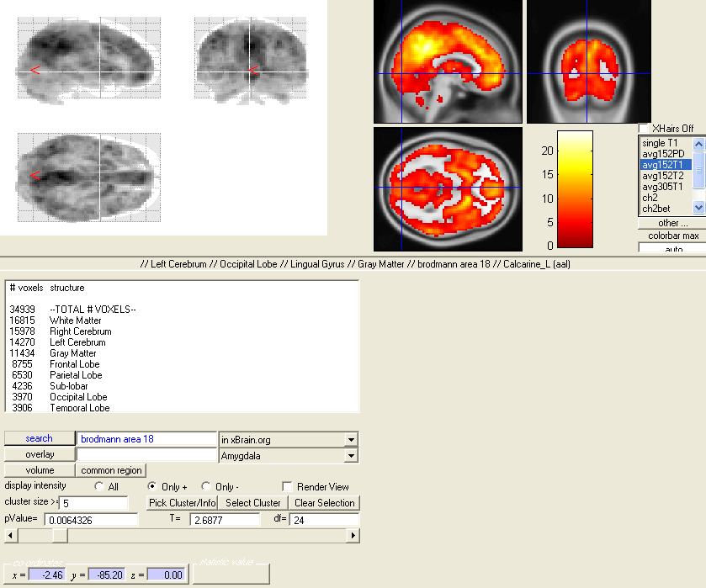
结果呈现—xjview

Slide 30
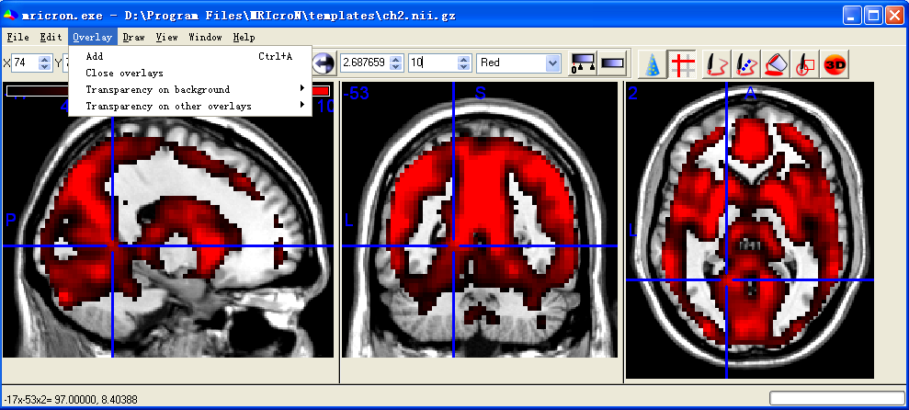
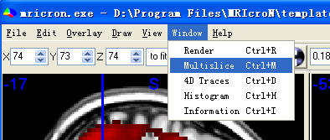
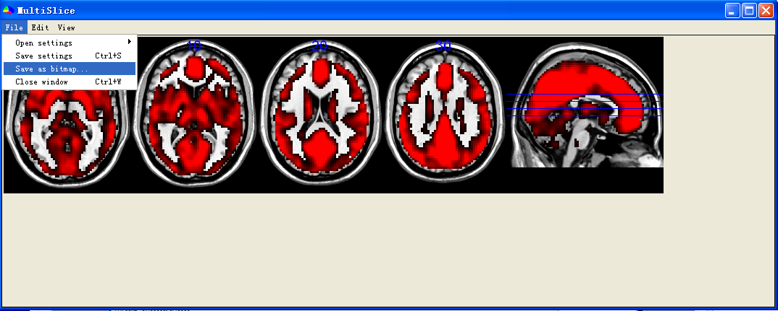
Results Viewing - MRIcroN

Slide 31
REST
Slice
Viewer

Slide 32
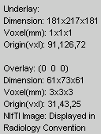
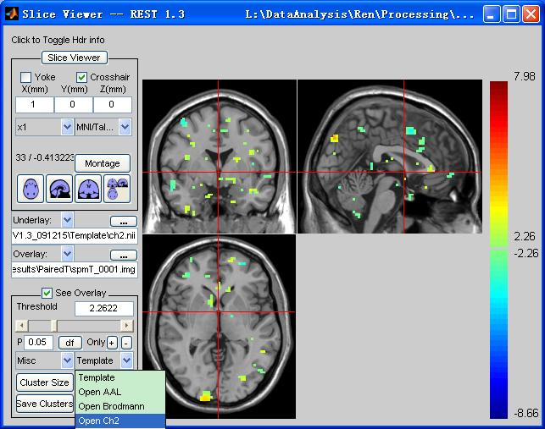
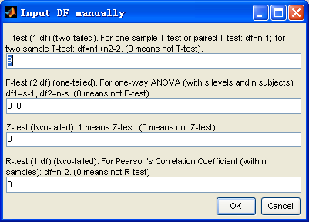

Slide 33
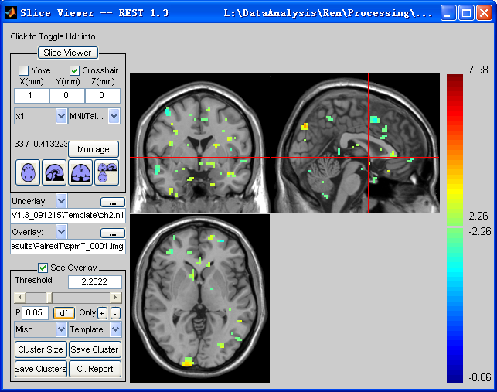
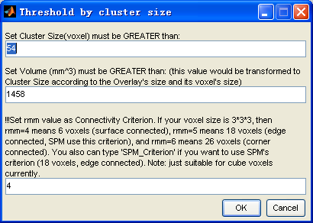

Slide 34
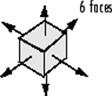
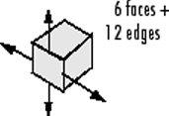
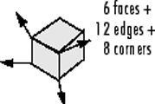
For Voxel size = 3*3*3
Voxels are connected if their faces touch rmm=4
Voxels are connected if their faces or edges touch
rmm=5; SPM_Criterion
Voxels are connected if their faces, edges, or corners touch
rmm=6

Slide 35
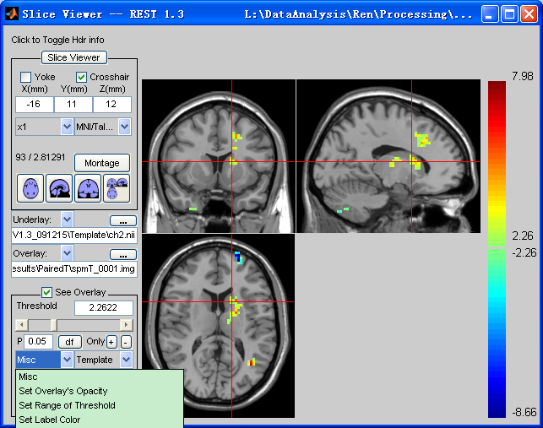
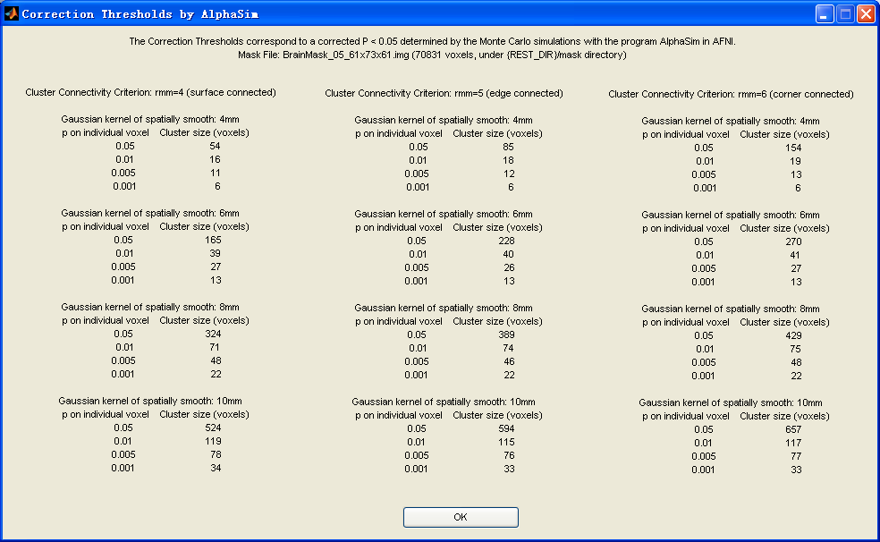
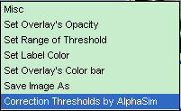

Slide 36
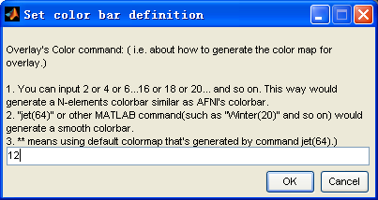

Slide 37
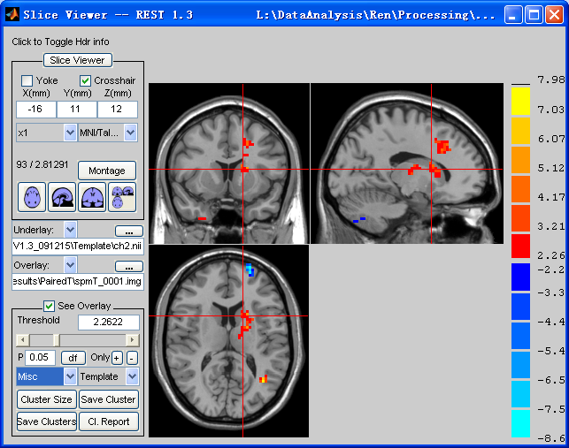


Slide 38
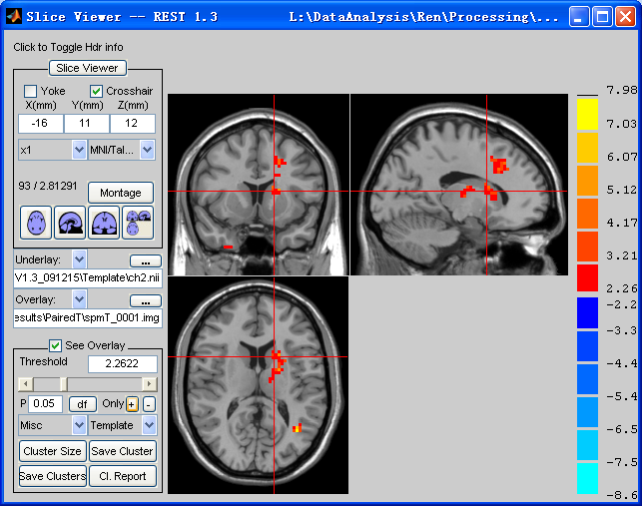

Slide 39



Slide 40
This report is based on CUI Xu's xjview. (http://www.alivelearn.net/xjview/)
Revised by YAN Chao-Gan and ZHU Wei-Xuan 20091108: suitable for different Cluster Connectivity Criterion: surface connected, edge connected, corner connected.
Number of clusters found: 7
----------------------
Cluster 1
Number of voxels: 59
Peak MNI coordinate: 27 6 -45
Peak MNI coordinate region: // Right Cerebrum // Temporal Lobe // Superior Temporal Gyrus // White Matter // undefined // Temporal_Inf_R (aal)
Peak intensity: 3.5023
# voxels structure
59 --TOTAL # VOXELS--
40 Right Cerebrum
33 Temporal Lobe
20 White Matter
19 Temporal_Inf_R (aal)
16 Gray Matter
14 Superior Temporal Gyrus
13 Fusiform_R (aal)
11 brodmann area 38
8 Inferior Temporal Gyrus
7 Middle Temporal Gyrus
7 Limbic Lobe
6 Uncus
6 Temporal_Pole_Mid_R (aal)
5 brodmann area 20
3 Sub-Gyral
----------------------
Cluster 2
Number of voxels: 98
Peak MNI coordinate: -9 -78 -51

Slide 41

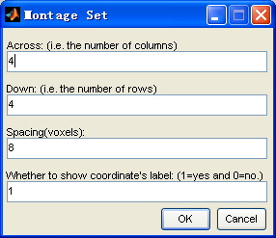

Slide 42



Slide 43


Create Brodmann Mask
Template\brodmann.nii
Or
Template\Brodmann_61x73x61.nii

Slide 44

Create Brodmann Mask

Slide 45

Data Resample
0 – Nearest Neighbor
1 – Trilinear
2- 2nd degree b-spline

Slide 46
Outline
Statistical Analysis
Results Viewing
Multiple Comparisons
REST Image Calculator
Other Functions

Slide 47

Multiple Comparisons
P=0.05
Probability of not getting a false positive result:
1 - 0.05 = 0.95
P=0.05
Probability of not getting a false positive result:
1 - 0.05 = 0.95
P=0.05
Probability of not getting a false positive result:
1 - 0.05 = 0.95
P=0.05
Probability of not getting a false positive result:
1 - 0.05 = 0.95
P=0.05
Probability of not getting a false positive result:
1 - 0.05 = 0.95
0.95 0.95 0.95 0.95 0.95
0.95⁵=0.774

Slide 48
Multiple Comparisons
Bonferroni correction: 0.05/5=0.01
False Discovery Rates (FDR) correction
Family-Wise Error (FWE) correction
Monte Carlo simulations (AlphaSim)

Slide 49


Multiple Comparisons
Monte Carlo simulations (AlphaSim)
?

Slide 50
REST AlphaSim

Slide 51


Slide 52
Cl Size Frequency Cum Prop p/Voxel Max Freq Alpha
1 235971 0.619898 0.009613 0 1.000000
2 76150 0.819945 0.006282 0 1.000000
3 32297 0.904789 0.004131 0 1.000000
4 15940 0.946664 0.002763 0 1.000000
5 8476 0.968930 0.001863 0 1.000000
6 4786 0.981503 0.001265 1 1.000000
7 2767 0.988772 0.000860 19 0.999000
8 1606 0.992991 0.000586 51 0.980000
9 1011 0.995647 0.000405 127 0.929000
10 585 0.997184 0.000276 132 0.802000
11 391 0.998211 0.000194 172 0.670000
12 236 0.998831 0.000133 146 0.498000
13 164 0.999262 0.000093 107 0.352000
14 98 0.999519 0.000063 78 0.245000
15 69 0.999701 0.000043 61 0.167000
16 37 0.999798 0.000029 30 0.106000
17 22 0.999856 0.000020 22 0.076000
18 22 0.999913 0.000015 21 0.054000
19 11 0.999942 0.000010 11 0.033000
20 7 0.999961 0.000007 7 0.022000
21 5 0.999974 0.000005 5 0.015000
22 5 0.999987 0.000003 5 0.010000
23 4 0.999997 0.000002 4 0.005000
24 1 1.000000 0.000000 1 0.001000

Slide 53
Outline
Statistical Analysis
Results Viewing
Multiple Comparisons
REST Image Calculator
Other Functions

Slide 54
REST
Image
Calculator

Slide 55

REST Image Calculator

Slide 56
REST Image Calculator
Example expressions:
(a) g1-1 Subtract 1 from each image in group 1
(b) g1-g2 Subtract each image in group 2 from each corresponding image in group1
(c) i1-i2 Subtract image 2 from image 1
(d) i1>100 Make a binary mask image at threshold of 100
(e) g1.*(i1>100) Make a mask and then apply to each image in group 1
(f) mean(g1) Calculate the mean image of group 1
(g) corr(g1,g2,''temporal'') Calculate the temporal correlation between two groups, i.e. one correlation coefficient between two ''time courses'' for each voxel.
(h) corr(g1,g2,''spatial'') Calculate the spatial correlation between two groups, i.e. one correlation coefficient between two images for each ''time point''.

Slide 57
Outline
Statistical Analysis
Results Viewing
Multiple Comparisons
REST Image Calculator
Other Functions

Slide 58
NIfTI nii to NIfTI pairs

Slide 59

NIfTI .nii to NIfTI pairs

Slide 60
Reading and Writing functions
Reading:
[Data Vox Head]=rest_readfile('brodmann.nii');
Data – 181*217*181 double
Vox – 1 1 1
Head - Structure
Processing:
BA20Data=(Data==20);
Writing:
rest_WriteNiftiImage(BA20Data,Head,'BA20.img');

Slide 61
Solve Problem "Out Of Memory"
1. Reboot your computer and do not run any other programs.
2. Enlarge your memory.
3. MATLAB Version 7.1 or above is suggested.
4. You can turn on the 3GB switch of Windows XP!!! Please see more details in http://www.microsoft.com/whdc/system/platform/server/PAE/PAEmem.mspx.
5. If this problem remains, please install Linux, especially 64 bit Linux and Matlab.

Slide 62
Further Help
Further questions:
www.restfmri.net
Further professional data analysis service:
Brain Imaging Data Analysis and Consultation Section (BIDACS)
bidacs@gmail.com

Slide 63
Thanks to
DONG Zhang-Ye
GUO Xiao-Juan
HE Yong
LONG Xiang-Yu
SONG Xiao-Wei
YAO Li
ZANG Yu-Feng
ZHANG Han
ZHU Chao-Zhe
ZOU Qi-Hong
ZUO Xi-Nian
……
SPM Team: Wellcome Department of Imaging Neuroscience, UCL
MRIcroN Team: Chris RORDEN
Xjview Team: CUI Xu
……
All the group members!

Slide 64
Thanks for your attention!

