Slide 1
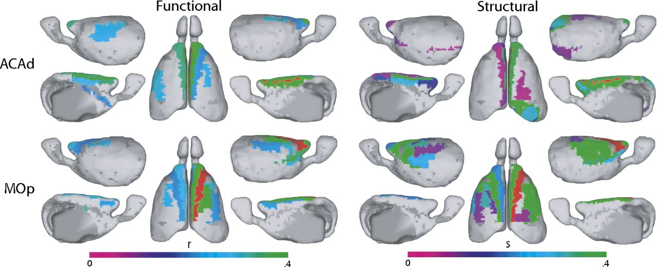
Qualitative comparison of whole-brain mouse functional and structural data.
James M. Stafford et al. PNAS 2014;111:18745-18750
©2014 by National Academy of Sciences
Notes:
Qualitative comparison of whole-brain mouse functional and structural data. Comparison of right primary motor cortex (MOp) and dorsal anterior cingulate (ACAd) seed regions. Note their strong similarities. The r label refers to correlation coefficient; s refers to the relative strength of the structural connections (30).

