Slide 1
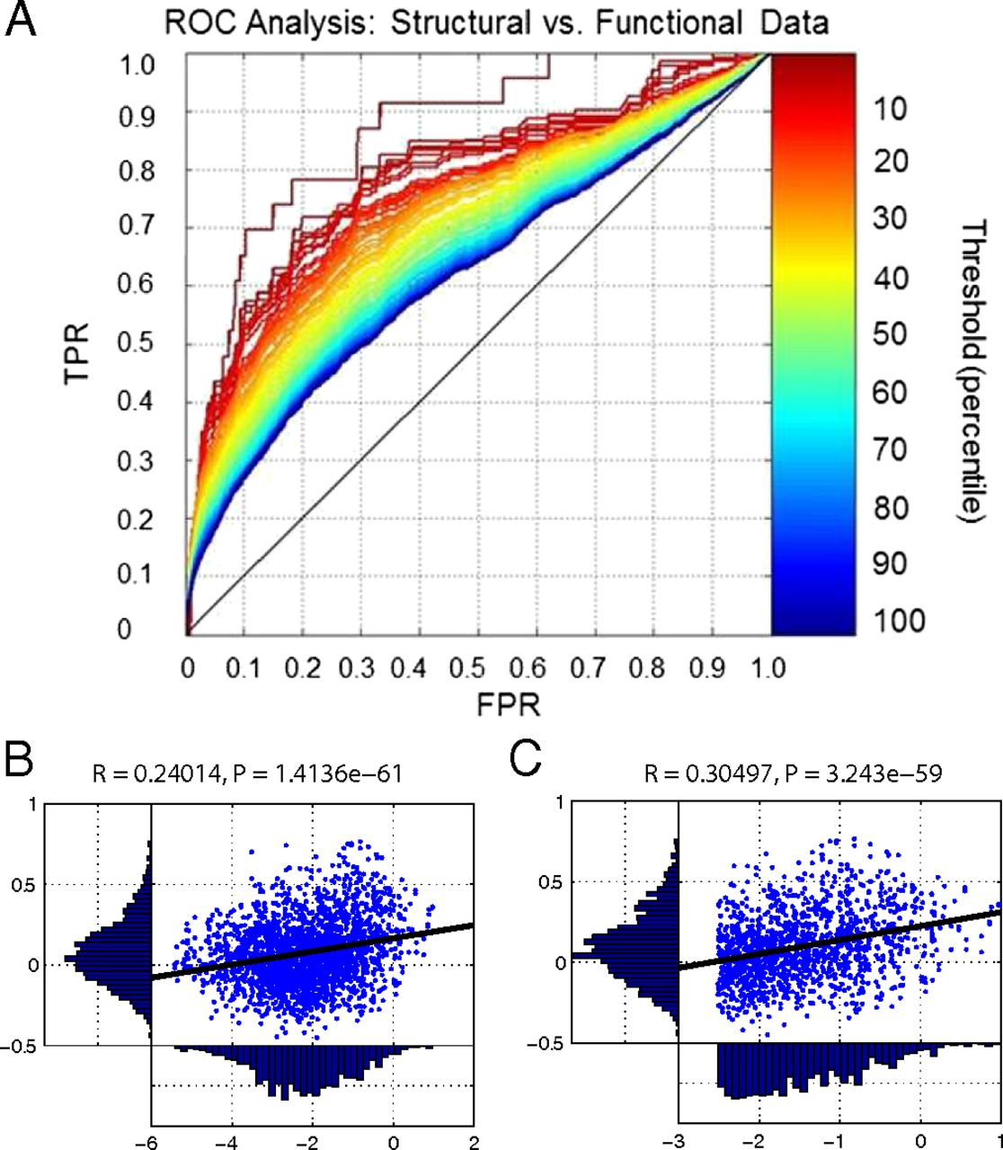
Quantitative comparison of mouse functional and structural data.
James M. Stafford et al. PNAS 2014;111:18745-18750
©2014 by National Academy of Sciences
Notes:
Quantitative comparison of mouse functional and structural data. (A) Full matrix comparison of the structural data with the functional data using receiver operator characteristic (ROC) analysis (details in the text and SI Methods). (B) Structural weights (i.e., nonzero connections) from the structural matrix (x axis) were compared with the corresponding functional weights of the functional connectivity data (y axis). Structural connection weights were log-transformed. A modest Pearson’s r value was observed with high significance (P < 0.00001). (C) The r value improved when the top 40% of the structural connections (i.e., top 10% of the total matrix) in B were considered (again with high significance; P < 0.00001). The structural data are presented on a lognormal scale because of the large range of connection strengths in the axonal structural data. TPR, true positive rate; FPR, false positive rate.

