Slide 1
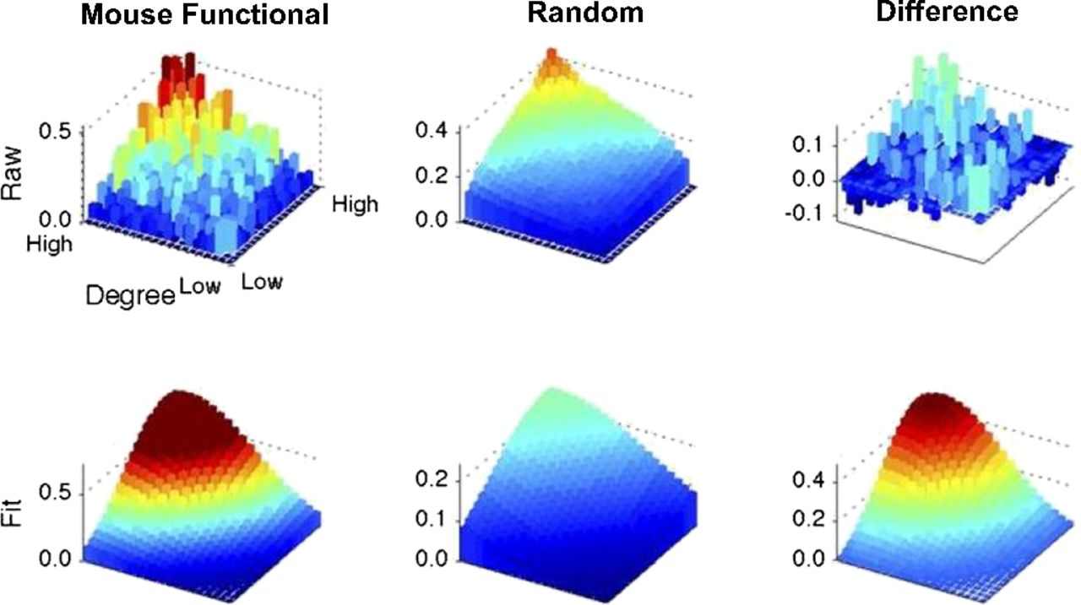
Rank–rank distribution and Rich Club topology of the mouse’s functional connectome.
James M. Stafford et al. PNAS 2014;111:18745-18750
©2014 by National Academy of Sciences
Notes:
Rank–rank distribution and Rich Club topology of the mouse’s functional connectome. Upper Left shows the rank–rank distribution of the functional connections of the mouse connectome. Lower Left shows its fit to a bivariate distribution (details in the text and SI Methods). (Center) To determine if this topology is unique relative to what would be expected by chance, we generated a test distribution using the average of 10,000 random copies of the mouse connectome where the degree distribution was preserved. (Right) The functional and test distributions were compared by simple subtraction as shown.

