Slide 1
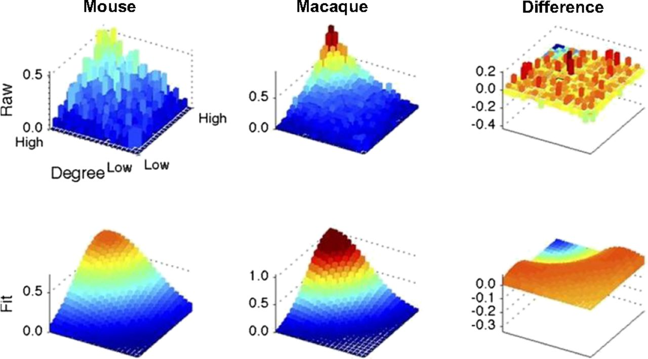
Comparison between the mouse and macaque connectomes.
James M. Stafford et al. PNAS 2014;111:18745-18750
©2014 by National Academy of Sciences
Notes:
Comparison between the mouse and macaque connectomes. Rank–rank distributions were compared between the mouse and macaque functional data using the same methodology as in Fig. 3.

