Slide 1
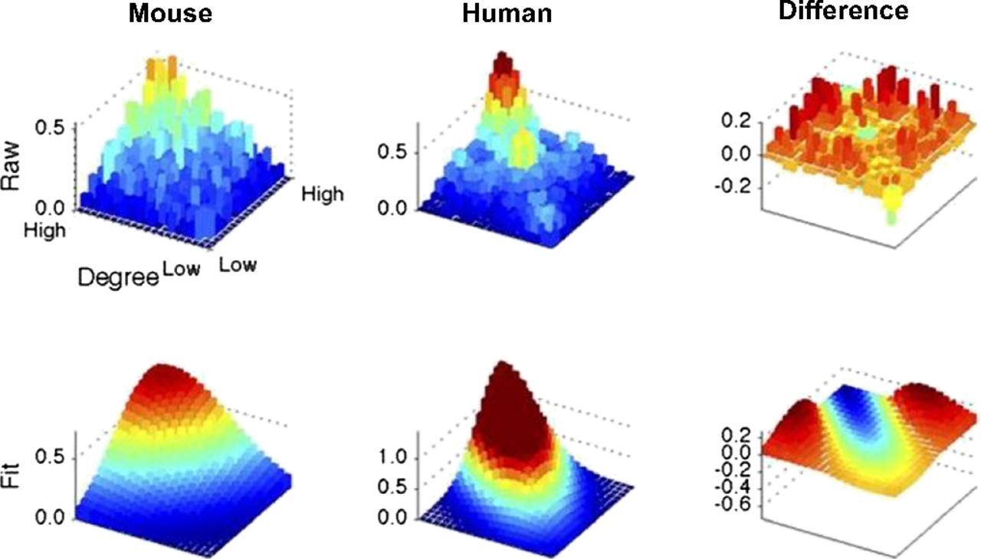
Comparison between the mouse and human connectomes.
James M. Stafford et al. PNAS 2014;111:18745-18750
©2014 by National Academy of Sciences
Notes:
Comparison between the mouse and human connectomes. Comparison of rank–rank distributions of the mouse and human functional connectomes using the same methodology as Fig. 3.

