Slide 1
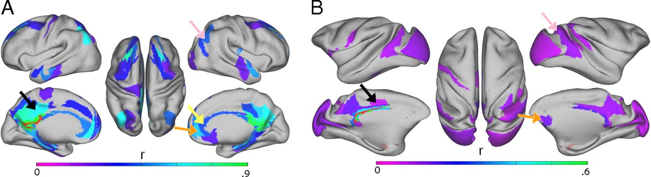
The DMN in humans and macaques.
James M. Stafford et al. PNAS 2014;111:18745-18750
©2014 by National Academy of Sciences
Notes:
The DMN in humans and macaques. Using area 30 (RSP) as the seed region (red) reveals the presence of both the inferior (DMN) subsystem and superior DMN, similar to that first described by Andrews-Hanna et al. (40, 47). The critical components of this system are the parietal cortex (pink arrow), the orbitofrontal cortex (orange arrow), and the anterior cingulate cortex (yellow arrow). Note that the superior subsystem is present in both (A) humans and (B) macaques and includes area 23 (posterior cingulate cortex; black arrow). The r label refers to correlation coefficient.

