Slide 1
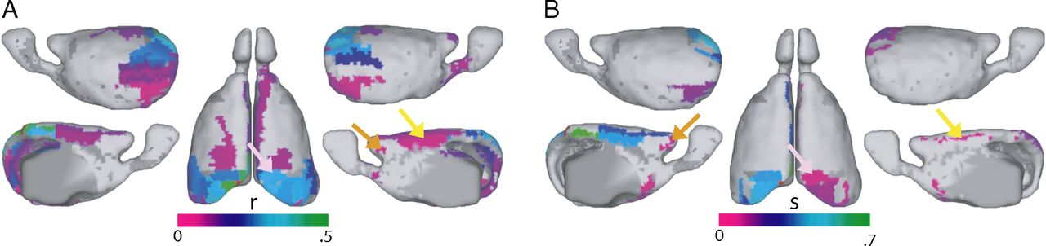
Presence of the inferior DMN core in mouse functional and structural connectivity.
James M. Stafford et al. PNAS 2014;111:18745-18750
©2014 by National Academy of Sciences
Notes:
Presence of the inferior DMN core in mouse functional and structural connectivity. The mouse seed region (red) used was the RSPagl, because it shows similar cytoarchitecture and location to that of area 30 in primates (45, 46). Both the (A) functional and (B) structural data in the mouse show hallmarks of the inferior DMN subsystem in primates, including the parietal cortex (pink arrow), the lateral/medial orbital cortex (orange arrow), and the cingulate area (yellow arrow). The r label refers to correlation coefficient; s refers to the relative strength of the structural connections (30).

