Slide 1
Deletion of the mu opioid receptor gene
in mice reshapes the
reward–aversion connectome

Slide 2
01
Part ONE
Ideas

Slide 3

Innovation
First studies (44) that open the way to targeted connectome genetics
First hypothesis-free analysis of combined rsfMRI/diffusion tractography data in the mouse
A single gene on
whole-brain FC

Slide 4
02
Part TWO
rsfMRI Data Analysis
Group, Cluster : ICA, ICASSO
MBFC, WUM

Slide 5
Exclusion
ICA
Independent component analysis
Functional grouping
100 components
But local minimum
13 artifactual components
ICASSO
Bootstrapping
ICA for many times
Assess pattern reliability/stability
Coregistration onto AMBA
Group
Cluster

Slide 6

Why 100 components ?
$I_{q}$ :
robustness of the identified component
compactness and isolation for each cluster
$I_{q}$ > 0.8 :in 92%, 86%, and 82% of the components for 60-, 80-, and 100-ICASSO respectively

Slide 7

Why 100 components ?
Of the 100 components:
55% : $I_{q}$ > 0.9
94% : $I_{q}$ > 0.65
100% : $I_{q}$ > 0.56
$I_{q}$ > 0.6 : a clear degradation of the IC estimates for 120- and 140-ICASSO

Slide 8
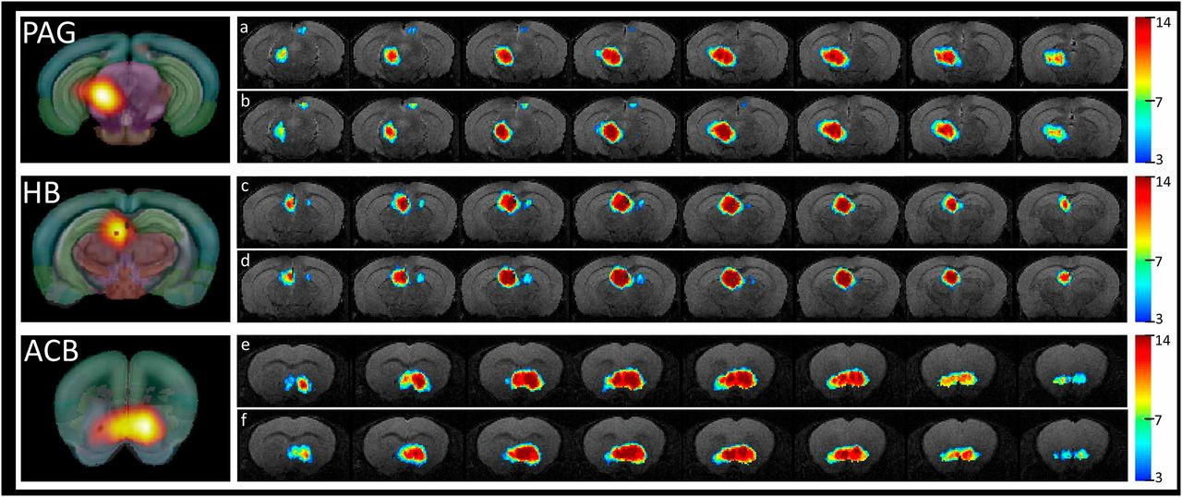
ICASSO
Low intragroup variability of the ICA patterns
Extremely high similarity between group patterns
Reproducibility
Back-reconstruction
Ctrl: a,c,e; Oprm1^{-/-} : b,d,f;
A group
Already replicated more than three times
Color: numer of animals

Slide 9
Mouse Brain
Functional connectome
MBFC
WUM
Weighted undirected matrix
Two for each group : Ctrl, Oprm1 ^{-/-}
IC : Independent component
PC : Partial correlation for each pair of IC nodes, including correlations (positive) and anticorrelations (negative)
A 87 × 87 adjacency PC matrix
Normalized via Fisher’s z-transformation
A two-sided one-sample t test
Significance of positive and negative correlations

Slide 10

A two-sided one-sample t test
H0: no differences
Calculate t: $t= \frac{‾X_{1}−‾X_{2} }{\sqrt{\frac{\sum{{X_{1}}^{2}+\sum{{X_{2}}^{2}}}}{n_{1}+n_{2}−2}×\frac{n_{1}+n_{2}}{n_{1}×n_{2}}}}$
Search in the table via‾X, $α_{S}$ for $t_{s}$
Compare t and $t_{s}$, and search for the range of the probaility α
Compare α and $α_{S}$,and find out whether to refuse H0

Slide 11
WUM
Through t test last page
Significance of positive and negative correlations
A WUM for both Ctrl and Oprm1 ^{-/-}
Lower triangular matrix : Ctrl
Upper triangular matrix : Oprm1 ^{-/-}

Slide 12
03
Part THREE
Analysis
Global Topological Features of the MBFC
An Oprm1 ^{-/-} -Specific Fingerprint via Quantitative comparison
Deletion of MOR Reshapes the Reward/Aversion Circuitry
Modifications of Functional and Structural Connectome

Slide 13
Global Topological Features of the MBFC
Small-world properties
Modularity
Hubs

Slide 14
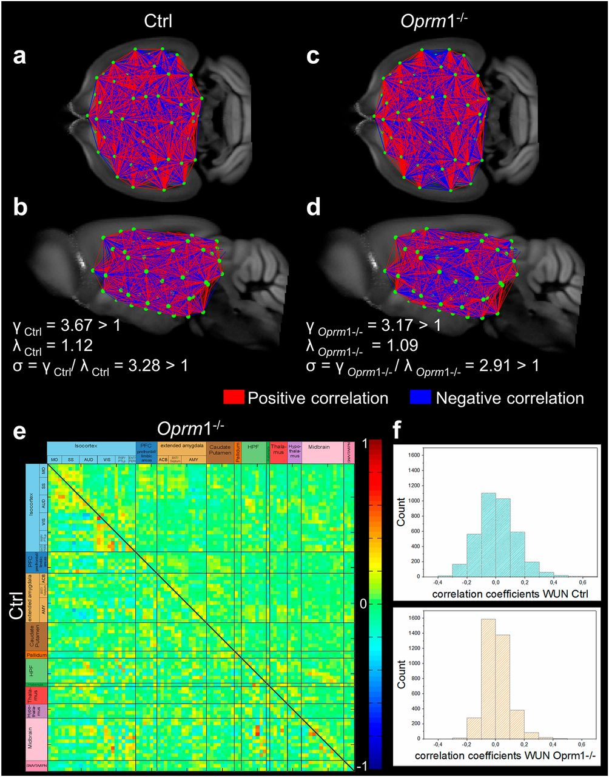
Two key metrics(57):
Clustering coefficient (C)
Mean clustering coefficient (Crand)
γ = C/Crand
Minimum path length (L)
Mean path length (Lrand)
λ = L/Lrand
For a small-world network :
γ > 1
λ ∼ 1
σ = γ/λ and σ ≥ 1
Fig a,b,c,d(MBFC):
Metrics:
a short average path length between all node pairs
Grapy theory:
clustering, especially in Oprm1 ^{-/-}
Fig e,d(WUM)
Small-world
properties

Slide 15
Modularity
Optimal criterion:
Nonoverlapping
maximizes the number of within-group connections
minimizes the number of between-group connections
Notes:
Structural
Mutual connection among 426 regions
426→168→164

Slide 16
Modularity
Q: quantifies the degree to which the network may be subdivided into such clearly delineated groups(59)
0.33 for Ctrl and 0.36 for Oprm1 ^{-/-} →
a prominent modular structure
Both in the Ctrl and Oprm1 ^{-/-} functional networks :
four very stable modules
Quantify the intermodular connectivity and respective stability
Notes:
Structural
Mutual connection among 426 regions
426→168→164

Slide 17
Hub regions
Definition :
Mean normalized strength :
Above 39 for Ctrl
Above 44 for Oprm1 ^{-/-}
Diversity :
Above 44 for Ctrl
Above 46 for Oprm1 ^{-/-}
Analysis in Ctrl and Oprm1 ^{-/-} :
Only positive correlation as they did before
Combined positive and negative correlation

Slide 18
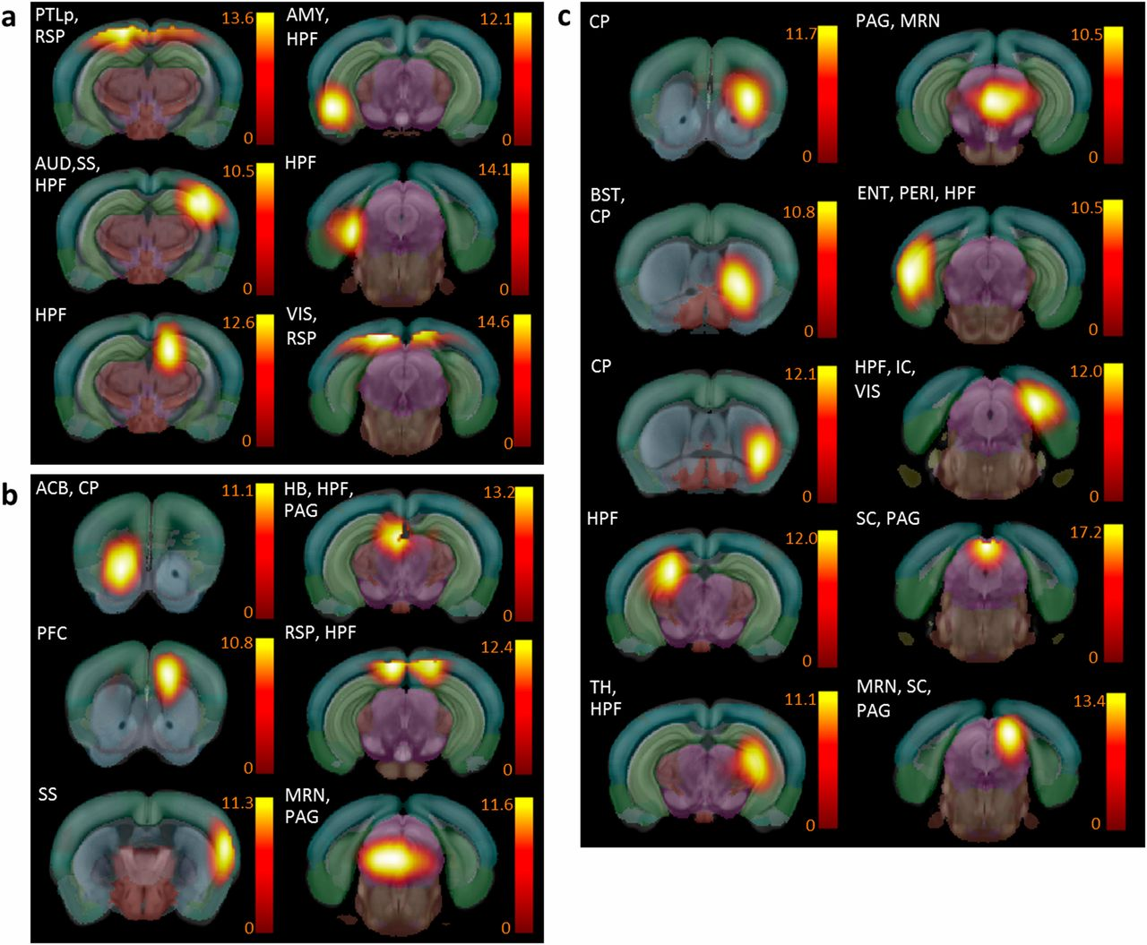
Three hub categories:
Hubs found in both Ctrl and Oprm1 ^{-/-}
Hubs detected only in the Ctrl group
lost their importance as connectivity
high expression of MORs
Hubs detected only in the Oprm1 ^{-/-} group
gained importance
pain/aversion processing areas
Positive Correlation

Slide 19
Three hub categories:
Hubs found in both Ctrl and Oprm1 ^{-/-}
Hubs detected only in the Ctrl group
lost their importance as connectivity
high expression of MORs
Hubs detected only in the Oprm1 ^{-/-} group
gained importance
pain/aversion processing areas
Reward-related areas:
positive affect and motivational processes
negative sensory and emotional experiences
Pain/aversion-processing centers
Positive Correlation

Slide 20
PAG: a major opioid-sensitive
pain-modulatory
structure
Remodel
Positive Correlation

Slide 21
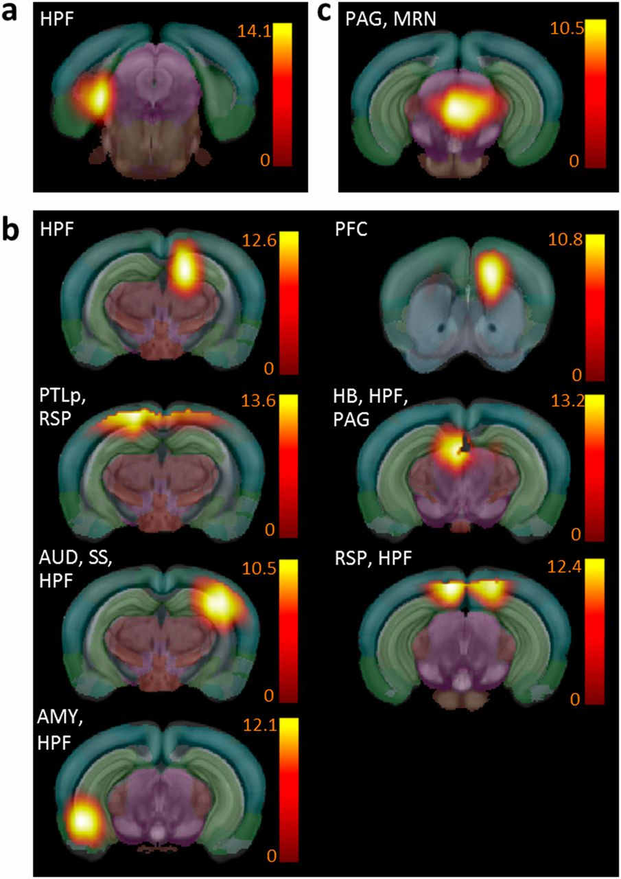
MRN/PAG :
the sole remaining Oprm1-dependent functional hub
Combined
positive and negative correlation

Slide 22
03
Part THREE
Analysis
Global Topological Features of the MBFC
An Oprm1 ^{-/-} -Specific Fingerprint via Quantitative comparison
Deletion of MOR Reshapes the Reward/Aversion Circuitry
Modifications of Functional and Structural Connectome

Slide 23

A two-sided two-sample t test
H0: no differences
Calculate t: $t= \frac{‾X_{1}−‾X_{2} }{\sqrt{\frac{{S_{p}}^{2}}{n_{1}}×\frac{{S_{p}}^{2}}{n_{2}}}}$ ,and $S_{p}= \frac{\left(n_{1}−1\right){S_{1}}^{2}+(n_{2}−1){S_{2}}^{2}}{n_{1}+n_{2}−2}$
Search in the table via‾X, $α_{S}$ for $t_{s}$
Compare t and $t_{s}$, and search for the range of the probaility α
Compare α and $α_{S}$,and find out whether to refuse H0
rejected

Slide 24
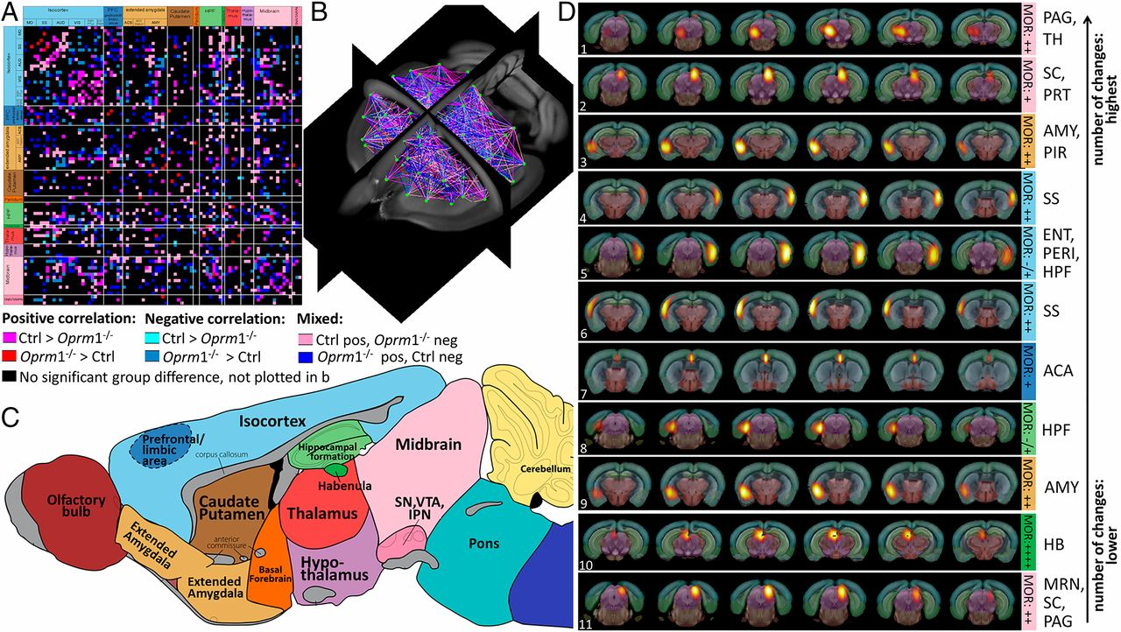
Oprm1 gene disruption at the level of whole-brain networks
the extent of Oprm1-dependent connectional activity appeared surprisingly broad

Slide 25
Nodes with the highest number of statistically significant connectivity changes are ranked .

Slide 26
An Oprm1 ^{-/-} -Specific Fingerprint
A clear dominance of connectivity changes for pain/aversion-related nodes
A detectable but only modest remodeling within this well-established brain substrate for reward processing

Slide 27
03
Part THREE
Analysis
Global Topological Features of the MBFC
An Oprm1 ^{-/-} -Specific Fingerprint via Quantitative comparison
Deletion of MOR Reshapes the Reward/Aversion Circuitry
Modifications of Functional and Structural Connectome

Slide 28
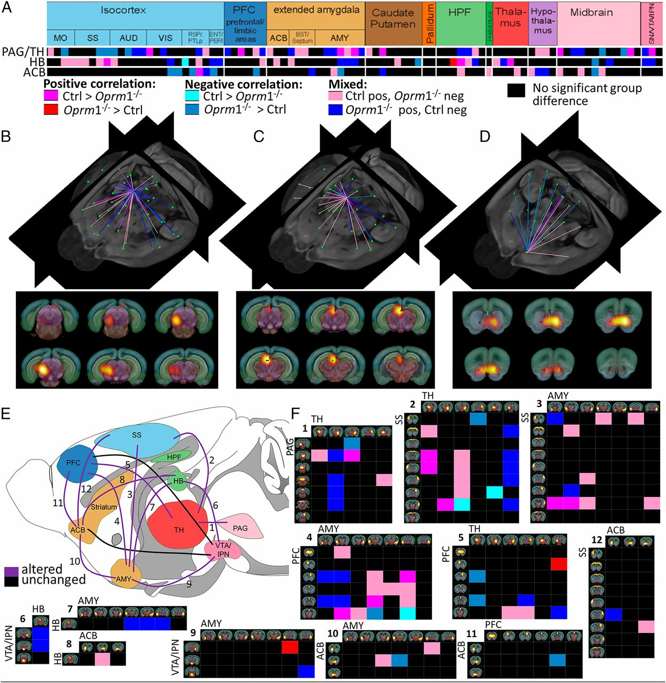
PAG/TH : pain/aversion component
HB : involved in both reward and aversion processing
ACB : dominant role in reward processing
MOR deletion predominantly reshapes the RAC, with a major impact on aversion-related components.

Slide 29
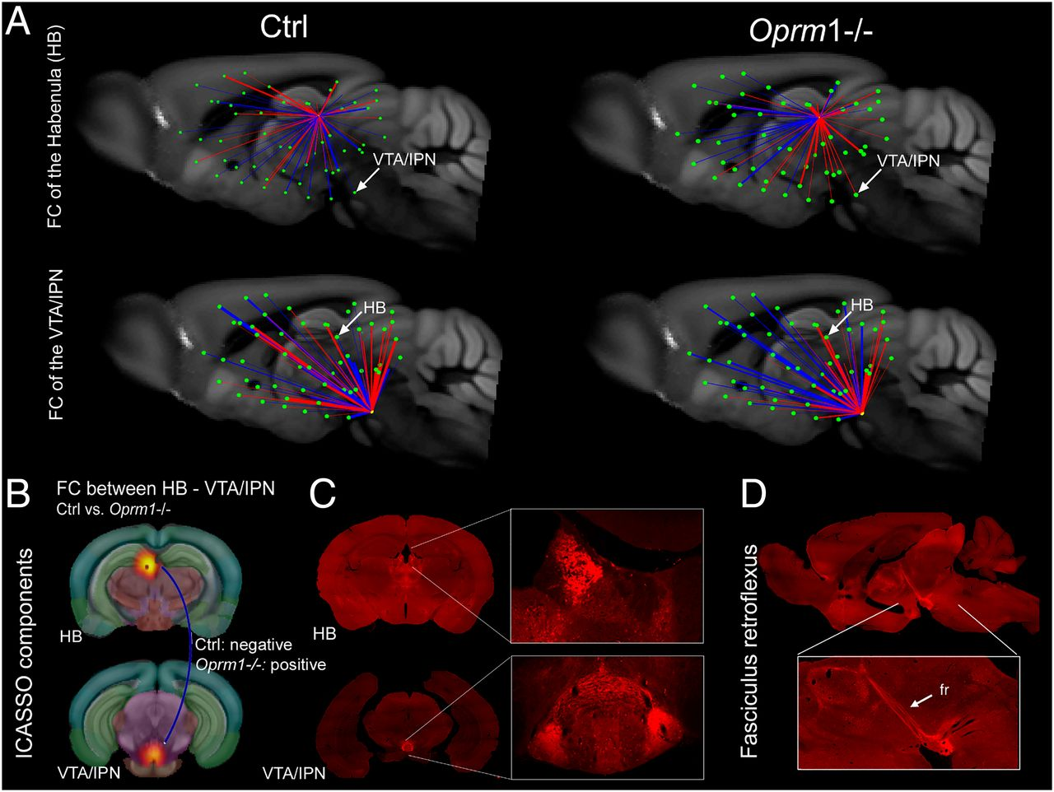
Reward/Aversion circuitry (RAC)
Highly mixed rostro-caudal correlated/anticorrelated connections in control mice
Prominent spatial segregation of correlated (mainly caudal) and anticorrelated (mainly rostral) connections in mutants

Slide 30
03
Part THREE
Analysis
Global Topological Features of the MBFC
An Oprm1-/--Specific Fingerprint via Quantitative comparison
Deletion of MOR Reshapes the Reward/Aversion Circuitry
Modifications of Functional and Structural Connectome

Slide 31
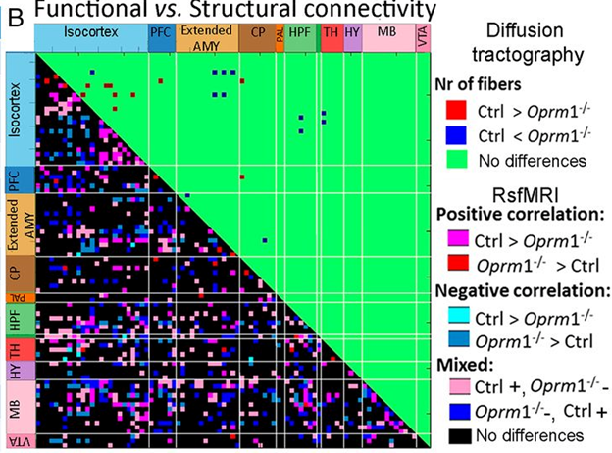
Difference
Of Modifications between functional and structural connectivity
Subtle modifications of structural scaffolding
Rich remodeling of FC
55%

Slide 32
Thank you all for listening~

