Slide 1
Lateralization
Hippocampus
Rodents & Human

Slide 2
01
Part ONE
Jordan, 2017
Identify brain regions scopolamine induce intensity changes
Evaluate the effects of scopolamine on FC
Whether scopolamine-induced memory effect could be
reversed with milameline

Slide 3
Interhemispheric specialization in the rodent hippocampus: Implications for storage and retrieval of short- and long-term memories

Slide 4

BioRxiv
Jordan , 2017
Storage and retrieval of memory
Overview
Rodents
Notes:
PNAS是《美国科学院院报》9.423

Slide 5
Conclusions
Synaptic Physiology:
left-dominance of NR2B density
right-dominance of GluR1 density
left-dominance at Schaffer collateral synapses

Slide 6
Conclusions
Goal-Directed Navigation:
right hippocampal dominance for memory retrieval
Route computation(human)
Left hippocampal dominance for memory storage
Store location(human)
right-dominance of spatial memory

Slide 7
Conclusions
Short- and Long-Term Memory:
left hippocampus be dominant for long-term memory storage
right hippocampus be dominant for spatial working memory
both are required for short-term recall

Slide 8
Conclusions
Gamma wave:
Bilaterally synchronized :
right hemisphere preceded the left in roughly two thirds of waves
the left preceded the right in the other third

Slide 9
Conclusions
Gamma wave :
Unilateral waves gamma wave:
occurred more frequently in the right than in the left hippocampus

Slide 10
Conclusions
Gamma wave :
Right hippocampus:
The amplitude of unilateral waves was smaller than that of bilateral waves
Left hippocampus:
No difference

Slide 11
Conclusions
Sharp wave-ripple complexes:
high frequency oscillations
memory consolidation
higher frequency oscillations in the left hippocampus
longer intervals between events in the right hippocampus

Slide 12
Conclusions
CA1 Lateralized:
Gene expression
Place cells
Head directions
Goal-distance/direction cells

Slide 13
02
Part TWO
Shipton, 2014
Identify brain regions scopolamine induce intensity changes
Evaluate the effects of scopolamine on FC
Whether scopolamine-induced memory effect could be
reversed with milameline

Slide 14
Left–right dissociation of hippocampal memory processes in mice

Slide 15
PNAS 9.423
Shipton , 2014
Optogenetics
LTP(CA3-CA1)
Spontaneous alternation T-maze task (86)
Spatial novelty preference Y-maze task (22)
Spatial long-term memory Y-maze task (80)
Visual discrimination T-maze task (67)
Notes:
PNAS是《美国科学院院报》9.423

Slide 16
Optogenetics
AAV5-CaMKIIα-eNpHR3.0-eYFP
Green light
Reversible silencing of spontaneous spiking
One-sample t tests

Slide 17
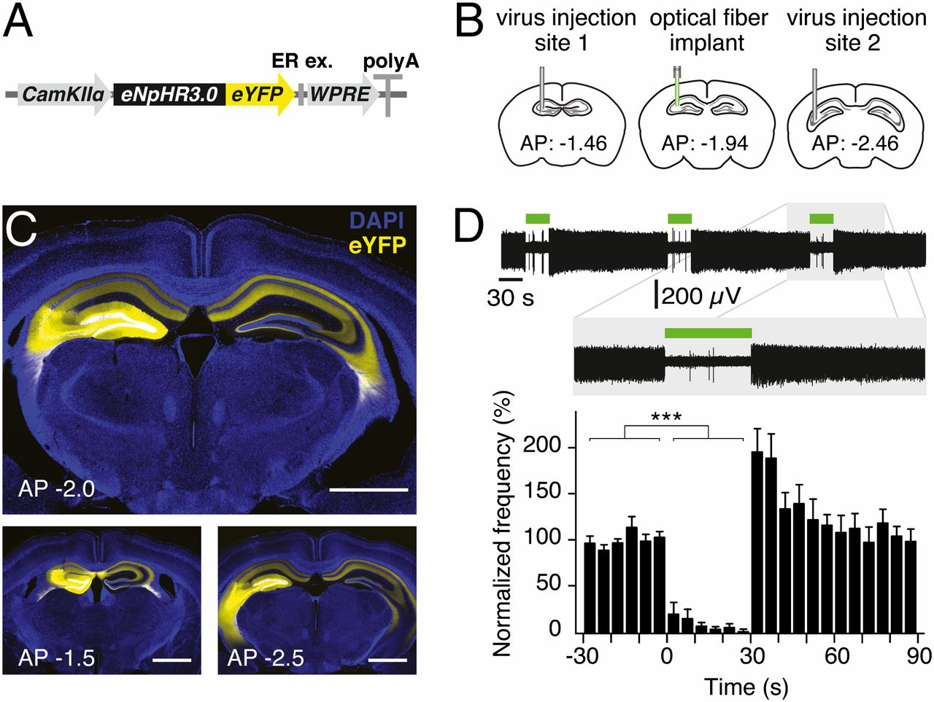

Optogenetics enables acute silencing of CA3 activity in vivo.
Olivia A. Shipton et al. PNAS 2014;111:42:15238-15243
©2014 by National Academy of Sciences
Notes:
Optogenetics enables acute silencing of CA3 activity in vivo. (A) Adeno-associated virus containing the eNpHR3.0-eYFP construct under the control of a CaMKIIα promoter was used. WPRE, woodchuck hepatitis posttranscriptional regulatory element. (B) Virus was unilaterally injected into two sites in the dorsal CA3 area of C57BL/6J mice for use in optrode recordings. For behavioral experiments, an optical fiber was also implanted between the two injection sites. (C) Two-site virus injection resulted in eNpHR3.0-eYFP or eYFP expression in CA3 and CA3 projections in the entire dorsal hippocampus. (Upper) Expression at approximate location of implant. (Lower) Approximate location of two injection sites. (Scale bars, 1 mm.) (D) Illumination of CA3 neurons in eNpHR3.0-expressing mice for 30 s resulted in a reversible reduction in spontaneous spiking frequency. A representative optrode recording trace as well as normalized mean frequency is shown. Error bars represent SEM.

Slide 18
Subjects
Adult male wild-type mice
Groups: 2 experimental groups of mice: left-NpHR and right-NpHR, with their respective control groups, left-YFP and right-YFP
Control mice received equivalent injections of a virus lacking eNpHR3.0

Slide 19
Behavioral tests
Short-term memory tasks :
Spontaneous alternation short-term memory T-maze task
Spatial novelty preference short-term memory Y-maze task
Long-term memory tasks :
Spatial long-term memory Y-maze task
Visual discrimination long-term memory T-maze task
Notes:
训练时间： light：
A 30s On & Off separately
B 6 min On
C 11 days ，then 7 days blank On
D 8 days On

Slide 20
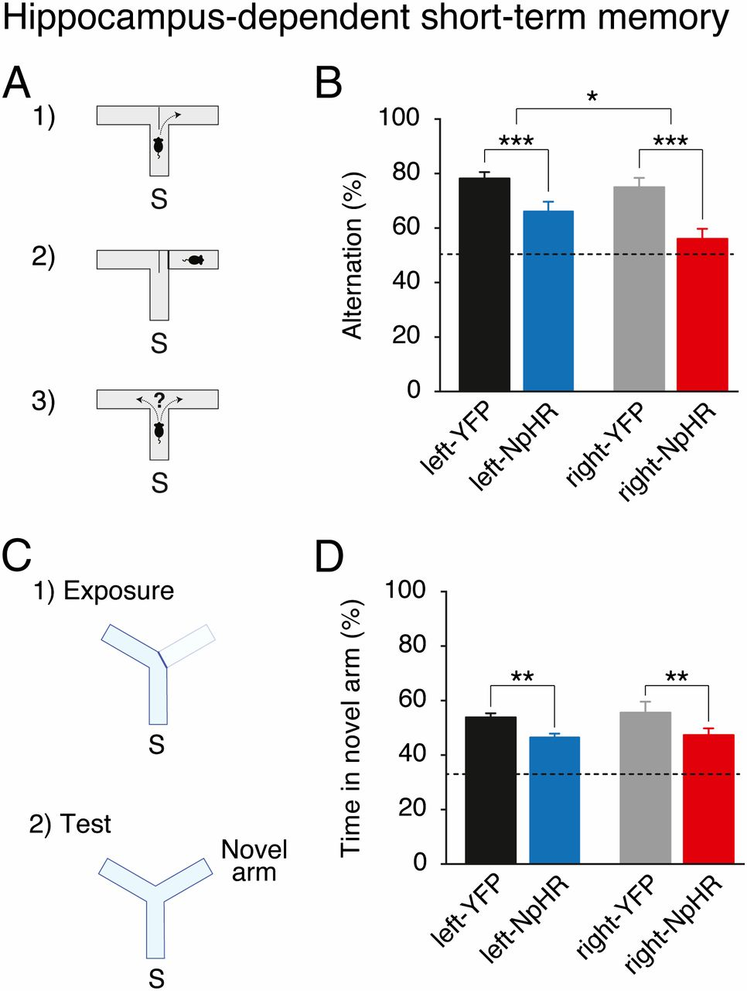
Hippocampus-dependent short-term memory requires the left and right CA3.
Notes:
Hippocampus-dependent short-term memory requires the left and right CA3. (A) Mice were tested on a spontaneous alternation task in a T-maze. S, start arm. (B) Light delivery during this task reduces spontaneous alternation of right-NpHR and left-NpHR mice compared with their respective YFP controls. (C) Mice were tested on a spatial novelty preference task in a Y-maze. (D) Light delivery during this task reduces preference for the novel arm in right-NpHR and left-NpHR mice compared with their respective YFP controls. Broken lines represent chance performance. Mean percentages ± SEM. *P < 0.05; **P < 0.01, ***P < 0.001.

Slide 21
Hippocampus-dependent short-term memory requires the left and right CA3.
Notes:
Hippocampus-dependent short-term memory requires the left and right CA3. (A) Mice were tested on a spontaneous alternation task in a T-maze. S, start arm. (B) Light delivery during this task reduces spontaneous alternation of right-NpHR and left-NpHR mice compared with their respective YFP controls. (C) Mice were tested on a spatial novelty preference task in a Y-maze. (D) Light delivery during this task reduces preference for the novel arm in right-NpHR and left-NpHR mice compared with their respective YFP controls. Broken lines represent chance performance. Mean percentages ± SEM. *P < 0.05; **P < 0.01, ***P < 0.001.

Slide 22
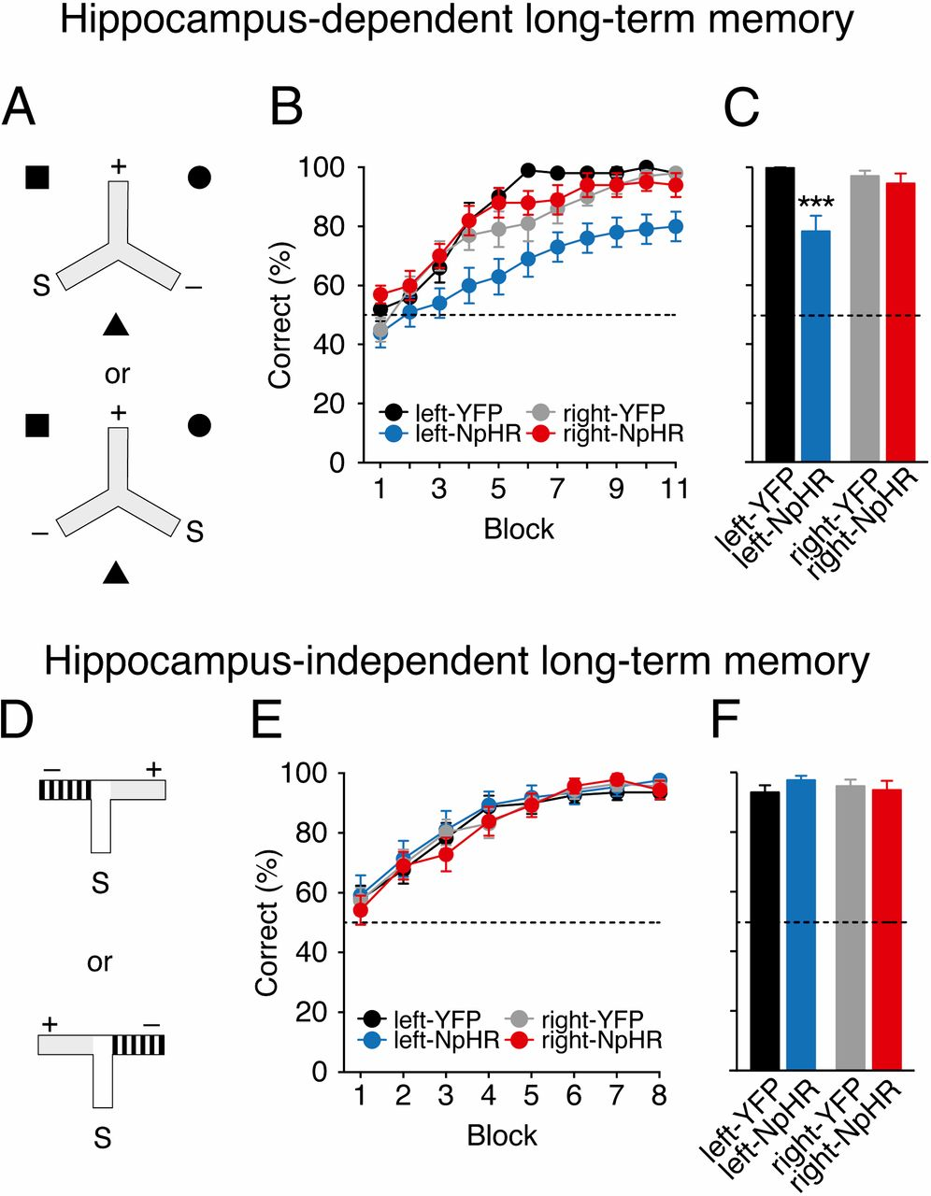
Hippocampus-dependent associative spatial long-term memory uniquely requires the left CA3.
Notes:
Hippocampus-dependent associative spatial long-term memory uniquely requires the left CA3. (A) Mice were trained on a hippocampus-dependent long-term memory task where they had to associate a reward location that was fixed with respect to allocentric extramaze spatial cues (black square, circle, and triangle), and remained constant for each mouse across consecutive days of testing. Mice received arm starts (S) to the left or the right of the rewarded arm (+) in a pseudorandom order. Mice entering the nonrewarded arm (−) were not allowed to self-correct. (B) Light delivery in mice expressing eNpHR3.0 in the left CA3 (left-NpHR, blue) impairs but does not affect learning in right-NpHR mice (red) and control groups (left-YFP: black, right-YFP: gray) in this hippocampus-dependent long-term memory task. (C) Average performance on penultimate day. (D) Mice were trained on a hippocampus-independent visual-discrimination long-term memory task where they had to associate arm floor and wall color (gray vs. black-and-white stripes) with a reward; this was fixed for each mouse across consecutive days of testing. Rewarded (+) and nonrewarded (−) arms were pseudorandomly interchanged so that reward location was learnt independent of the spatial position of the arms of the maze. (E) Mice in all groups successfully learned this task at an equivalent rate. (F) Average performance on penultimate day. In both tasks, on the last day of testing, reward was delivered after the animal had chosen to control for the possibility of mice smelling the milk (postchoice baiting). Broken lines represent chance performance. Mean percentage correct choices ± SEM. ***P < 0.001.

Slide 23
Notes:
Hippocampus-dependent associative spatial long-term memory uniquely requires the left CA3. (A) Mice were trained on a hippocampus-dependent long-term memory task where they had to associate a reward location that was fixed with respect to allocentric extramaze spatial cues (black square, circle, and triangle), and remained constant for each mouse across consecutive days of testing. Mice received arm starts (S) to the left or the right of the rewarded arm (+) in a pseudorandom order. Mice entering the nonrewarded arm (−) were not allowed to self-correct. (B) Light delivery in mice expressing eNpHR3.0 in the left CA3 (left-NpHR, blue) impairs but does not affect learning in right-NpHR mice (red) and control groups (left-YFP: black, right-YFP: gray) in this hippocampus-dependent long-term memory task. (C) Average performance on penultimate day. (D) Mice were trained on a hippocampus-independent visual-discrimination long-term memory task where they had to associate arm floor and wall color (gray vs. black-and-white stripes) with a reward; this was fixed for each mouse across consecutive days of testing. Rewarded (+) and nonrewarded (−) arms were pseudorandomly interchanged so that reward location was learnt independent of the spatial position of the arms of the maze. (E) Mice in all groups successfully learned this task at an equivalent rate. (F) Average performance on penultimate day. In both tasks, on the last day of testing, reward was delivered after the animal had chosen to control for the possibility of mice smelling the milk (postchoice baiting). Broken lines represent chance performance. Mean percentage correct choices ± SEM. ***P < 0.001.

Slide 24
Notes:
Hippocampus-dependent associative spatial long-term memory uniquely requires the left CA3. (A) Mice were trained on a hippocampus-dependent long-term memory task where they had to associate a reward location that was fixed with respect to allocentric extramaze spatial cues (black square, circle, and triangle), and remained constant for each mouse across consecutive days of testing. Mice received arm starts (S) to the left or the right of the rewarded arm (+) in a pseudorandom order. Mice entering the nonrewarded arm (−) were not allowed to self-correct. (B) Light delivery in mice expressing eNpHR3.0 in the left CA3 (left-NpHR, blue) impairs but does not affect learning in right-NpHR mice (red) and control groups (left-YFP: black, right-YFP: gray) in this hippocampus-dependent long-term memory task. (C) Average performance on penultimate day. (D) Mice were trained on a hippocampus-independent visual-discrimination long-term memory task where they had to associate arm floor and wall color (gray vs. black-and-white stripes) with a reward; this was fixed for each mouse across consecutive days of testing. Rewarded (+) and nonrewarded (−) arms were pseudorandomly interchanged so that reward location was learnt independent of the spatial position of the arms of the maze. (E) Mice in all groups successfully learned this task at an equivalent rate. (F) Average performance on penultimate day. In both tasks, on the last day of testing, reward was delivered after the animal had chosen to control for the possibility of mice smelling the milk (postchoice baiting). Broken lines represent chance performance. Mean percentage correct choices ± SEM. ***P < 0.001.

Slide 25
Analysis
The behavioral results were analyzed by two-way ANOVA with between-subjects factors of transgene (NpHR vs. YFP) and hemisphere (left vs. right), and also a within-subjects factor of block for the long-term memory tests.

Slide 26
Results
Silencing of either the left or right CA3 can impair short-term memory.
A striking asymmetry emerged in long-term memory :
Only left CA3 silencing impaired associative spatial long-term memory.
Notes:
Unilateral silencing of either the left or right CA3 was sufficient to impair short-term memory
A striking asymmetry emerged in long-term memory, wherein only left CA3 silencing impaired performance on an associative spatial long-term memory task.

Slide 27
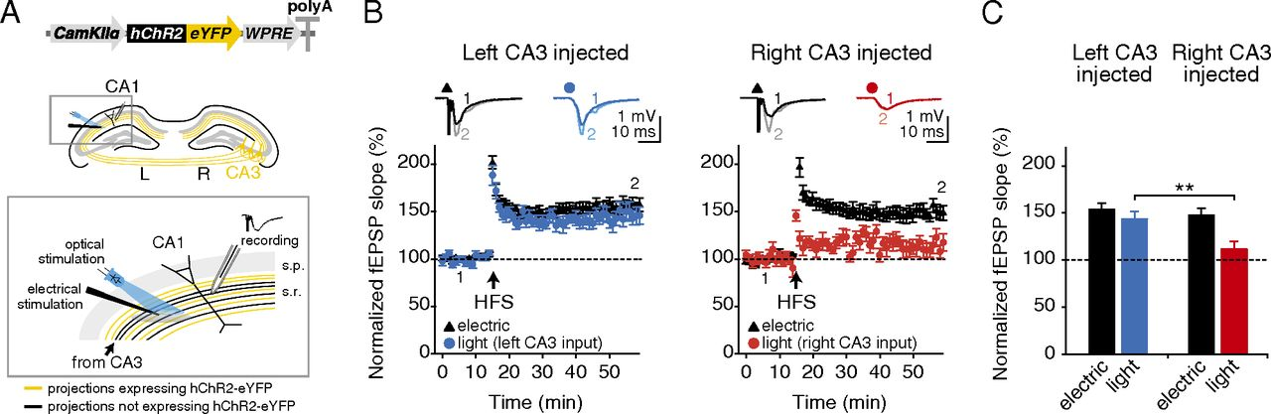
High-frequency stimulation-induced LTP is asymmetrically expressed at the CA3–CA1 pyramidal cell synapse.
Olivia A. Shipton et al. PNAS 2014;111:42:15238-15243
©2014 by National Academy of Sciences
Notes:
High-frequency stimulation-induced LTP is asymmetrically expressed at the CA3–CA1 pyramidal cell synapse. (A, Upper) Adeno-associated virus containing hChR2-eYFP construct under the control of a CaMKIIα promoter was unilaterally injected into the dorsal CA3 area of C57BL/6J mice. (Lower) An electrode to deliver nonselective electrical stimulation was placed in the stratum radiatum and a high-power 470-nm LED was arranged to recruit an overlapping population of projections. Optical stimulation only recruits projections originating in the CA3 of the injected hemisphere (yellow), whereas electrical stimulation is nonselective (black and yellow). Electrical stimulation was used to deliver the high-frequency LTP induction protocol and the effects were monitored via field recording of EPSPs evoked by electrical or optical stimulation. (B) HFS produces robust LTP in the electrical pathway (black triangles), but LTP is only expressed in the optical pathway (circles) when projections originate in the left CA3. (Insets) Representative field EPSPs at the indicated time points (1, 2). (C) Significantly more LTP is observed in left-injected mice than in right-injected mice in the optical pathway. Broken lines represent baseline. Error bars represent SEM. **P < 0.01, Student’s t test.

Slide 28
Discussion
Silencing
A

Slide 29
03
Part THREE
Lee, 2016
Identify brain regions scopolamine induce intensity changes
Evaluate the effects of scopolamine on FC
Whether scopolamine-induced memory effect could be
reversed with milameline

Slide 30
Functional Cross-Hemispheric Shift Between Object-Place Paired Associate Memory and Spatial Memory in the Human Hippocampus
Notes:
PNAS是《美国科学院院报》9.423

Slide 31
HIPPOCAMPUS 4.162
Lee , 2016
VR
Human(5f+11m,aging
19~25)
fMRI
Efficiency index
Object-based event memory task
Spatial navigation task
Notes:
HIPPOCAMPUS 4.162
Pindex:0.914 (极难发表)

Slide 32
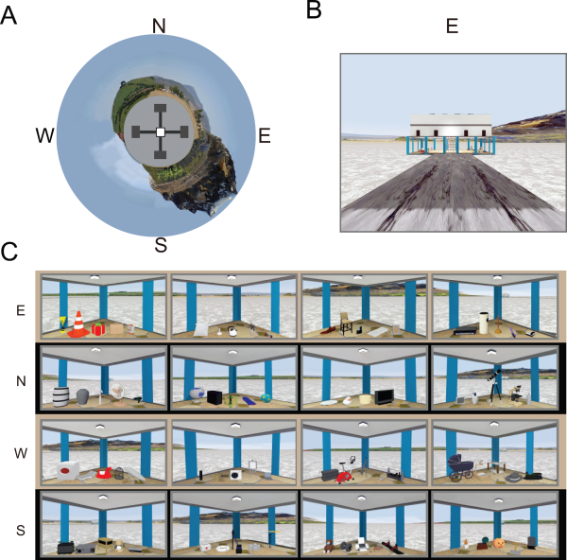
Notes:
Fig1 VR Environment. (A) Bird's eye view of the VR environment. N: North, E: East, S: South, W: West. (B) Front view of the east building. (C) Objects in the four corners inside each building. [Color figure can be viewed in the online issue, which is available at wileyonlinelibrary.com.]
IF THIS IMAGE HAS BEEN PROVIDED BY OR IS OWNED BY A THIRD PARTY, AS INDICATED IN THE CAPTION LINE, THEN FURTHER PERMISSION MAY BE NEEDED BEFORE ANY FURTHER USE. PLEASE CONTACT WILEY'S PERMISSIONS DEPARTMENT ON PERMISSIONS@WILEY.COM OR USE THE RIGHTSLINK SERVICE BY CLICKING ON THE 'REQUEST PERMISSIONS' LINK ACCOMPANYING THIS ARTICLE. WILEY OR AUTHOR OWNED IMAGES MAY BE USED FOR NON-COMMERCIAL PURPOSES, SUBJECT TO PROPER CITATION OF THE ARTICLE, AUTHOR, AND PUBLISHER.

Slide 33
Objects
Each building: 5 objects each conner
Four buildings in total :20*4
First day: half of the 80, and another 40 novel objects
Second day: another half of the 80

Slide 34
Groups
Experimental group：descibe below
Control group:
the same object for all trail ( a pear- shaped object)
extra cue when recogniton

Slide 35
Experimental procedures
Before 1st session: 5-10 min
1st session:
Outside the scanner
Explore the environment(5’20)
Building order: twice, preference, no consecutively
Corner order: green light controlled by enpreimenters
Object recognition task(short-term memory)
In the center of the maze with grey wall

Slide 36
2nd sessison next day(24hr later)：
Subjects with at least 70% correct performance
Inside the scanner
Explore(2’40)
80 trails : alternate between exp and ctrl trails
Each trail contains 3 periods:
Object-cuing period(11,2 → 4TR)
Object-cued place recogniton period(at most 11.2)
Spatial navigation period(11.1 in average)
Intertrail interval period: 2.8~5.6

Slide 37
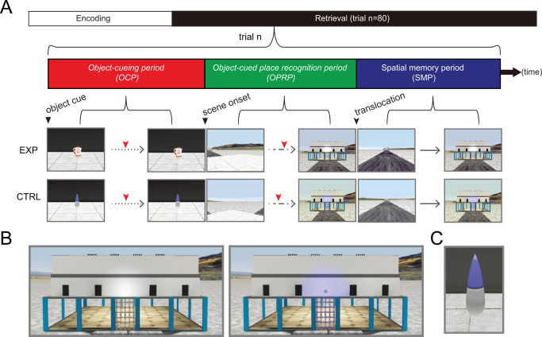
Notes:
Fig2 Experimental design. (A) After the encoding period, fMRI scanning was conducted for testing memory retrieval. The structure of a single trial is shown (trial n). Red tick marks denote button responses for recognition. EXP and CTRL denote experimental and control conditions, respectively. Dotted, dashed, and continuous lines denote three types of movement allowed for each period: passive viewing, rotation at a fixed position, and free navigation, respectively. (B) Close‐up views of the building in experimental (left) and control (right) conditions. Note that the light above the entrance door was lit only in the control condition. (C) The control object used throughout all control trials. [Color figure can be viewed in the online issue, which is available at wileyonlinelibrary.com.]
IF THIS IMAGE HAS BEEN PROVIDED BY OR IS OWNED BY A THIRD PARTY, AS INDICATED IN THE CAPTION LINE, THEN FURTHER PERMISSION MAY BE NEEDED BEFORE ANY FURTHER USE. PLEASE CONTACT WILEY'S PERMISSIONS DEPARTMENT ON PERMISSIONS@WILEY.COM OR USE THE RIGHTSLINK SERVICE BY CLICKING ON THE 'REQUEST PERMISSIONS' LINK ACCOMPANYING THIS ARTICLE. WILEY OR AUTHOR OWNED IMAGES MAY BE USED FOR NON-COMMERCIAL PURPOSES, SUBJECT TO PROPER CITATION OF THE ARTICLE, AUTHOR, AND PUBLISHER.

Slide 38
Behavioral Analysis
Binomial threshold: higher than chance
Efficiency index: dividing the standard angular distance (shortest distance) by the cumulative angular distance
Individual efficiency: dividing the average efficiency index for experimental trials by that for control trials
Advantages: linearly, recall or rerecogniton, confidence

Slide 39
Result 1:
Successful Behavioral Performance in the VR Task
period 2 & 3

Slide 40
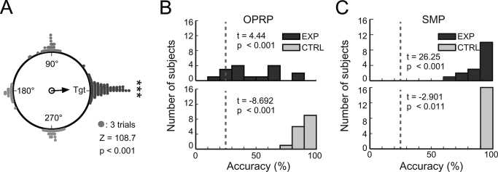
Notes:
Fig3 Task performance. (A) Cumulative choices for target buildings (Tgt) in the object‐cued place recognition period (all targets aligned to 0°). The vector arrow indicates the strength of the target response. (B–C) Distributions of response accuracies in the object‐cued place recognition period (OPRP) (B) and the spatial memory period (SMP) (C) for individual subjects. Dashed lines denote chance level (25%). For each period, results of one‐sample t tests for comparing average retrieval accuracy during the experimental condition (top) and paired t test for comparing average retrieval accuracies between experimental and control conditions (bottom) are shown.
IF THIS IMAGE HAS BEEN PROVIDED BY OR IS OWNED BY A THIRD PARTY, AS INDICATED IN THE CAPTION LINE, THEN FURTHER PERMISSION MAY BE NEEDED BEFORE ANY FURTHER USE. PLEASE CONTACT WILEY'S PERMISSIONS DEPARTMENT ON PERMISSIONS@WILEY.COM OR USE THE RIGHTSLINK SERVICE BY CLICKING ON THE 'REQUEST PERMISSIONS' LINK ACCOMPANYING THIS ARTICLE. WILEY OR AUTHOR OWNED IMAGES MAY BE USED FOR NON-COMMERCIAL PURPOSES, SUBJECT TO PROPER CITATION OF THE ARTICLE, AUTHOR, AND PUBLISHER.

Slide 41
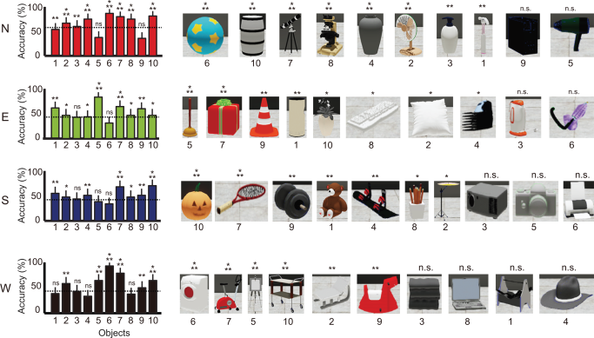
Notes:
Fig4 Choice accuracy for individual buildings and objects. Average choice accuracy for all objects associated with the four buildings in the experimental condition in the object‐cued place recognition period. Dotted lines indicate the mean accuracy for the corresponding building. Objects are shown in a descending order based on choice accuracy. Mean ± S.E.M. *P < 0.05, **P < 0.01, ***P < 0.001, n.s. P > 0.05. [Color figure can be viewed in the online issue, which is available at wileyonlinelibrary.com.]
IF THIS IMAGE HAS BEEN PROVIDED BY OR IS OWNED BY A THIRD PARTY, AS INDICATED IN THE CAPTION LINE, THEN FURTHER PERMISSION MAY BE NEEDED BEFORE ANY FURTHER USE. PLEASE CONTACT WILEY'S PERMISSIONS DEPARTMENT ON PERMISSIONS@WILEY.COM OR USE THE RIGHTSLINK SERVICE BY CLICKING ON THE 'REQUEST PERMISSIONS' LINK ACCOMPANYING THIS ARTICLE. WILEY OR AUTHOR OWNED IMAGES MAY BE USED FOR NON-COMMERCIAL PURPOSES, SUBJECT TO PROPER CITATION OF THE ARTICLE, AUTHOR, AND PUBLISHER.

Slide 42
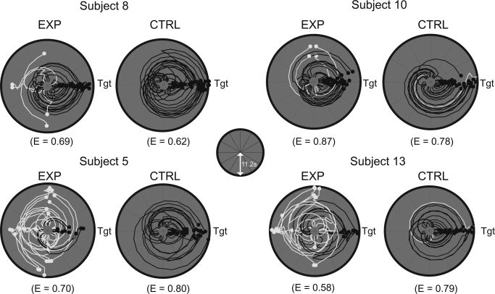
Notes:
Fig5 Individual difference in search efficiency. Examples of angular trajectory of four subjects with efficiency indices (E) during the object‐cued place recognition period. For each subject, trajectory data were aligned so that the correct target (denoted as Tgt) was located on the east, separately shown for the experimental and control conditions. Distance from the center of the plot represents the duration of time (maximum of 11.2 s, as depicted in inset) and the azimuth of the point depicts the viewing angle of the subject at that particular time. Black and white lines denote trajectories for correct and incorrect trials, respectively.
IF THIS IMAGE HAS BEEN PROVIDED BY OR IS OWNED BY A THIRD PARTY, AS INDICATED IN THE CAPTION LINE, THEN FURTHER PERMISSION MAY BE NEEDED BEFORE ANY FURTHER USE. PLEASE CONTACT WILEY'S PERMISSIONS DEPARTMENT ON PERMISSIONS@WILEY.COM OR USE THE RIGHTSLINK SERVICE BY CLICKING ON THE 'REQUEST PERMISSIONS' LINK ACCOMPANYING THIS ARTICLE. WILEY OR AUTHOR OWNED IMAGES MAY BE USED FOR NON-COMMERCIAL PURPOSES, SUBJECT TO PROPER CITATION OF THE ARTICLE, AUTHOR, AND PUBLISHER.

Slide 43
Result 2:
BOLD Signal Change during Memory-based versus Visually Guided Retrieval

Slide 44
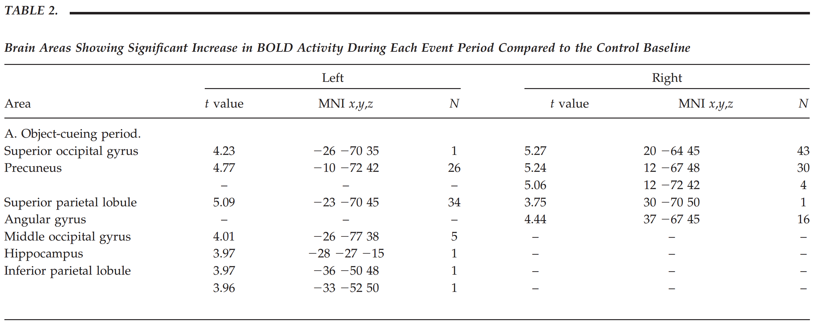

Slide 45
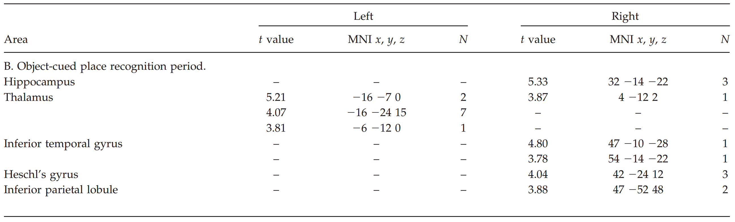

Slide 46
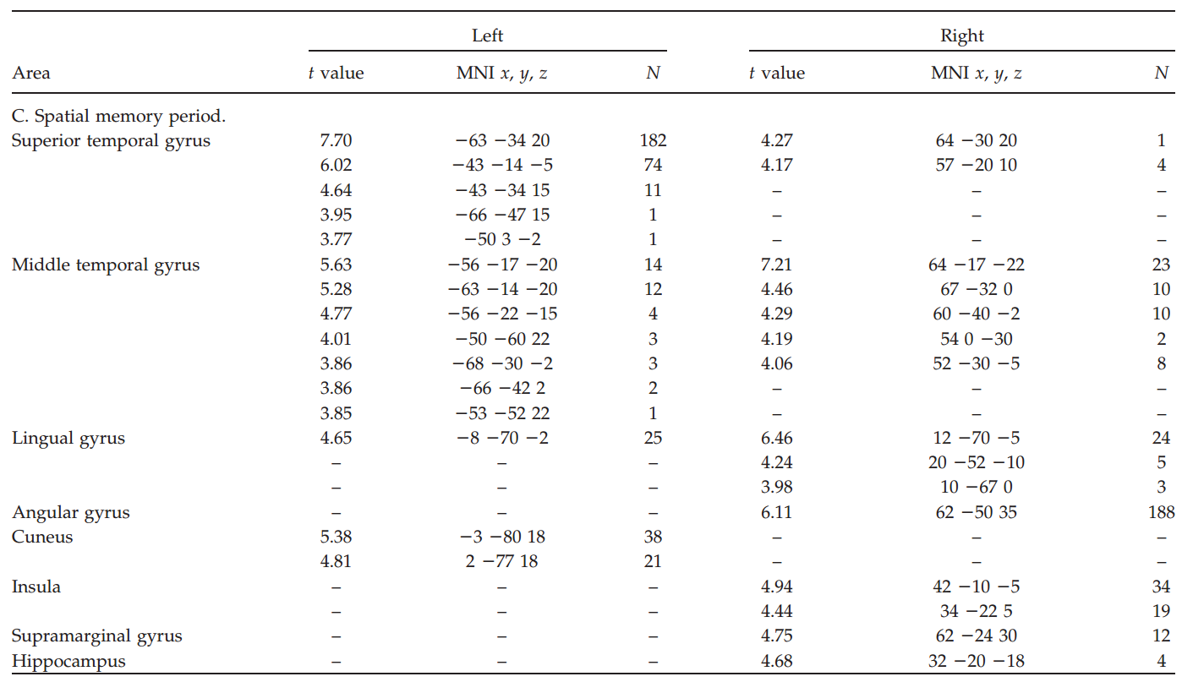

Slide 47
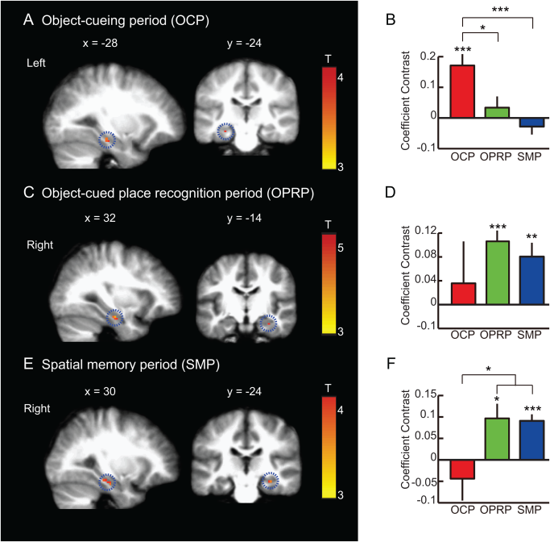
Notes:
Fig6 BOLD activity during object‐cueing period, object‐cued place recognition period, and spatial memory period. (A, C, E) A sagittal (left) and a coronal (right) section showing the peak hippocampal activity for each event period (P < 0.05, FWE‐corrected, one‐sample t test). MNI coordinates are shown above the corresponding sections. In each row, the scale bar shows the range of the t‐statistics from GLM analysis for each event period with red color representing higher response. OCP: Object‐cueing period, OPRP: Object‐cued place recognition period, SMP: Spatial memory period. Mean ± S.E.M. *P < 0.05, **P < 0.01, ***P < 0.001. (A) Object‐cueing period (OCP): A subset of voxels in the left hippocampus showing significant activity during the object‐cueing period (highlighted with a dotted circle), compared to the control. (B) Mean coefficient contrasts of the OCP‐responsive voxels in the left hippocampus across three different periods. (C) Object‐cued place recognition period (OPRP): A subset of voxels in the right hippocampus (highlighted with dotted circles) showing significant BOLD activity during the OPRP. (D) Mean coefficient contrasts of the OPRP‐response voxels in the right hippocampus across three different event periods. (E) Spatial memory period (SMP): During the spatial memory period, the right hippocampus (highlighted with a dotted circle) showed significant BOLD activity compared to the control condition. (F) Average coefficient contrasts of the SMP‐responsive voxels in the right hippocampus across three different event periods. [Color figure can be viewed in the online issue, which is available at wileyonlinelibrary.com.]
IF THIS IMAGE HAS BEEN PROVIDED BY OR IS OWNED BY A THIRD PARTY, AS INDICATED IN THE CAPTION LINE, THEN FURTHER PERMISSION MAY BE NEEDED BEFORE ANY FURTHER USE. PLEASE CONTACT WILEY'S PERMISSIONS DEPARTMENT ON PERMISSIONS@WILEY.COM OR USE THE RIGHTSLINK SERVICE BY CLICKING ON THE 'REQUEST PERMISSIONS' LINK ACCOMPANYING THIS ARTICLE. WILEY OR AUTHOR OWNED IMAGES MAY BE USED FOR NON-COMMERCIAL PURPOSES, SUBJECT TO PROPER CITATION OF THE ARTICLE, AUTHOR, AND PUBLISHER.

Slide 48
Result 3:
Contributions of Other Factors to Hemispheric Bias
GLM
Differences in task difficulty
Gender

Slide 49
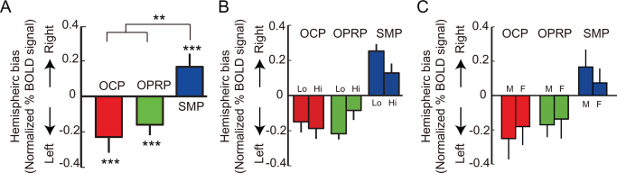
Notes:
Fig7 Contributions of object‐associated task difficulty and sex to the hemispheric bias in %BOLD signal change. (A) Hemispheric bias in normalized %BOLD signal change in each event period. (B) Hemispheric bias in normalized %BOLD signal change for each event period, shown separately for the objects with which performance levels were either high (Hi, n = 19) or low (Lo, n = 21). (C) Hemispheric bias in normalized % BOLD signal change for each event period, drawn separately for female (F, n = 5) and male (M, n = 11) subjects. OCP: object‐cueing period, OPRP: object‐cued place recognition period, SMP: spatial memory period. Mean ± S.E.M. **P < 0.01, ***P < 0.001. [Color figure can be viewed in the online issue, which is available at wileyonlinelibrary.com.]
IF THIS IMAGE HAS BEEN PROVIDED BY OR IS OWNED BY A THIRD PARTY, AS INDICATED IN THE CAPTION LINE, THEN FURTHER PERMISSION MAY BE NEEDED BEFORE ANY FURTHER USE. PLEASE CONTACT WILEY'S PERMISSIONS DEPARTMENT ON PERMISSIONS@WILEY.COM OR USE THE RIGHTSLINK SERVICE BY CLICKING ON THE 'REQUEST PERMISSIONS' LINK ACCOMPANYING THIS ARTICLE. WILEY OR AUTHOR OWNED IMAGES MAY BE USED FOR NON-COMMERCIAL PURPOSES, SUBJECT TO PROPER CITATION OF THE ARTICLE, AUTHOR, AND PUBLISHER.

Slide 50
Notes:
Fig3 Task performance. (A) Cumulative choices for target buildings (Tgt) in the object‐cued place recognition period (all targets aligned to 0°). The vector arrow indicates the strength of the target response. (B–C) Distributions of response accuracies in the object‐cued place recognition period (OPRP) (B) and the spatial memory period (SMP) (C) for individual subjects. Dashed lines denote chance level (25%). For each period, results of one‐sample t tests for comparing average retrieval accuracy during the experimental condition (top) and paired t test for comparing average retrieval accuracies between experimental and control conditions (bottom) are shown.
IF THIS IMAGE HAS BEEN PROVIDED BY OR IS OWNED BY A THIRD PARTY, AS INDICATED IN THE CAPTION LINE, THEN FURTHER PERMISSION MAY BE NEEDED BEFORE ANY FURTHER USE. PLEASE CONTACT WILEY'S PERMISSIONS DEPARTMENT ON PERMISSIONS@WILEY.COM OR USE THE RIGHTSLINK SERVICE BY CLICKING ON THE 'REQUEST PERMISSIONS' LINK ACCOMPANYING THIS ARTICLE. WILEY OR AUTHOR OWNED IMAGES MAY BE USED FOR NON-COMMERCIAL PURPOSES, SUBJECT TO PROPER CITATION OF THE ARTICLE, AUTHOR, AND PUBLISHER.

Slide 51
Result 4:
Hemispheric Difference in BOLD Activity Correlated with the Efficient Retrieval of Object-place Memory and Spatial Memory
period 2 & 3

Slide 52
Notes:
Fig5 Individual difference in search efficiency. Examples of angular trajectory of four subjects with efficiency indices (E) during the object‐cued place recognition period. For each subject, trajectory data were aligned so that the correct target (denoted as Tgt) was located on the east, separately shown for the experimental and control conditions. Distance from the center of the plot represents the duration of time (maximum of 11.2 s, as depicted in inset) and the azimuth of the point depicts the viewing angle of the subject at that particular time. Black and white lines denote trajectories for correct and incorrect trials, respectively.
IF THIS IMAGE HAS BEEN PROVIDED BY OR IS OWNED BY A THIRD PARTY, AS INDICATED IN THE CAPTION LINE, THEN FURTHER PERMISSION MAY BE NEEDED BEFORE ANY FURTHER USE. PLEASE CONTACT WILEY'S PERMISSIONS DEPARTMENT ON PERMISSIONS@WILEY.COM OR USE THE RIGHTSLINK SERVICE BY CLICKING ON THE 'REQUEST PERMISSIONS' LINK ACCOMPANYING THIS ARTICLE. WILEY OR AUTHOR OWNED IMAGES MAY BE USED FOR NON-COMMERCIAL PURPOSES, SUBJECT TO PROPER CITATION OF THE ARTICLE, AUTHOR, AND PUBLISHER.

Slide 53
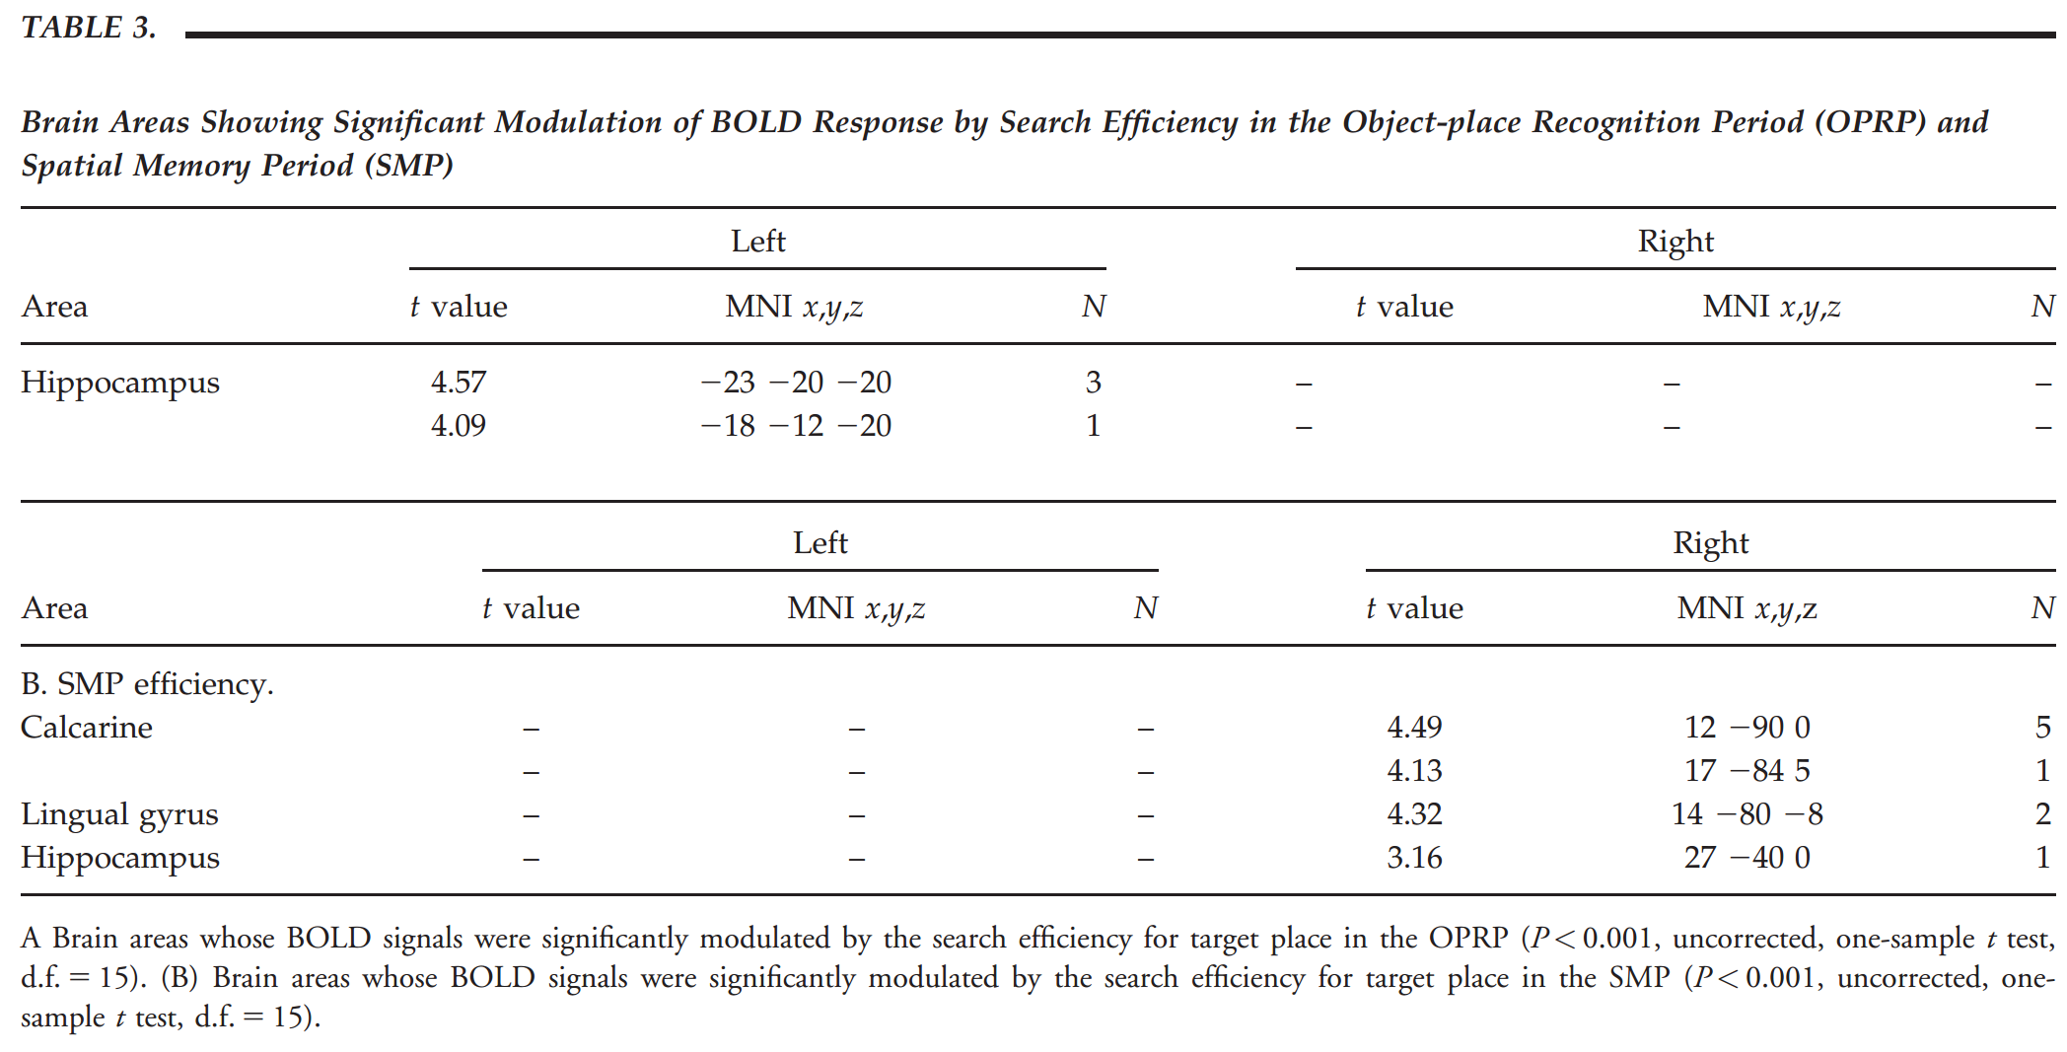

Slide 54
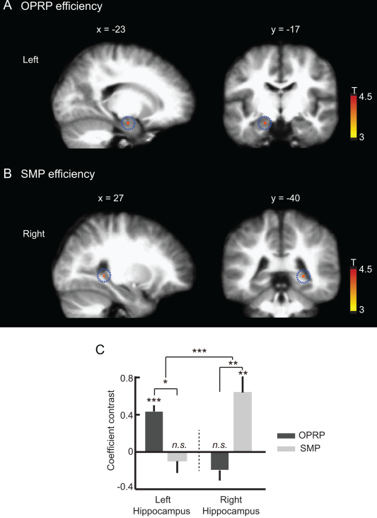
Notes:
Fig8 Left and right hippocampal BOLD activity correlated with efficient search for target place during the object‐cued place recognition period (OPRP) and spatial memory period (SMP), respectively. (A,B) Sagittal (left) and coronal (right) hippocampal sections showing the regions significantly modulated by search efficiency during the OPRP and the SMP, two event periods in which spatial memory components were important. Scale bars show the range of the t‐statistics from t test. (A) The BOLD signal in the left hippocampus (highlighted with dotted circles) was significantly modulated by search efficiency during the OPRP, compared to the control baseline (P < 0.001, uncorrected, one‐sample t test). (B) The BOLD response of the right hippocampus (highlighted with dotted circles) was significantly modulated by search efficiency during the SMP, compared to the control baseline (P < 0.001, uncorrected, one‐sample t test). (C) Comparison of the modulatory coefficient contrasts for the left and right hippocampal voxels showed a significant interaction between hemisphere and event period. Mean ± S.E.M. *P < 0.05, **P < 0.01, ***P < 0.001 (Bonferroni corrected, paired t test). [Color figure can be viewed in the online issue, which is available at wileyonlinelibrary.com.]
IF THIS IMAGE HAS BEEN PROVIDED BY OR IS OWNED BY A THIRD PARTY, AS INDICATED IN THE CAPTION LINE, THEN FURTHER PERMISSION MAY BE NEEDED BEFORE ANY FURTHER USE. PLEASE CONTACT WILEY'S PERMISSIONS DEPARTMENT ON PERMISSIONS@WILEY.COM OR USE THE RIGHTSLINK SERVICE BY CLICKING ON THE 'REQUEST PERMISSIONS' LINK ACCOMPANYING THIS ARTICLE. WILEY OR AUTHOR OWNED IMAGES MAY BE USED FOR NON-COMMERCIAL PURPOSES, SUBJECT TO PROPER CITATION OF THE ARTICLE, AUTHOR, AND PUBLISHER.

Slide 55
Discussion
Silencing
A

Slide 56
Thank you all for listening~

