Slide 1
Functional networks and network
perturbations in rodents

Slide 2

NeuroImage
Kai-Hsiang Chuang， 2017
Synchronous low-frequency oscillation
Similar ： human & rodents
Many research areas
Overview

Slide 3
Resting-state network of the rodent brain
Rat & mouse & human
FC patterns
Awake & Anesthetized

Slide 4
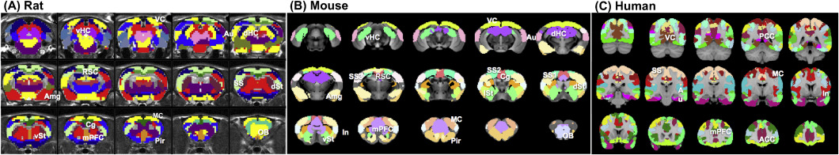

Slide 7
Effects of anesthesia on functional networks
Functions of RSN
Changing in & after task
Functional parcellation and modules
ICA
voxel-wise correlation
Neural, vascular and FC effects of different anesthesia

Slide 8
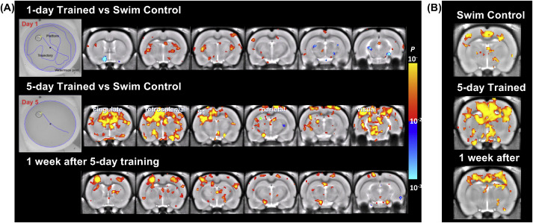

Slide 9
Effects of anesthesia on functional networks
Functions of RSN
Changing in & after task
Functional parcellation and modules
ICA
voxel-wise correlation
Neural, vascular and FC effects of different anesthesia
Awake
Practical consideration

Slide 10
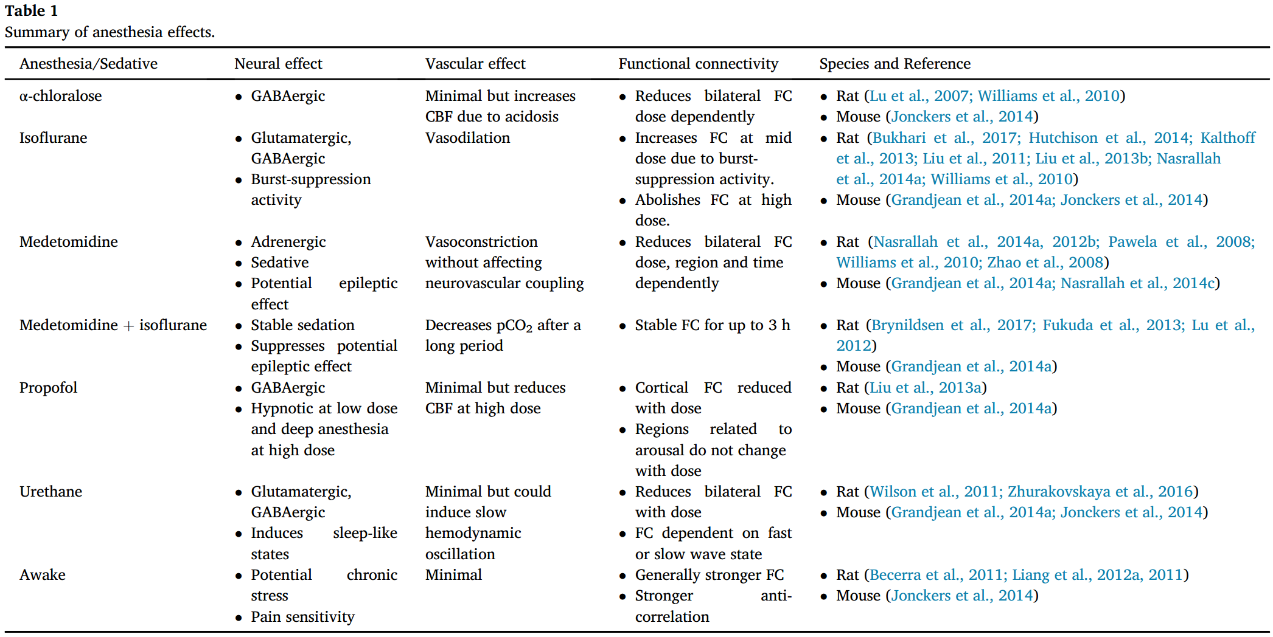

Slide 11
Awake restrained rodents:
Spontaneous activity amplitude and FC strength are generally greater
More long-range connections
Awake mouse & rat

Slide 12
Anesthesia injection:
Continous delivery
Affect: Spectral distribution
Effect: Animal species, strain, gender, age and disease state dependent

Slide 13
Pharmacological effects on functional networks
phMRI
Neural activation
Pharmacodynamics
A change in FC
Efficacy of drug treatment
Neural correlate of FC
Drugs that target specific receptors
Notes:
In the following section, the effect of drugs that target the major neurotransmission systems are discussed.（6 kinds：examples）
Potential confounds：peripheral/vascular effects and interaction with anesthesia

Slide 14
Behavior-induced
network change
phMRI
A change in FC
Neural correlate of FC

Slide 15
Passive avoidance test for each group twice respectively on
Training day
Testing day (test 55 min after first injection)

Slide 16
Brightly lit compartment

Slide 17
Ph rsfMRI
Design 1:
N = 12/group
Baseline : 15 min post-injection
Scopolamine administered
25 min later: Ph rsfMRI
Milameline administered
25 min later: Ph rsfMRI
Design 2:
Three groups:
Saline
Scopolamine
Milameline
N = 8/group

Slide 18
Scopolamine can induce memory effects.
Scopolamine-caused memory effects could be reversed with milameline.
Identify scopolamine-affected regions
Scopolamine can induce FC intensity decrease.
Milameline can induce FC intensity increase.
Decrease in FC intensity caused by scopolamine is not effected by peripheral factors.
Decrease caused by scopolamine is dose-dependent.
Topics

Slide 19
Supplementary
Doses chosen
Intensity changes observed partly in the thalamus
Intensity differences ,not extensive
VTA/SN, no intensity difference
Some different results in human and rodents
Some region affected by low dose of scopolamine, vulnerable, target
Notes:
Previos study
Signal spreading from hippocampus
The use of anesthesia
Distortion,low signal-to-noise ratio

Slide 20
Thank you all for listening~

