Slide 1
01
Part ONE
Jordan, 2017
Identify brain regions scopolamine induce intensity changes
Evaluate the effects of scopolamine on FC
Whether scopolamine-induced memory effect could be
reversed with milameline

Slide 2
02
Part TWO
Shipton, 2014
Identify brain regions scopolamine induce intensity changes
Evaluate the effects of scopolamine on FC
Whether scopolamine-induced memory effect could be
reversed with milameline

Slide 3
Left–right dissociation of hippocampal memory processes in mice

Slide 4

PNAS 9.423
Shipton , 2014
Optogenetics
LTP(CA3-CA1)
Spontaneous alternation T-maze task (86)
Spatial novelty preference Y-maze task (22)
Spatial long-term memory Y-maze task (80)
Visual discrimination T-maze task (67)
Notes:
PNAS是《美国科学院院报》9.423

Slide 5
Optogenetics
AAV5-CaMKIIα-eNpHR3.0-eYFP
Green light
Reversible silencing of spontaneous spiking
One-sample t tests

Slide 6
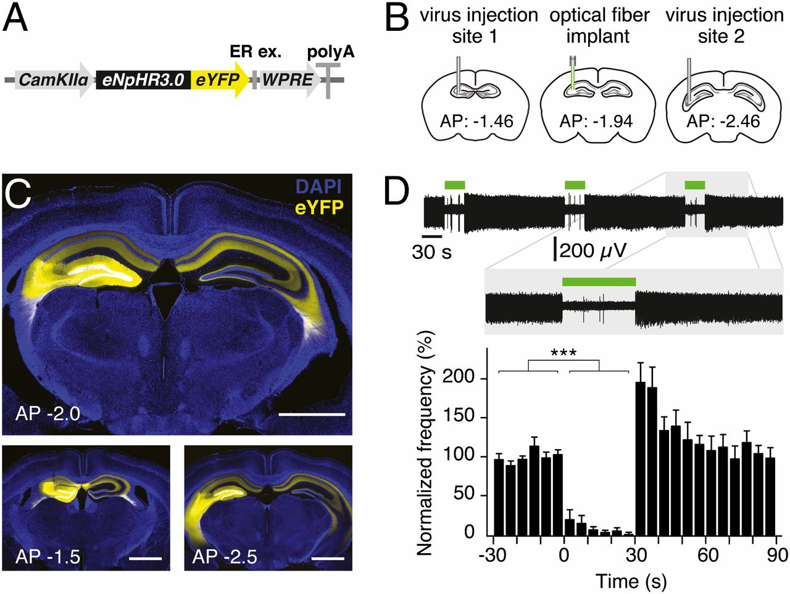

Optogenetics enables acute silencing of CA3 activity in vivo.
Olivia A. Shipton et al. PNAS 2014;111:42:15238-15243
©2014 by National Academy of Sciences
Notes:
Optogenetics enables acute silencing of CA3 activity in vivo. (A) Adeno-associated virus containing the eNpHR3.0-eYFP construct under the control of a CaMKIIα promoter was used. WPRE, woodchuck hepatitis posttranscriptional regulatory element. (B) Virus was unilaterally injected into two sites in the dorsal CA3 area of C57BL/6J mice for use in optrode recordings. For behavioral experiments, an optical fiber was also implanted between the two injection sites. (C) Two-site virus injection resulted in eNpHR3.0-eYFP or eYFP expression in CA3 and CA3 projections in the entire dorsal hippocampus. (Upper) Expression at approximate location of implant. (Lower) Approximate location of two injection sites. (Scale bars, 1 mm.) (D) Illumination of CA3 neurons in eNpHR3.0-expressing mice for 30 s resulted in a reversible reduction in spontaneous spiking frequency. A representative optrode recording trace as well as normalized mean frequency is shown. Error bars represent SEM.

Slide 7
Subjects
Adult male wild-type mice
Groups: 2 experimental groups of mice: left-NpHR and right-NpHR, with their respective control groups, left-YFP and right-YFP
Control mice received equivalent injections of a virus lacking eNpHR3.0

Slide 8
Behavioral tests
Short-term memory tasks :
Spontaneous alternation short-term memory T-maze task
Spatial novelty preference short-term memory Y-maze task
Long-term memory tasks :
Spatial long-term memory Y-maze task
Visual discrimination long-term memory T-maze task
Notes:
训练时间： light：
A 30s On & Off separately
B 6 min On
C 11 days ，then 7 days blank On
D 8 days On

Slide 9
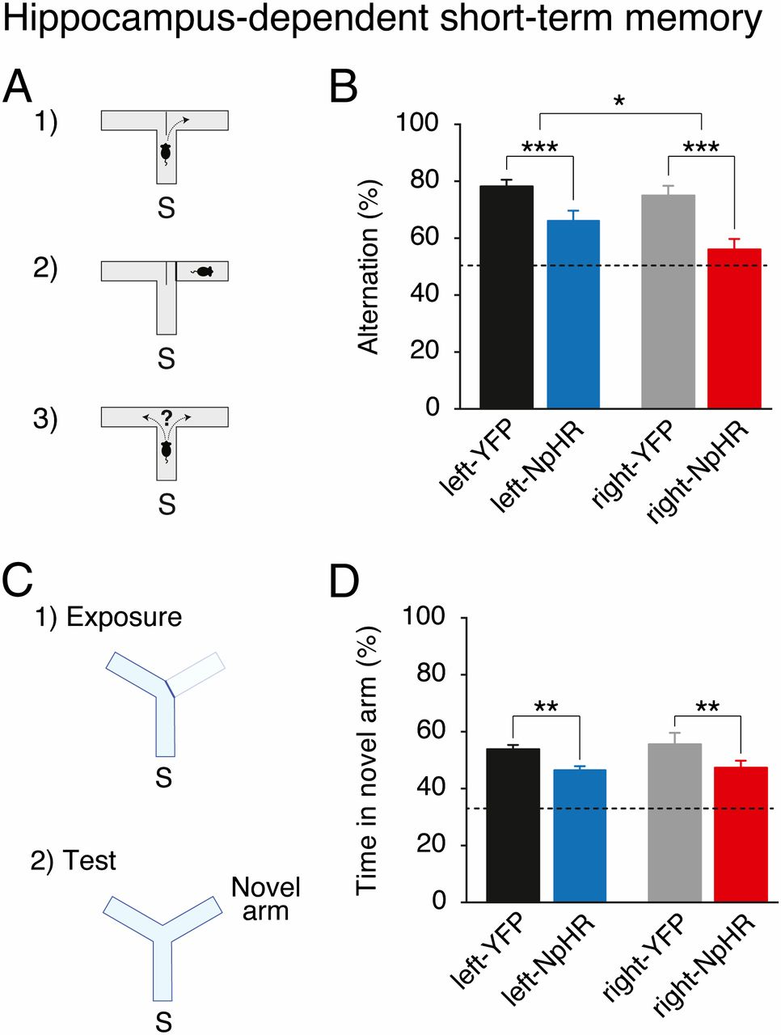
Hippocampus-dependent short-term memory requires the left and right CA3.
Notes:
Hippocampus-dependent short-term memory requires the left and right CA3. (A) Mice were tested on a spontaneous alternation task in a T-maze. S, start arm. (B) Light delivery during this task reduces spontaneous alternation of right-NpHR and left-NpHR mice compared with their respective YFP controls. (C) Mice were tested on a spatial novelty preference task in a Y-maze. (D) Light delivery during this task reduces preference for the novel arm in right-NpHR and left-NpHR mice compared with their respective YFP controls. Broken lines represent chance performance. Mean percentages ± SEM. *P < 0.05; **P < 0.01, ***P < 0.001.

Slide 10
Hippocampus-dependent short-term memory requires the left and right CA3.
Notes:
Hippocampus-dependent short-term memory requires the left and right CA3. (A) Mice were tested on a spontaneous alternation task in a T-maze. S, start arm. (B) Light delivery during this task reduces spontaneous alternation of right-NpHR and left-NpHR mice compared with their respective YFP controls. (C) Mice were tested on a spatial novelty preference task in a Y-maze. (D) Light delivery during this task reduces preference for the novel arm in right-NpHR and left-NpHR mice compared with their respective YFP controls. Broken lines represent chance performance. Mean percentages ± SEM. *P < 0.05; **P < 0.01, ***P < 0.001.

Slide 11
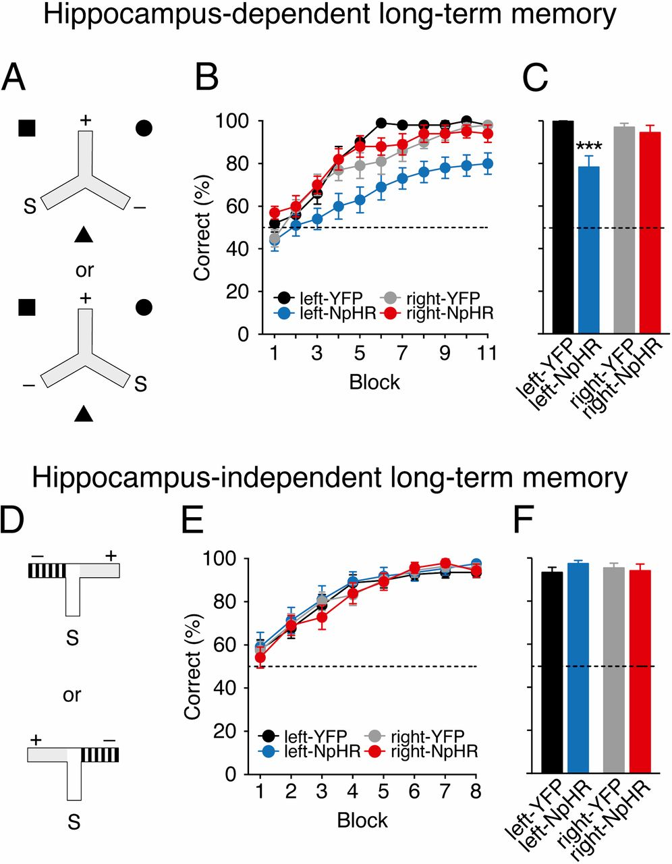
Hippocampus-dependent associative spatial long-term memory uniquely requires the left CA3.
Notes:
Hippocampus-dependent associative spatial long-term memory uniquely requires the left CA3. (A) Mice were trained on a hippocampus-dependent long-term memory task where they had to associate a reward location that was fixed with respect to allocentric extramaze spatial cues (black square, circle, and triangle), and remained constant for each mouse across consecutive days of testing. Mice received arm starts (S) to the left or the right of the rewarded arm (+) in a pseudorandom order. Mice entering the nonrewarded arm (−) were not allowed to self-correct. (B) Light delivery in mice expressing eNpHR3.0 in the left CA3 (left-NpHR, blue) impairs but does not affect learning in right-NpHR mice (red) and control groups (left-YFP: black, right-YFP: gray) in this hippocampus-dependent long-term memory task. (C) Average performance on penultimate day. (D) Mice were trained on a hippocampus-independent visual-discrimination long-term memory task where they had to associate arm floor and wall color (gray vs. black-and-white stripes) with a reward; this was fixed for each mouse across consecutive days of testing. Rewarded (+) and nonrewarded (−) arms were pseudorandomly interchanged so that reward location was learnt independent of the spatial position of the arms of the maze. (E) Mice in all groups successfully learned this task at an equivalent rate. (F) Average performance on penultimate day. In both tasks, on the last day of testing, reward was delivered after the animal had chosen to control for the possibility of mice smelling the milk (postchoice baiting). Broken lines represent chance performance. Mean percentage correct choices ± SEM. ***P < 0.001.

Slide 12
Notes:
Hippocampus-dependent associative spatial long-term memory uniquely requires the left CA3. (A) Mice were trained on a hippocampus-dependent long-term memory task where they had to associate a reward location that was fixed with respect to allocentric extramaze spatial cues (black square, circle, and triangle), and remained constant for each mouse across consecutive days of testing. Mice received arm starts (S) to the left or the right of the rewarded arm (+) in a pseudorandom order. Mice entering the nonrewarded arm (−) were not allowed to self-correct. (B) Light delivery in mice expressing eNpHR3.0 in the left CA3 (left-NpHR, blue) impairs but does not affect learning in right-NpHR mice (red) and control groups (left-YFP: black, right-YFP: gray) in this hippocampus-dependent long-term memory task. (C) Average performance on penultimate day. (D) Mice were trained on a hippocampus-independent visual-discrimination long-term memory task where they had to associate arm floor and wall color (gray vs. black-and-white stripes) with a reward; this was fixed for each mouse across consecutive days of testing. Rewarded (+) and nonrewarded (−) arms were pseudorandomly interchanged so that reward location was learnt independent of the spatial position of the arms of the maze. (E) Mice in all groups successfully learned this task at an equivalent rate. (F) Average performance on penultimate day. In both tasks, on the last day of testing, reward was delivered after the animal had chosen to control for the possibility of mice smelling the milk (postchoice baiting). Broken lines represent chance performance. Mean percentage correct choices ± SEM. ***P < 0.001.

Slide 13
Notes:
Hippocampus-dependent associative spatial long-term memory uniquely requires the left CA3. (A) Mice were trained on a hippocampus-dependent long-term memory task where they had to associate a reward location that was fixed with respect to allocentric extramaze spatial cues (black square, circle, and triangle), and remained constant for each mouse across consecutive days of testing. Mice received arm starts (S) to the left or the right of the rewarded arm (+) in a pseudorandom order. Mice entering the nonrewarded arm (−) were not allowed to self-correct. (B) Light delivery in mice expressing eNpHR3.0 in the left CA3 (left-NpHR, blue) impairs but does not affect learning in right-NpHR mice (red) and control groups (left-YFP: black, right-YFP: gray) in this hippocampus-dependent long-term memory task. (C) Average performance on penultimate day. (D) Mice were trained on a hippocampus-independent visual-discrimination long-term memory task where they had to associate arm floor and wall color (gray vs. black-and-white stripes) with a reward; this was fixed for each mouse across consecutive days of testing. Rewarded (+) and nonrewarded (−) arms were pseudorandomly interchanged so that reward location was learnt independent of the spatial position of the arms of the maze. (E) Mice in all groups successfully learned this task at an equivalent rate. (F) Average performance on penultimate day. In both tasks, on the last day of testing, reward was delivered after the animal had chosen to control for the possibility of mice smelling the milk (postchoice baiting). Broken lines represent chance performance. Mean percentage correct choices ± SEM. ***P < 0.001.

Slide 14
Analysis
The behavioral results were analyzed by two-way ANOVA with between-subjects factors of transgene (NpHR vs. YFP) and hemisphere (left vs. right), and also a within-subjects factor of block for the long-term memory tests.

Slide 15
Results
Silencing of either the left or right CA3 can impair short-term memory.
A striking asymmetry emerged in long-term memory :
Only left CA3 silencing impaired associative spatial long-term memory.
Notes:
Unilateral silencing of either the left or right CA3 was sufficient to impair short-term memory
A striking asymmetry emerged in long-term memory, wherein only left CA3 silencing impaired performance on an associative spatial long-term memory task.

Slide 16
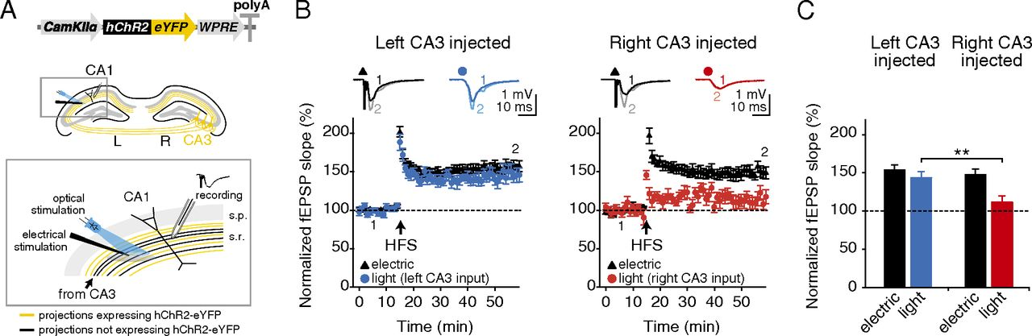
High-frequency stimulation-induced LTP is asymmetrically expressed at the CA3–CA1 pyramidal cell synapse.
Olivia A. Shipton et al. PNAS 2014;111:42:15238-15243
©2014 by National Academy of Sciences
Notes:
High-frequency stimulation-induced LTP is asymmetrically expressed at the CA3–CA1 pyramidal cell synapse. (A, Upper) Adeno-associated virus containing hChR2-eYFP construct under the control of a CaMKIIα promoter was unilaterally injected into the dorsal CA3 area of C57BL/6J mice. (Lower) An electrode to deliver nonselective electrical stimulation was placed in the stratum radiatum and a high-power 470-nm LED was arranged to recruit an overlapping population of projections. Optical stimulation only recruits projections originating in the CA3 of the injected hemisphere (yellow), whereas electrical stimulation is nonselective (black and yellow). Electrical stimulation was used to deliver the high-frequency LTP induction protocol and the effects were monitored via field recording of EPSPs evoked by electrical or optical stimulation. (B) HFS produces robust LTP in the electrical pathway (black triangles), but LTP is only expressed in the optical pathway (circles) when projections originate in the left CA3. (Insets) Representative field EPSPs at the indicated time points (1, 2). (C) Significantly more LTP is observed in left-injected mice than in right-injected mice in the optical pathway. Broken lines represent baseline. Error bars represent SEM. **P < 0.01, Student’s t test.

Slide 17
03
Part THREE
Lee, 2016
Identify brain regions scopolamine induce intensity changes
Evaluate the effects of scopolamine on FC
Whether scopolamine-induced memory effect could be
reversed with milameline

Slide 18
Functional Cross-Hemispheric Shift Between Object-Place Paired Associate Memory and Spatial Memory in the Human Hippocampus
Notes:
PNAS是《美国科学院院报》9.423

Slide 19
HIPPOCAMPUS 4.162
Lee , 2016
VR
Human
fMRI
Efficiency index
Object-based event memory task
Spatial navigation task
Notes:
HIPPOCAMPUS 4.162
Pindex:0.914 (极难发表)

Slide 20
Thank you all for listening~

Slide 21
