Slide 1
Functional networks and network
perturbations in rodents

Slide 2

NeuroImage
Kai-Hsiang Chuang， 2017
Synchronous low-frequency oscillation
Similar ： human & rodents
Many research areas
Overview

Slide 3
Resting-state network of the rodent brain
Rat & mouse & human
FC patterns
Awake & Anesthetized

Slide 4
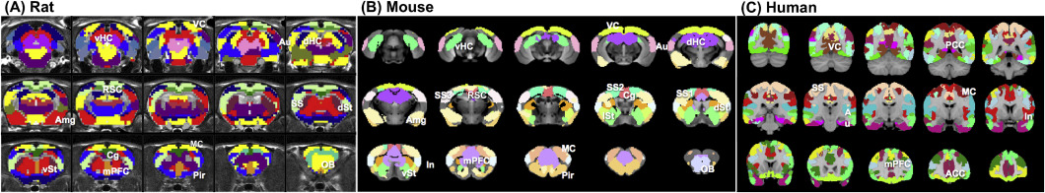

Slide 7
Resting-state network of the rodent brain
Functions of RSN
Changing in & after task
Functional parcellation and modules
ICA
voxel-wise correlation

Slide 8
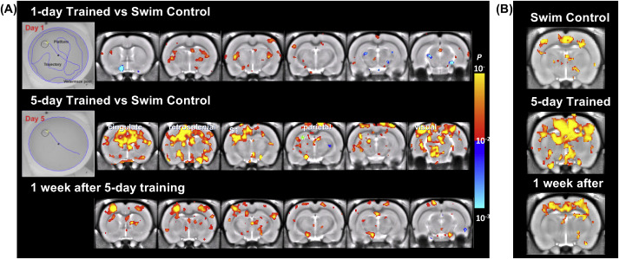

Slide 9
Effects of anesthesia on functional networks
Neural, vascular and FC effects of different anesthesia
Awake
Practical consideration

Slide 10
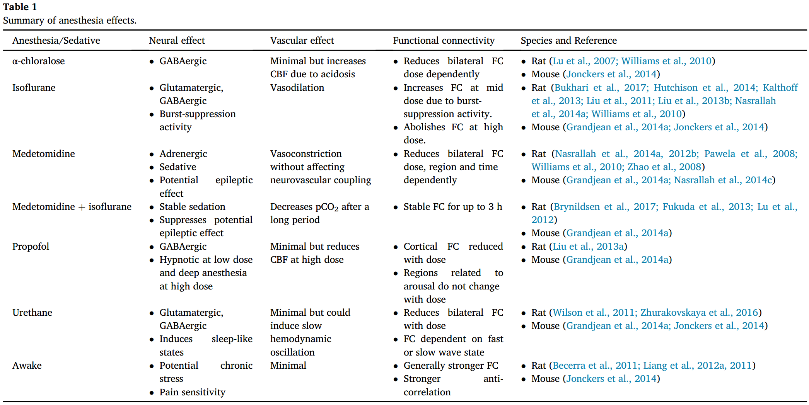

Slide 11
Awake restrained rodents:
Spontaneous activity amplitude and FC strength are generally greater
More long-range connections
Awake mouse & rat

Slide 12
Anesthesia injection:
Continous delivery
Affect: Spectral distribution
Effect: Animal species, strain, gender, age and disease state dependent

Slide 13
Pharmacological effects on functional networks
phMRI
Neural activation
Pharmacodynamics
A change in FC
Efficacy of drug treatment
Neural correlate of FC
Drugs that target specific receptors
Notes:
In the following section, the effect of drugs that target the major neurotransmission systems are discussed.（6 kinds：examples）
Potential confounds：peripheral/vascular effects and interaction with anesthesia

Slide 14
Behavior-induced
network change
Behavior/Learning change FC
Passive & active
Morris water maze
Duration dependent, reorganized
Neural oscillations
Fear

Slide 15
Manipulation of networks by brain stimulation
Brain stimulation
High frequency
RSNs
Shape RSN activity
Low frequency
Sensory gain
FC
Optogenetics
Chemogenetics
Notes:
To determine: functional role of a specific pathway or cell type in behavior

Slide 16
Structural connectivity affect network organization
Axonal connectivity
Correspondence between regions
Unidirectional monosynaptic
Bidirectional and/or polysynaptic projections
Cortical FC :
monosynaptic projections
Subcortical FC :
polysynaptic projections

Slide 17
Genetic and strain effects on network changes
Gene expression
Highly coupled
Molecular & energetic demand
Specific gene
Connectome
Knock in/out
FC
Notes:
Gene variaions
Brain structure and function

Slide 18
Disease-dependent network changes
Brain, spinal cord and peripheral nerve injury
Stroke
AD
ASD
Stress and depression
Schizophrenia

Slide 19
Physiological considerations during experiments
Respiratory
Cardiac artifacts
Body temperature
Baseline difference in:
CO2, O2
Blood pressure
CBF

Slide 20
Technical considerations in data processing
Susceptibility artifacts
Motion artifacts
Physiological artifacts
Filter bandwidth

Slide 21
Thank you all for listening~

