Slide 1
Automatic Content-Aware Color and
Tone Stylization
Life Science and Technology
Brian Image and Neuroscience
Li Siyang

Slide 2
PART 1:
Abstract

Slide 3
Abstract
What they do in this paper:
a technique that automatically generates stylizations for a photograph in an unsupervised manner

Slide 4
Abstract
Key steps:
Style Selection:
Semantic clustering
Style ranking
Style sampling
Style Transfer

Slide 5
PART 2:
Introduction

Slide 6
Introduction
Softwares do not fit every photo well
Example-based style transfer techniques
Quality depend on the exemplar chosen
Improve:learn style transform from input-stylized image pairs
Disadvantage: the amout of training data

Slide 7
Introduction
Method in this paper:
Automatically learning the ‘right’ looks
Robustly apply styles to generate stylized outputs
Define stylizations as global transformations of color and luminance
Unsupervised

Slide 8
Introduction
Dataset used :
Target style database, S(small, not enough):
1500 stylized exemplar images(good styles)
Automatically select the style from here
A large photo collection, P(not curated,good&poor):
Millions(‘All’ styles & Semantic content)
Notes:
Both these two databases are used for training,there is another database bigger and more random to test/practice

Slide 9
Introduction
They use the large photo collection to :
Learn a content-to–style mapping
Generate the transform between one photo and one certain exemplar in target style database
Unsupervised

Slide 10
Introduction
They do steps below to the large photo collection :
Segment it to conten-based clusters by semantic features(from CNN)
Learn a ranking of the style exemplar for each cluster by eveluating the respective style similarities to images in the cluster

Slide 11
Introduction
Run time:
Input photo
Nearest cluster to it(by semantic features)
Sample stylized exemplar ranking to get a diverse subset of relevant style exemplar(not only one exemplar)

Slide 12
Introduction
Transfomation:
Statisics of exemplar → input photo
Regularized previous techniques(color and tone mapping functions)
Face-specific luminance correction step
Last two steps : minimize artifacts

Slide 13
Introduction
Contributions:
A robust style transfer method that captures a wide range of looks while avoiding image artifacts
An unsupervised method to learn a content-specific style ranking using semantic and style similarity

Slide 14
Introduction
Contributions:
A style selection method to sample the ranked styles to ensure both diversity and quality in the results
A new benchmark dataset with professional stylizations and a comprehensive user evaluation of various style selection and transfer techniques.

Slide 15
PART 3:
Method Overview

Slide 16
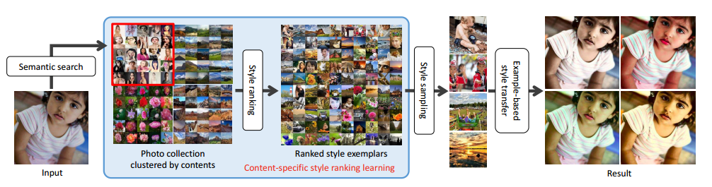
Method
I→P
P→S
Sample
Notes:
Draw a graph about how this work

Slide 17
Method Overview
Stylization : global transformations of the input color and luminance (one I → O₁,O₂,...O_{k}),using functions
Styles: S₁,S₂,...S_{n}
I +S → O
The quality of the stylized result O is also closely tied to the choice of the exemplar S

Slide 18
Method Overview
Semantic similarity metric: learned using CNN
S is limited and unlikely to contain style examples for every content class – not good to directly match S with I
P involved to generate a content-specific style ranking
|P| >> |S| >> |O|
P → S(leverage), I → P(stylization) using metric above

Slide 19
Method Overview
Leverage :
For every image in each semantic class of P ,find a exemplar using metric mentioned
For each semantic class of P, generate a exemplar ranking
Sampling (eg: first four exemplars)

Slide 20
PART 4:
Method Details

Slide 21
1 Example-based Style Transfer (do to I, along with S)
Function : Stylize an input photo
First compress the dynamic ranges of the two images using a γ (= 2.2) mapping
Then convert the images into the CIELab colorspace

Slide 22
1 Example-based Style Transfer
We model the chrominance distribution of an image using a multivariate Gaussian
Then find a transfer function that creates the output image O by mapping the Gaussian statistics NS(µS, ΣS) of the style exemplar S to the Gaussian statistics NI(µI, ΣI) of the input image I

Slide 23
1 Example-based Style Transfer
Next, we stretch the luminance (L channel) to cover the full dynamic range after clipping both the minimum and the maximum 0.5 percent pixels of luminance levels,
Last, apply different transfer functions to the luminance and chrominance components

Slide 24

1 Example-based Style Transfer
Chrominance:
T : a linear transformation that maps chrominance between the images and c(x) is the chrominance at pixel x as below:

Slide 25

1 Example-based Style Transfer
I : an identity matrix
Advantage : only regularizes colors channels with low
variation without affecting the others
λr = 7.5.

Slide 26

1 Example-based Style Transfer
Luminance:
l_{I}(x) and l_{O}(x) : the input and output luminance
m and δ : two parameters of the mapping function

Slide 27
1 Example-based Style Transfer
Luminance:
m :determines the inflection point of the mapping function
δ :determines the degree of luminance stretching around the inflection point.

Slide 28

1 Example-based Style Transfer
Luminance:
L_{I} and L_{S} : the input and style luminance features
: represents how closely we want to match the
exemplar luminance distribution
τ =0.4

Slide 29
1 Example-based Style Transfer
Face exposure corection:
First detect face regions in the input image, given by center p and radius r, using the Haar cascade classifier implemented in the OpenCV

Slide 30
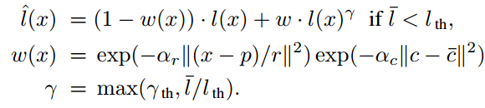
1 Example-based Style Transfer
Face exposure corection:
If the median luminance in a face region is lower than a threshold l_{th,} do γ-correction below:

Slide 31
1 Example-based Style Transfer
Face exposure corection:
W(x):compute these weights based on spatial distance from the face center

Slide 32
1 Example-based Style Transfer
Face exposure corection:
: chrominance distance from the median face chrominance value (to capture the color of the skin)

Slide 33
1 Example-based Style Transfer
Face exposure corection:
α_{r} and α_{c} : normalization parameters that control the weights of the spatial and chrominance kernels respectively

Slide 34
1 Example-based Style Transfer
Face exposure corection:
set {lth, γ th, αr, αc} to {0.5, 0.5, 0.45, 0.001}.

Slide 35
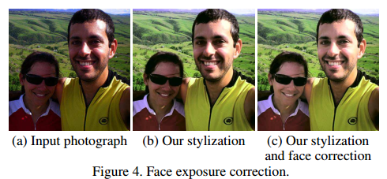
1 Example-based Style Transfer
Face exposure corection:

Slide 36
2.1 Semantic clustering (do with P)
Do to : P (a large photo collection)
Using : semantic features
Generate from :CNN
Tool : Modified CaffeNet(have fewer nodes in the fully- connected layers )
Formation : 512-demensional featire vector

Slide 37
2.1 Semantic clustering (do with P)
Way of clustering: k-means clustering
1000 clusters (balance the numbers and content classes)
small number of clusters → different content classes being grouped in the same cluster
large number of clusters →the style variations of the same content class of images being split into different clusters

Slide 38
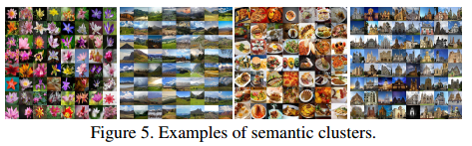
2.1 Semantic clustering (do with P)

Slide 39
2.2 Style ranking(do with P and S)
Statistics : style similarity
Calculate between each style and the images in a cluster
Rank the styles for that clusters
Generate as below:

Slide 40
2.2 Style ranking(do with P and S)
P: cluster photo in the large photo colleciton
S: style exemplar
D_{e} : Euclidean distance → difference
D_{h} : Hellinger distance → overlap
set λ_{l} = 0.005 and λ_{c} = 0.05

Slide 41

2.2 Style ranking(do with P and S)
D_{h} : Hellinger distance:
NP = (µP , ΣP ) : multivariate Gaussian statistics of chrominance channel for an image
ǫ = 1

Slide 42

2.2 Style ranking(do with P and S)
C_{K} : compatibility of a stylized exemplar S, with a semantic cluster
For each semantic cluster, we compute for all the style exemplars and determine the style example ranking by sorting in decreasing order.
Notes:
CK：each semantic cluster in the large photo collection
P : each image in cluster CK
S : a exemplar in S(style database)
RK(S) : for each S each CK, there is one this figure
Get all R about CK ,then rank them

Slide 43
2.3 Style sampling(do with S)
I → nearest semantic cluster (P,senmantic features)
Pre-computed style exemplar ranking for each cluster(S,P)
Top k style images → I → O₁,..O_{k} (S+I,O)
New similarity measure for sampling:
Squared Frechet distance
To find similar semantic clusters

Slide 44
2.3 Style sampling(do with S)
Use 3 semantic clusters and set threshold to 7.5
How to get these k style images:
Merge style lists for multiple nearest semantic clusters
Order them by mentioned in last slice and no repeated ones

Slide 45
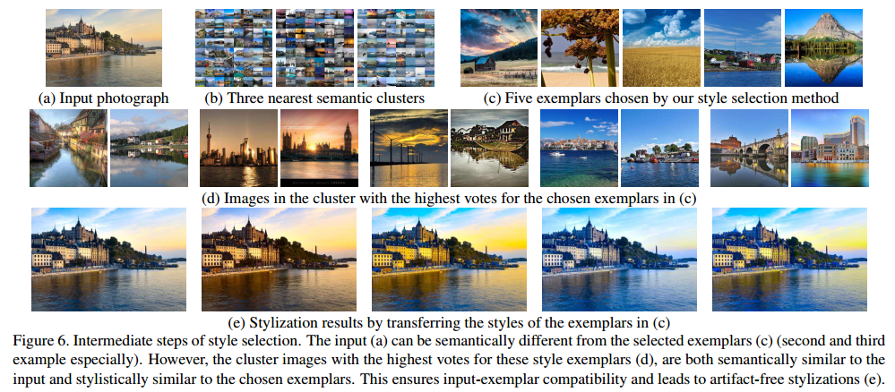
3 Subset of results

Slide 46
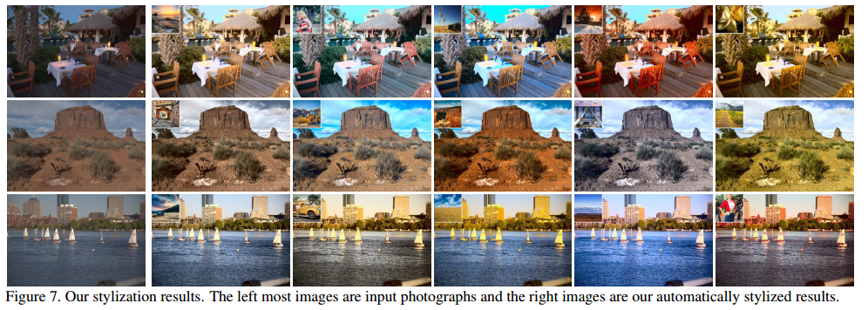
3 Subset of results

Slide 47
PART 5:
Results and Discussion

Slide 48
User study
Pre-work:
A benchmark dataset of 55 images :
50 images :randomly chosen from the FiveK dataset
the rest : downloaded from Flickr
Resize : 500-pixels wide
Store : 8-bit sRGB JPEG

Slide 49
User study
Baseline(Pro) :
5 diverse stylizations created by a professional artist
Globally edit the color and tone
Using tools in Adobe Photoshop
Two studys

Slide 50
Study 1
Evaluated two style selection methods:
Our style selection(P→S,I→P)
Direct semantic search : I→S(directly searches for semantically similar images in the style database)
In different sizes of style exemplars: 1500 and 50

Slide 51
Study 1
Both apply the same sytle sampling and transfer tech
37 users participated :rate the stylization quality of each group of results on a five-point Likert scale ranging from 1 (worst) to 5 (best)

Slide 52
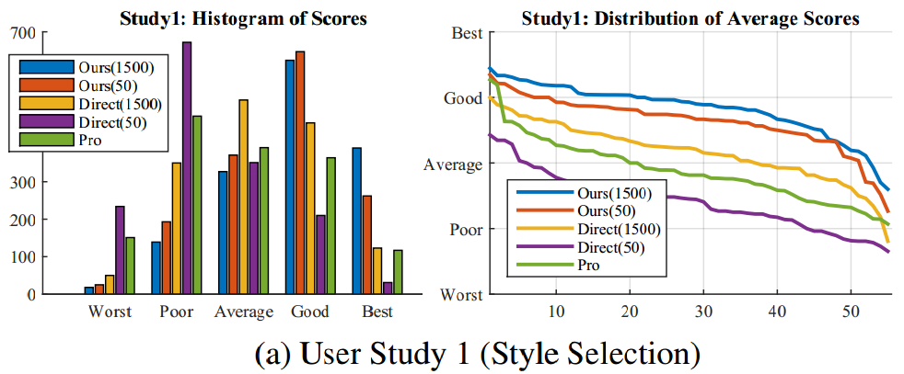
Results and Discussion

Slide 53
Results and Discussion
OURS 1500 (3.820 ± 0.403) outperforms all the other techniques
DIRECT 1500 (3.169 ± 0.444) is substantially worse than OURS 1500

Slide 54
Results and Discussion
When the style database becomes smaller:
the performance of direct search drops dramatically (2.421 ± 0.436 for DIRECT 50)
our style selection stays stable (3.620 ± 0.413 for OURS 50)

Slide 55
Results and Discussion
Explaination : the novel two-step style ranking algorithm can learn the mapping between semantic content and style even with very few style examples

Slide 56
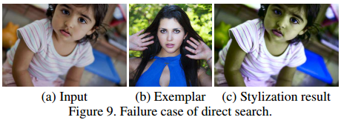
Results and Discussion
Found that :
direct search finds a semantically meaningful match a good style transfer result

Slide 57
Results and Discussion
PRO (2.881 ± 0.480) got a lower mean score than {OURS 1500, OURS 50, DIRECT 1500} with the largest standard deviation of scores

Slide 58
Results and Discussion
Explaination :
The artist-created filters do not adapt to the content of the image in the same way our example-based style transfer technique does.

Slide 59
Results and Discussion
Explaination :
Image stylization tends to be subjective in nature;
Some of users might be uncomfortable with the aggressive stylizations of a professional
Our style selection is learned from a more ‘natural’ style database

Slide 60
Study 2
We compare our style transfer technique with four different statistics-based style transfer techniques : MK, SMH, PDF, PHR
Style exemplars are chosen by our style selection and these methods are used only for the transfer.
Notes:
MK, which computes an affine transform in CIELab SMH, which combines three different affine transforms in different luminance bands with a non-linear tone curve PDF, which use 3-d histogram matching in CIELab PHR, which progressively reshapes the histograms to make them match

Slide 61
Study 2
What we give users(27):
An input photograph
an exemplar
A randomly arranged set of five stylized images created using the techniques
Notes:
MK, which computes an affine transform in CIELab SMH, which combines three different affine transforms in different luminance bands with a non-linear tone curve PDF, which use 3-d histogram matching in CIELab PHR, which progressively reshapes the histograms to make them match

Slide 62
Study 2
Ask users to rate the results in terms of style transfer and visual quality on a five-point Likert scale ranging from 1 (worst) to 5 (best)

Slide 63
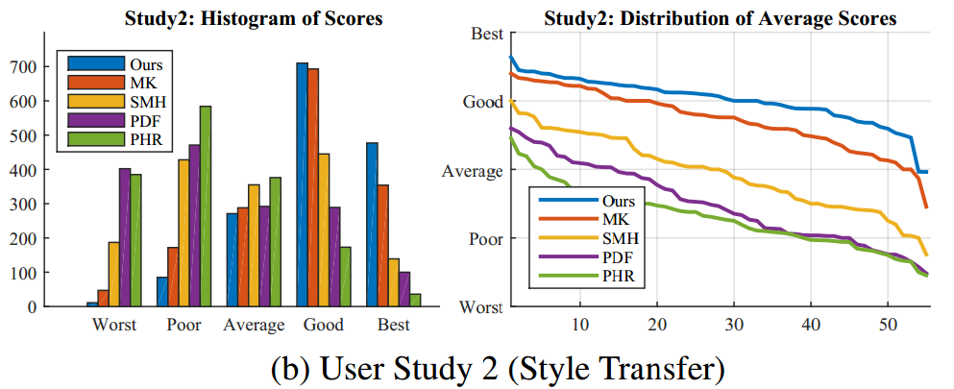
Results and Discussion

Slide 64
Results and Discussion
OURS (4.002± 0.336) records the best rating
MK (3.730±0.440) is ranked second
SHM (2.949 ± 0.545), PDF(2.494 ± 0.577), and PHR (2.286 ± 0.452) are less favored by users

Slide 65
Results and Discussion
Explaination :
Last three techniques have more expressive color transfer models leading to over-fitting and poor results

Slide 66
PART 5:
Conclusion

Slide 67
Conclusion
Proposed an automatic technique to stylize photographs based on their content
P → S :
semantic features,clusteromg,leverage, style ranking
I → P:
Nearest(semantic featiures),merging, sampling

Slide 68
Conclusion
Our technique produces a diverse set of compelling, high-quality stylized results.
We have extensively evaluated both style selection and transfer components of our technique and studies show that users clearly prefer our results over other variations of our pipeline.

Slide 69
Thank you ~

