Slide 1
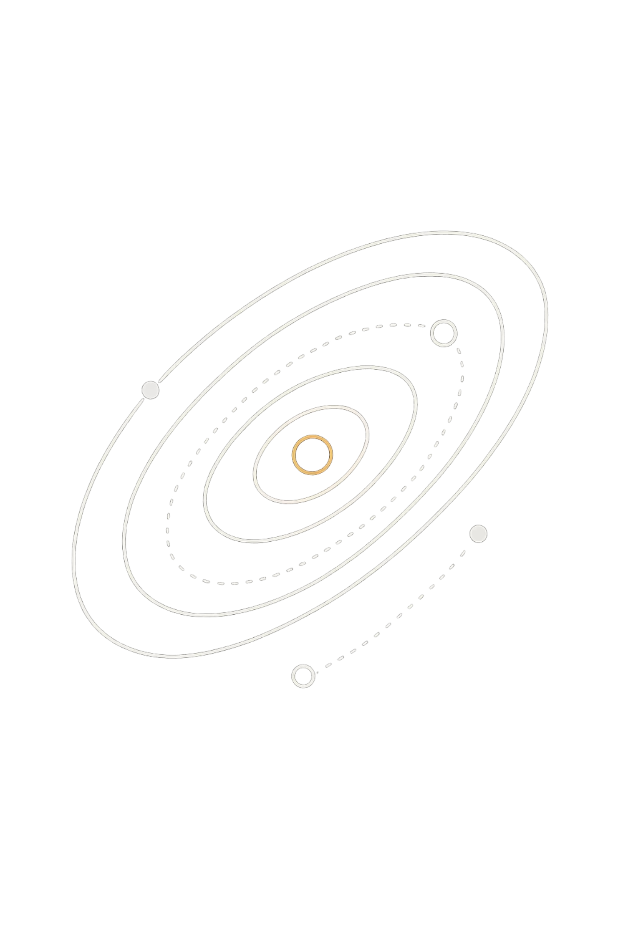

CosmicLens API
A RESTful web service providing programmatic access to NASA's Astronomy Picture of the Day dataset — spanning 31 years of astronomical imagery.
LIU SIYUAN (2022115992)
XJCO3011
APRIL 2026

Slide 2

EXECUTIVE SUMMARY
Bridging NASA's Cosmos to Developers
CosmicLens transforms NASA's APOD archive into a developer-friendly middleware layer, enabling everything from simple picture browsing to complex data analysis workflows.
Full CRUD for pictures and collections
JWT authentication with bcrypt hashing
27 endpoints across 4 logical categories
Rich analytics and search capabilities

Slide 3
The APOD Dataset at a Glance
11K+
31
Records
Years
Images and videos curated since 1995
From June 16, 1995 to present day
96.3%
3.4%
Images
Videos
Traditional photographic content
YouTube and Vimeo embedded
Curated by Dr. Jerry Bonnell and Dr. Robert Nemiroff, with contributions from Hubble, James Webb, and global observatories.

Slide 4
TECHNOLOGY STACK
Built for Performance and Maintainability
Component
Technology
Version
Key Benefits
Framework
FastAPI
0.109+
High performance, auto OpenAPI docs, async support
Database
PostgreSQL
15+
ACID compliance, advanced SQL, native JSON
ORM
SQLAlchemy
2.0+
Type-safe queries, async operations
Auth
JWT + bcrypt
jose/bcrypt
Stateless tokens, secure hashing
Each technology selected after evaluating alternatives like Flask, Django, Express.js, MySQL, and MongoDB — prioritizing developer experience and long-term maintainability.

Slide 5
27 Endpoints Across 4 Categories
1
2
Authentication
Pictures
4 endpoints: register, login, profile, logout. JWT with 7-day expiration.
8 endpoints: list, retrieve, CRUD, search, random, date lookup.
3
4
Collections
Analytics
8 endpoints: user collections, public browsing, picture management with isolation.
7 endpoints: overview, media types, timelines, keywords, summaries.

Slide 6

Media Distribution in the Archive
3.4%
A Photographic Universe
The vast majority of APOD content is photographic imagery captured by space and ground-based observatories. Video content — primarily from YouTube and Vimeo — supplements the archive with dynamic visualizations.
Images·96.3%
·96.3%
·
Videos·3.4%
·3.4%
·
Other·0.3%
·0.3%
·
All content is in the Public Domain, courtesy of NASA.
96.3%

Slide 7

Data Schema
Each record contains rich metadata enabling powerful search and analytics.
Identifiers
Unique id and publication date (both unique constraints)
Content
Title, explanation, media_url, optional hd_url
Metadata
Media type, copyright, user-contributed keyword array

Slide 8
TESTING & CHALLENGES
Solving Real Engineering Problems
01
02
Database Initialization
Data Import at Scale
Dockerized PostgreSQL with custom init script for consistent environments.
Robust parsing of 11,000+ records with inconsistent dates, missing fields, and malformed URLs.
03
04
Many-to-Many Relationships
User Isolation
Association table with foreign key constraints and cascade delete rules.
Service-layer authorization checks returning 403 Forbidden for unauthorized access.

Slide 9
Limitations & Future Roadmap
Current Limitations
Planned Improvements
No caching layer — every request hits DB
SQL LIKE only, no fuzzy search
JWT tokens cannot be revoked early
No rate limiting on endpoints
Limited URL validation
Token refresh for extended sessions
Redis caching for analytics
Elasticsearch for fuzzy full-text search
WebSocket real-time suggestions
ML-based recommendation engine
Per-client rate limiting & API keys

Slide 10

Deployment & GenAI Reflection
Deployment
GenAI Usage: High (80-89)
Access docs at /docs (Swagger) and /redoc. Containerized via docker-compose up -d.
AI leveraged creatively across architecture, debugging, and learning — not just code generation.
uvicorn app.main:app --reload
--host 0.0.0.0 --port 8000
~11 hours saved
All code reviewed and understood
Transparent declaration per course rules

