Slide 1
CO4 · MULTI-FRAMEWORK BACKEND ENGINEERING
Spring Boot Core & Security
IoC · Dependency Injection · REST · JPA · Validation · Spring Security

Slide 2
SESSION ROADMAP
1
IoC & Dependency Injection
How Spring creates and wires your objects, instead of you doing it by hand.
2
REST Fundamentals
How an HTTP request becomes Java code, and how CRUD maps to HTTP methods.
3
JPA & Relational Persistence
Entities, repositories, and the full CRUD flow against a relational database.
4
Validation
Rejecting bad input before it reaches your business logic or database.
5
Spring Security
Authentication, password hashing, and a full JWT-based login flow.

Slide 3
FOUNDATIONS
What Is Spring?
A Java framework and ecosystem
Not one library — a whole family of tools that work together.
Core ideas: IoC, Dependency Injection, web, data, security
These pieces combine to handle almost every backend concern.
The Spring container manages objects called Beans
You describe what you need; Spring creates and connects it for you.
Understand the architecture before memorizing annotations
Annotations are shortcuts for concepts — the concepts matter more.
Spring Boot Core — Complete Flow with MongoDB
5

Slide 4
FOUNDATIONS
What Is Spring Boot?
Simplifies Spring application setup-Less configuration, more sensible defaults out of the box.
Starters bring in required functionality- One dependency (e.g. spring-boot-starter-web) pulls in everything that feature needs.
Auto-configuration reduces repetitive setup- Spring Boot guesses sensible configuration based on what's on your classpath.
An embedded web server lets it run directly- No separate Tomcat install — just run the app and it's already listening for requests.
Spring Boot Core — Complete Flow with MongoDB
6

Slide 5
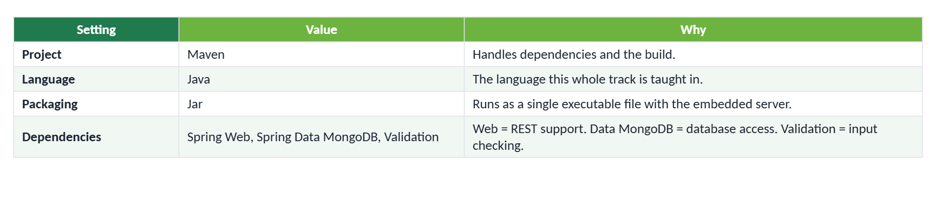
GETTING STARTED
Create the Project (Spring Initializr)
Spring Boot Core — Complete Flow with MongoDB
7

Slide 6
STARTUP
@SpringBootApplication
Marks the main Spring Boot application class- This is the one annotation that kicks everything else off.
Spring uses it as the entry point for startup- It's where SpringApplication.run() is called from main().
Component scanning discovers your components- Spring automatically finds your Controllers, Services, and Repositories nearby.
Auto-configuration sets up infrastructure-Database connections, web server settings, and more are configured automatically.
The ApplicationContext is created and manages Beans-This is the running container holding every object Spring controls.
Spring Boot Core — Complete Flow with MongoDB
9

Slide 7
IOC BASICS
What Is a Bean?
A Bean is simply an object that Spring creates and manages for you — instead of you writing new SomeClass() yourself.
Examples in this app:
Spring creates and connects these three objects to each other through the IoC container — you never write "new" for any of them.
Spring Boot Core — Complete Flow with MongoDB
10

Slide 8
IOC — INVERSION OF CONTROL
Who Creates Your Objects?
TRADITIONAL JAVA
SPRING / IoC
Your code controls object creation
The container controls object creation
StudentService service
= new StudentService();
// nowhere in your code:
// new StudentService()
// Spring creates it and
// injects it where needed
You are responsible for creating, and later wiring, every dependency by hand.
Control over object creation has moved OUT of your code and INTO the Spring container. That's the "inversion."

Slide 9
FOUNDATIONS
Quick Refresher: Spring Boot
1
Spring Boot simplifies Spring application setup
Less configuration, sensible defaults out of the box.
2
Starters bring in required functionality
One dependency (e.g. spring-boot-starter-web) pulls in everything that feature needs.
3
An embedded web server lets it run directly
No separate server install — just run the app and it's already listening.
4
The Spring container manages objects called Beans
You describe what you need; Spring creates and connects it for you — this is IoC, next up.

Slide 10
GETTING STARTED
Project Structure
student-records-spring/
── src/main/java/com/example/studentrecords/
│ ── StudentRecordsApplication.java
│ ── controller/
│ ── service/
│ ── repository/
│ ── document/
│ └── dto/
── src/main/resources/
│ └── application.properties
└── pom.xml
Each folder is one responsibility: controller = HTTP, service = business logic, repository = database, document = persistence shape, dto = API input/output.
Spring Boot Core — Complete Flow with MongoDB
8

Slide 11
IOC BASICS
What Is a Bean?
A Bean is simply an object that Spring creates and manages for you — instead of you writing new SomeClass() yourself.
Examples in this app:
Spring creates and connects these three objects to each other through the IoC container — you never write "new" for any of them.
Spring Boot Core — Complete Flow with MongoDB
10

Slide 12
IOC — INVERSION OF CONTROL
Who Creates Your Objects?
TRADITIONAL JAVA
Your code controls object creation
StudentService service
= new StudentService();
You are responsible for creating, and later wiring, every dependency by hand.
SPRING / IoC
The container controls object creation
// nowhere in your code:
// new StudentService()
// Spring creates it and
// injects it where needed
Control over object creation has moved OUT of your code and INTO the Spring container. That's the "inversion."
Spring Boot Core — Complete Flow with MongoDB
11

Slide 13
IOC — INVERSION OF CONTROL
IoC Startup Flow
main()
SpringApplication.run()
ApplicationContext created
component scanning
Beans created
dependencies injected
embedded server starts
application ready
This entire sequence happens once, automatically, every time the app starts.

Slide 14
DEPENDENCY INJECTION
Supplying Dependencies From Outside
1
DI means supplying a required dependency from outside
A class doesn't build what it needs — it receives it, already built.
2
StudentController depends on StudentService
The controller needs a working service to actually do anything.
3
StudentService depends on StudentRepository
The service needs a working repository to reach the database.
4
Spring resolves and injects all of these automatically
You declare the dependency; Spring figures out the wiring.

Slide 15
DEPENDENCY INJECTION
Constructor Injection in Practice
@RestController
@RequestMapping("/students")
public class StudentController {
private final StudentService service;
public StudentController(StudentService service) {
this.service = service;
}
}
No "new StudentService()" anywhere here. Spring sees the constructor parameter and supplies a ready-made bean automatically.

Slide 16
REST FUNDAMENTALS
How a REST Request Travels
Postman (HTTP request)
Spring Web
Controller
Service
Repository
Database
Response bubbles back up
JSON response
Every layer only talks to its direct neighbor — the Controller never touches the database directly.

Slide 17
REST FUNDAMENTALS
HTTP Methods and CRUD
Method + Path | CRUD Operation | What it means
POST /students | CREATE | Add a brand-new student record.
GET /students | READ ALL | List every student in the database.
GET /students/{id} | READ ONE | Fetch a single student by their id.
PUT /students/{id} | UPDATE | Modify an existing student's details.
DELETE /students/{id} | DELETE | Remove a student record permanently.
This mapping is the backbone of REST: the HTTP verb tells you the intent before you even read the path.

Slide 18
REST FUNDAMENTALS
Path Variables vs. Query Parameters
Path Variable
Query Parameter
Identifies WHICH resource — part of the URL path itself.
Filters or narrows results — appended after a ? in the URL.
GET /students/42
@PathVariable Long id
GET /students/search?course=CSE
@RequestParam String course
Used here to say "give me exactly this one student."
Used here to say "give me every student matching this filter."

Slide 19
REST FUNDAMENTALS
The Request Body
POST /students
{
"name": "Anita",
"age": 20,
"course": "CSE",
"email": "anita@example.com"
}
@RequestBody is what converts this incoming JSON into an actual Java object your Controller can work with — you never parse JSON by hand.

Slide 20
JPA & PERSISTENCE
What Is JPA?
1
JPA = Java Persistence API
A standard way to map Java objects onto rows in a relational database.
2
Hibernate is the most common implementation
It's the engine that turns your JPA annotations into real SQL.
3
An Entity class represents one database table
Each instance of the class becomes one row.
4
Spring Data JPA builds on top of plain JPA
It gives you a repository interface with CRUD methods generated for you — no SQL to write for the basics.

Slide 21
JPA & PERSISTENCE
The Student Entity
@Entity
@Table(name = "students")
public class Student {
@Id
@GeneratedValue(strategy = GenerationType.IDENTITY)
private Long id;
private String name;
private Integer age;
private String course;
private String email;
// getters and setters
}

Slide 22
JPA & PERSISTENCE
JpaRepository — CRUD for Free
public interface StudentRepository
extends JpaRepository<Student, Long> {}
Just extending this interface gives you:
save()
findAll()
findById()
deleteById()
existsById()
No implementation code required — Spring Data JPA generates working CRUD methods for you at runtime, just from this interface.

Slide 23
JPA & PERSISTENCE
Derived Queries From Method Names
public interface StudentRepository
extends JpaRepository<Student, Long> {
List<Student> findByCourse(String course);
Optional<Student> findByEmail(String email);
}
Spring Data reads the method name itself — "findByCourse" — and builds the matching SQL query automatically. No query code to write.

Slide 24
JPA & PERSISTENCE
Connecting to a Relational Database
spring.datasource.url=jdbc:postgresql://localhost:5432/student_records
spring.datasource.username=postgres
spring.datasource.password=your_password
spring.jpa.hibernate.ddl-auto=update
spring.jpa.show-sql=true
This goes in application.properties. ddl-auto=update lets Hibernate create/update tables from your Entity classes automatically — handy for learning, worth tightening for production.

Slide 25
ARCHITECTURE
The Service Layer
@Service
public class StudentService {
private final StudentRepository repository;
public StudentService(StudentRepository repository) {
this.repository = repository;
}
public Student create(Student student) {
return repository.save(student);
}
public List<Student> getAll() {
return repository.findAll();
}
}

Slide 26
CRUD IN DETAIL
CREATE — Every Step, in Order
POST /students
Controller
@RequestBody
Student object / DTO
Validation
Service
JpaRepository.save()
students table (PostgreSQL)
JSON response

Slide 27
CRUD IN DETAIL
READ (GET) — Every Step, in Order
GET /students
Controller
Service
JpaRepository.findAll()
SQL SELECT
students table
Java objects
JSON
Postman

Slide 28
CRUD IN DETAIL
UPDATE and DELETE
UPDATE
PUT /students/{id}
Controller
Service
findById → modify
save()
Database
DELETE
DELETE /students/{id}
Controller
Service
deleteById()
Database
UPDATE has to look the record up first so it knows what to change; DELETE just needs the id.

Slide 29
DATA INTEGRITY
Validation — Why Bother?
The API should reject invalid input before it ever reaches business logic or the database.
Examples of what should be rejected:
blank name
age below 16
blank course
invalid email
Spring Boot supports Jakarta Bean Validation — a standard set of annotations (@NotBlank, @Min, @Email, etc.) that do this checking for you.

Slide 30
DATA INTEGRITY
Validation Rules on StudentRequest
public class StudentRequest {
@NotBlank
private String name;
@Min(16) @Max(100)
private Integer age;
@NotBlank
private String course;
@NotBlank @Email
private String email;
}

Slide 31
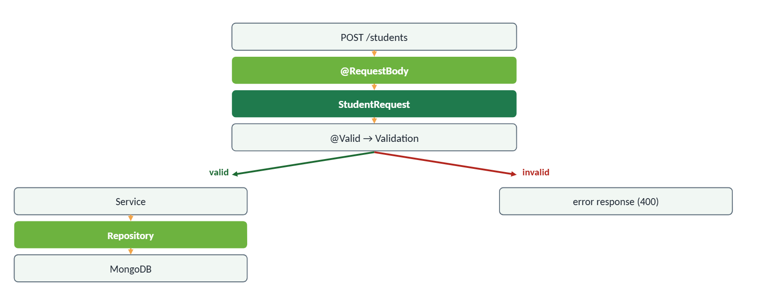
DATA INTEGRITY
@Valid — The Branching Request Flow
One validation check decides which of these two very different paths the request takes — invalid input never reaches the Service layer.

Slide 32
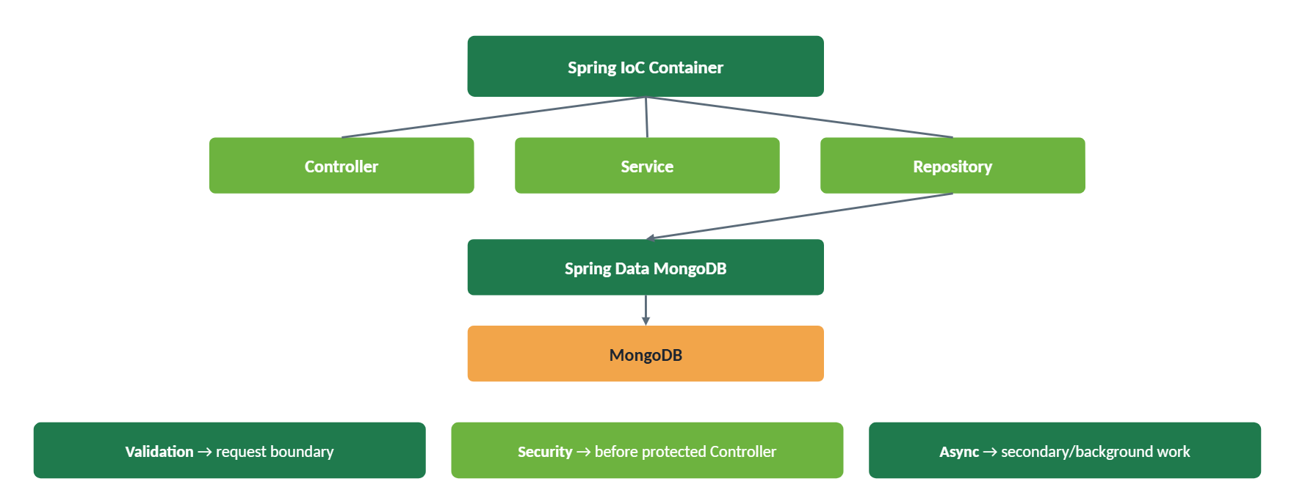
PUTTING IT TOGETHER
Full Student Records Architecture
Spring Boot Core — Complete Flow with MongoDB
35

Slide 33
SPRING SECURITY
Authentication vs. Authorization
1
Authentication — Who are you?
Confirms identity, typically via a username/password or a token.
2
Authorization — What are you allowed to do?
Confirms permission for a specific action, once identity is known.
3
Spring Security sits in front of your Controllers
Every request passes through a filter chain before it ever reaches your code.
4
Unauthenticated or unauthorized requests are rejected early
Your Controller only ever sees requests that were allowed through.

Slide 34
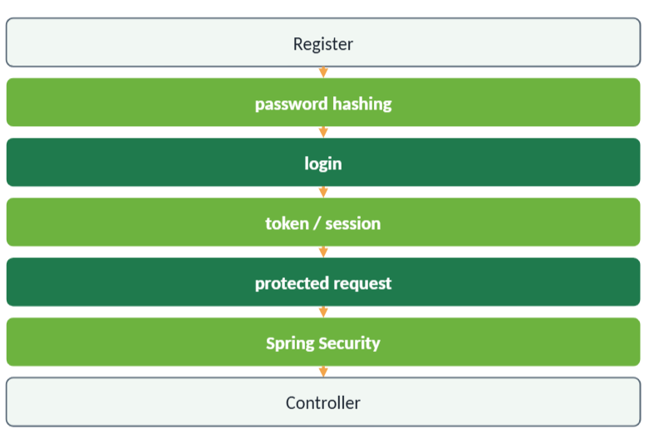
BRIEF PREVIEW
Security — Authentication & Authorization
Authentication
Who are you? Confirms identity.
Authorization
What are you allowed to do? Confirms permission.
Security wraps around the core API as an additional layer.
Spring Boot Core — Complete Flow with MongoDB
36

Slide 35
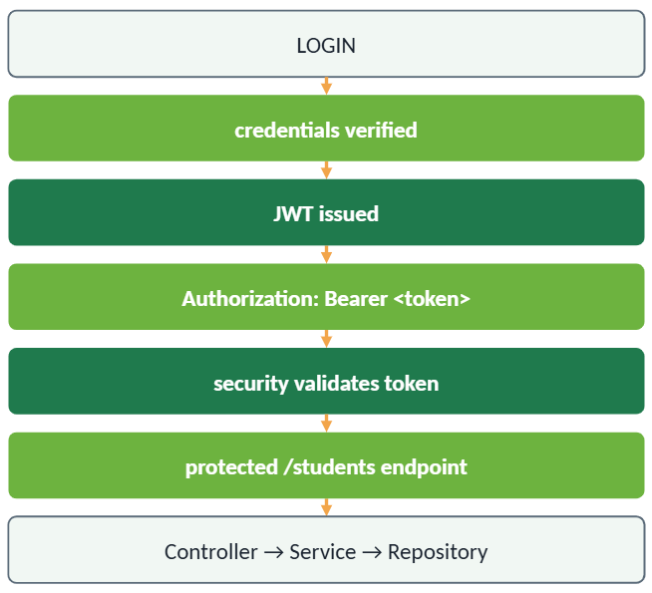
BRIEF PREVIEW
JWT — Token-Based Access
Once issued, the token itself proves who's calling — no need to log in again on every request.
Spring Boot Core — Complete Flow with MongoDB
37

Slide 36
BRIEF PREVIEW
Async — Work That Can Wait
Some work doesn't need to block the HTTP response
  The client doesn't need to wait for it before getting an answer.
Example: audit logging or notifications after creating a student
  The student is already saved — logging that fact can happen a moment later.
@Async can support this, when configured
  Spring runs the annotated method on a separate thread.
For now, just understand WHERE background work fits in the architecture — the implementation is taught later.
Spring Boot Core — Complete Flow with MongoDB
38

Slide 37
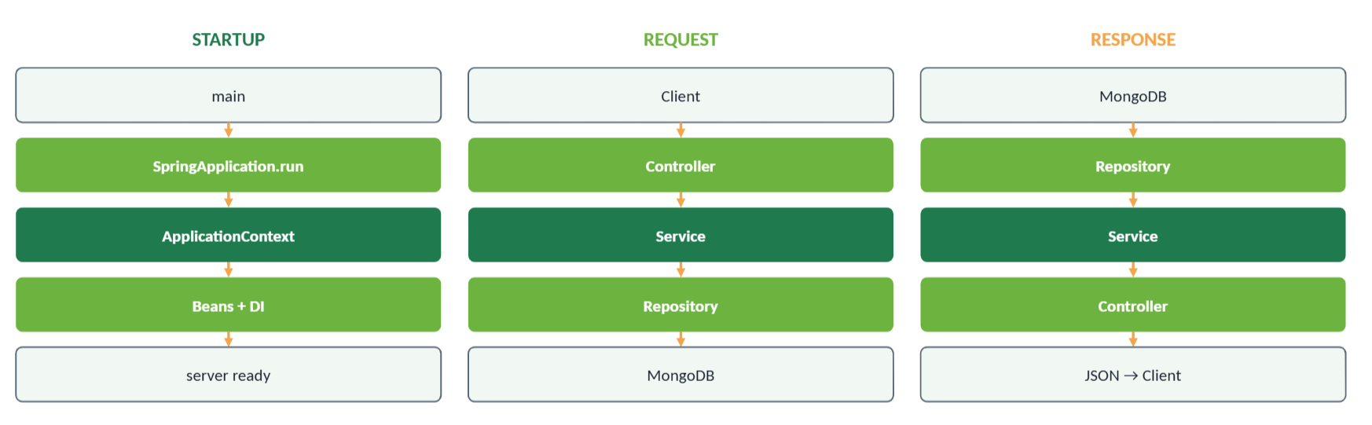
RECAP
Startup, Request, and Response — Side by Side
Spring Boot Core — Complete Flow with MongoDB
39

Slide 38
SPRING SECURITY
What Changes When You Add the Starter
<!-- pom.xml -->
<dependency>
<groupId>org.springframework.boot</groupId>
<artifactId>spring-boot-starter-security</artifactId>
</dependency>
The moment this dependency is added, Spring Security locks down every endpoint by default and generates a temporary login page — nothing is public until you say so.

Slide 39
SPRING SECURITY
Configuring Access With SecurityFilterChain
@Bean
public SecurityFilterChain filterChain(HttpSecurity http) throws Exception {
http
.csrf(csrf -> csrf.disable())
.authorizeHttpRequests(auth -> auth
.requestMatchers("/auth/**").permitAll()
.anyRequest().authenticated()
);
return http.build();
}
This says: login/register routes are public, everything else requires authentication.

Slide 40
SPRING SECURITY
Never Store Plain-Text Passwords
@Bean
public PasswordEncoder passwordEncoder() {
return new BCryptPasswordEncoder();
}
// when registering a user:
String hashed = passwordEncoder.encode(rawPassword);
user.setPassword(hashed);
userRepository.save(user);
BCrypt is a one-way hash — the original password can never be recovered from what's stored, only verified against.

Slide 41
SPRING SECURITY
Registration and Login Flow
POST /auth/register
hash password (BCrypt)
save user
POST /auth/login
verify credentials
issue JWT
return token to client

Slide 42
SPRING SECURITY — JWT
What's Inside a JWT
header.payload.signature
header: { "alg": "HS256", "typ": "JWT" }
payload: { "sub": "anita@example.com", "exp": 1730000000 }
signature: verifies the token hasn't been tampered with
The client stores this token and sends it back on every request — no need to log in again each time.

Slide 43
SPRING SECURITY — JWT
How a Protected Request Is Verified
Request + Authorization: Bearer <token>
JWT filter intercepts
signature verified
token not expired?
SecurityContext populated
Controller
Service → Repository → Database
If the token is missing, invalid, or expired, the filter rejects the request before it ever reaches your Controller.

Slide 44
PUTTING IT TOGETHER
Full Architecture, Security Included
Spring Security Filter Chain
Controller
Service
JpaRepository
PostgreSQL
Security wraps around the whole flow at the very front — by the time a request reaches the Controller, it has already been authenticated.

Slide 45
FINAL TAKEAWAY
Every Layer Has One Job
IoC + DI
→ object management
Controller
→ HTTP
Service
→ business logic
JpaRepository
→ persistence access
Entity
→ table mapping
Validation
→ safer input
Security Filter Chain
→ authentication
JWT
→ stateless identity

