Slide 1

Legal Document Repository
Efficient storage and retrieval of legal documents using advanced algorithms
Team
Busala Laxmi Praveen • Dharani Dhar • N. Nishanth

Slide 2

Abstract
Law firms and courts manage thousands of documents—manual search is slow and inefficient. This system digitizes legal documents and enables fast retrieval using efficient search algorithms, improving organization, reducing search time, and ensuring quick access to legal information.

Slide 3
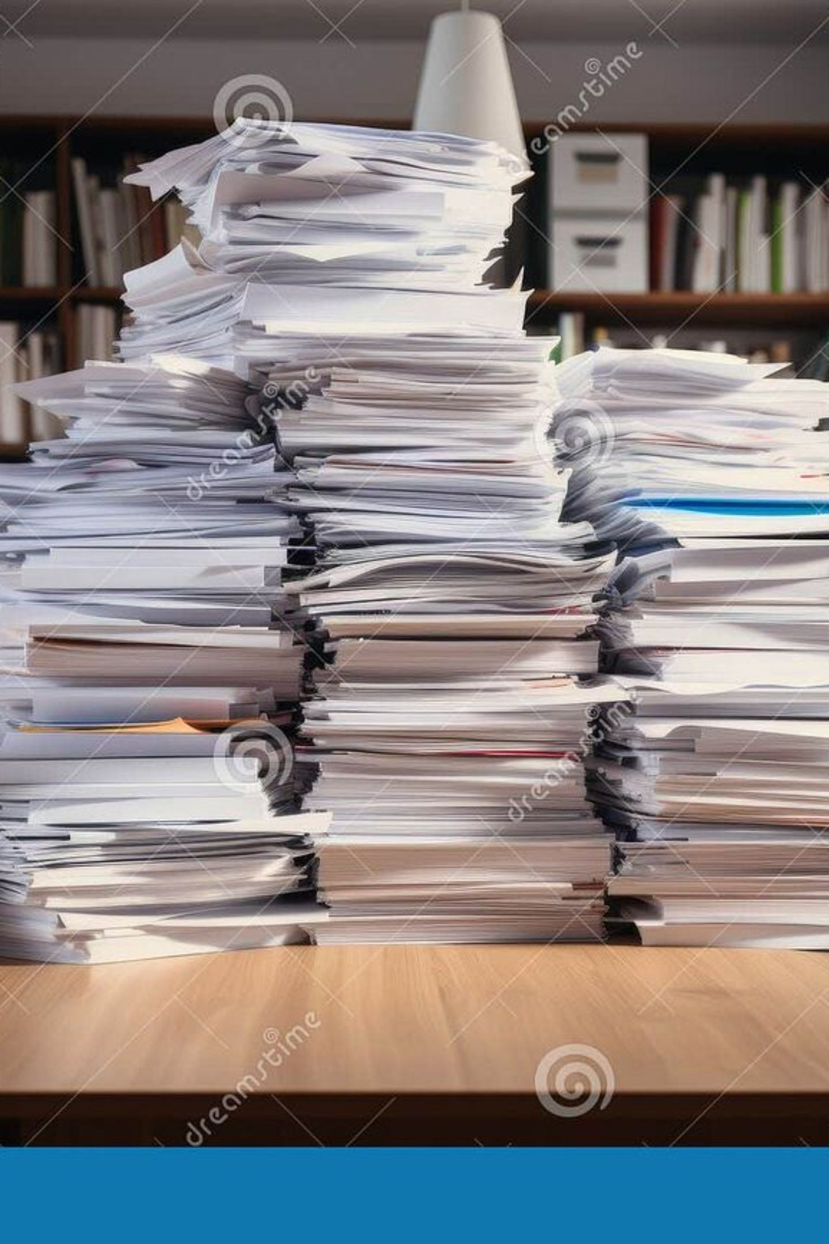
Problem Statement
Core Challenges
Proposed Solution
Time-consuming manual searching; duplicate records; poor organization; keyword search failure; slow retrieval.
A repository that stores legal documents and supports fast searching, filtering, and retrieval using efficient data structures and advanced algorithms.

Slide 4
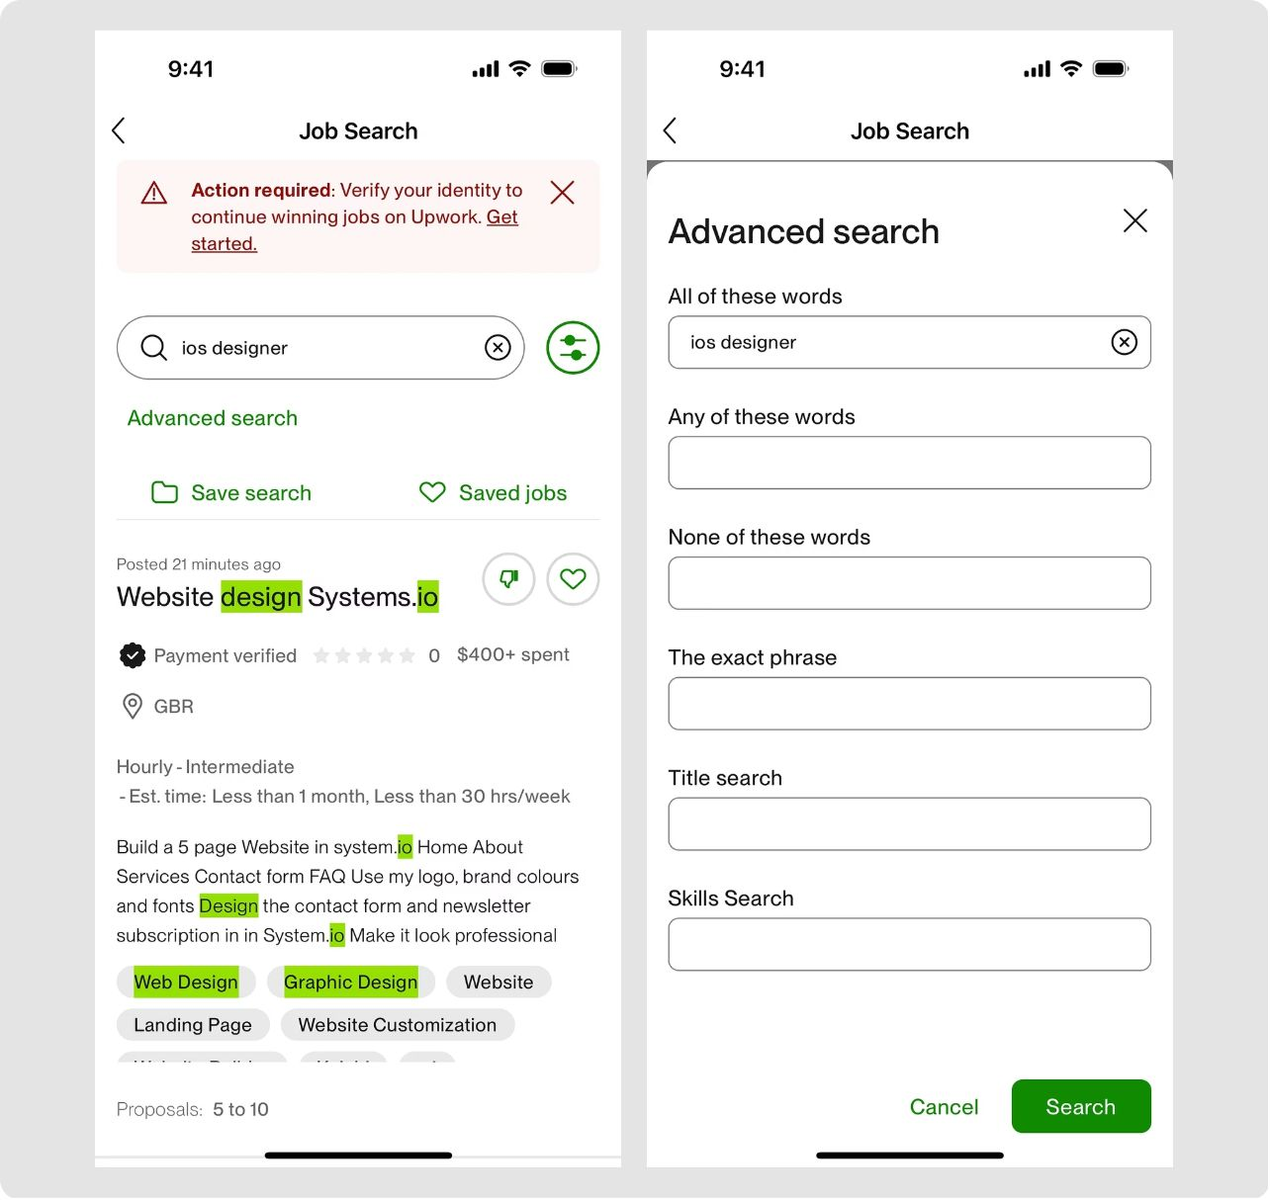
Key Functionalities
User login (optional)
Add, update, delete documents
Search by ID, case number, client, lawyer, keywords, court
Keyword search, sort, view all
Display search time & generate results

Slide 5
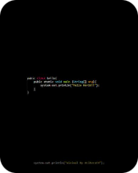
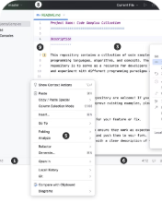

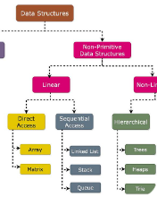
Tools & Technologies
Programming
IDE
Algorithms
Data Structures
Java
IntelliJ IDEA / VS Code
KMP • Rabin-Karp • Binary Search • Merge Sort
Arrays • Linked Lists • Hash Tables • Trie (keyword search)
Aligned with DSA-3 focus on efficient string searching and advanced algorithm selection.

Slide 6
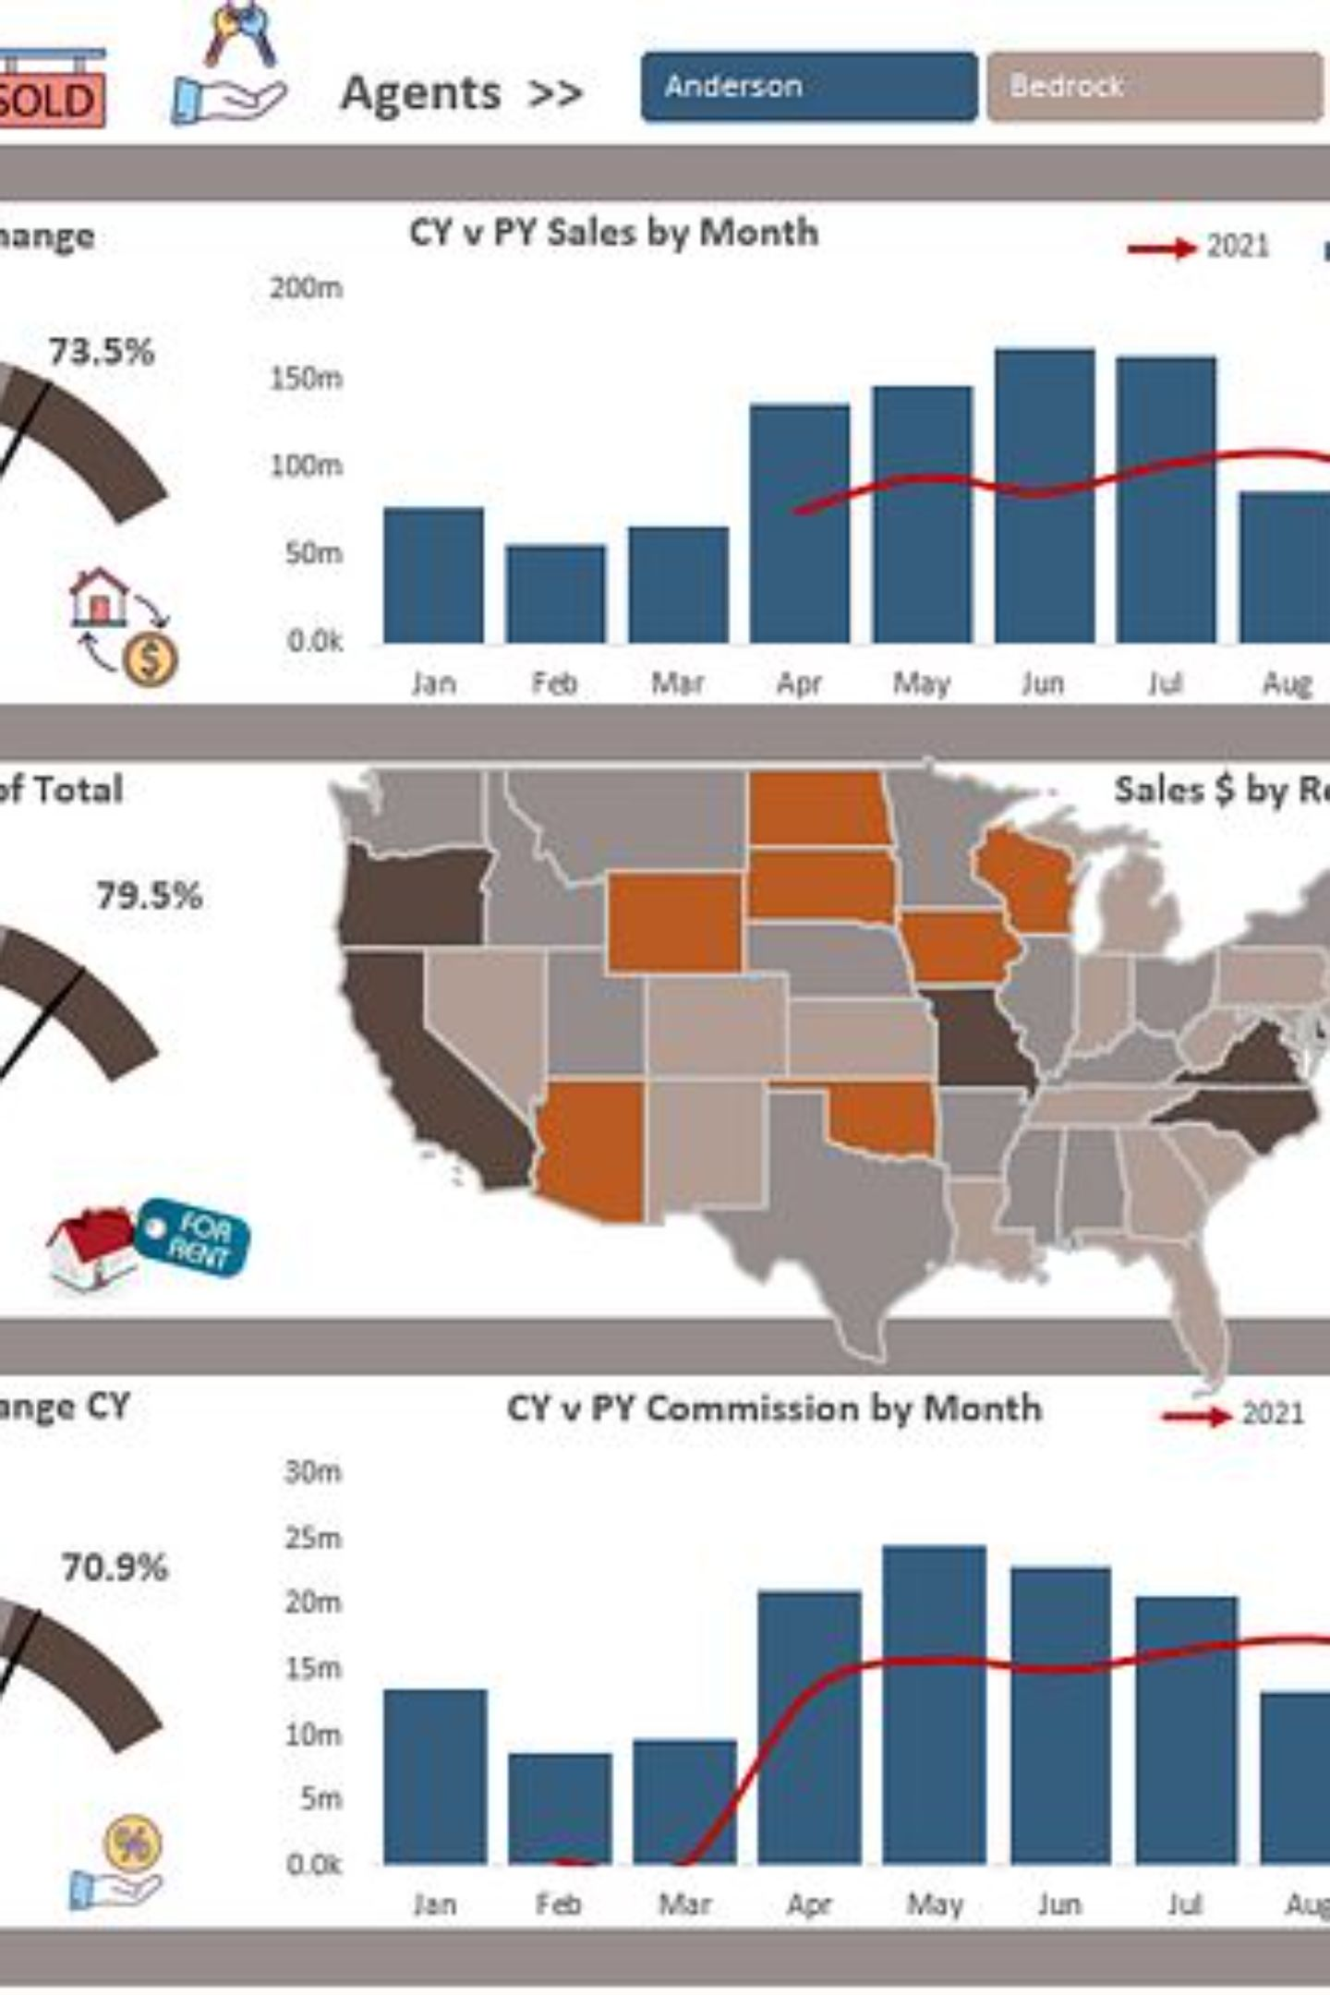
Expected Outcome
Efficient Storage
Faster Search
Improved Organization
Significantly reduced retrieval time versus manual search.
Store legal documents in an organized, scalable digital repository.
Better document indexing, deduplication, and sorting.
DSA Demonstration
Showcases advanced string-search algorithms and scalable design for law firms and courts.

Slide 7


Thank you
Questions or feedback?
Team: Busala Laxmi Praveen • Dharani Dhar • N. Nishanth

