Slide 1
CHALLENGE n°2
MOBILE LAB

Slide 2

Timeline
C1
C2
C3

Slide 3
Before we start …
Matteo - Gabriel

Slide 4
Before we start …
Download the base project:
repository

Slide 5
Tasks
Create a Sprite class
gameView
Bitmap
n° rows
n° columns
Create a Spaceship class that extends the Sprite class
EXTRA: add music to the game

Slide 6

Create a Sprite class
gameView
Bitmap
n° rows
n° columns
Create a Spaceship class that extends the Sprite class
EXTRA: add music to the game

Slide 7
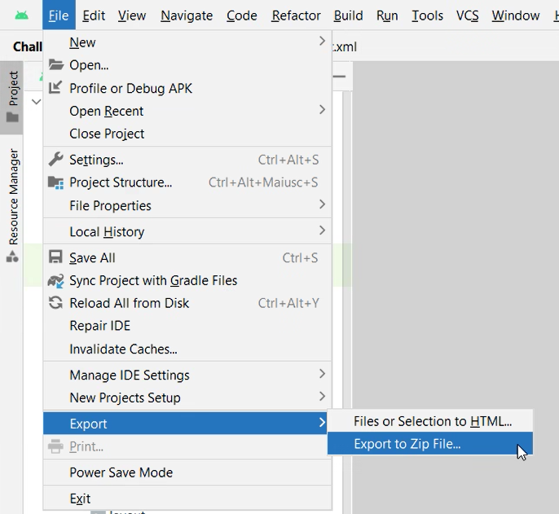
Submission
Export your project in a zip file;
Create a folder inside "challenge_2" following this pattern: surname_name;
Submit the project inside the created folder.

