Slide 1
Wukong: A Scalable and Locality-Enhanced Framework for Serverless Parallel Computing
李涛
2021.4.2
[1] Wukong: A Scalable and Locality-Enhanced Framework for Serverless Parallel Computing SoCC’20
Notes:
我汇报的主要内容是：Serverless数据分析应用特征的定性分析以及发现的几个问题

Slide 2
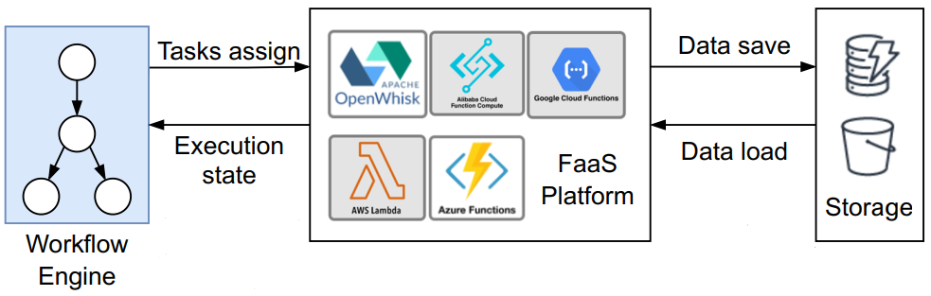
Background
Serverless workflow
Traditional serverless workflow
Notes:
* 首先看serverless传统的workflow，首先由workflow engine生成应用执行的DAG图，然后workflow engine再FaaS平台上进行任务分配，同时FaaS平台需要向workflow引擎返回任务执行状态，以供engine进行调度；同时由FaaS平台的无状态性，中间数据的传输需要通过外部存储完成

Slide 3
Motivation
Overhead analysis for serverless workflow
Scheduling Overhead
Data movement Overhead
Data movement Overhead
Scheduling Overhead
The overhead analysis for traditional workflow
Notes:
* 通过刚才对serverless workflow的分析，可以看到整个workflow的开销集中在两个方面：调度和数据移动
* 接下来展示两种开销出现的原因以及问题的严重程度

Slide 4
Motivation
Scheduling Overhead
Centralized scheduling
Assign tasks
Track execution state
Node
Node
Tasks assign
Worker
Worker
Worker
Node
Node
Worker
Worker
Worker
Execution state
Central
Scheduler
FaaS Platform
Notes:
* 首先来看调度开销
* 现行的serverless方案采用的是集中化的调度方式，由一个中心调度器完成任务的分发并且跟踪任务执行状态来进行接下来的调度

Slide 5
Motivation
Scheduling Overhead
Centralized scheduling
Burst-parallel application
Functions are short and parallel
Large amount of Eexecution states are frequently transferred
Node
Node
Tasks assign
Worker
Worker
Worker
Scheduling Overhead
Node
Node
Worker
Worker
Worker
Execution state
Central
Scheduler
FaaS Platform
Notes:
* 同时又因为serverless应用通常是突发并行的，函数生命周期短，而且并发度高，这就会导致大量的任务执行状态在中心调度器和各个woker之间频繁传递，造成较高的调度开销

Slide 6
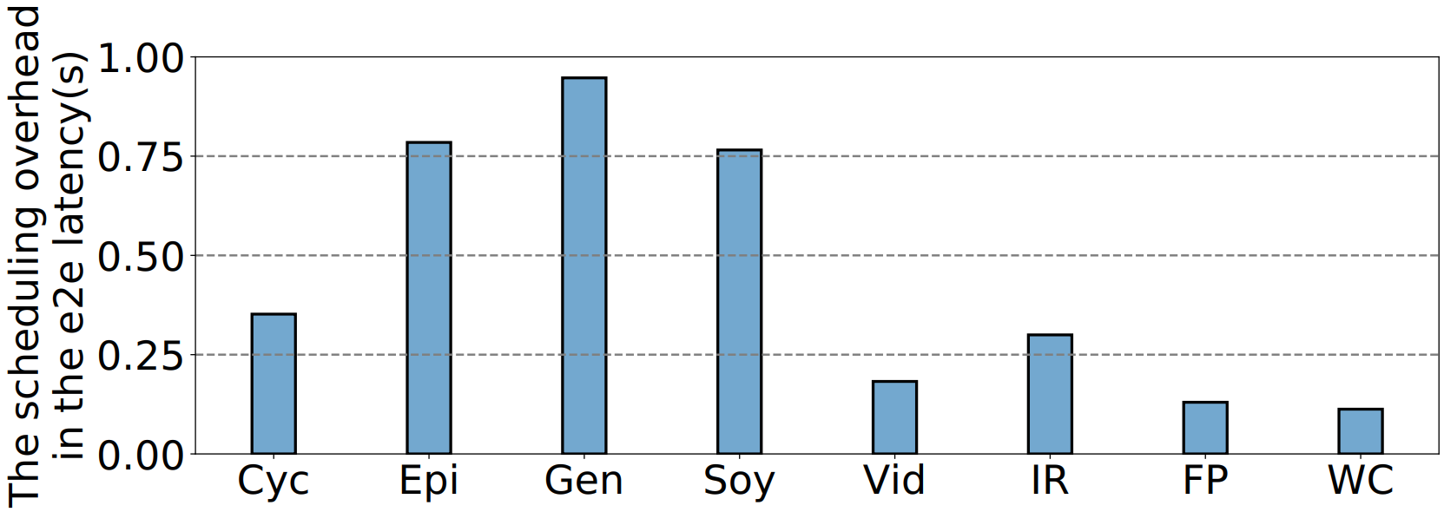
Motivation
Scheduling Overhead
Centralized scheduling
Burst-parallel application
The scheduling overhead of executing the workflow benchmark
Notes:
* 这张图展示了八种典型的serverless workflow应用调度开销对端到端时延也就是应用执行时间的占比，可以看到调度开销比较大

Slide 7


Motivation
Data Movement Overhead
Function is stateless
Use remote storage services to exchange intermediate data
Node
Node
Data save
Worker
Worker
Worker
Data movement Overhead
Node
Node
Worker
Worker
Worker
Data load
Remote
Storage
FaaS Platform
Notes:
* 应为函数是无状态的，所以需要使用远端存储交换中间数据，导致了数据移动的开销

Slide 8
Key idea
Decentralized scheduling
Partition the workﬂow DAG into sub-graphs
Assign each subgraph to a task Executor
Schedule and Execute tasks by each Executor in parallel
E2
E1
[1] Wukong: A Scalable and Locality-Enhanced Framework for Serverless Parallel Computing SoCC’20

Slide 9




Design
Wukong architecture
Lambda executor
Dynamic schedule
Submit
jobs
DAG generator
Initial task
executor invokers
Become
Invoke
User
...
... ...
...
DAG
Invoke
Invoke
Become
...
...
Static-Schedule generator
Intermediate data
Intermediate KV store
[1] Wukong: A Scalable and Locality-Enhanced Framework for Serverless Parallel Computing SoCC’20
Notes:
* 下面详细介绍wukong的完整架构
* 首先用户提交任务
* 然后由DAG generator生成workflow的DAG
* 接着由静态调度生成器将DAG划分成子图，生成最初的调度策略
* 然后为每个子图分配一个executor执行静态调度
* 然后各个executor动态的调整调度
* 对于一个executor内的中间数据通过executor的本地存储传输；跨executor的中间数据通过外部的kv数据库传输

Slide 10
Decentralized Scheduling
Static scheduling
Input DAG partitioned into static schedules，or
subgraphs of the original DAG (DFS)
Task Executors are assigned a static schedule
Each Executor executes the tasks through its
schedule in parallel
T6
T5
T4
T3
T1
T2
Executor 1
Static Schedule
Executor 2
[1] Wukong: A Scalable and Locality-Enhanced Framework for Serverless Parallel Computing SoCC’20
Notes:
* 接下来就详细介绍一下wukong的解决方案
* 首先是去中心化的调度，它包含静态调度和动态调度两部分
* 首先看静态调度
** 第一步输入的DAG图被划分为几个静态调度，或者说子图（通过深度优先搜索）
** 第二部每个子图被分配到一个executor上执行
** 第三步每个executor并行执行自己静态调度中的任务

Slide 11
Decentralized Scheduling
Static scheduling problems
Subgraphs can overlap
Not consider the amount of data transferred
State synchronization between executors
T6
OR
T5
T4
T3
T1
T2
Executor 1
Static Schedule
Executor 2
[1] Wukong: A Scalable and Locality-Enhanced Framework for Serverless Parallel Computing SoCC’20
Notes:
* 通过简单的DFS生成的静态调度存在一些问题
** 第一划分的子图可能重叠，比如T6同时在两个子图中，有哪个executor执行就会产生冲突
** 第二静态划分时没有考虑函数之间传输的数据量，例如如果t3-t4之间传输的数据量很大，就应该放在一个executor中执行来减少数据移动
** 第三需要在各个executor之间同步任务执行状态，这样才能进行接下来的调度

Slide 12
Decentralized Scheduling
Dynamic Scheduling
Dynamic Scheduling for Fan-Out tasks
‘Become’
‘Invoke’
E2
E3
E1
T2
T3
T4
Invoke
Invoke
Become
Fan
-out
T1
E1
[1] Wukong: A Scalable and Locality-Enhanced Framework for Serverless Parallel Computing SoCC’20
Notes:
* 首先看对于fan-out任务的动态调度，fan-out任务就是包含多个出边的节点
* 动态调度包含两种操作，首先他会在就绪的任务中选择一个调度到fan-out任务所在executor中，也就是become
* 对其他任务调分别调用新的executors执行，也就是invoke

Slide 13
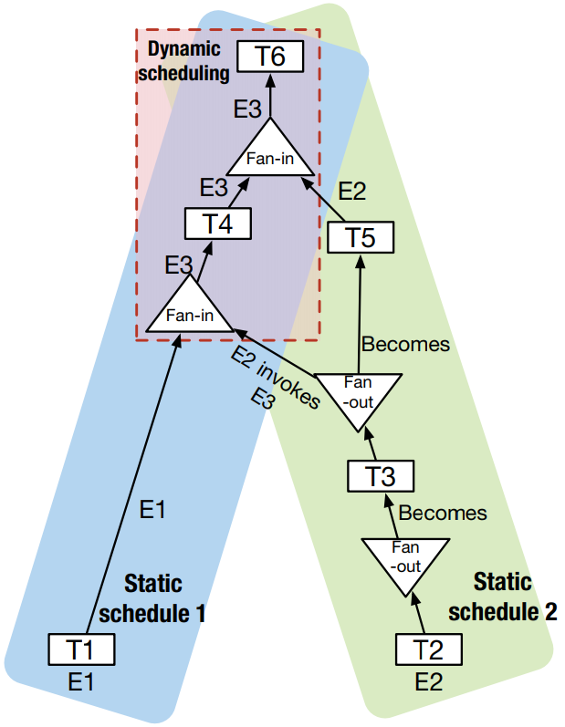
Decentralized Scheduling
Dynamic Scheduling
Dynamic Scheduling for Fan-Out tasks
‘Become’
‘Invoke’
Dymanic Schedule
[1] Wukong: A Scalable and Locality-Enhanced Framework for Serverless Parallel Computing SoCC’20
Notes:
再看刚开始的例子，对于t3t4t5，t5和t3都在e2中执行，而t4由e2调用的新的executor执行

Slide 14
Decentralized Scheduling
Dynamic Scheduling
Dynamic Scheduling for Fan-In tasks
E1
T4
Fan
-in
T1
T2
T3
E1
E2
E3
[1] Wukong: A Scalable and Locality-Enhanced Framework for Serverless Parallel Computing SoCC’20
Notes:
* 再看对于fan-in任务的动态调度，fan-in任务就是包含多个入边的节点
* 动态调度会在入边中选择一个executor执行fan-in task，这样就可以解决静态调度子图重合的问题

Slide 15
Decentralized Scheduling
Dynamic Scheduling
Dynamic Scheduling for Fan-In tasks
Dymanic Schedule
[1] Wukong: A Scalable and Locality-Enhanced Framework for Serverless Parallel Computing SoCC’20
Notes:
再看刚开始的例子，对于t4t5t6，t6选择再e3中执行

Slide 16
Decentralized Scheduling
Dynamic Scheduling
Cluster tasks
intermediate data is too large
E1
E1
T2
T3
Become
Become
Fan
-out
T1
E1
[1] Wukong: A Scalable and Locality-Enhanced Framework for Serverless Parallel Computing SoCC’20
Notes:
* 为了进一步减少数据移动，动态调度将数据传输量较大的任务对聚集到一个executor中

Slide 17
Storage Mangement
Within a executor
All intermediate task outputs are cached in the Executor’s local memory
Across executors
Task Executors exchange their intermediate through the KV Store
Intermediate data
Local Storage
Local Storage
Executor
Intermediate KV store
Executor
[1] Wukong: A Scalable and Locality-Enhanced Framework for Serverless Parallel Computing SoCC’20
Notes:
接下来再来看悟空的存储管理，如下图所示，对于一个executor内的任务中间数据由executor的本地存储缓存；对于跨executor的中间数据传输由外部的kv数据库完成S

Slide 18
Storage Mangement
Within a executor
All intermediate task outputs are cached in the Executor’s local memory
Across executors
Task Executors exchange their intermediate through the KV Store
Intermediate data
Local Storage
Local Storage
Executor
Intermediate KV store
Executor
[1] Wukong: A Scalable and Locality-Enhanced Framework for Serverless Parallel Computing SoCC’20
Notes:
接下来再来看悟空的存储管理，如下图所示，对于一个executor内的任务中间数据由executor的本地存储缓存；对于跨executor的中间数据传输由外部的kv数据库完成S

Slide 19
Idea
Large fan-out task
Schedule can poorly reduce data movement for large fan-out tasks
Long term storage
range partition
...
...
...
...
merge sort
Long term storage
Mapreduce Sort application
Notes:
* 对于有大量扇出的任务，调度不能很好的减少数据移动，因为一个task的数据被多个任务需要
* 能不能简化任务之间的数据依赖，从而为调度创造机会

Slide 20
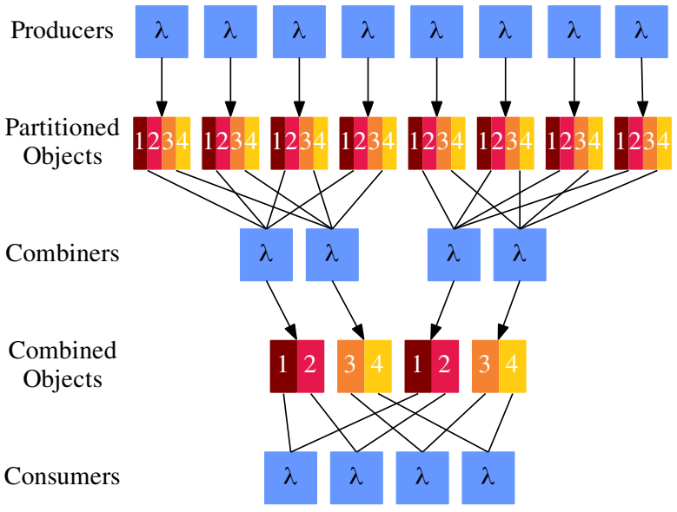
Idea
Multistage shuffle
Combining stage reads a subset of input objects and produces a single combined output
Tradeoff between compute time and object storage request costs
读写请求数变少
读写数据量变多
Multistage shuffle
[1] Starling: A Scalable Query Engine on Cloud Functions SIGMOD’20
Notes:
* multistage shuffle在map和reduce阶段增加了一个combine阶段，combining stage 读取map阶段的一个子集进行初级合并
* 这篇paper采用这种方案的初衷实现计算时间和对象存储请求成本的trade-off
** 虽然S3的成本低，但是它是按请求收费的，当请求过多时，成本也是不可忽略的
** 采用多阶段shuffle第一可以让读写请求数变少，但是会让读写的数据量变多

Slide 21
Idea
High fanout -> Low fanout
Shuffle task
low fanout task
G1
G1
G2
G2
G3

Slide 22
下一步
Related work
Wukong^{[1]} (open source)
FaaSFlow^{[2]} (open source)
在Wukong/FaasFlow上实现multistage shuffle
[1] Wukong: A Scalable and Locality-Enhanced Framework for Serverless Parallel Computing SoCC’20
[2] FaaSFlow: Enable Efficient Workflow Execution for Function-as-a-Service ASPLOS’22

Slide 23
Reference
[1] Wukong: A Scalable and Locality-Enhanced Framework for Serverless Parallel Computing SoCC’20
[2] FaaSFlow: Enable Efficient Workflow Execution for Function-as-a-Service ASPLOS’22
[3] Starling: A Scalable Query Engine on Cloud Functions SIGMOD’20

