Slide 1
Serverless Data Analytics
李涛
2021.3.24
Notes:
我汇报的主要内容是：Serverless数据分析应用的I/O时延问题以及初步的解决方案

Slide 2
本周工作
定性分析数据分析应用的数据特征
从相关paper中找出典型的数据分析应用
从I/O size、Throughput、Capacity reqirements四个个方面分析数据分析应用的数据特征
进一步验证serverless analytics的I/O时延问题
定量分析数据分析应用的数据特征
数据分析应用的I/O size、I/O rate的分布函数图(CDF)
数据分析应用的数据访问频率图，即吞吐量随时间的变化
数据分析应用产生中间数据的规模
S3/Redis 聚合带宽和时延与I/O size的关系图，以此分析数据分析应用的I/O size和吞吐率是不是会导致S3 I/O rate的瓶颈问题
Notes:
* 接下来是请求吞吐率
* 下面这张表格展示了随数据对象大小变化时，S3和redis的请求吞吐量限制
* 可以看出S3的请求速率是受限的，尤其是对于小文件的读写无法提供较高的吞吐率，可以看到对于10KB大小的文件S3的吞吐量比Redis低了两个数量级

Slide 3
典型的数据分析应用
 | Mapreduce sort benchmark | Video analytics | Distributed compilation | TPC-DS | Big data benchmark
Locus^{[1]} | ✔️ |  |  | ✔ | ✔
Caerus^{[2]} | ✔ |  |  | ✔ | ✔
Pocket^{[3]} | ✔ | ✔ | ✔
Ephemeral Storage^{[4]} | ✔ | ✔ | ✔
Sonic^{[5]} | ✔ | ✔
Application
Paper
[1] Shuffling, Fast and Slow: Scalable Analytics on Serverless Infrastructure NSDI’19
[2] Caerus: NIMBLE Task Scheduling for Serverless Analytics NSDI’21
[3] Pocket: Elastic Ephemeral Storage for Serverless Analytics OSDI ’18
[4] Understanding Ephemeral Storage for Serverless Analytics ATC’18
[5] Sonic: Application-aware Data Passing for Chained Serverless Applications ATC’21
Notes:
- 首先介绍一下serverless的计算框架
* 为了实现资源的高弹性和扩展性，serverless采用存算分离的架构，由FaaS提供计算资源，BaaS提供存储服务。
* 下面这张图展示了完整的serverless的计算架构。
* 当请求到达时首先通过API网关路由到对应的沙箱；
* 然后在沙箱中实例化无状态函数进行计算；
* 这里的无状态是指函数计算完成后，产生的数据和状态或者原地销毁，或者存储到外部的共享存储中，也就是BaaS这一端。
* 这里的共享存储可以是跨数据中心的对象存储S3、kv数据库DynamoDB，也可以是内存kv存储系统ElastiCache，可以在上面部署redis或者memcached。考虑成本问题，S3使用最为广泛。

Slide 4
典型的数据分析应用
MapReduce sort
Two stage：partition stage and merge stage
I/O-intensive
remoteread
Partition0
Map task
wirte
Partition1
Reeduce task
read
... ...
wirte
Split 0
tag
PartitionR-1
sort
Output
file0
Split 1
Partition0
Split 2
tag
Partition1
... ...
sort
Output
file1
Split 3
PartitionR-1
... ...
Split 4
Partition0
tag
Partition1
... ...
Output
file2
PartitionR-1
sort
... ...
... ...
... ...
... ...
... ...
Partition0
sort
Output
file0
Split K
tag
Partition1
... ...
PartitionR-1
Input files
Map phrase
Intermediate files
Reduce phrase
Output files
Notes:
* MapReduce sort （Terasort）
** We implemented the Terasort [30] algorithm to perform sort in two stages:
** a partition stage that range-partitions the input and writes out to intermediate storage；
** a merge stage that, for each partition, merges and sorts all intermediate data for that partition and writes out the sorted output
** Each intermediate file is written and read only once and its size is directly proportional to the dataset size and inversely related to the number of
workers
** I/O intensive
** gensort Data Generator. http://www.ordinal.com/gensort.html.

Slide 5
典型的数据分析应用
Video analytics
Three stage：Split video、Decode frames and MXNET classification
Long term storage
Split_Video
Extract Frame
... ...
Extract Frame
Classify Frame
... ...
Classify Frame
Long term storage
DAG overview for Video Analytics application
Notes:
* Video analytics （Thousand Island Scanner(THIS)）
** The input is an encoded video that is divided into batches and uploaded to ephemeral storage.
** First stage lambdas read a batch of encoded video frames from ephemeral storage and write back decoded video frames.
** Each lambda then launches a second stage lambda which reads a set of decoded frames from ephemeral storage, computes a MXNET deep learning classification algorithm and outputs a
classification result

Slide 6
典型的数据分析应用
Distributed compilation
Two stage：compile stage and link stage
preprocess
&
parse
code
generation
.obj
files
C file
assemble
preprocess
&
parse
code
generation
.obj
files
C file
assemble
link
Compile stage
library
files
Link stage
The traditional compilation sequence
Notes:
* Distributed compilation

Slide 7
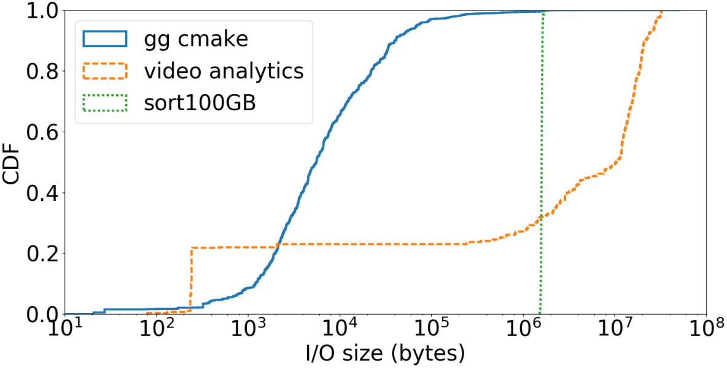
数据分析应用的数据特征
I/O size
The granularity of data access varies widely
I/O size-aware
I/Os range from 100s of bytes to 100s of MBs^{[1]}
[1] Understanding Ephemeral Storage for Serverless Analytics ATC’18
Notes:
* 接下来是请求吞吐率
* 下面这张表格展示了随数据对象大小变化时，S3和redis的请求吞吐量限制
* 可以看出S3的请求速率是受限的，尤其是对于小文件的读写无法提供较高的吞吐率，可以看到对于10KB大小的文件S3的吞吐量比Redis低了两个数量级

Slide 8
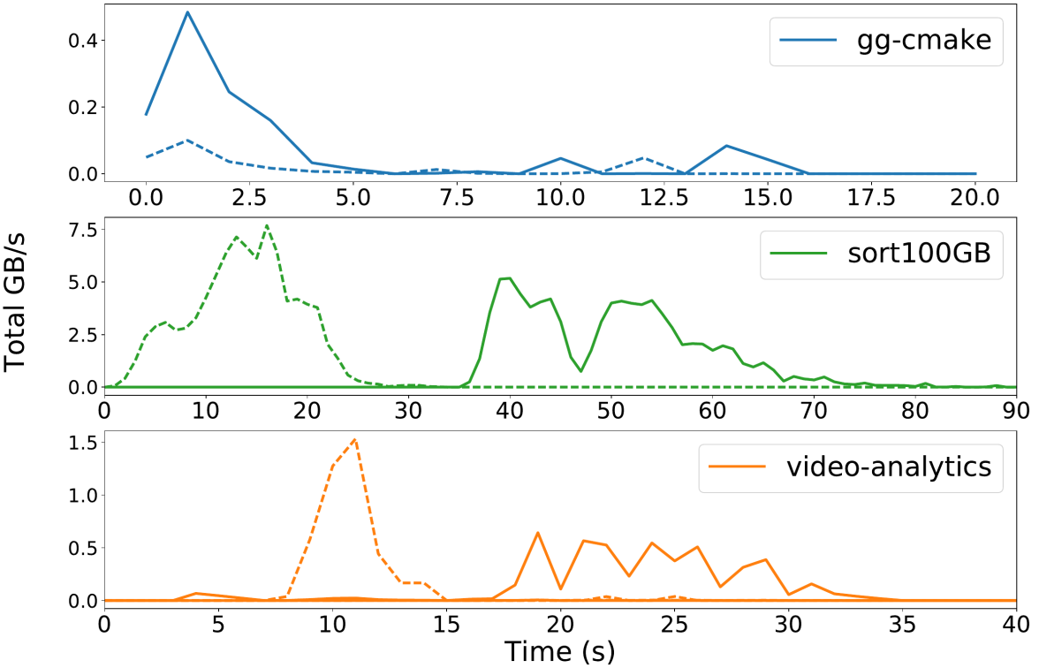
数据分析应用的数据特征
Data access frequency
Ephemeral I/O Throughput:
Write (dotted), Read (solid)^{[1]}
Application Type
Application Type
Distributed
Compilation
0.95GB
MapReduce
100GB
Video Analytics
6GB
[1] Understanding Ephemeral Storage for Serverless Analytics ATC’18
Notes:
* 接下来是请求吞吐率
* 下面这张表格展示了随数据对象大小变化时，S3和redis的请求吞吐量限制
* 可以看出S3的请求速率是受限的，尤其是对于小文件的读写无法提供较高的吞吐率，可以看到对于10KB大小的文件S3的吞吐量比Redis低了两个数量级

Slide 9
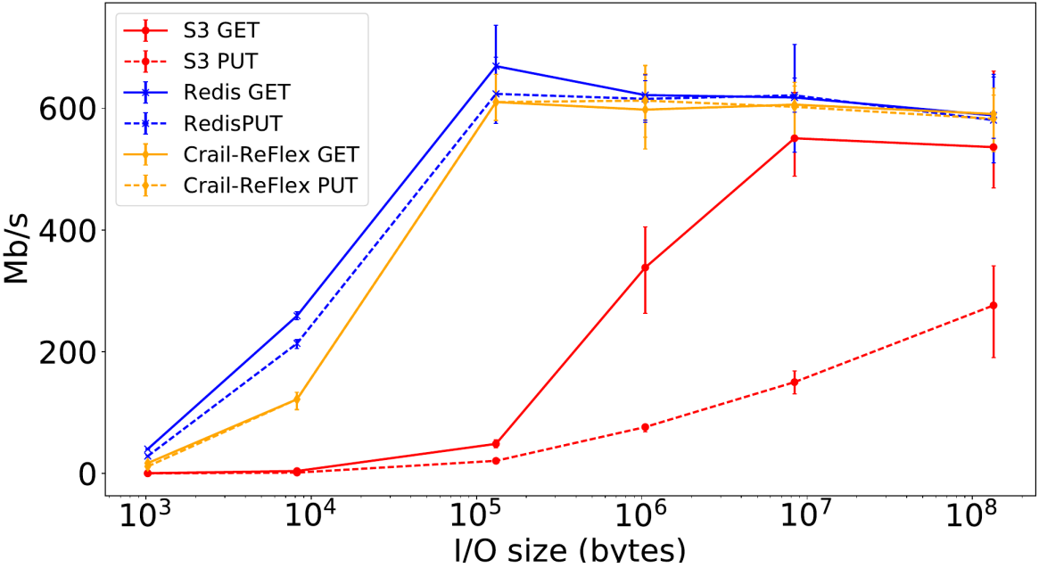
数据分析应用的数据特征
S3/Redis throughput
S3 is not designed to sustain high request rate for small objects
S3 is a multi-tenant service, there is an imposed limit on request throughput per S3 bucket for the benefit of overall availability
Peak storage throughput per lambda^{[1]}
[1] Understanding Ephemeral Storage for Serverless Analytics ATC’18
Notes:
* S3 is not designed to sustain high request rate for small objects
* S3 is a multi-tenant service, there is an imposed limit on request throughput per S3 bucket for the benefit of overall availabilityB大小的文件S3的吞吐量比
Redis低了两个数量级

Slide 10
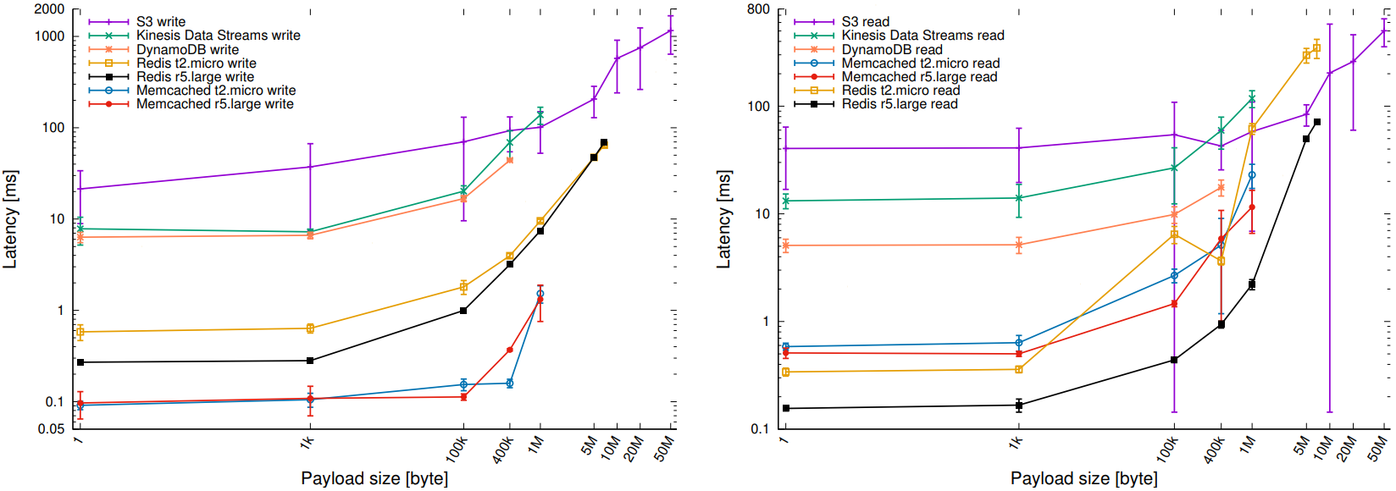
数据分析应用的数据特征
S3/Redis latency
Latency of write (left) and read (right) operations
using different AWS data storage services^{[1]}
[1] Towards Latency Sensitive Cloud Native Applications: A Performance Study on AWS CLOUD’19
Notes:
* 接下来是请求吞吐率
* 下面这张表格展示了随数据对象大小变化时，S3和redis的请求吞吐量限制
* 可以看出S3的请求速率是受限的，尤其是对于小文件的读写无法提供较高的吞吐率，可以看到对于10KB大小的文件S3的吞吐量比Redis低了两个数量级

Slide 11
定量实验
Notes:
* 接下来是请求吞吐率
* 下面这张表格展示了随数据对象大小变化时，S3和redis的请求吞吐量限制
* 可以看出S3的请求速率是受限的，尤其是对于小文件的读写无法提供较高的吞吐率，可以看到对于10KB大小的文件S3的吞吐量比Redis低了两个数量级

Slide 12
Pocket^{[1]}
Motivation
Existing storage services are not a good fit for sharing short-lived intermediate data
 | Elastic scaling | Latency | Throughput | Max object size | Cost
S3 | Auto, coarse-grain️ | High | Medium | 5 TB | $
DynamoDB | Auto, fine-grain, pay per hour | Medium | Low | 400 KB | $$
Elasticache Redis | Manual | Low | High | 512 MB | $$$
Aerospike | Manual | Low | High | 1 MB | $$
Apache Crail | Manual | Low | High | any size | $$
Desired for λs | Auto, fine-grain, pay per second | Low | High | any size | $
[1] Pocket: Elastic Ephemeral Storage for Serverless Analytics OSDI ’18
Notes:
* 接下来是请求吞吐率
* 下面这张表格展示了随数据对象大小变化时，S3和redis的请求吞吐量限制
* 可以看出S3的请求速率是受限的，尤其是对于小文件的读写无法提供较高的吞吐率，可以看到对于10KB大小的文件S3的吞吐量比Redis低了两个数量级

Slide 13
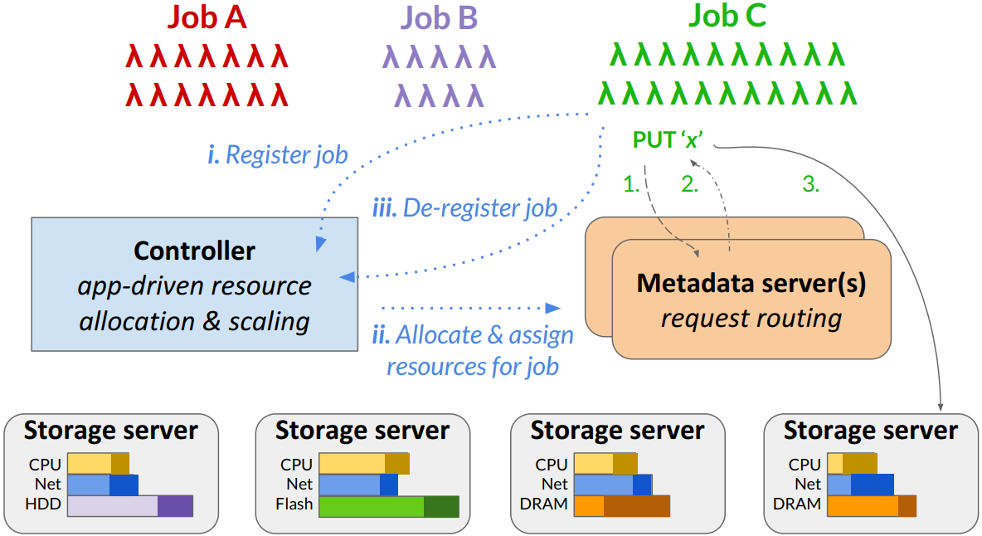
Pocket^{[1]}
Design
Multi-tier storage
Leverage different storage media to satisfy I/O demands of different applications while minimizing cost
Pocket system architecture
[1] Pocket: Elastic Ephemeral Storage for Serverless Analytics OSDI ’18
Notes:
* 接下来是请求吞吐率
* 下面这张表格展示了随数据对象大小变化时，S3和redis的请求吞吐量限制
* 可以看出S3的请求速率是受限的，尤其是对于小文件的读写无法提供较高的吞吐率，可以看到对于10KB大小的文件S3的吞吐量比Redis低了两个数量级

Slide 14
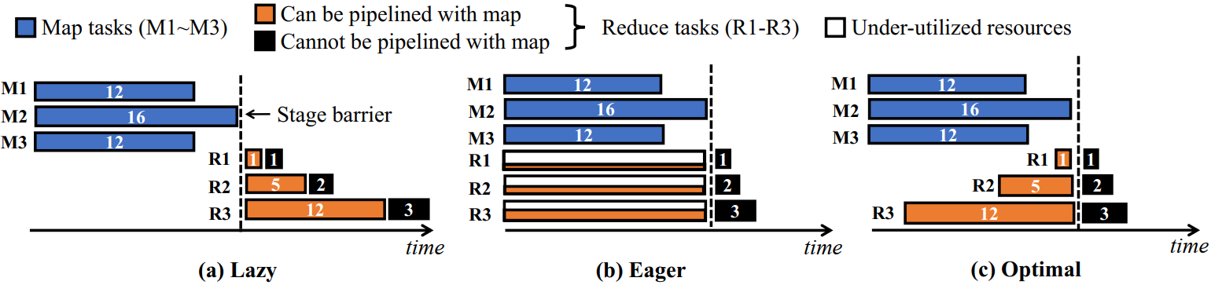
Caerus^{[1]}
Motivation
Different schedule goals
Server-centric Analytics：minimize job runtime, maximize resource utilization and ensure resource isolation (or fairness) across jobs
Serverless Analytics：minimize job completion time and execution cost
Trade-off between JCT and cost
cost-optimal
JCT-optimal
Three schedule approaches for a simple map-reduce job
[1] Caerus: NIMBLE Task Scheduling for Serverless Analytics NSDI’21
Notes:
* 接下来是请求吞吐率
* 下面这张表格展示了随数据对象大小变化时，S3和redis的请求吞吐量限制
* 可以看出S3的请求速率是受限的，尤其是对于小文件的读写无法提供较高的吞吐率，可以看到对于10KB大小的文件S3的吞吐量比Redis低了两个数量级

Slide 15
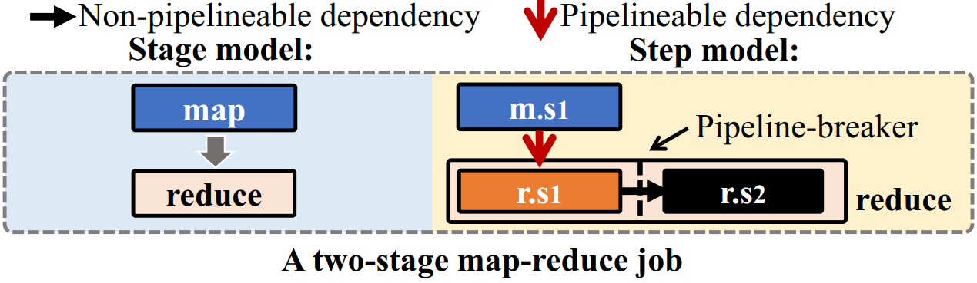
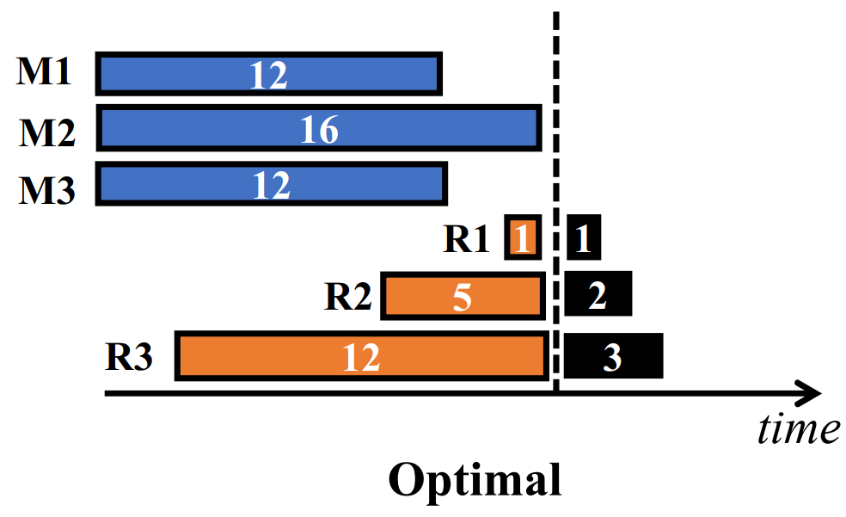
Caerus^{[1]}
Design
Sub-task level schedule
stages are separated into one or more steps by pipeline breakers
Step dependency model for a map-reduce job
[1] Caerus: NIMBLE Task Scheduling for Serverless Analytics NSDI’21
Notes:
* 接下来是请求吞吐率
* 下面这张表格展示了随数据对象大小变化时，S3和redis的请求吞吐量限制
* 可以看出S3的请求速率是受限的，尤其是对于小文件的读写无法提供较高的吞吐率，可以看到对于10KB大小的文件S3的吞吐量比Redis低了两个数量级

Slide 16
Reference
[1] Shuffling, Fast and Slow: Scalable Analytics on Serverless Infrastructure NSDI’19
[2] Caerus: NIMBLE Task Scheduling for Serverless Analytics NSDI’21
[3] Pocket: Elastic Ephemeral Storage for Serverless Analytics OSDI ’18
[4] Understanding Ephemeral Storage for Serverless Analytics ATC’18
[5] Sonic: Application-aware Data Passing for Chained Serverless Applications ATC’21
[6] Towards Latency Sensitive Cloud Native Applications: A Performance Study on AWS CLOUD’19

