Slide 1
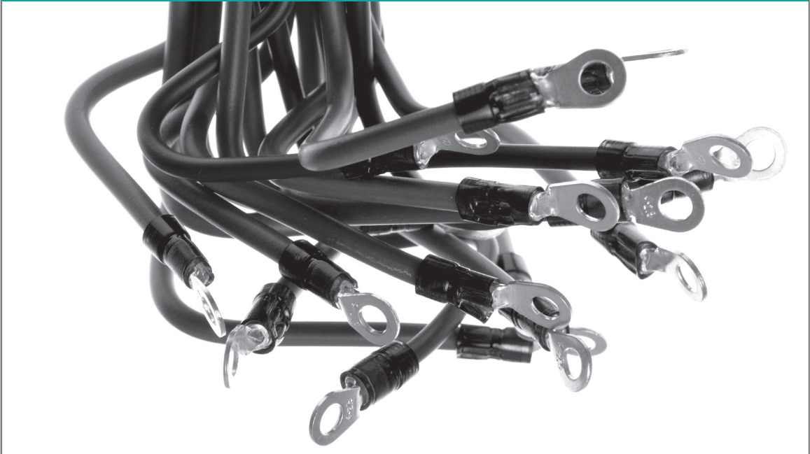
NBWGuard:network bandwidth manager
李涛
2020.11.18

Slide 2

本此工作：
1>使用Linux TC构造HTB队列
2> 使用Jperf工具测试HTB

Slide 3
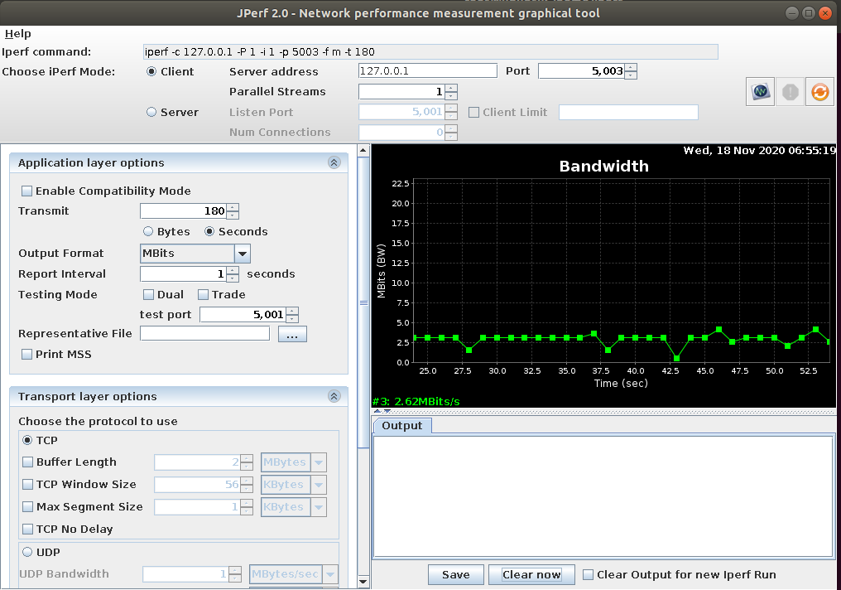
环境
Ubuntu 18.04
Iperf 2.0.10
Jperf 2.0.0
Linux TC
Iperf命令
客户端

Slide 4
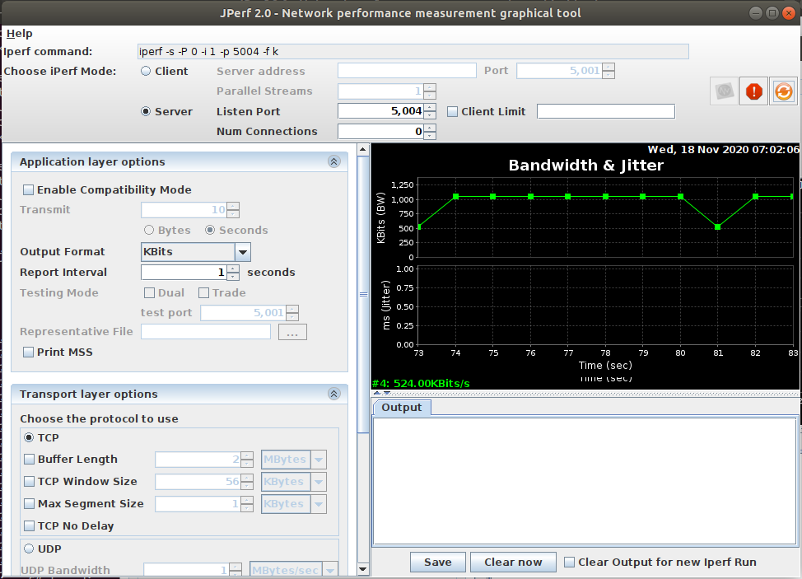
环境
Ubuntu 18.04
Iperf 2.0.10
Jperf 2.0.0
Linux TC
服务端

Slide 5
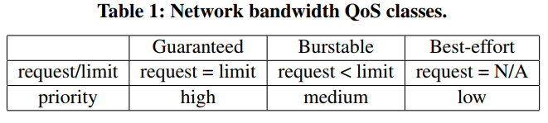
  NBWGuard:network bandwidth manager
Design
- overview
    Prioritize the pod based on the size of the required network resources
    The unused network bandwidth of high priority pods is dynamically shifted to the low priority pods.

Slide 6
  NBWGuard:network bandwidth manager
Design
- 3 QoS classes
    Guaranteed: each pod has a guaranteed bandwidth and one dedicated queue.
    Burstable: Each pod has a guaranteed minimum band-width and a maximum bandwidth.
    Best-effort:They can only use the unused network band-width left by Guaranteed pods and Burstable pods

Slide 7
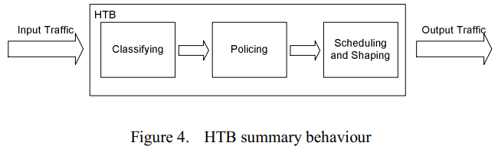
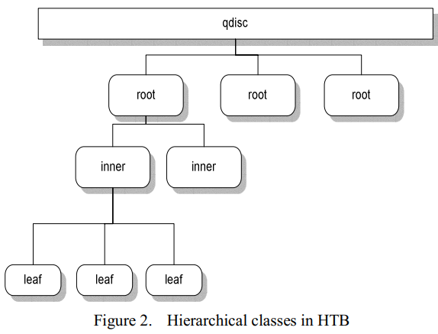
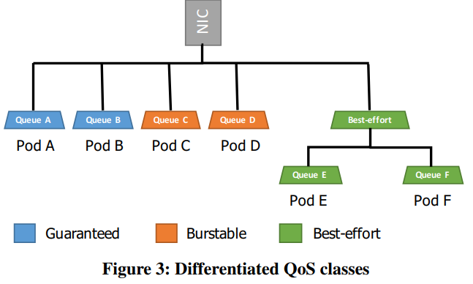
  NBWGuard:network bandwidth manager
Design
- HTB(Hierarchical Token Bucket)
    Classfying

Slide 8
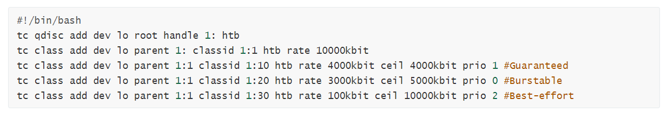
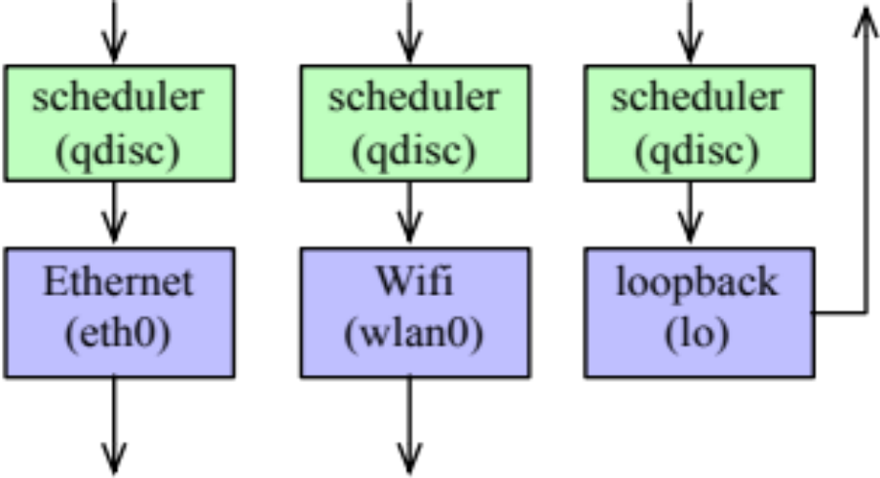
  NBWGuard:network bandwidth manager
Design
Consider the loopback device
  It is a virtual device with IP address 127.0.0.1.
  Packets sent to loopback are bounced back to the sending host

Slide 9
  NBWGuard:network bandwidth manager
Design
- HTB(Hierarchical Token Bucket)
    Policiing
      Limit traffic、share bandwitdth
      prio、rate、ceil
Design

Slide 10
  NBWGuard:network bandwidth manager
Design
- HTB(Hierarchical Token Bucket)
    Policiing
      rate
      ceil
Maximum rate this class and all its children are guaranteed.Mandatory.
<set the minimum desired speed to which to limit transmitted traffic>
Maximum rate at which a class can send, if its parent has bandwidth to spare

Slide 11
  NBWGuard:network bandwidth manager
Design
- HTB(Hierarchical Token Bucket)
    Policiing
      prio
prio是对剩余带宽而言的，所有类的rate必须满足，不受prio的影响。
prio越小优先级越高，并不是说优先级高的会将所有剩余带宽霸占直到ceil，采用RR。
In the round-robin process, classes with the lowest priority field are tried for packets first.

Slide 12
  NBWGuard:network bandwidth manager
Design
- HTB(Hierarchical Token Bucket)
    Policiing
rate:10Mbit
ceil: 10Mbit
CAN_SEND:
MAY_BORROW:
CANT_SEND:
1:1
1:10
1:20
1:30
rate:4Mbit
ceil: 4Mbit
prio: 1
rate:3Mbit
ceil: 5Mbit
prio: 2
rate:0.1Mbit
ceil: 10Mbit
prio: 3

Slide 13
  NBWGuard:network bandwidth manager
Design
- HTB(Hierarchical Token Bucket)
    Policiing
rate:10Mbit
ceil: 10Mbit
CAN_SEND:
MAY_BORROW:
CANT_SEND:
1:1
1:10
1:20
1:30
rate:4Mbit
ceil: 4Mbit
prio: 1
rate:3Mbit
ceil: 5Mbit
prio: 2
rate:0.1Mbit
ceil: 10Mbit
prio: 3

Slide 14
  NBWGuard:network bandwidth manager
Design
- HTB(Hierarchical Token Bucket)
    Policiing
rate:10Mbit
ceil: 10Mbit
CAN_SEND:
MAY_BORROW:
CANT_SEND:
1:1
1:10
1:20
1:30
rate:4Mbit
ceil: 4Mbit
prio: 1
rate:3Mbit
ceil: 5Mbit
prio: 2
rate:0.1Mbit
ceil: 10Mbit
prio: 3

Slide 15
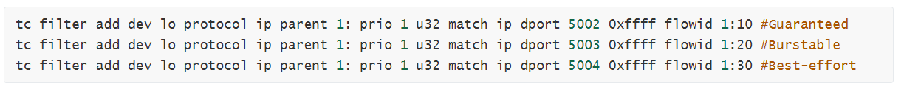
  NBWGuard:network bandwidth manager
Design
- HTB(Hierarchical Token Bucket)
    Policiing
过滤：将上面分的类通过过滤分配到lo的不同端口。

Slide 16
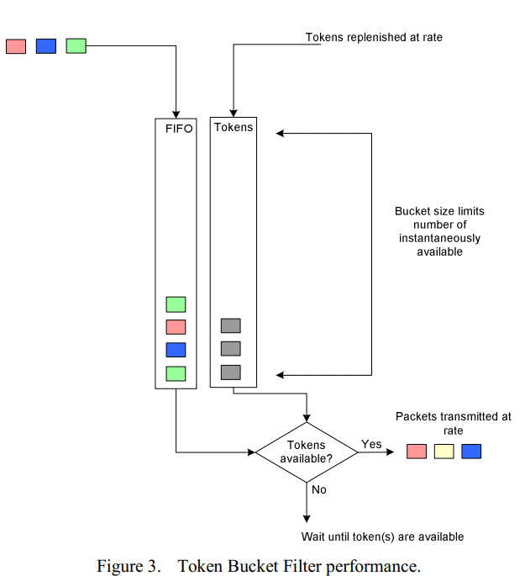
  NBWGuard:network bandwidth manager
Design
- HTB(Hierarchical Token Bucket)
    Scheduling and Shaping
      TBF
      control traffic rate

Slide 17
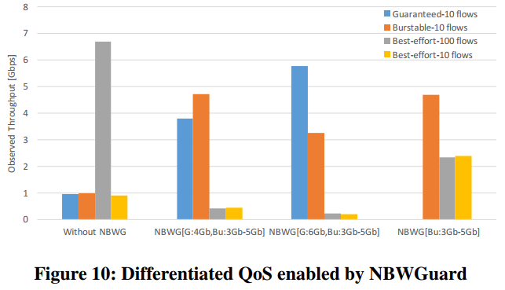
  NBWGuard:network bandwidth manager
Result
- Differentiated QoS Classes
<1>
<2>
<3>

Slide 18
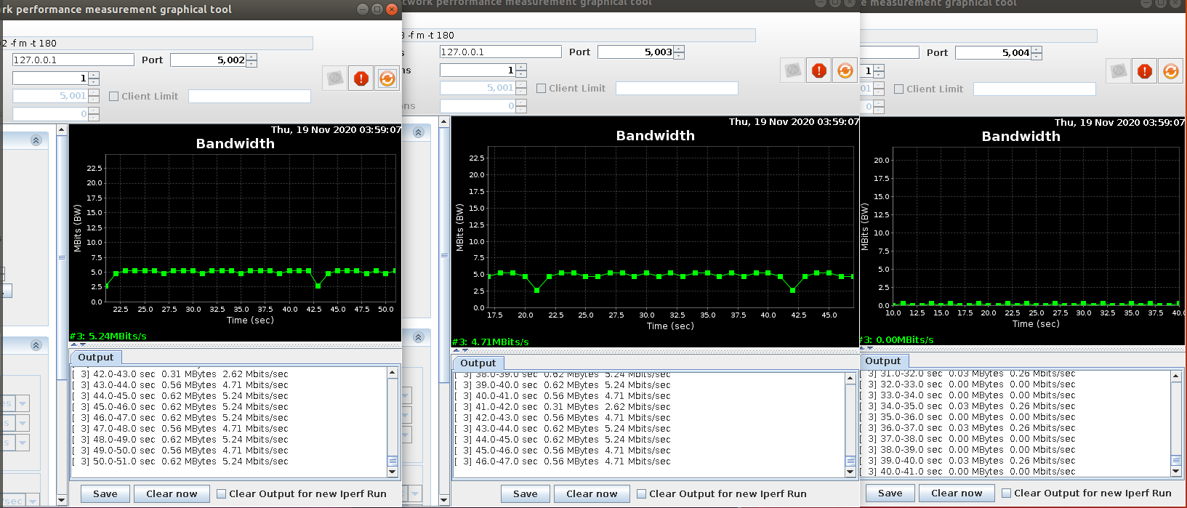
  测试
prio
rate:5Mbit
ceil: 6Mbit
prio: 1
rate:3Mbit
ceil: 5Mbit
prio: 2
rate:0.1Mbit
ceil: 10Mbit
prio: 3

Slide 19
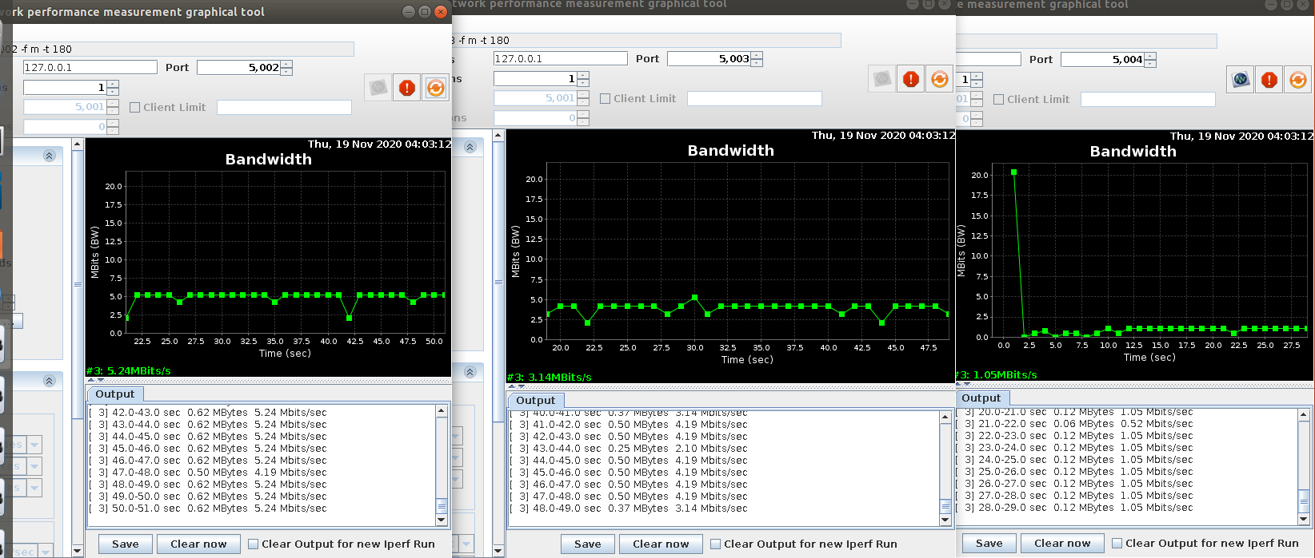
  测试
prio
rate:5Mbit
ceil: 6Mbit
prio: 1
rate:3Mbit
ceil: 5Mbit
prio: 2
rate:1Mbit
ceil: 10Mbit
prio: 3

Slide 20
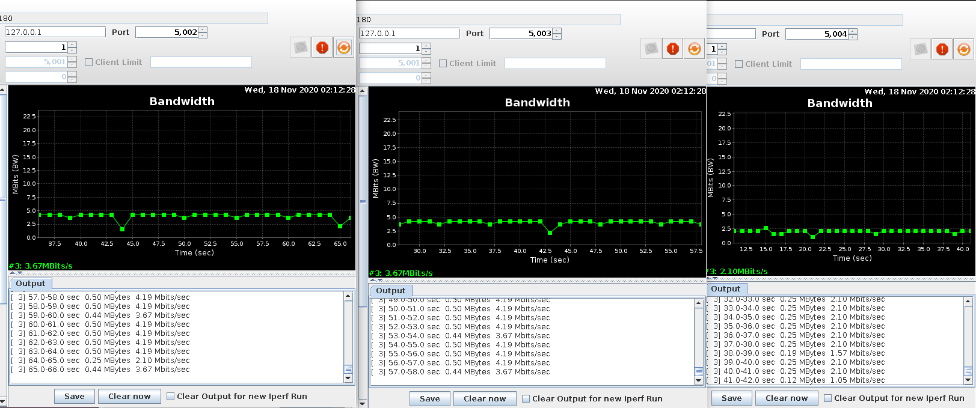
  测试
test1
rate:4Mbit
ceil: 4Mbit
prio: 1
rate:3Mbit
ceil: 5Mbit
prio: 2
rate:0.1Mbit
ceil: 10Mbit
prio: 3

Slide 21
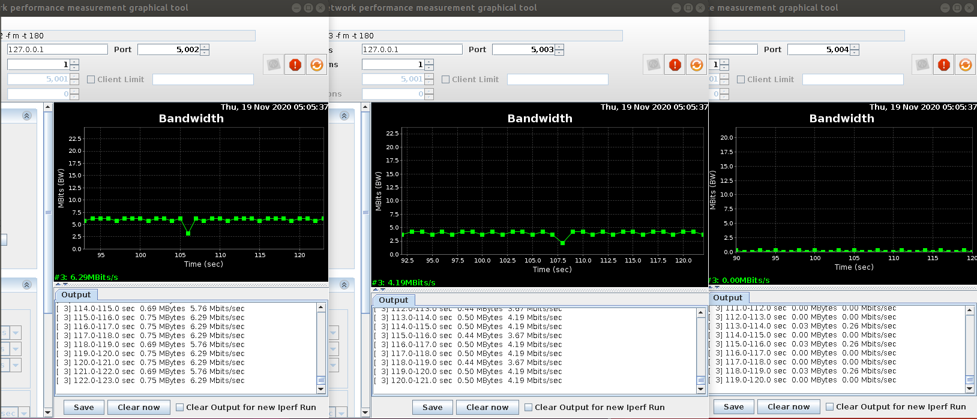
  测试
test2
rate:6Mbit
ceil: 6Mbit
prio: 1
rate:3Mbit
ceil: 5Mbit
prio: 2
rate:0.1Mbit
ceil: 10Mbit
prio: 3

Slide 22
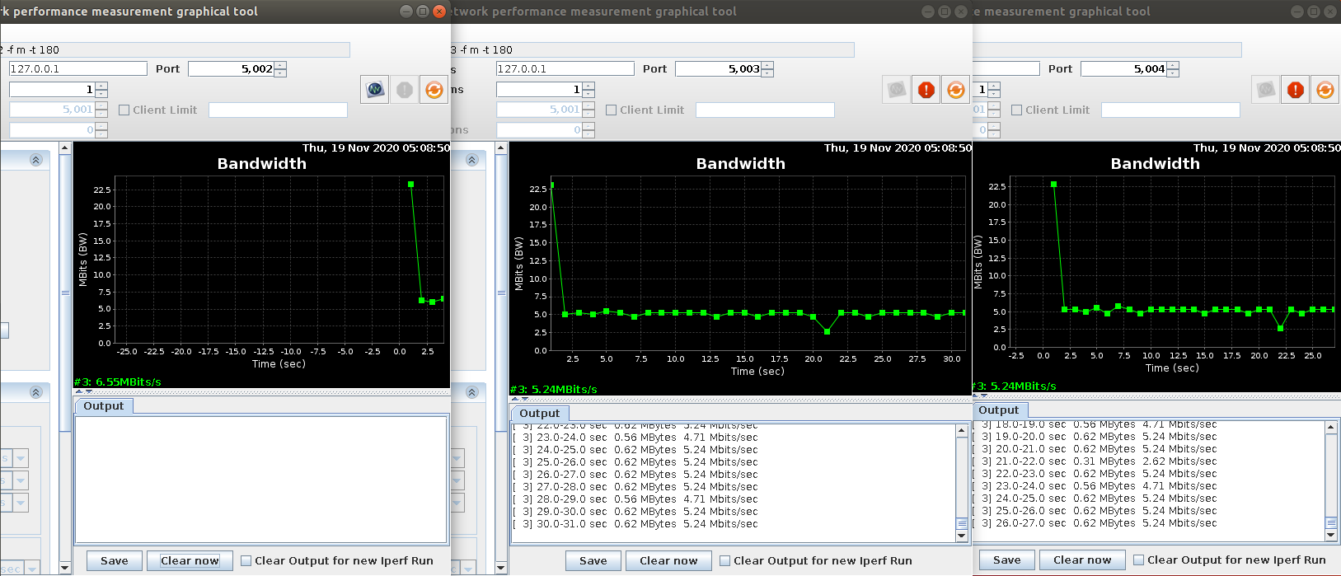
  测试
test3
rate:3Mbit
ceil: 5Mbit
prio: 2
rate:0.1Mbit
ceil: 10Mbit
prio: 3
不工作

Slide 23
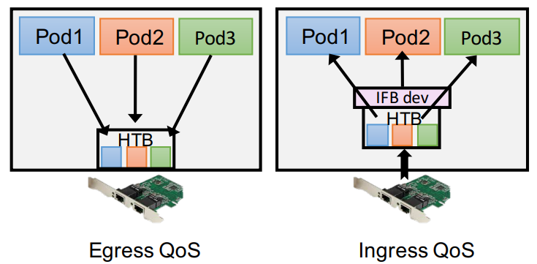
  问题
RR
剩余带宽round-robin策略具体的分配方法
分片是否是固定的？
是否可以设置分片大小？
通过设置分片大小是否可以吻合paper上的数据？
Ingress vs Egress
TC 只工作在egress端

Slide 24
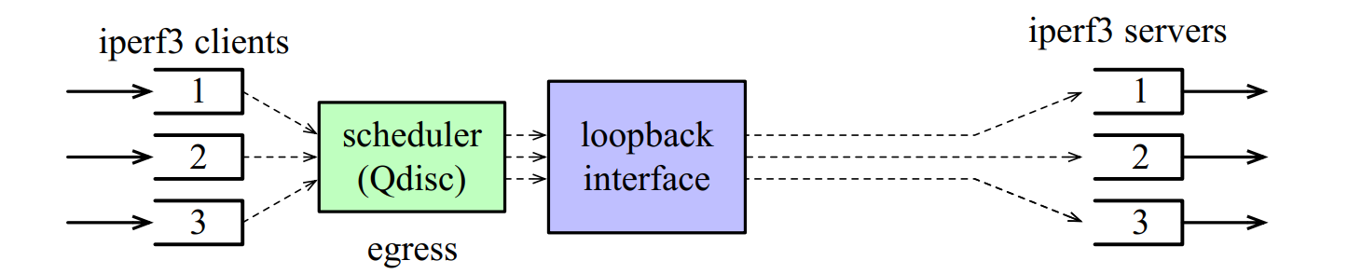
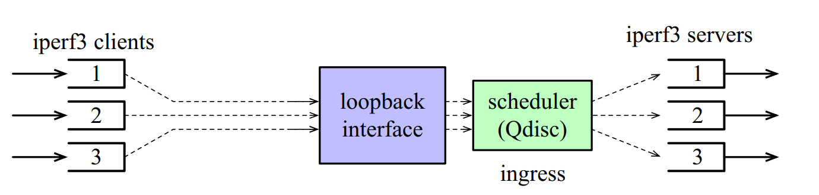
  问题
Ingress vs Egress
TC 只工作在egress端并不是说TC只在流量出去的时候工作

Slide 25
  问题
Ingress vs Egress
TC 只工作在egress端并不是说TC只在流量出去的时候工作

Slide 26
  问题
Ingress vs Egress
There are interactions with higher-layer protocols
For example, there may be restrictions that a packet from a client can enter the scheduler only when the previous packet from the client has been transmitted.
This becomes more of an issue when we want to set the transmission rate of the scheduler to a value that is well below the capacity of the scheduler

Slide 27
问题
- ceil的值会影响剩余带宽的分配？
 | rate | ceil | prio | real-rate
p | 10 | 10
c1 | 4 | 10 | 1 | 8
c2 | 2 | 10 | 2 | 2 link
 | rate | ceil | prio | real-rate
p | 10 | 10
c1 | 4 | 7 | 1 | 6
c2 | 2 | 7 | 2 | 4 link
 | rate | ceil | prio | real-rate
p | 10 | 10
c1 | 4 | 8 | 1 | 6.2
c2 | 2 | 8 | 2 | 3.8 link

Slide 28
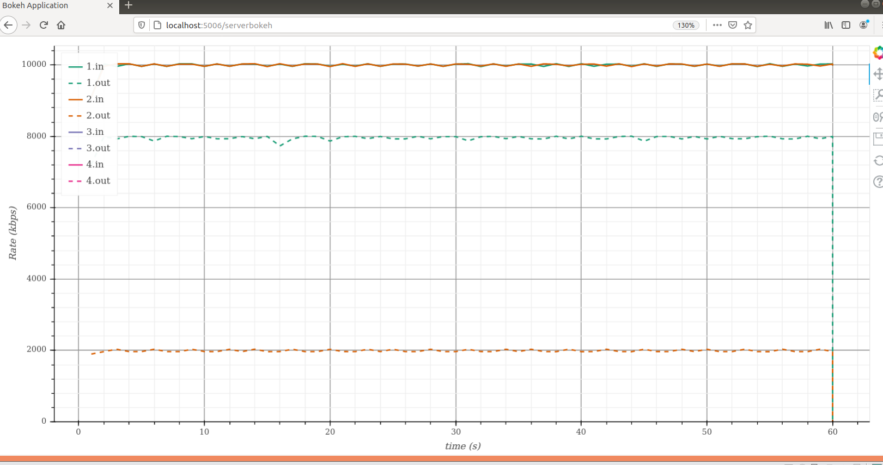
问题：

Slide 29
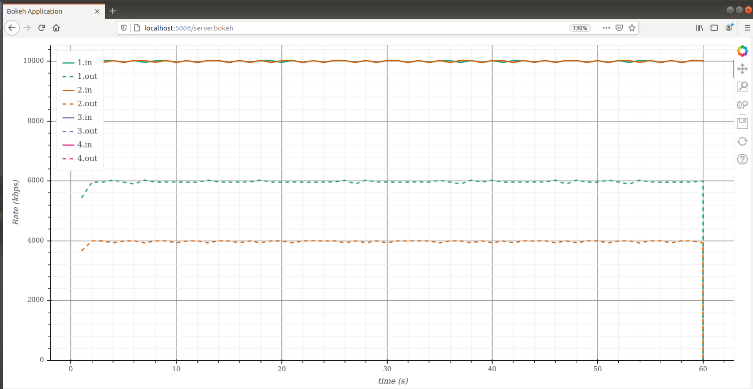

Slide 30
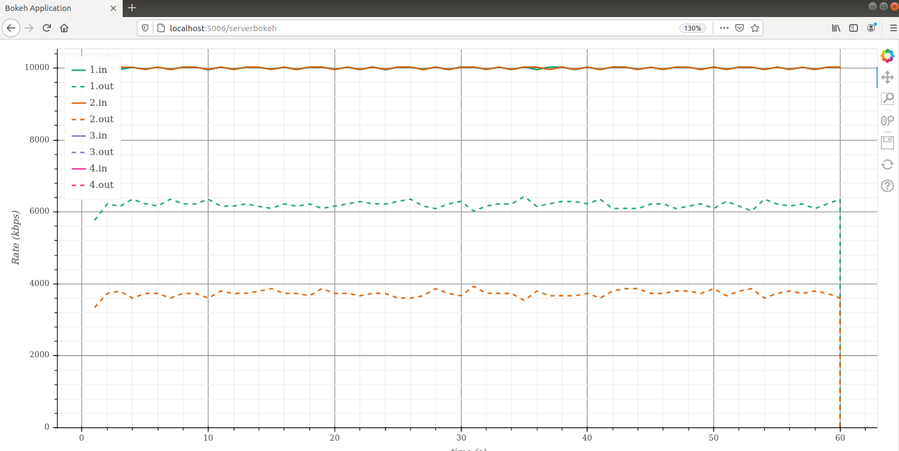

Slide 31


