Slide 1
I/O latency Issue of Serverless Data Analytics
李涛
2021.3.3
Notes:
我汇报的主要内容是：Serverless数据分析应用的I/O时延问题以及初步的解决方案

Slide 2
Background
Remote storage characteristics
Bandwith
the gap between network bandwidth and storage I/O bandwidth is narrowing
Cost
Storage Medium | SSD on c3.8xlarge | SSD on i2.8xlarge | 4 SSDs on i2.8xlarge | S3
Write Speed (MB/s) | 208.73 | 460.36 | 1768.04 | 501.13
Comparison of single-machine write bandwidth to instance local SSD and S3^{[4]}
Service | $/Mo/GB | $/million writes
S3 | 0.023 | 5
Redis | 7.9 | -
Cloud storage cost from major providers (Feb 2019)^{[3]}
[3] Shuffling, Fast and Slow: Scalable Analytics on Serverless Infrastructure NSDI’19
[4] Occupy the Cloud: Distributed Computing for the 99% SoCC ’17
Notes:
- 接下来是带宽，测试表明目前网络带宽和存储I/O差距很小，写入S3的速度已经比写入单个SSD要快了
- 但是S3的请求吞吐量是有限制的，对于10KB的文件，S3的IOPS只能到达6000，而redis高出了两个数量级，也就是说S3对小文件的读写不支持较高的吞吐率

Slide 3
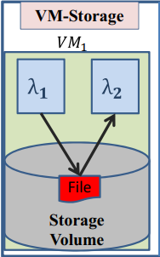
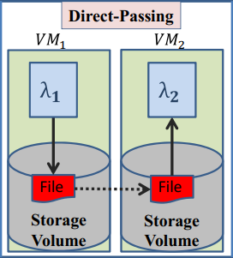

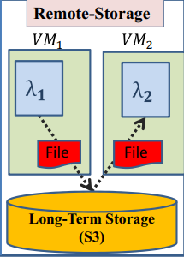
Application-aware Data Passing^{[7]}
Design
Application-aware Data Passing
Memory footprint、Excution time、Funout degree、Intermediate data size
Challenge
VM-Storage：Scheduling constraints、Hot-spots issue
Direct-Passing：Data copy、VM network bandwidth
Remote-Storage：Latency
Trained prediction model
Job’s optimized decisions
DAG
Input size | DAG’s parameters
Co-location perferences
λi → λi+1 data passing method
user
Vraying size
input
Map
new input size
[7] Sonic: Application-aware Data Passing for Chained Serverless Applications ATC’21
Notes:
- design
- 采用应用感知的传输方式，根据DAG图的参数自适应的选择三种数据传输方式
- 根据用户提供的应用DAG和不同大小的输入，训练出输入规模到DAG参数的映射；
- 当新的输入到达时，根据训练模型确定每个函数的最佳位置以及相邻函数间的最佳传输方式。

