Slide 1
Wukong: A Scalable and Locality-Enhanced Framework for Serverless Parallel Computing
李涛
2021.3.31
[1] Wukong: A Scalable and Locality-Enhanced Framework for Serverless Parallel Computing SoCC’20
Notes:
我汇报的主要内容是：Serverless数据分析应用特征的定性分析以及发现的几个问题

Slide 2
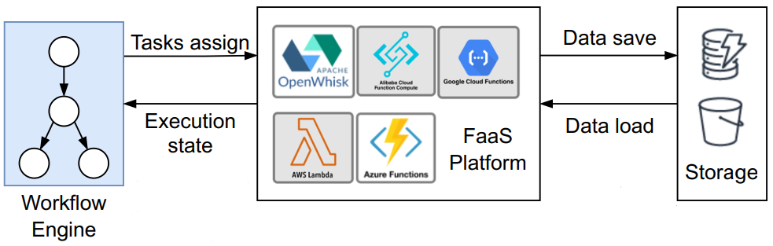
Background
Serverless workflow
Data-dependent functions are required to be invoked following a pre-defined logic（DAG）
Traditional serverless workflow

Slide 3
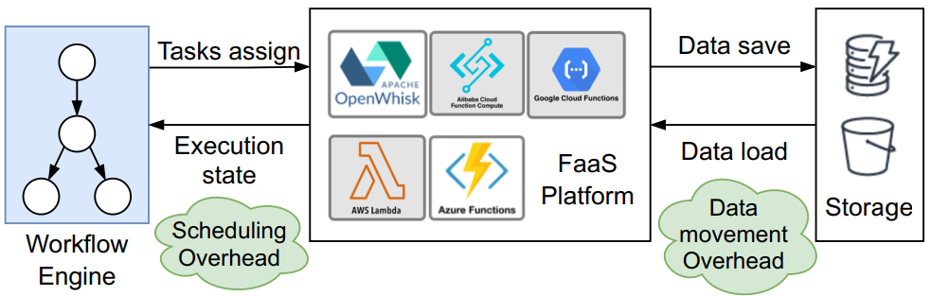
Motivation
Overhead analysis for serverless workflow
Scheduling Overhead
Data movement Overhead
The overhead analysis for traditional workflow

Slide 4
Motivation
Scheduling Overhead
问题说明
数据支撑

Slide 5
Motivation
Data Movement Overhead

Slide 6
Key idea
Decentralized scheduling
Partition the workﬂow DAG into sub-graphs
Assign each subgraph to a task Executor
Schedule and Execute tasks by each Executor in parallel
[1] Wukong: A Scalable and Locality-Enhanced Framework for Serverless Parallel Computing SoCC’20

Slide 7
Design
Wukong architecture
[1] Wukong: A Scalable and Locality-Enhanced Framework for Serverless Parallel Computing SoCC’20

Slide 8
Idea
Large fan-out task
Long term storage
range partition
...
...
...
...
merge sort
Long term storage
Mapreduce Sort application
[1] Sonic: Application-aware Data Passing for Chained Serverless Applications ATC’21

Slide 9
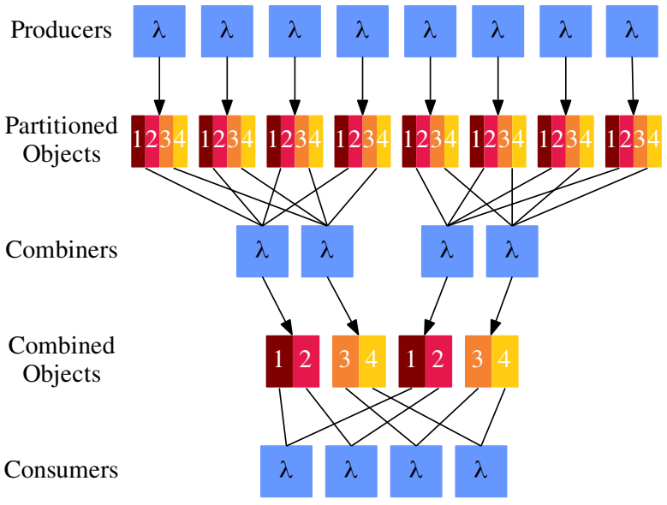
Idea
Multistage shuffle
Tradeoff between compute time and object storage request costs
读写请求数变少，读写数据量变多
s：num of producers
r：num of consumers
p：the fraction of partitions each combiner
reads
f：the fraction of files each combiner reads
s=8
r=4
p=1/2
f=1/2
Multistage shuffle
[1] Starling: A Scalable Query Engine on Cloud Functions SIGMOD’20

Slide 10
Idea
High fanout -> Low fanout
Shuffle task
low fanout task
G1
G1
G2
G2
G3

Slide 11
Reference
[1] Wukong: A Scalable and Locality-Enhanced Framework for Serverless Parallel Computing SoCC’20
[2] FaaSFlow: Enable Efficient Workflow Execution for Function-as-a-Service ASPLOS’22
[3] Starling: A Scalable Query Engine on Cloud Functions SIGMOD’20
[4] Sonic: Application-aware Data Passing for Chained Serverless Applications ATC’21

