Slide 1
Serverless数据分析应用特征的定性分析
李涛
2021.3.24
Notes:
我汇报的主要内容是：Serverless数据分析应用的I/O时延问题以及初步的解决方案

Slide 2
典型的数据分析应用
 | Mapreduce sort benchmark | Video analytics | Distributed compilation | LightGBM | TPC-DS | Big data benchmark
Locus^{[1]} | ✔️ |  |  |  | ✔ | ✔
Caerus^{[2]} | ✔ |  |  |  | ✔ | ✔
Pocket^{[3]} | ✔ | ✔ | ✔
Ephemeral Storage^{[4]} | ✔ | ✔ | ✔
Sonic^{[5]} | ✔ | ✔ |  | ✔
Application
Paper
[1] Shuffling, Fast and Slow: Scalable Analytics on Serverless Infrastructure NSDI’19
[2] Caerus: NIMBLE Task Scheduling for Serverless Analytics NSDI’21
[3] Pocket: Elastic Ephemeral Storage for Serverless Analytics OSDI ’18
[4] Understanding Ephemeral Storage for Serverless Analytics ATC’18
[5] Sonic: Application-aware Data Passing for Chained Serverless Applications ATC’21
Notes:
- 首先介绍一下serverless的计算框架
* 为了实现资源的高弹性和扩展性，serverless采用存算分离的架构，由FaaS提供计算资源，BaaS提供存储服务。
* 下面这张图展示了完整的serverless的计算架构。
* 当请求到达时首先通过API网关路由到对应的沙箱；
* 然后在沙箱中实例化无状态函数进行计算；
* 这里的无状态是指函数计算完成后，产生的数据和状态或者原地销毁，或者存储到外部的共享存储中，也就是BaaS这一端。
* 这里的共享存储可以是跨数据中心的对象存储S3、kv数据库DynamoDB，也可以是内存kv存储系统ElastiCache，可以在上面部署redis或者memcached。考虑成本问题，S3使用最为广泛。

Slide 3
典型的数据分析应用
MapReduce sort
Two stage：range partition stage and merge sort stage
Num
of
functions
Long term storage
...
range partition
...
range partition
range partition
500
Stage 1
Scatter
Stage 2
...
merge sort
...
merge sort
500
merge sort
Long term storage
DAG overview for Mapreduce Sort application
Notes:
* MapReduce sort （Terasort）
** We implemented the Terasort [30] algorithm to perform sort in two stages:
** a partition stage that range-partitions the input and writes out to intermediate storage；
** a merge stage that, for each partition, merges and sorts all intermediate data for that partition and writes out the sorted output
** Each intermediate file is written and read only once and its size is directly proportional to the dataset size and inversely related to the number of
workers
** I/O intensive
** gensort Data Generator. http://www.ordinal.com/gensort.html.
** 采用scatter的通信方式，并发度并不会增加中间数据的规模

Slide 4
典型的数据分析应用
Video analytics
Three stage：Split video、Decode frames and MXNET classification
Long term storage
Num
of
functions
Stage 1
Split_Video
Stage 2
Extract Frame
... ...
Extract Frame
62
Stage 3
Classify Frame
... ...
Classify Frame
301
Long term storage
DAG overview for Video Analytics application
Notes:
* Video analytics （Thousand Island Scanner(THIS)）
** The input is an encoded video that is divided into batches and uploaded to ephemeral storage.
** First stage lambdas read a batch of encoded video frames from ephemeral storage and write back decoded video frames.
** Each lambda then launches a second stage lambda which reads a set of decoded frames from ephemeral storage, computes a MXNET deep learning classification algorithm and outputs a
classification result

Slide 5
典型的数据分析应用
LightGBM
Three stage：PCA、Decision trees training and Combine&Test
Long term storage
Stage 1
PCA
Broadcast
Stage 2
Train Model
... ...
Train Model
Stage 3
Combine and Test
Long term storage
DAG overview for LightGBM application
Notes:
* Video analytics （Thousand Island Scanner(THIS)）
** The input is an encoded video that is divided into batches and uploaded to ephemeral storage.
** First stage lambdas read a batch of encoded video frames from ephemeral storage and write back decoded video frames.
** Each lambda then launches a second stage lambda which reads a set of decoded frames from ephemeral storage, computes a MXNET deep learning classification algorithm and outputs a
classification result

Slide 6
典型的数据分析应用
Distributed compilation
Two stage：compile stage and link stage
preprocess
&
parse
code
generation
.obj
files
C file
assemble
...
...
...
...
...
link
preprocess
&
parse
code
generation
.obj
files
C file
assemble
Ephemeral
storage
Compile
library
files
Link
Stage 1
Stage 2
The traditional compilation sequence
Notes:
* Distributed compilation

Slide 7
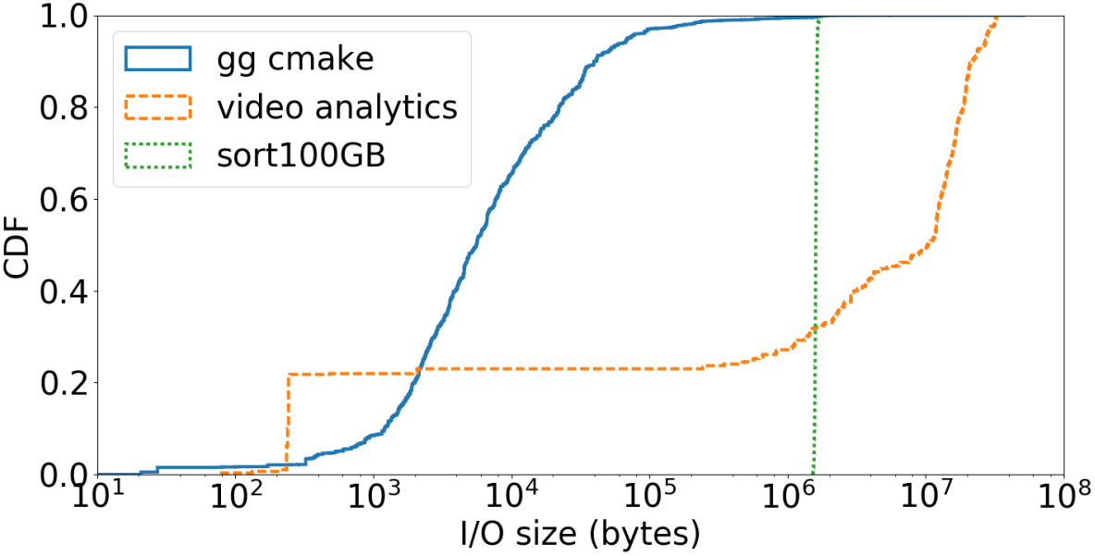
数据分析应用的数据特征
I/O size
The granularity of data access varies widely^{[1]}
Applications that read/write large objects demand high throughput while low latency is important for small object accesses^{[1]}
I/Os range from 100s of bytes to 100s of MBs^{[1]}
[1] Understanding Ephemeral Storage for Serverless Analytics ATC’18

Slide 8
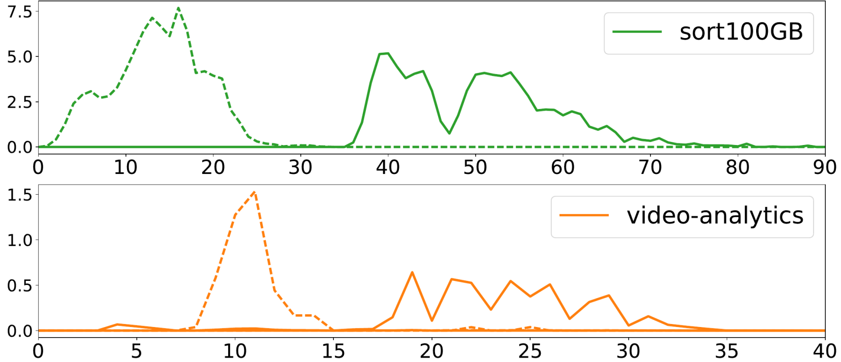
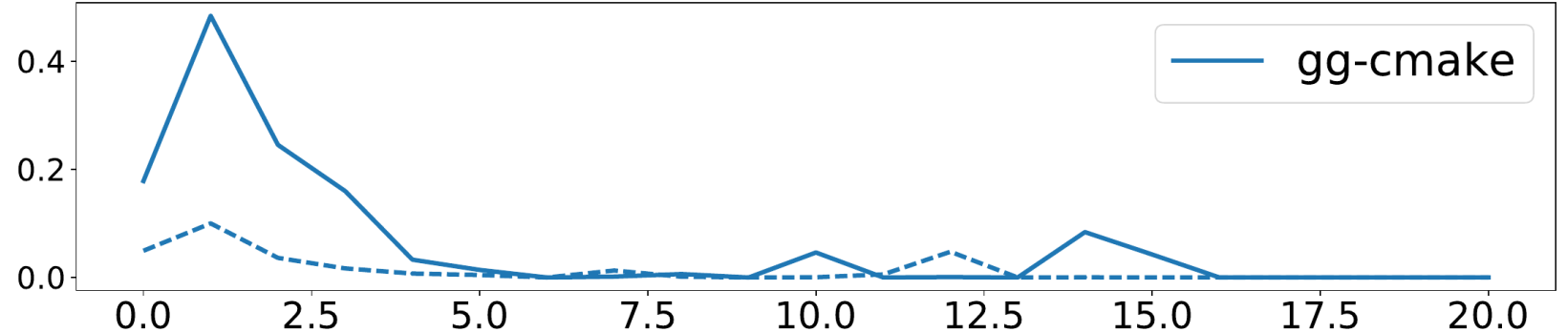
数据分析应用的访问特征
Data access pattern
Fanout degree？？
Ephemeral I/O Throughput:
Write (dotted), Read (solid)^{[1]}
Application Type
Ephemeral Data Capacity
MapReduce
100GB
Total GB/s
Video Analytics
6GB
Distributed
Compilation
0.95GB
Time(s)
[1] Understanding Ephemeral Storage for Serverless Analytics ATC’18

Slide 9
数据分析应用的DAG特征
How many Stages a job is compose of ？
The number of stages is small in practice^{[1]}
A DAG of 8 stages is considered long for current serverless applications^{[1]}
How many Tasks a stage is compose of ？
10~10²
Upper bounded by the degree of parallelism of the stage(AWS : 1,000)
How many Functions a tsak is compose of ？
One
MapReduce Sort、Video analytics、LightGBM
[1] Caerus: NIMBLE Task Scheduling for Serverless Analytics NSDI’21

Slide 10
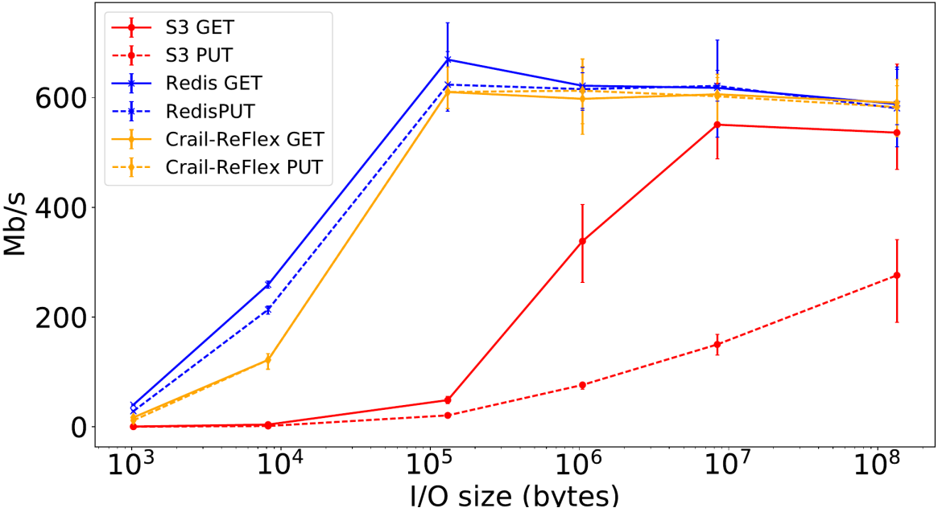
问题一：进一步明确远端存储的瓶颈
S3/Redis throughput
S3 delivers faster throughput on large objects than small ones due to a high per-transaction overhead^{[1]}
S3 is a multi-tenant service, there is an imposed limit on request throughput per S3 bucket for the benefit of overall availability^{[2]}
[1] An Evaluation of Amazon's
Grid Computing Services: EC2, S3, and SQS HARVARD’07
[2] Pywren SoCC’17
[3] Ephemeral Storage ATC’18
Peak storage throughput per lambda^{[3]}
Notes:
* S3 is not designed to sustain high request rate for small objects,Our testing confirms that S3 delivers dramatically faster throughput on large objects than small ones due to a high per-transaction overhead
* S3 is a multi-tenant service, there is an imposed limit on request throughput per S3 bucket for the benefit of overall availability
* The bandwidth for samll files transactions is dominated by S3's transaction processing overhead, while the 100MByte transactions is presumably dominated by bulk data transfer

Slide 11
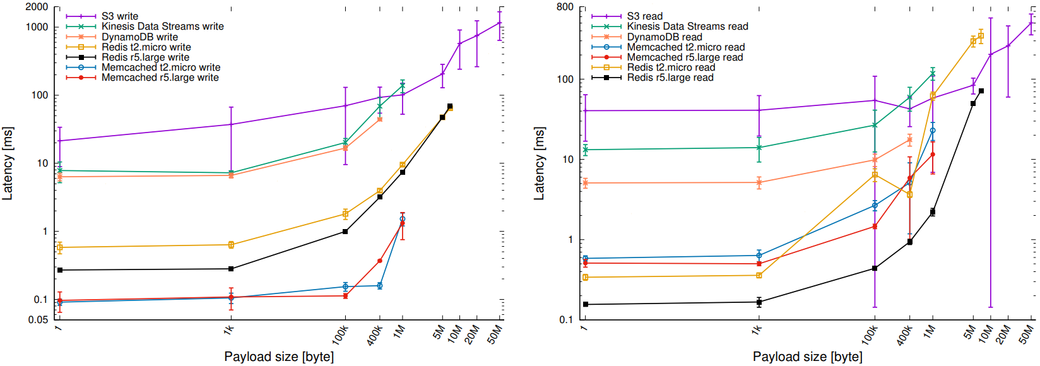
问题一：进一步明确远端存储的瓶颈
S3/Redis latency
Network latency & Storage I/O latency
Latency of write (left) and read (right) operations
using different AWS data storage services^{[1]}
[1] Towards Latency Sensitive Cloud Native Applications: A Performance Study on AWS CLOUD’19

Slide 12
问题二：I/O size-aware的想法
I/O size-aware
Small objects -> Latency-sensitive；Large objects -> Throughtput-sensitive
对不同大小的I/O size采用不同的数据传输方案
I/Os range from 100s of bytes to 100s of MBs^{[1]}
[1] Understanding Ephemeral Storage for Serverless Analytics ATC’18

Slide 13


问题三：Stage-aware的问题
Stage-aware
A tsak is compose of a function
Sonic^{[1]}: application-aware ≈ stage-aware
相邻阶段的所有函数对都采用相同的数据传输方式
Stage 1
Stage 2
Stage 1
Stage 2
[1] Sonic: Application-aware Data Passing for Chained Serverless Applications ATC’21
Notes:
* 问题：调研的数据分析应用一个任务只由一个函数构成（至少应用感知的那篇paper中的三个应用都是这样的），而且一个stage内的任务都是并行的，这样一个stage内就不存在函数之间的通信。这样Sonic的应用感知方案虽然是以函数为粒度，但也可以理解为stage-aware
* 想法：一种可能就是调研的任务太简单，复杂的应用可能会将一个任务解耦成多个函数；还有一种可能就是 one function per task是通用的范式，但是这样过于笨重，削弱了弹性，不便于调度 ，可以把它 解耦成函数链(通信开销和扩展性的trade-off) ，从而可以去做stage-aware

Slide 14
问题三：Stage-aware的问题
猜想
任务太简单？
复杂的应用会不会将一个Task解耦成多个Function？
One function per task是通用的设计范式？
One function per task -> 过于笨重，削弱了弹性，不便于调度 -> 解耦成函数链(通信开销和扩展性的trade-off) -> stage-aware ?
Stage 1
Stage 2
Stage 1
Stage 2
[1] Sonic: Application-aware Data Passing for Chained Serverless Applications ATC’21

Slide 15
Pocket^{[1]}
Motivation
Existing storage services are not a good fit for sharing short-lived intermediate data
 | Elastic scaling | Latency | Throughput | Max object size | Cost
S3 | Auto, coarse-grain️ | High | Medium | 5 TB | $
DynamoDB | Auto, fine-grain, pay per hour | Medium | Low | 400 KB | $$
Elasticache Redis | Manual | Low | High | 512 MB | $$$
Aerospike | Manual | Low | High | 1 MB | $$
Apache Crail | Manual | Low | High | any size | $$
Desired for λs | Auto, fine-grain, pay per second | Low | High | any size | $
[1] Pocket: Elastic Ephemeral Storage for Serverless Analytics OSDI ’18
Notes:
* 接下来是请求吞吐率
* 下面这张表格展示了随数据对象大小变化时，S3和redis的请求吞吐量限制
* 可以看出S3的请求速率是受限的，尤其是对于小文件的读写无法提供较高的吞吐率，可以看到对于10KB大小的文件S3的吞吐量比Redis低了两个数量级

Slide 16
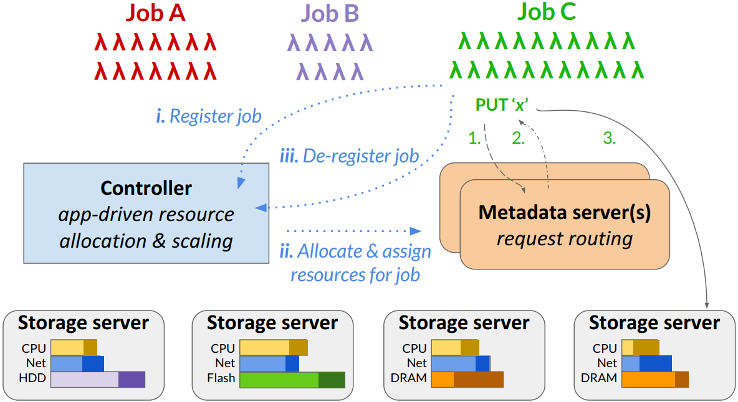
Pocket^{[1]}
Design
Multi-tier storage
Leverage different storage media to satisfy I/O demands of different applications while minimizing cost
Pocket system architecture
[1] Pocket: Elastic Ephemeral Storage for Serverless Analytics OSDI ’18
Notes:
* 接下来是请求吞吐率
* 下面这张表格展示了随数据对象大小变化时，S3和redis的请求吞吐量限制
* 可以看出S3的请求速率是受限的，尤其是对于小文件的读写无法提供较高的吞吐率，可以看到对于10KB大小的文件S3的吞吐量比Redis低了两个数量级

Slide 17
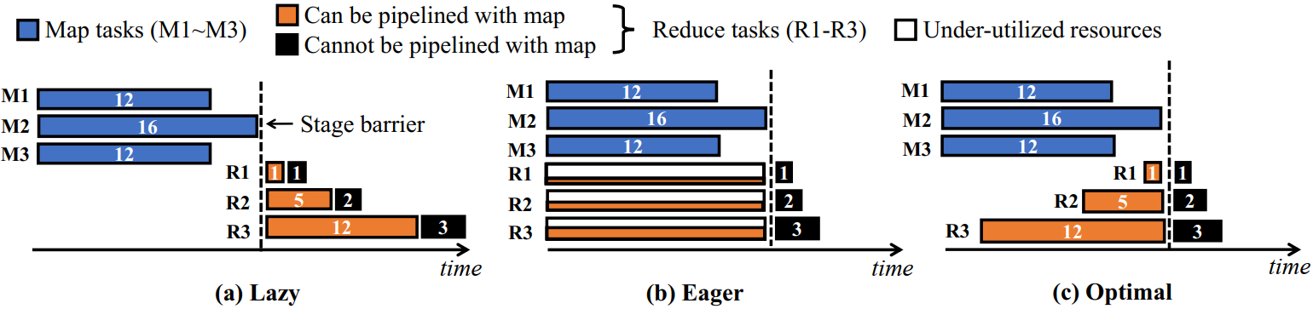
Caerus^{[1]}
Motivation
Different schedule goals
Server-centric Analytics：minimize job runtime, maximize resource utilization and ensure resource isolation (or fairness) across jobs
Serverless Analytics：minimize job completion time and execution cost
Trade-off between JCT and cost
cost-optimal
JCT-optimal
Three schedule approaches for a simple map-reduce job
[1] Caerus: NIMBLE Task Scheduling for Serverless Analytics NSDI’21
Notes:
* 接下来是请求吞吐率
* 下面这张表格展示了随数据对象大小变化时，S3和redis的请求吞吐量限制
* 可以看出S3的请求速率是受限的，尤其是对于小文件的读写无法提供较高的吞吐率，可以看到对于10KB大小的文件S3的吞吐量比Redis低了两个数量级

Slide 18
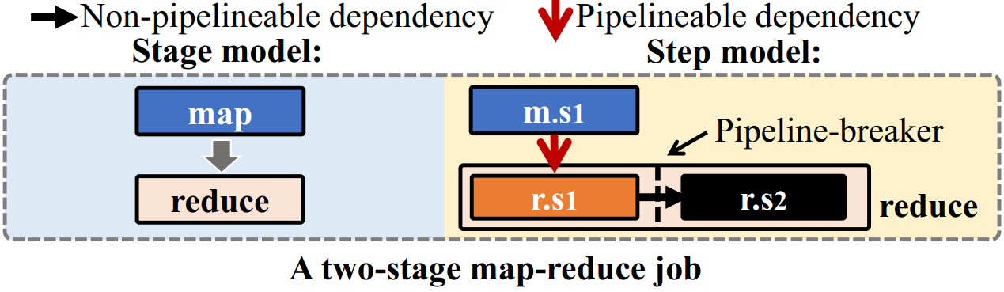
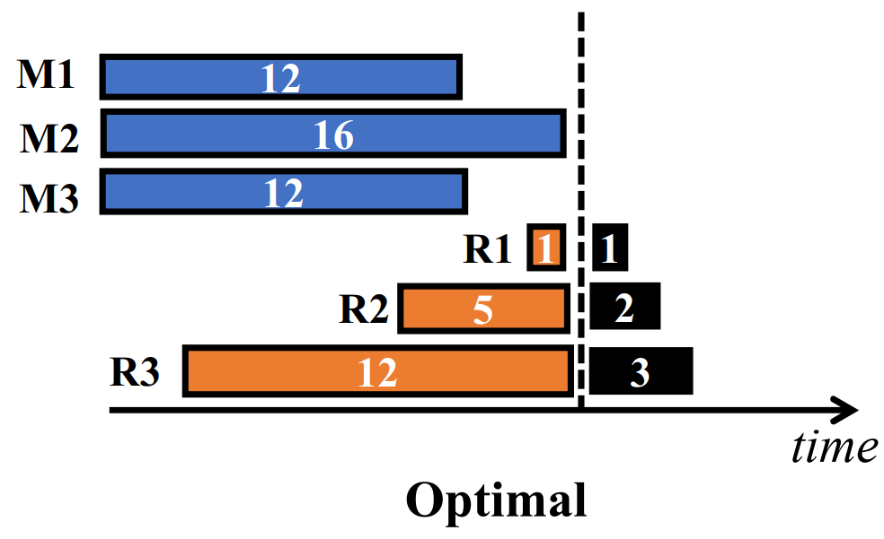
Caerus^{[1]}
Design
Sub-task level schedule
stages are separated into one or more steps by pipeline breakers
Step dependency model for a map-reduce job
[1] Caerus: NIMBLE Task Scheduling for Serverless Analytics NSDI’21
Notes:
* 接下来是请求吞吐率
* 下面这张表格展示了随数据对象大小变化时，S3和redis的请求吞吐量限制
* 可以看出S3的请求速率是受限的，尤其是对于小文件的读写无法提供较高的吞吐率，可以看到对于10KB大小的文件S3的吞吐量比Redis低了两个数量级

Slide 19
定量实验
Pywren^{[1]}
Map-reduce style serverless framework for highly parallel analytics workloads
Mapreduce sort
Partition0
remoteread
Stage 1
wirte
Partition1
Stage 2
read
... ...
wirte
Split 0
tag
PartitionR-1
sort
Output
file0
Split 1
Partition0
Split 2
tag
Partition1
... ...
sort
Output
file1
Split 3
PartitionR-1
... ...
Split 4
Partition0
tag
Partition1
... ...
Output
file2
PartitionR-1
sort
... ...
... ...
... ...
... ...
... ...
Partition0
sort
Output
file0
Split K
tag
Partition1
... ...
PartitionR-1
Input files
Map phrase
Intermediate files
Reduce phrase
Output files
[1] Occupy the Cloud: Distributed Computing for the 99% SoCC’17

Slide 20
Reference
[1] Shuffling, Fast and Slow: Scalable Analytics on Serverless Infrastructure NSDI’19
[2] Caerus: NIMBLE Task Scheduling for Serverless Analytics NSDI’21
[3] Pocket: Elastic Ephemeral Storage for Serverless Analytics OSDI ’18
[4] Understanding Ephemeral Storage for Serverless Analytics ATC’18
[5] Sonic: Application-aware Data Passing for Chained Serverless Applications ATC’21
[6] Occupy the Cloud: Distributed Computing for the 99% SoCC’17
[7] Towards Latency Sensitive Cloud Native Applications: A Performance Study on AWS CLOUD’19

