Slide 1
Pywren&Lithops: Serverless Data Analytics
李涛
2021.4.12
[1] Pywren: Occupy the Cloud: Distributed Computing for the 99% SoCC’17
[2] Lithops: Serverless Data Analytics in the IBM Cloud Middleware’18

Slide 2
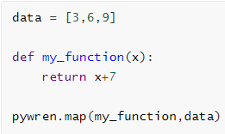
Pywren
Map-reduce style serverless framework
my_function(3)
FaaS
my_function(6)
my_function(9)
Invocation
Function code
& data
result
Pywren
Serialize put in Baas
Function code & data
result
Object Storage
Client
Cloud
[1] Pywren: Occupy the Cloud: Distributed Computing for the 99% SoCC’17

Slide 3
Pywren vs Lithops
SoCC’17
Middleware’18
Pywren
完善功能增加特性
Lithops
NSDI’19
Locus
Combines slow storage with fast but expensive storage for state management
Sub-task scheduling to minimize execution and job completion time
NSDI’21
Caerus
[1] Pywren: Occupy the Cloud: Distributed Computing for the 99% SoCC’17
[2] Lithops: Serverless Data Analytics in the IBM Cloud Middleware’18
[3] Locus: Shuffling, Fast and Slow: Scalable Analytics on Serverless Infrastructure NSDI’19
[4] Caerus: NIMBLE Task Scheduling for Serverless Analytics NSDI’21

Slide 4
Pywren vs Lithops
 | Pywren | Lithops
MapReduce | Map️ | Map&MapReduce
Composability | None | Dynamic compositions of functions
Runtime | Fixed | Based on Docker（custom runtime）
Open-source portability & extensibility | AWS | AWS IBM Cloud Google Cloud Aliyun

Slide 5
为什么选择Lithops ？
Map-reduce style serverless framework
可以便于验证并分析Serverless state management的问题
基于Pywren的最新工作
Locus NSDI’19、Caerus NSDI’21
开源且仍在维护
Pywren：starred 782
Lithops：starred 200

Slide 6
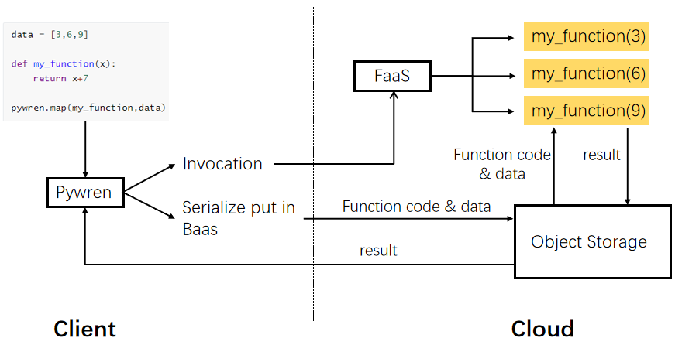
Evaluation
实验环境
Client：Ubuntu 16.04.6 LTS；2 CPU 24 Cores
Cloud：
computing：阿里云FC
storage：阿里云OSS

Slide 7
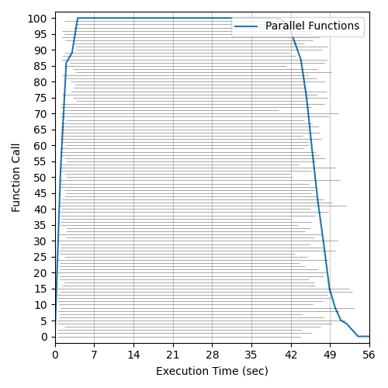
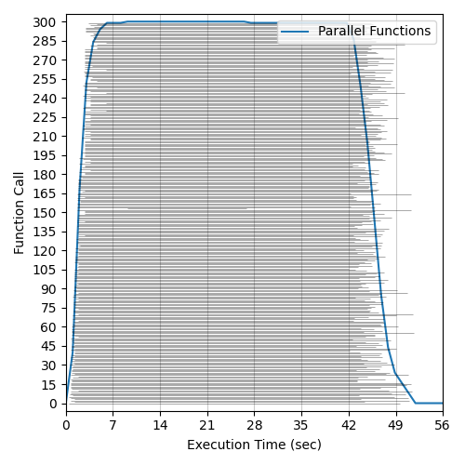
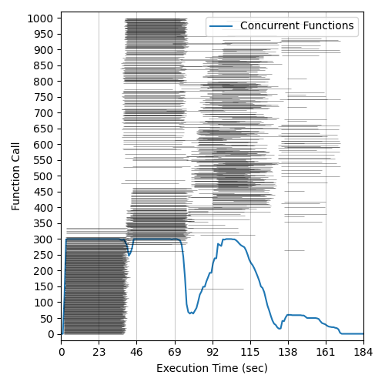
Evaluation
函数并发性
阿里云FC函数并发度最大为300
100 functions
300 functions
1000 functions

Slide 8
Evaluation
对象存储的读写性能
阿里云FC函数并发度最大为300

Slide 9
下一步实验
利用Lithops实现Mapreduce类应用
Wordcount
Terasort
测试Wordcount/Terasort运行时间的breakdown
S3 I/O time
Computing time
Shuffle I/O time
在Wordcount/Terasort上实现Multistage shuffle

Slide 10
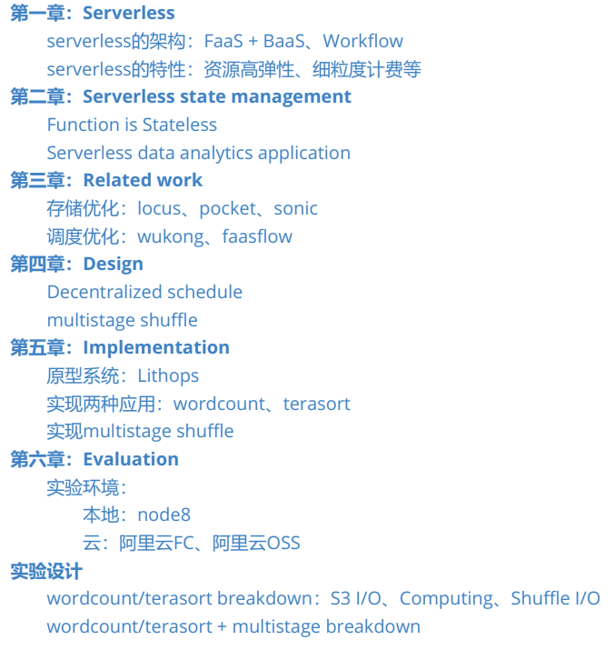
提纲

Slide 11
Reference
[1] Pywren: Occupy the Cloud: Distributed Computing for the 99% SoCC’17
[2] Lithops: Serverless Data Analytics in the IBM Cloud Middleware’18
[3] Locus: Shuffling, Fast and Slow: Scalable Analytics on Serverless Infrastructure NSDI’19
[4] Caerus: NIMBLE Task Scheduling for Serverless Analytics NSDI’21

