Slide 1
Lithops实验
李涛
2021.4.26
[1] Lithops: Serverless Data Analytics in the IBM Cloud Middleware’18

Slide 2
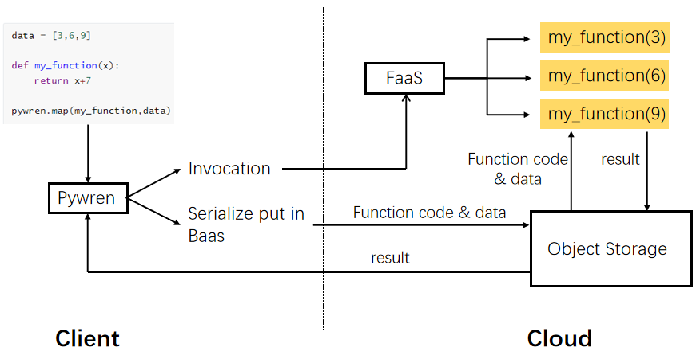
Evaluation
实验环境
Client：Ubuntu 16.04.6 LTS；2 CPU 24 Cores
Cloud：
computing：阿里云FC
storage：阿里云OSS

Slide 3
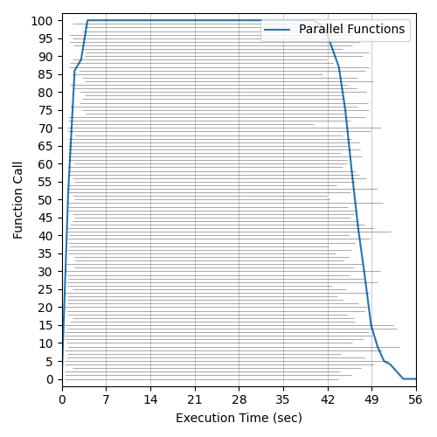
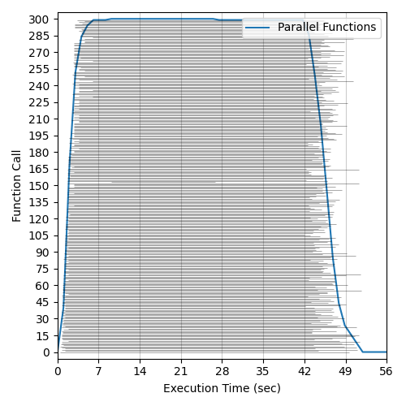
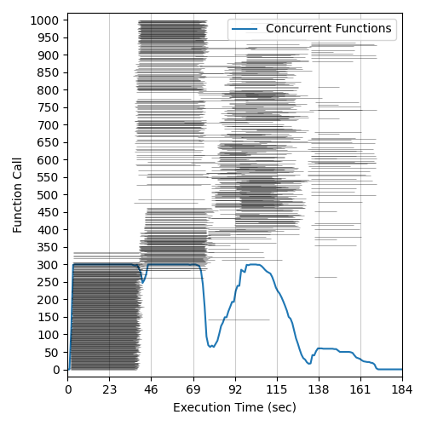
Evaluation
函数并发性
阿里云FC函数并发度最大为300
100 functions
300 functions
1000 functions

Slide 4
Evaluation
OSS读写时延

Slide 5
Evaluation
OSS读写吞吐量

Slide 6
Evaluation
Wordcount runtime breakdown

Slide 7
下一步实验
在Wordcount上实现Multistage shuffle
利用Lithops实现Terasort
测试Terasort运行时间的breakdown

Slide 8
毕设提纲
在Wordcount上实现Multistage shuffle
利用Lithops实现Terasort
测试Terasort运行时间的breakdown

Slide 9
Reference
[1] Pywren: Occupy the Cloud: Distributed Computing for the 99% SoCC’17
[2] Lithops: Serverless Data Analytics in the IBM Cloud Middleware’18
[3] Locus: Shuffling, Fast and Slow: Scalable Analytics on Serverless Infrastructure NSDI’19
[4] Caerus: NIMBLE Task Scheduling for Serverless Analytics NSDI’21

