Slide 1
Wukong: A Scalable and Locality-Enhanced Framework for Serverless Parallel Computing
李涛
2021.3.31
[1] Wukong: A Scalable and Locality-Enhanced Framework for Serverless Parallel Computing SoCC’20
Notes:
我汇报的主要内容是：Serverless数据分析应用特征的定性分析以及发现的几个问题

Slide 2
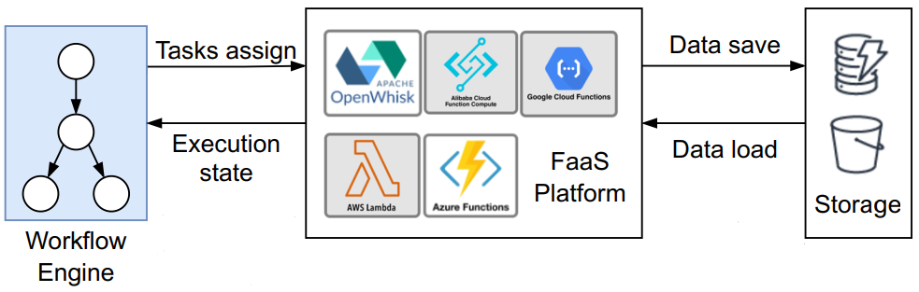
Background
Serverless workflow
Data-dependent functions are required to be invoked following a pre-defined logic（DAG）
Traditional serverless workflow

Slide 3
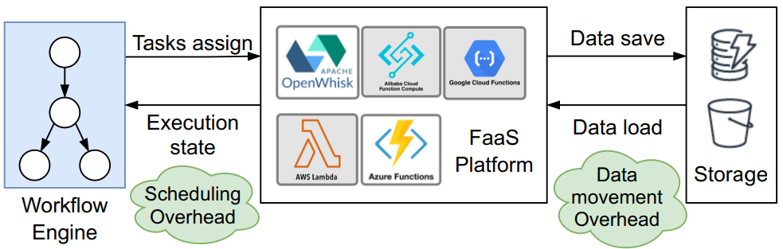
Motivation
Overhead analysis for serverless workflow
Scheduling Overhead
Data movement Overhead
The overhead analysis for traditional workflow

Slide 4
Motivation
Scheduling Overhead
Centralized scheduling
Assign tasks
Track execution state
Node
Node
Tasks assign
Worker
Worker
Worker
Node
Node
Worker
Worker
Worker
Execution state
Central
Scheduler
FaaS Platform

Slide 5
Motivation
Scheduling Overhead
Centralized scheduling
Burst-parallel application
Functions are short and parallel
Eexecution states are frequently transferred
Node
Node
Tasks assign
Worker
Worker
Worker
Scheduling Overhead
Node
Node
Worker
Worker
Worker
Execution state
Central
Scheduler
FaaS Platform

Slide 6
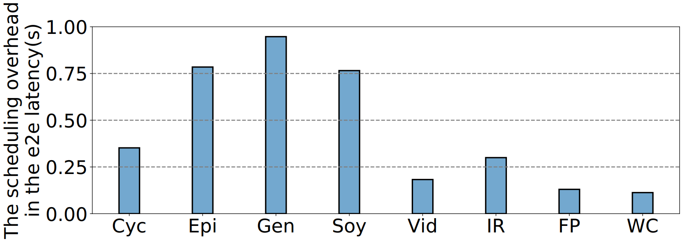
Motivation
Scheduling Overhead
Centralized scheduling
Burst-parallel application
The scheduling overhead of executing the workflow benchmark

Slide 7


Motivation
Data Movement Overhead
Function is stateless
Use remote storage services to exchange intermediate data
Node
Node
Data save
Worker
Worker
Worker
Data movement Overhead
Node
Node
Worker
Worker
Worker
Data load
Remote
Storage
FaaS Platform

Slide 8
Key idea
Decentralized scheduling
Partition the workﬂow DAG into sub-graphs
Assign each subgraph to a task Executor
Schedule and Execute tasks by each Executor in parallel
[1] Wukong: A Scalable and Locality-Enhanced Framework for Serverless Parallel Computing SoCC’20

Slide 9




Design
Wukong architecture
Lambda executor
Submit
jobs
DAG generator
Initial task
executor invokers
Become
Invoke
User
...
... ...
...
DAG
Invoke
Invoke
Become
Schedule generator
...
...
Intermediate data
Intermediate KV store
[1] Wukong: A Scalable and Locality-Enhanced Framework for Serverless Parallel Computing SoCC’20

Slide 10
Design
Static Scheduling
T6
T5
T4
T3
T1
T2
Static Schedule
[1] Wukong: A Scalable and Locality-Enhanced Framework for Serverless Parallel Computing SoCC’20

Slide 11
Design
Task Execution
[1] Wukong: A Scalable and Locality-Enhanced Framework for Serverless Parallel Computing SoCC’20

Slide 12
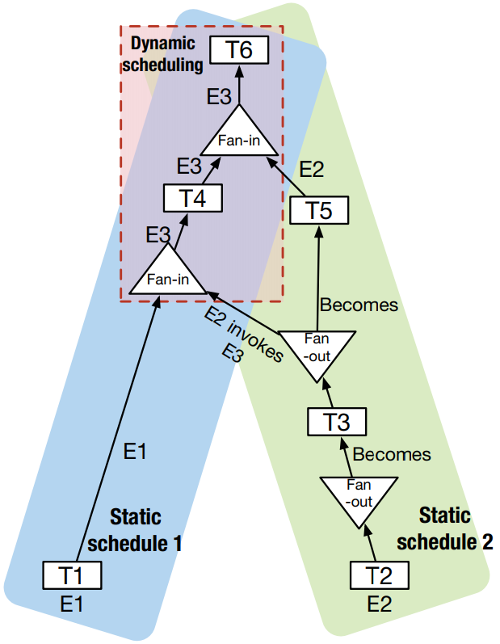
Design
Dynamic Scheduling
Dymanic Schedule
[1] Wukong: A Scalable and Locality-Enhanced Framework for Serverless Parallel Computing SoCC’20

Slide 13
Design
Storage Mangement
Within a executor
Across executors
[1] Wukong: A Scalable and Locality-Enhanced Framework for Serverless Parallel Computing SoCC’20

Slide 14
Idea
Large fan-out task
Long term storage
range partition
...
...
...
...
merge sort
Long term storage
Mapreduce Sort application
[1] Sonic: Application-aware Data Passing for Chained Serverless Applications ATC’21

Slide 15
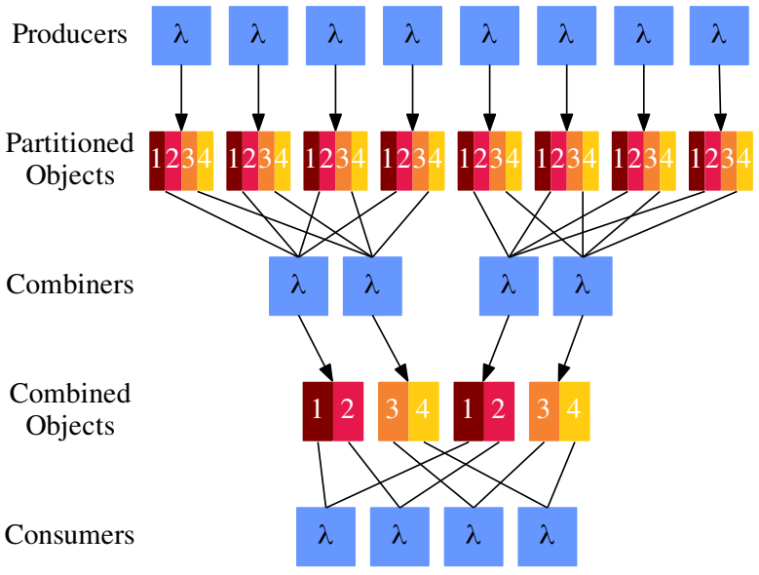
Idea
Multistage shuffle
Tradeoff between compute time and object storage request costs
读写请求数变少，读写数据量变多
s：num of producers
r：num of consumers
p：the fraction of partitions each combiner
reads
f：the fraction of files each combiner reads
s=8
r=4
p=1/2
f=1/2
Multistage shuffle
[1] Starling: A Scalable Query Engine on Cloud Functions SIGMOD’20

Slide 16
Idea
High fanout -> Low fanout
Shuffle task
low fanout task
G1
G1
G2
G2
G3

Slide 17
Reference
[1] Wukong: A Scalable and Locality-Enhanced Framework for Serverless Parallel Computing SoCC’20
[2] FaaSFlow: Enable Efficient Workflow Execution for Function-as-a-Service ASPLOS’22
[3] Starling: A Scalable Query Engine on Cloud Functions SIGMOD’20

