Slide 1
DBUS详述
Jinhui Li
Nov 26, 2015

Slide 2
Agenda
Brief introduction
DBUS layers
Concepts
Examples

Slide 3
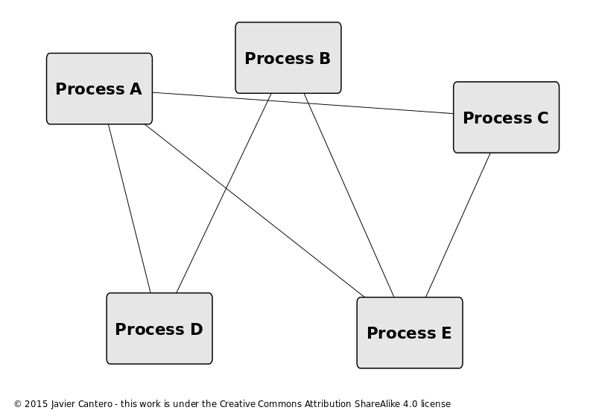
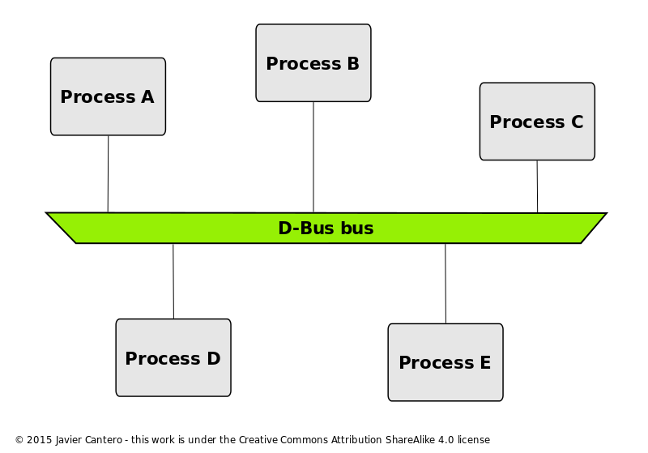
Brief Introduction
DBUS is a IPC mechanism provided by Project freedesktop.org
It is based on unix socket

Slide 4
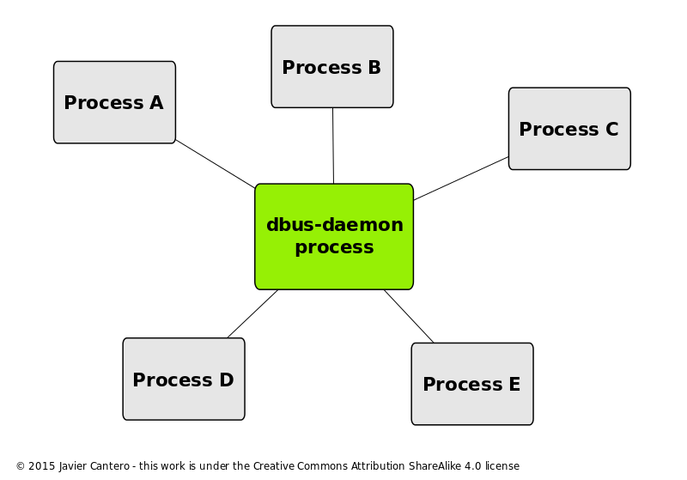
DBUS-layers
libdbus
Low-level pure C api
One to one connection, like raw socket
Dbus-deamon
Forms the hub, dbus-deamon forwards the message
Wrapper libraries or bindings
Related to specific framework or language
E : Pydbus, qtdbus , glib-dbus ,dbus-java

Slide 5
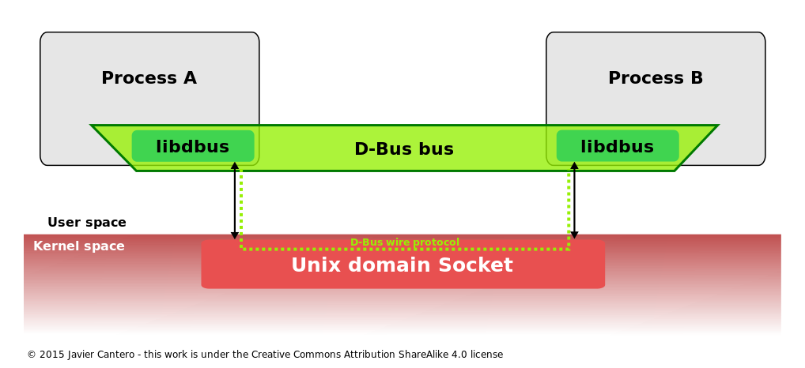
Communication through libdbus

Slide 6
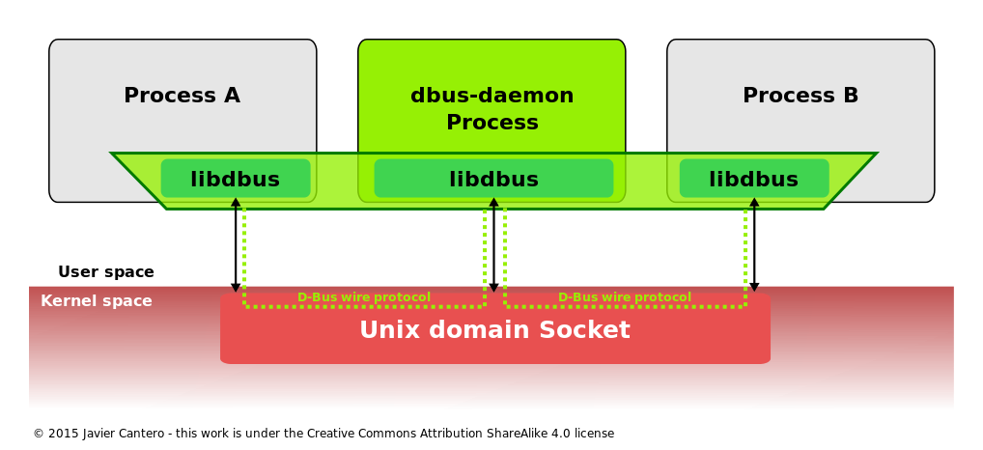
Communication through dbus-deamon

Slide 7
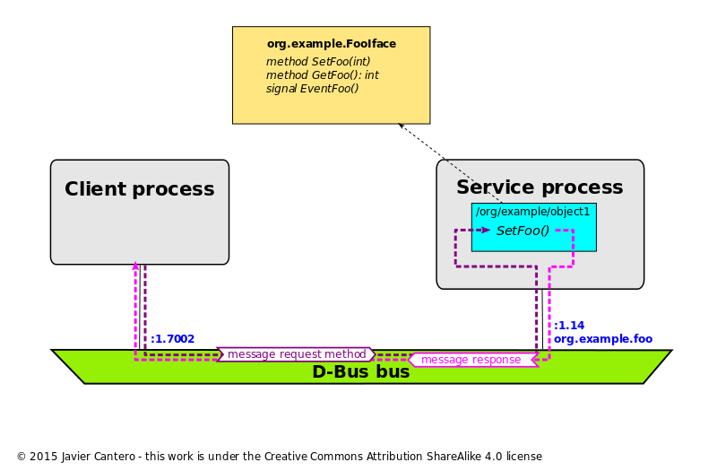
Data Flow

Slide 8
DBUS protocol
Type System
wire format - sequence of bytes
marshaling and unmarshaling
Basic Types
Container types

Slide 9
DBUS protocol-Basic types
Conventional name | ASCII type-code | Encoding
BYTE | y (121) | Unsigned 8-bit integer
BOOLEAN | b (98) | Boolean value: 0 is false, 1 is true, any other value allowed by the marshalling format is invalid
INT16 | n (110) | Signed (two's complement) 16-bit integer
UINT16 | q (113) | Unsigned 16-bit integer
INT32 | i (105) | Signed (two's complement) 32-bit integer
UINT32 | u (117) | Unsigned 32-bit integer
INT64 | x (120) | Signed (two's complement) 64-bit integer (mnemonic: x and t are the first characters in "sixty" not already used for something more common)
UINT64 | t (116) | Unsigned 64-bit integer
DOUBLE | d (100) | IEEE 754 double-precision floating point
UNIX_FD | h (104) | Unsigned 32-bit integer representing an index into an out-of-band array of file descriptors, transferred via some platform-specific mechanism (mnemonic: h for handle)

Slide 10
DBUS protocol-Container types
container | ARRAY | 97 (ASCII 'a') | Array
container | STRUCT | 114 (ASCII 'r'), 40 (ASCII '('), 41 (ASCII ')') | Struct; type code 114 'r' is reserved for use in bindings and implementations to represent the general concept of a struct, and must not appear in signatures used on D-Bus.
container | VARIANT | 118 (ASCII 'v') | Variant type (the type of the value is part of the value itself)
container | DICT_ENTRY | 101 (ASCII 'e'), 123 (ASCII '{'), 125 (ASCII '}') | Entry in a dict or map (array of key-value pairs). Type code 101 'e' is reserved for use in bindings and implementations to represent the general concept of a dict or dict-entry, and must not appear in signatures used on D-Bus.

Slide 11
DBUS Signatures
Examples:
(ii) struct contains two 32-bit unsigned integers
(i(ii)) nested struct
a(ii) array of struct with two 32-bit unsigned integers
aai array of array of integer

Slide 12
Wire Format
Byte order and alignment
Big or Little endian
Alignment and padding
“naturally”
Exception: struct &DICT_ENTRY always align by 8 bytes
Example : int A[1]; A[0]=5; 64bits-int
00 00 00 08 8 bytes of data
00 00 00 00 padding to 8-byte boundary
00 00 00 00
00 00 00 05 first element = 5

Slide 13
Message Protocol
Head
Body
Byte
Byte
Byte
Byte
UINT
UINT
ARRAY of Struct
"yyyy uu a(yv)"

Slide 14
Message Protocol
Four Types
Conventional name | Decimal value | Description
INVALID | 0 | This is an invalid type.
METHOD_CALL | 1 | Method call. This message type may prompt a reply.
METHOD_RETURN | 2 | Method reply with returned data.
ERROR | 3 | Error reply. If the first argument exists and is a string, it is an error message.
SIGNAL | 4 | Signal emission.

Slide 15
Authentication Protocol
From the client to the server are as follows:
AUTH [mechanism] [initial-response]
CANCEL
BEGIN
DATA <data in hex encoding>
ERROR [human-readable error explanation]
NEGOTIATE_UNIX_FD
From server to client are as follows:
REJECTED <space-separated list of mechanism names>
OK <GUID in hex>
DATA <data in hex encoding>
ERROR
AGREE_UNIX_FD

Slide 16
Authentication Protocol
C: AUTH
S: REJECTED KERBEROS_V4 SKEY
C: AUTH SKEY 7ab83f32ee
S: DATA 8799cabb2ea93e
C: DATA 8ac876e8f68ee9809bfa876e6f9876g8fa8e76e98f
S: OK 1234deadbeef
C: BEGIN

Slide 17
Authentication Protocol
C: AUTH
S: REJECTED KERBEROS_V4 SKEY
C: AUTH SKEY 7ab83f32ee
S: DATA 8799cabb2ea93e
C: DATA 8ac876e8f68ee9809bfa876e6f9876g8fa8e76e98f
S: OK 1234deadbeef
C: BEGIN

Slide 18

Common Control Evidence Gaps
Access Reviews
Exceptions Follow up
Evidence Retention
Handoffs
Password Changes
System Implementations
Testing Changes

Slide 19
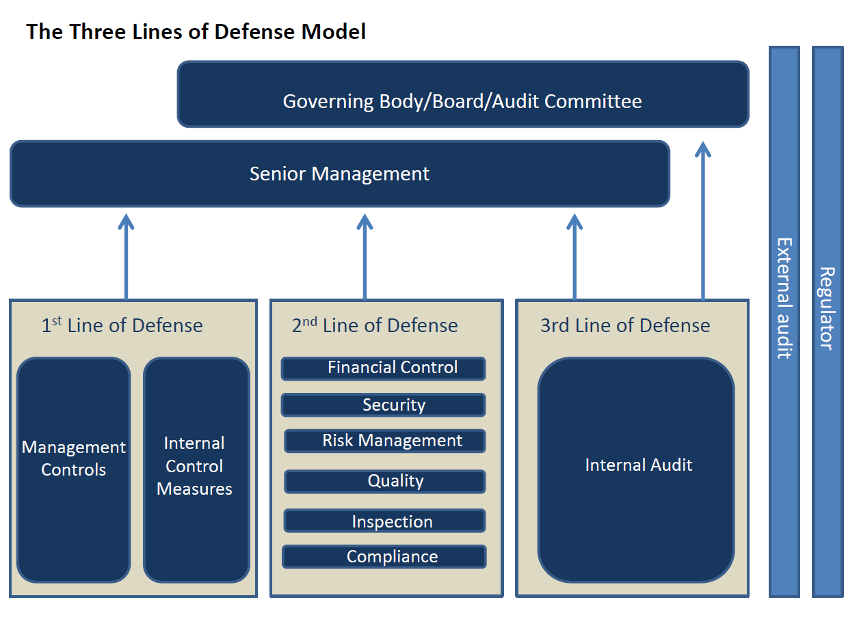
Control Functions

Slide 20
Internal Audit’s Role
3rd layer of defense
Provide independent assurance over 1st and 2nd lines.
Aligning individual IT auditors to coordinate with ORC champions
Provide feedback on evidence
May assess control design and effectiveness periodically based on the evidence

