Slide 1


Dr. M.C. FONTAINE Loïc TALIGNANI
SHAVE
SHort read Alignment pipeline for VEctors

Slide 2






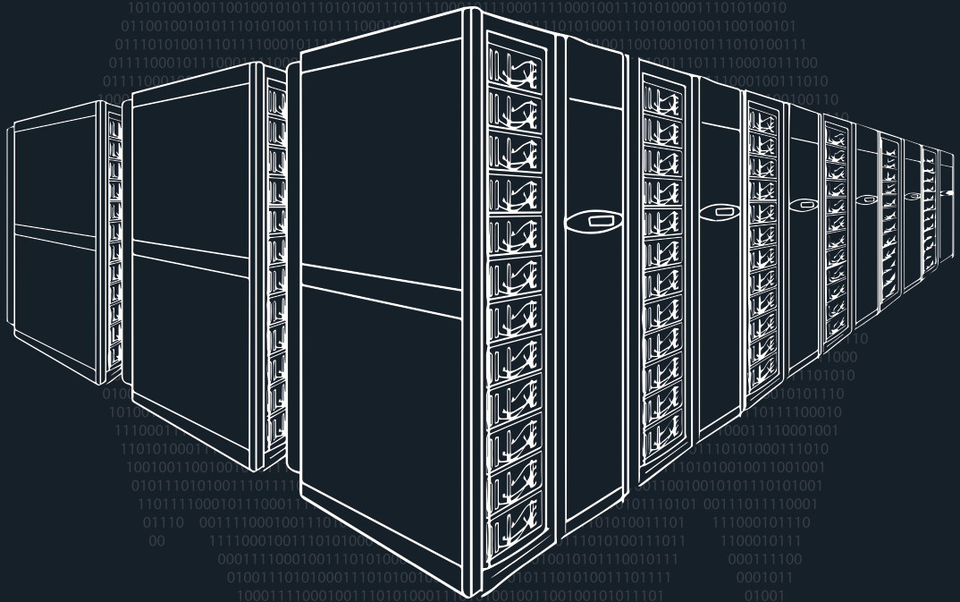



SHAVE: SHort read Alignment pipeline for VEctors
IN BRIEF:
For mosquitoes:
- Aedes
- Anopheles
Based on GATK v.3 Best Practices workflow for SNP and indel discovery
( except for BQSR & VQSR )
Workflow manager:
Run jobs in conda environments
Print out shell commands
MalariaGEN compliant
Tested on different architectures :
macOS Monterey
macOS Ventura

Slide 3
SHAVE: SHort read Alignment pipeline for VEctors
IN BRIEF:
About BQSR & VQSR:
Base Quality Score Recalibration:
Needs as input a known variation VCF file (Ensembl, dbSNP…)
Do not have any prior list of know variants for our mosquito species
-> Can't perform BQSR
Variant Quality Score Recalibration:
A sophisticated filtering technique applied on the variant callset that uses machine learning to model the technical profile of variants in a training set and uses that to filter out probable artifacts from the callset.
It uses known, highly validated variant resources to select a subset of variants within our callset that we are really confident.
No highly validated variant resource is available for mosquitoes at this time.
-> Use Hard Filtering technique.

Slide 4
SHAVE: SHort read Alignment pipeline for VEctors
Workflow Overview:
WORKFLOW PREPARATION
OS detection
Hardware specs detection
Programs installation with conda
--rerun-incomplete
--conda-frontend conda
--keep-going
--dry-run
--printshellcmds
config.yaml:
resources:
cpus*
mem_gb*
conda envs.yaml
Snakemake options:
RAW DATA PREPARATION
Illumina R1 fastq.gz
Illumina R2 fastq.gz
Remove barcode ID
Remove Line ID
Remove end-name ID
{s}_R1.fastq.gz
{s}_R2.fastq.gz
FASTQ QUALITY CONTROL & TRIMMING
{s}_R1.fastq.gz
{s}_R2.fastq.gz
config.yaml:
fastq-screen:
config: fastq-screen.conf
subset: 1000
aligner: "bwa"
cutadapt:
length:"50"
kits:
truseq:"AGATCGGAAGAGC"
nextera:"CTGTCTCTTATACACATC"
…
sickle:
reads: "pe"
method: "sanger"
quality: "30"
length:"50"
FastQC Quality Control
Fastq Screen Contamination checking
Cutadapt Adapters removing
Sickle Quality Trimming
MultiQC
{s}: {sample}
{s}_sickle-
trimmed_ R1.fastq.gz
{s}_sickle-
trimmed_ R2.fastq.gz
*: not on cluster config file

Slide 5
SHAVE: SHort read Alignment pipeline for VEctors
Workflow Overview:
MAPPING
{s}_sickle-
trimmed_ R1.fastq.gz
{s}_sickle-
trimmed_R2.fastq.gz
bwa mem
OR
bowtie2
MARK DUPLICATES
{s}_{a}-mapped.sam
{s}_{a}-mapped.sam
config.yaml:
aligner:"bwa"
bwa:
indexes_path:"resources/indexes/bwa/"
bowtie2:
indexes_path:"resources/indexes/bowtie2/"
reference:
reference filepath
samtools sort -n
by read name
samtools fixmate
Fills-in mate coordinates
samtools sort -n
by read coordinates
samtools calmd Generates MD & NM tags*
samtools
markdup
OR
picard
MarkDuplicatesSpark
samtools index
Index markdup bam file
{s}_{a}_{md}-mark-dup.bam
{s}_{a}_{md}-mark-dup.bai
{s}: {sample}
{a}: {aligner}
{md}: {markdup}
* Necessary for GATK's UnifiedGenotyper
MD: for SNP/indel calling w/o looking at the reference.
NM: number of mismatches tag, which records the Levenshtein distance between the read and the reference.

Slide 6
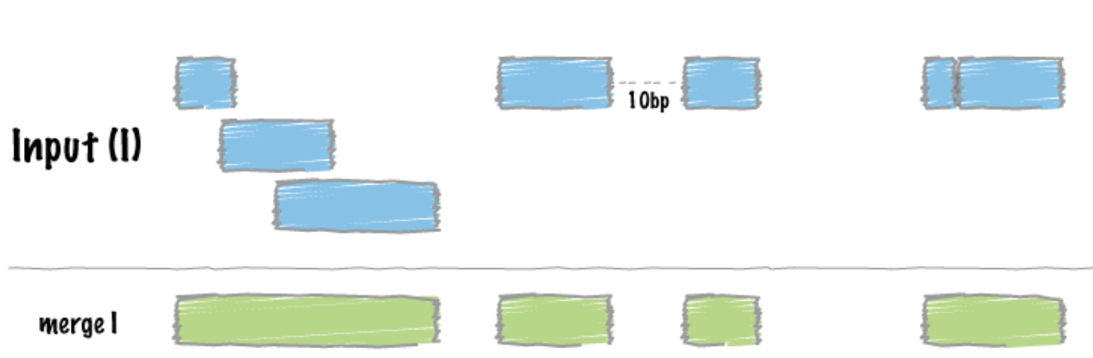
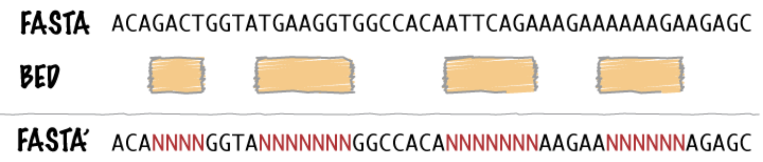
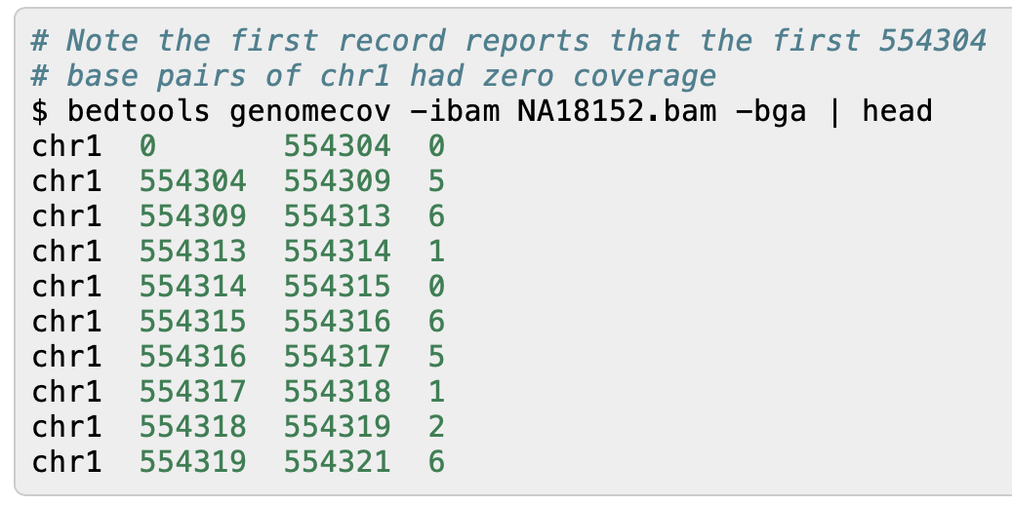
SHAVE: SHort read Alignment pipeline for VEctors
Workflow Overview:
GENOME COVERAGE STATS
{s}_{a}_{md}-mark-dup.bam
{s}_{a}_{md}-mark-dup.bai
bedtools genomecov –bga –ibam
Report genome coverage for all positions in bedgraph format
awk stats extraction
( Thanks to iTrop help )
MINIMUM COVERAGE FILTRATION
Create a new ref with regions of coverage gt mincov
{s}_{a}_{md}-genome-cov.bed
{s}_{a}_{md}_{mc}X_coverage-stats.tsv
{s}_{a}_{md}-genome-cov.bed
reference-sequence
awk
minimum coverage extraction
bedtools merge overlaps
bedtools maskfasta
REMOVE LOW COVERAGE REGIONS,
ADD INDEL QUALITIES & INDEL INDEX FOR GATK
{s}_{a}_{md}_{mc}X_masked-ref.fasta
{s}_{a}_{md}_{mc}X_masked-ref.fasta
{s}_{a}_{md}_{mc}-mark-dup.bam
lofreq indelqual -–dindel –ref masked-ref.fasta
Add BI & BD tags for indel realignment / calling
config.yaml:
mincov: 10
samtools index
{s}: {sample}
{a}: {aligner}
{md}: {markdup}
{mc}: {minimumcoverage}
{s}_{a}_{md}_{mc}X_indel-qual.bam
{s}_{a}_{md}_{mc}X_indel-qual.bai
* Necessary for GATK's UnifiedGenotyper
MD: for SNP/indel calling w/o looking at the reference.
NM: number of mismatches tag, which records the Levenshtein distance between the read and the reference.

Slide 7
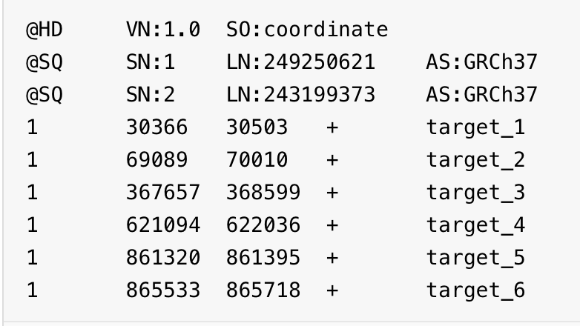
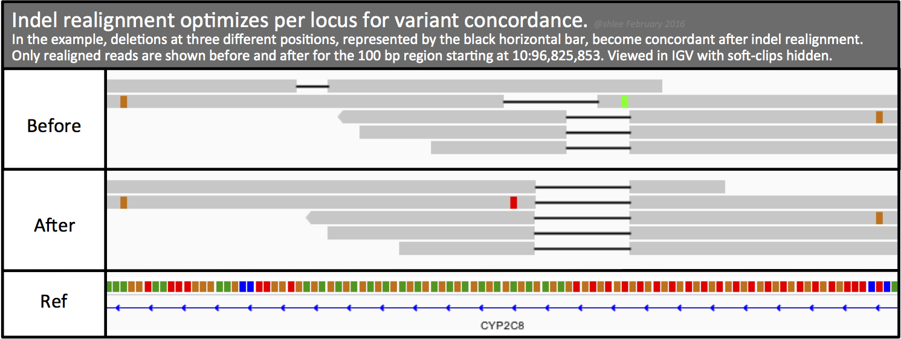
SHAVE: SHort read Alignment pipeline for VEctors
Workflow Overview:
IDENTIFY WHAT REGIONS NEED TO BE REALIGNED
{s}_{a}_{md}_{mc}X_indel-qual.bam
{s}_{a}_{md}_{mc}X_indel-qual.bai
reference-sequence
INDEL REALIGNMENT
reference-sequence index
reference-sequence.dict
{s}_{a}_{md}_{mc}X_indel-qual.bam
gatk RealignerTargetCreator
create a target intervals list
{s}_{a}_{md}_{mc}X_indel-qual.bai
reference-sequence
reference-sequence index
{s}_{a}_{md}_{mc}X.intervals
reference-sequence.dict
gatk IndelRealigner
Local realignment around indels
{s}_{a}_{md}_{mc}X_realign.bam
INTERVALS FOR IGV
{s}_{a}_{md}_{mc}X_realign.bai
{s}_{a}_{md}_{mc}X.intervals
awk extraction
( found in GATK's forum )
{s}: {sample}
{a}: {aligner}
{md}: {markdup}
{mc}: {minimumcoverage}
{s}_{a}_{md}_{mc}X_realignertargetcreator.bed

Slide 8
SHAVE: SHort read Alignment pipeline for VEctors
Workflow Overview:
BAM QUALITY CONTROL
CALLABLE LOCI
Collects statistics on callable, uncallable, poorly mapped, and other parts of the genome
{s}_{a}_{md}_{mc}X_realign.bam
{s}_{a}_{md}_{mc}X_realign_fixed-mate_sorted.bam
picard FixMateInformation*
After realignment
{s}_{a}_{md}_{mc}X_realign_fixed-mate_sorted.bai
reference-sequence
samtools index
Index fixed bam file
gatk CallableLoci
qualimap bamqc
Overall view of data
callable_status.bed
summary_table.txt
Samtools stats
Collects stats on bam file
picard ValidateSamFile
Basic check for bam file
{s}_{a}_{md}_{mc}X_realign_fixed-mate_sorted.bam
{s}_{a}_{md}_{mc}X_realign_fixed-mate_sorted.bai
MultiQC
stats.txt
validateSam.txt
{s}: {sample}
{a}: {aligner}
{md}: {markdup}
{mc}: {minimumcoverage}
* Picard FixMateInformation: ensures that all mate-pair information is in sync between each read and its mate pair

Slide 9
SHAVE: SHort read Alignment pipeline for VEctors
Workflow Overview:
VARIANT, INDELS & GENOTYPE CALLING
Parameters comes from the MalariaGEN
Can't perform VQSR?
No highly validated variant resource is available for mosquitoes at this time
{s}_{a}_{md}_{mc}X_realign_fixed-mate_sorted.bam
{s}_{a}_{md}_{mc}X_realign_fixed-mate_sorted.bai
reference-sequence
gatk UnifiedGenotyper
HARD FILTERING
Filter variant calls based on INFO and/or FORMAT annotations
{s}_{a}_{md}_{mc}X_indels.vcf
{s}_{a}_{md}_{mc}X_indels.vcf
gatk Variantfiltration
{s}_{a}_{md}_{mc}X_hardfiltered.vcf
config.yaml:
filtering:
vqsr: false
hard:
snvs:
{
"myfilter": "QD < 2.0 || FS > 60.0 || MQ < 40.0 || MQRankSum < -12.5 || ReadPosRankSum < -8.0",
}
indels: { "QD < 2.0 || FS > 200.0 || ReadPosRankSum < -20.0" }
{s}: {sample}
{a}: {aligner}
{md}: {markdup}
{mc}: {minimumcoverage}
Notes:
Variant Quality Score recalibration is a sophisticated filtering technique applied on the variant callset that uses machine learning to model the technical profile of variants in a training set and uses that to filter out probable artifacts from the callset.
It uses known, highly validated variant resources to select a subset of variants within our callset that we’re really confident are probably true positives (that’s the training set). Unfortunately, no highly validated variant resource is available for mosquitoes at this time, so we use GATK's VariantFiltration hard-filtering and leave the choice of parameters to the user.

Slide 10
SHAVE: SHort read Alignment pipeline for VEctors
Workflow Overview:
VCF COMPRESSION
{s}_{a}_{md}_{mc}X_hardfiltered.vcf
VCF INDEXING
bcftools view
{s}_{a}_{md}_{mc}X_variant-filt.vcf.gz
MULTIQC REPORT
{s}_{a}_{md}_{mc}X_variant-filt.vcf.gz
tabix
fastqc
fastq-screen
qualimap
{s}_{a}_{md}_{mc}X_variant-filt.gz.tbi
multiqc
html file
{s}: {sample}
{a}: {aligner}
{md}: {markdup}
{mc}: {minimumcoverage}

Slide 11
SHAVE: SHort read Alignment pipeline for VEctors
https://github.com/ltalignani/SHAVE
Also in development:
SHAVE2 with HaplotypeCaller
Need to optimize Variant Calling by scatter-gather strategy
https://github.com/ltalignani/SHAVE2

